Slide 1
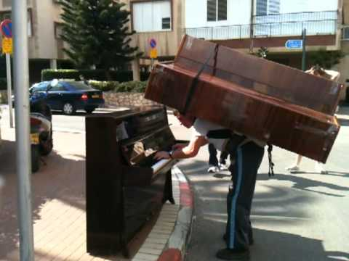
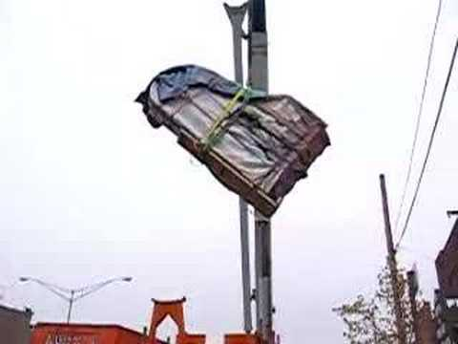
Notes:
A
Test note

Slide 2
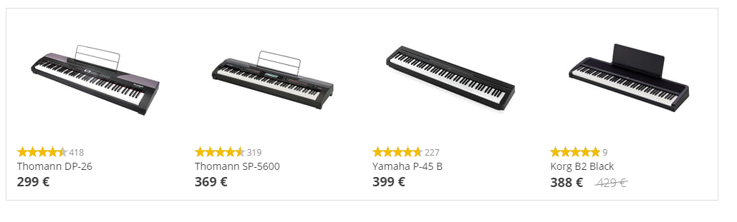
Notes:
A

Slide 3
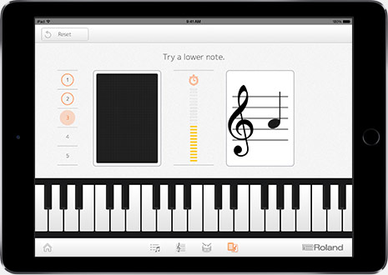
Notes:
A

Slide 4
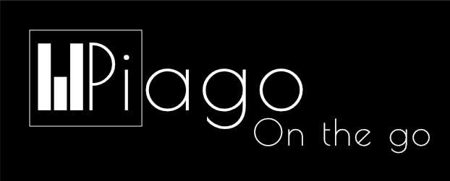
Group 1
Notes:
A

Slide 5
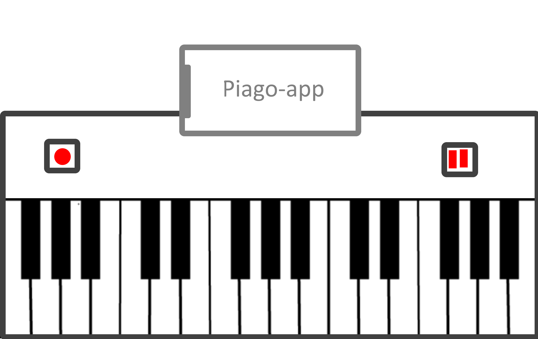
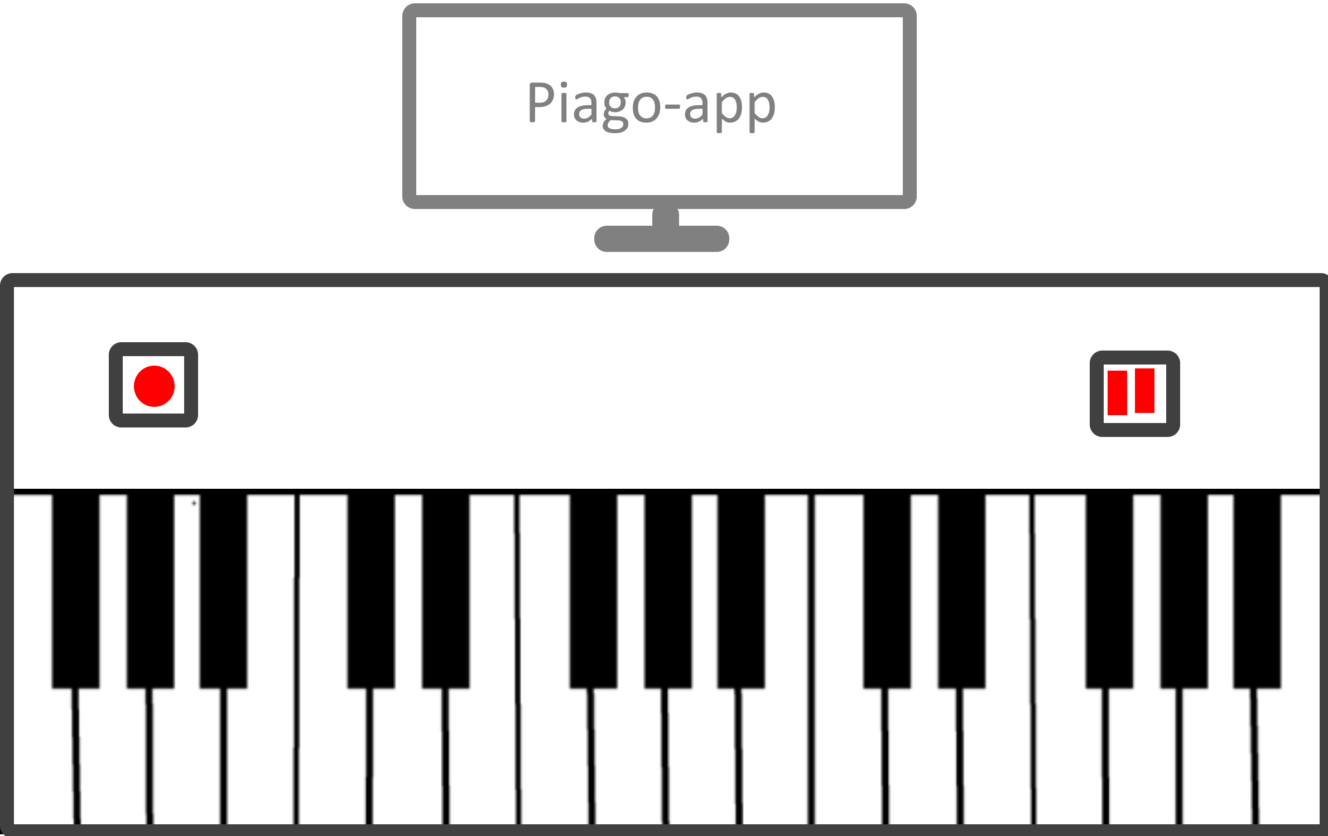
Notes:
B
- Rollable mat
Bluetooth
Music from device
2 platforms
Database

Slide 6
Target Market
Musicians
Beginners
Travelers
Children
Notes:
B what is our target market
Musicians: different overlays and instruments
Beginners: cheaper than other fully sized pianos
Travel: doesn’t take a lot of space
Children: no mechanical parts

Slide 7
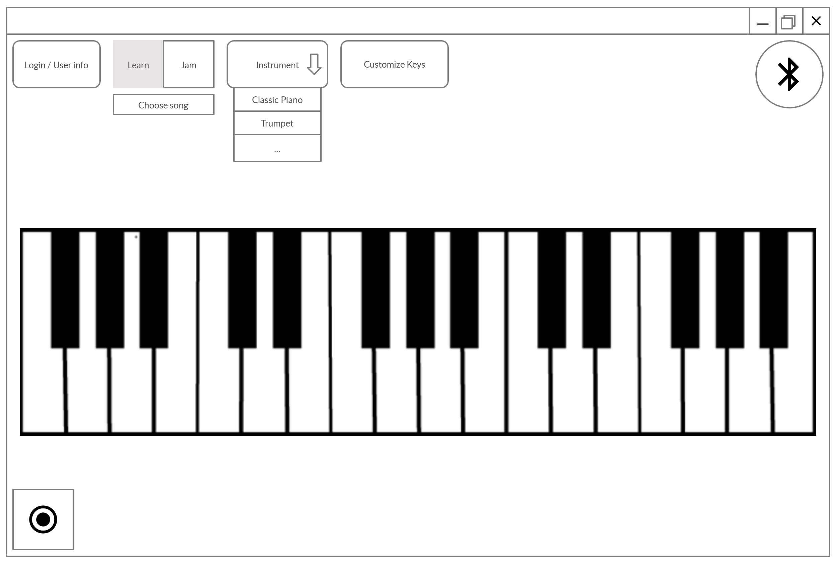
Software : Windows App
Notes:
A
- explain all buttons
Key lights up

Slide 8
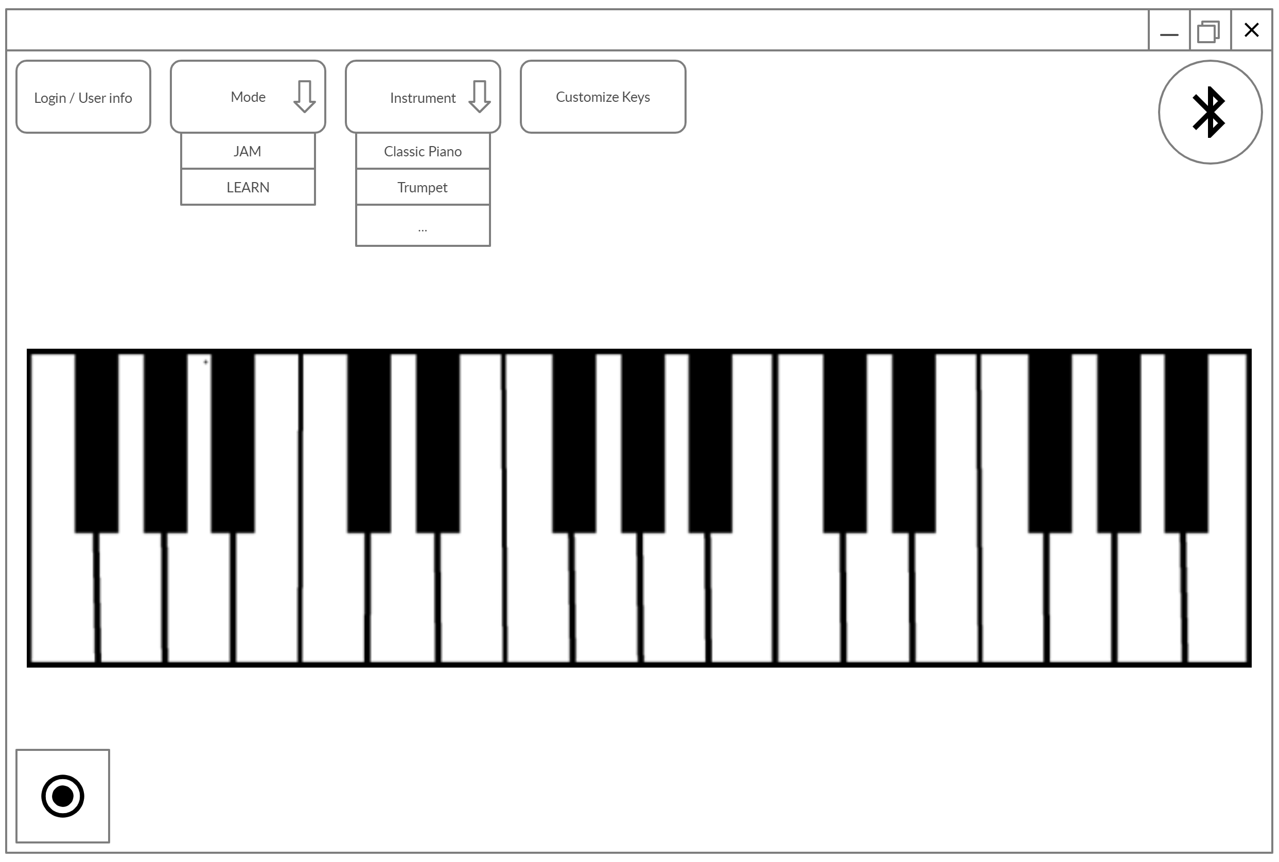
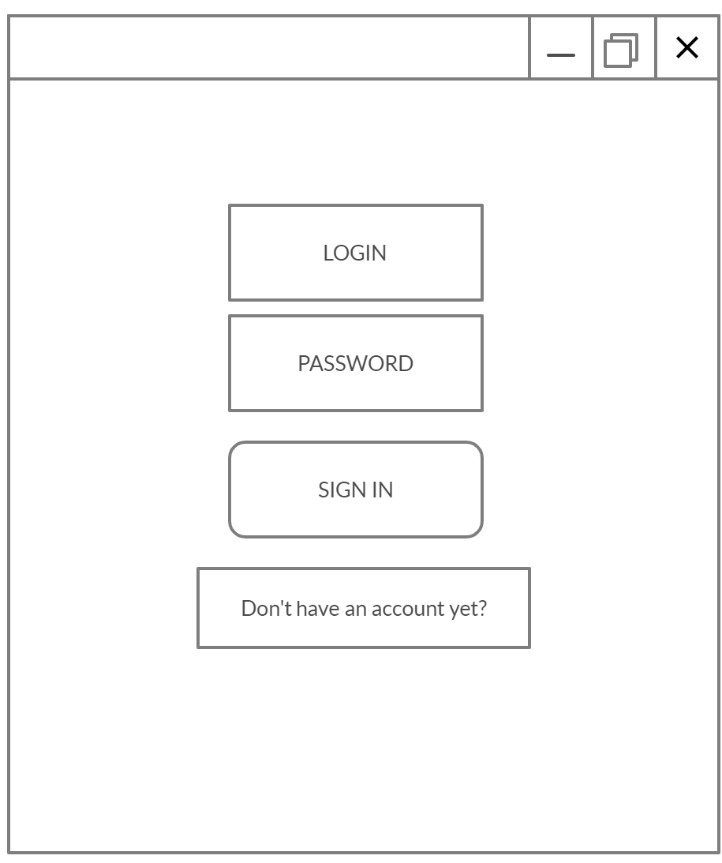
Software : Windows App
Notes:
A
Firebase auth (misschien via google account)

Slide 9
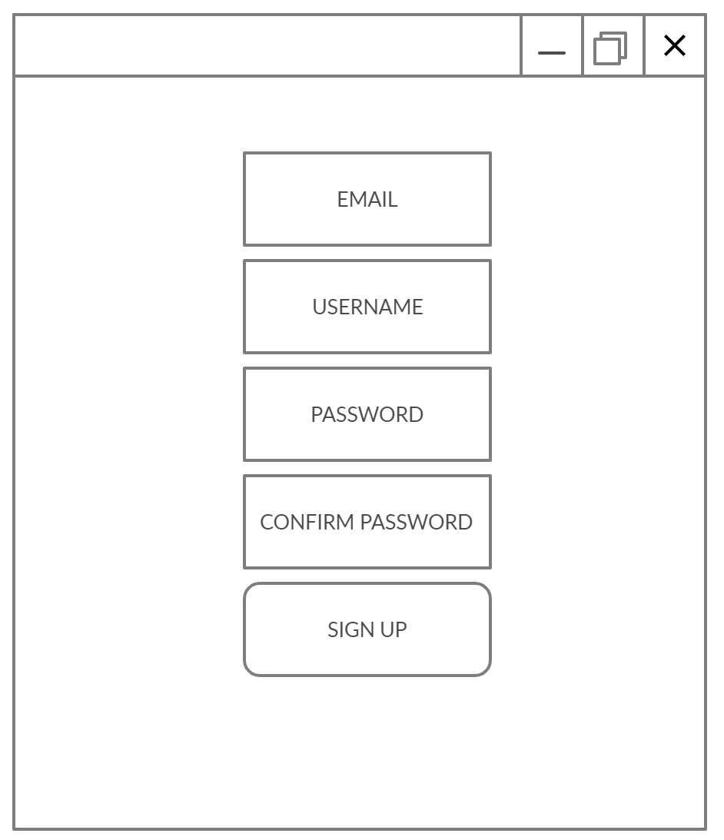
Software : Windows App
Notes:
A

Slide 10
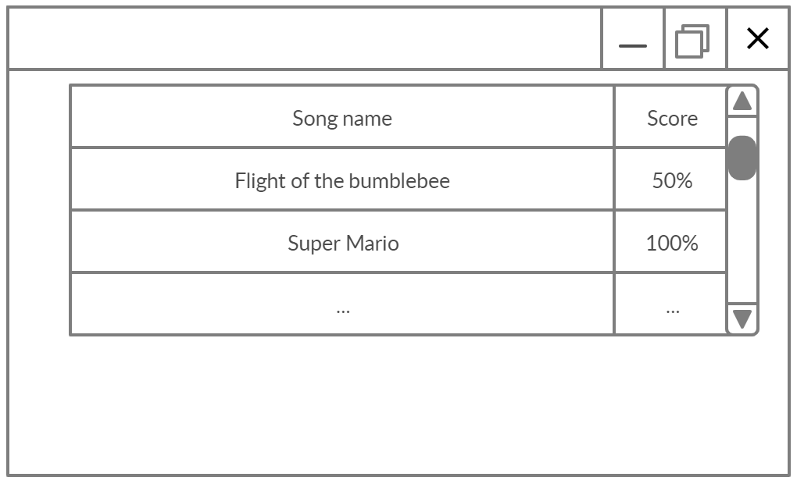
Software : Windows App
Notes:
A
Songs in database (download all songs at app start)

Slide 11
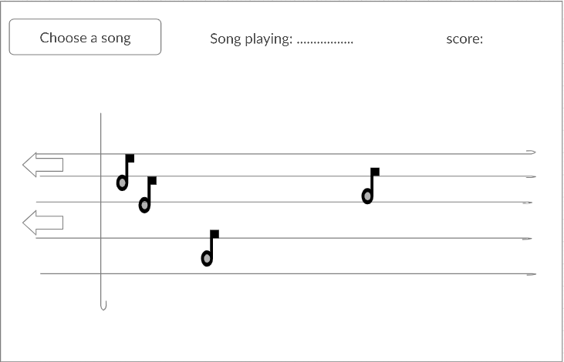
Software : Windows App
Notes:
A
Ander GUI mogelijk
Noten van lied bewegen

Slide 12
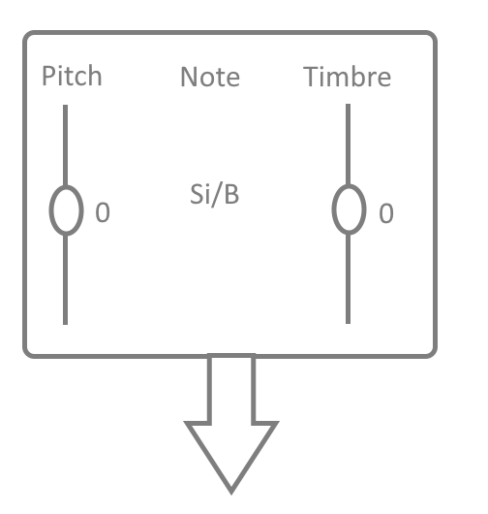
Software : Windows App
Notes:
A
-explain all buttons

Slide 13
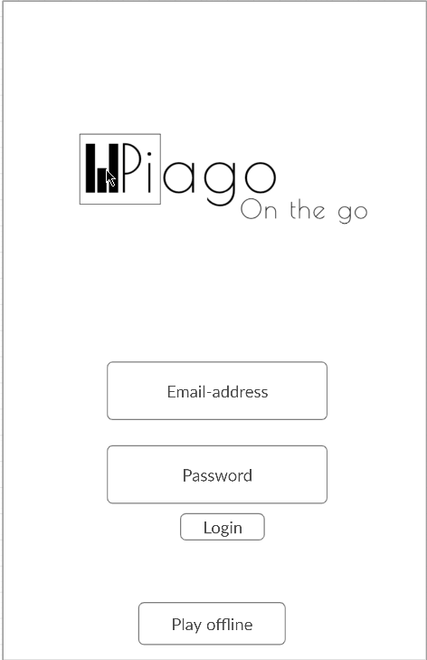
Software : Android App
Notes:
B

Slide 14
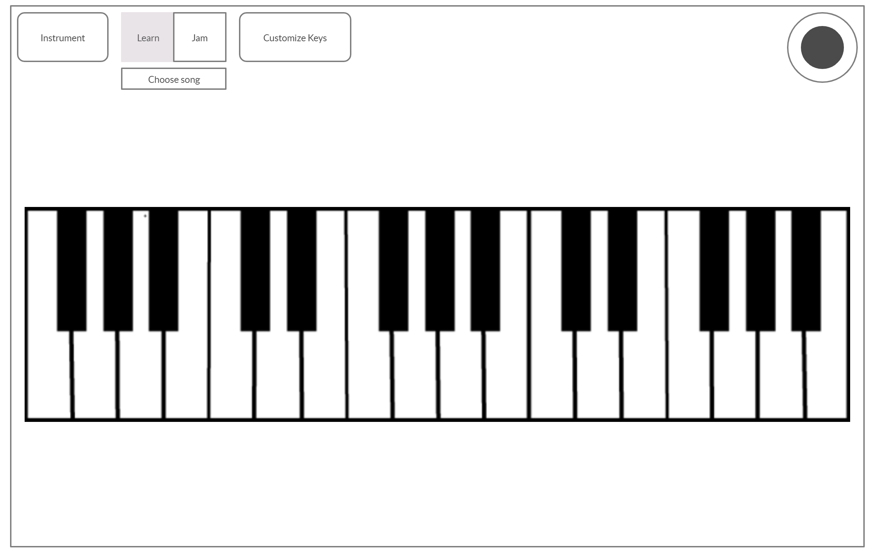
Software : Android App
Notes:
B
Uitleg buttons

Slide 15
Software : Android App
Notes:
B
Uitleg buttons

Slide 16
Software : Android App
Notes:
B

Slide 17
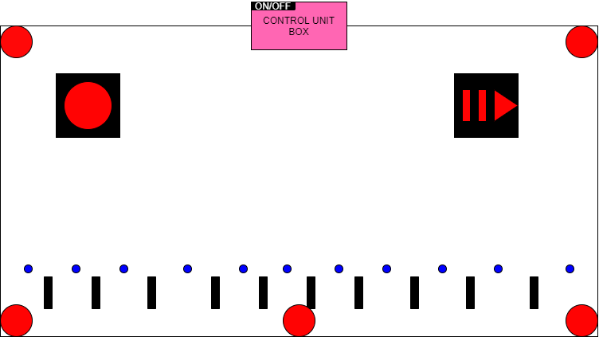
Hardware
Notes:
T

Slide 18
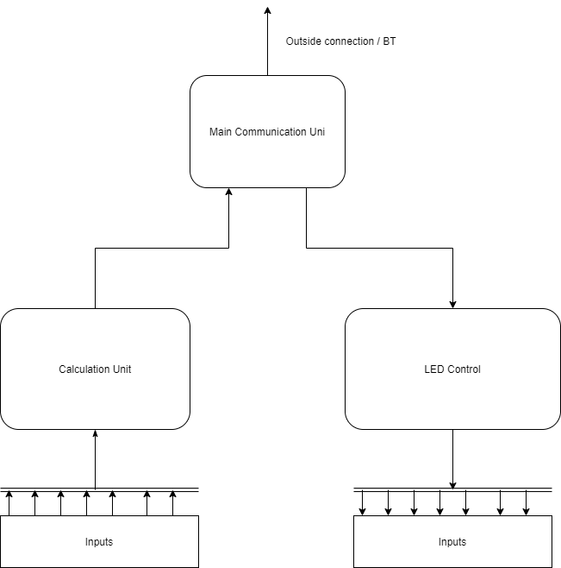
Notes:
T

Slide 19
Why our product?
Cheap
Portable
Versatile
Durable
Sound quality
Ease of use
Notes:
B

Slide 20
What’s next?
Interchangeable overlays
Daisy chaining
Expandable song database
Expandable instrument database
Notes:
B
Our plan….
This was our present.. Thanks for listening. If you have any quest..., feel free to ask us

