Slide 1
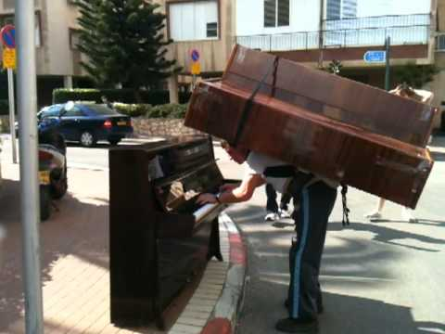
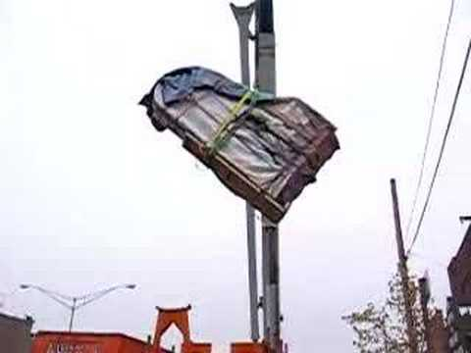
Notes:
A

Slide 2
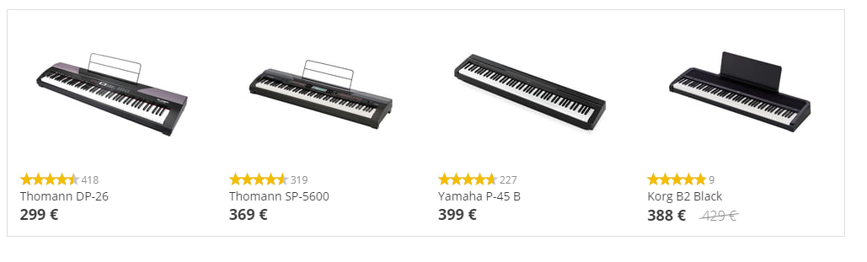
Notes:
A

Slide 3
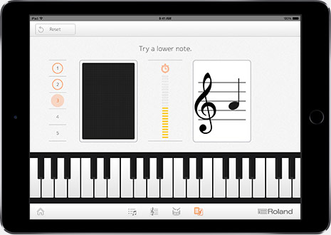
Notes:
A

Slide 4
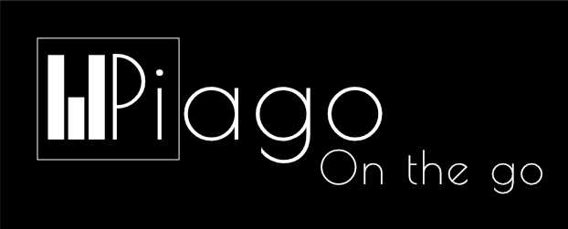
Group 1
Notes:
A

Slide 5
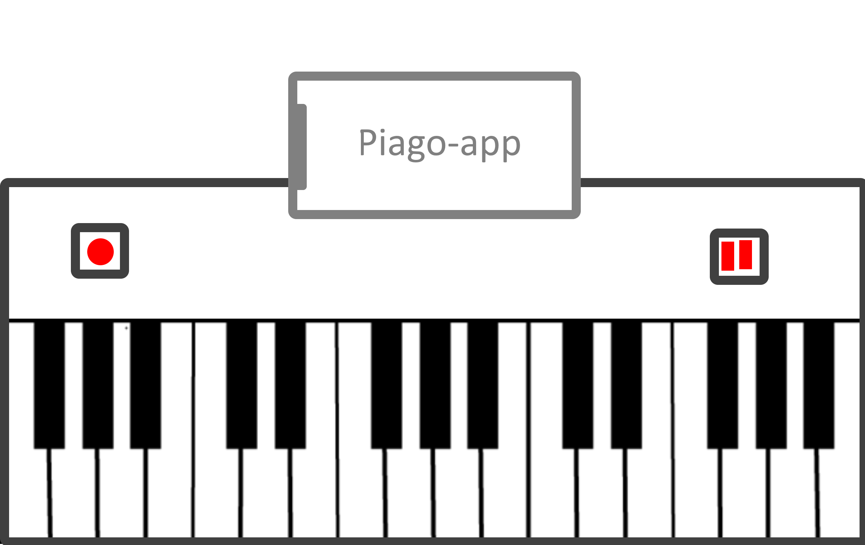
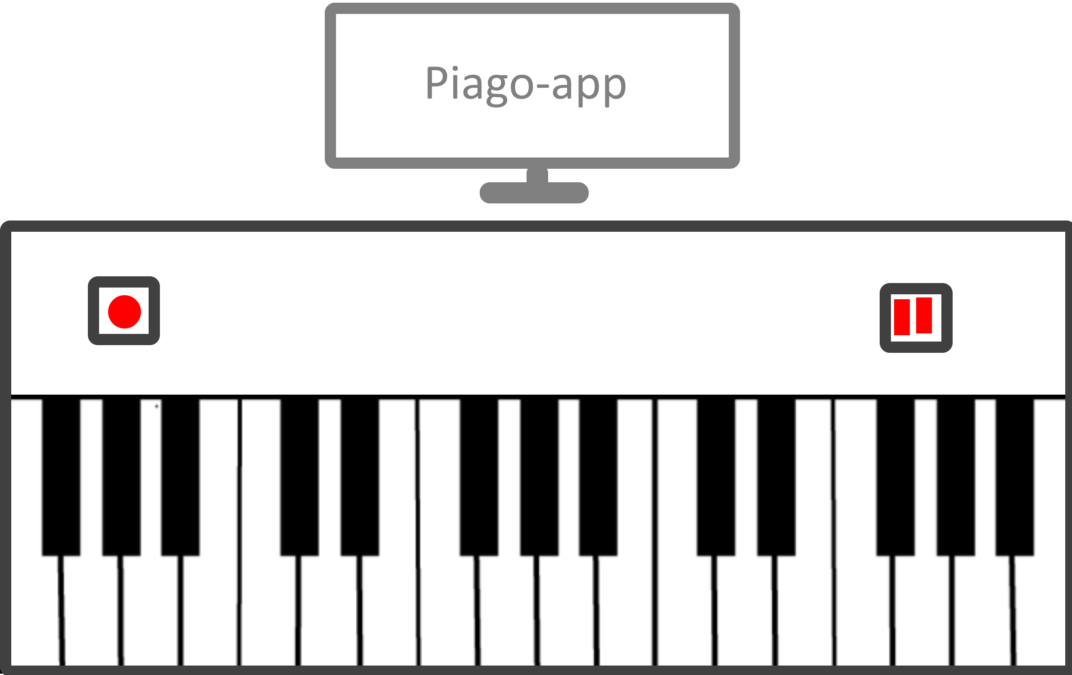
Notes:
B
- Rollable mat
Bluetooth
Music from device
2 platforms

Slide 6
Target Market
Musicians
Beginners
Travelers
Children
Notes:
B

Slide 7
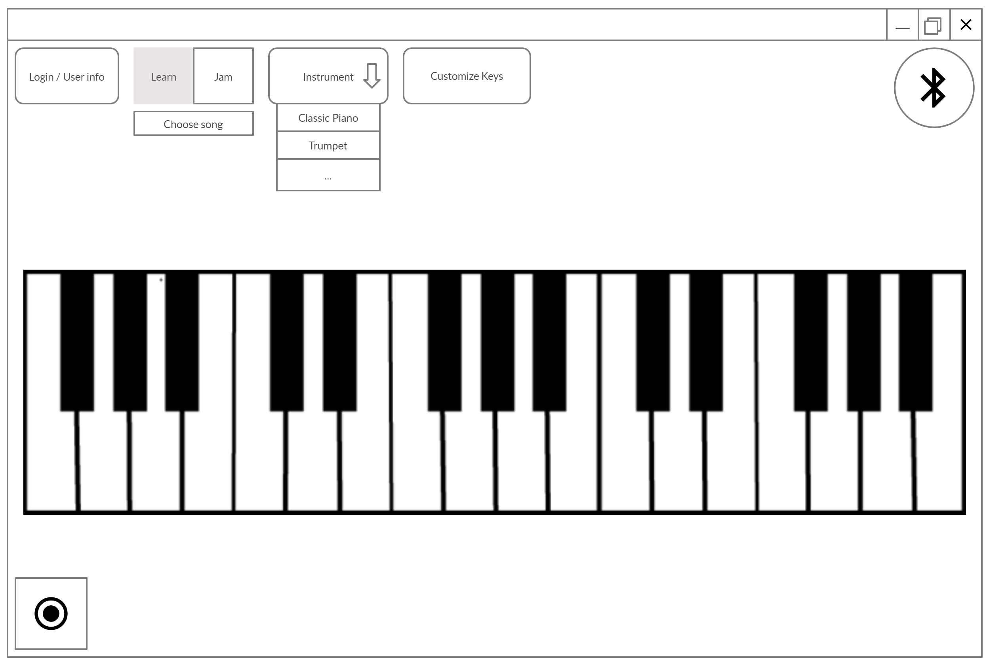
Software : Desktop App
Notes:
A
-explain all buttons

Slide 8
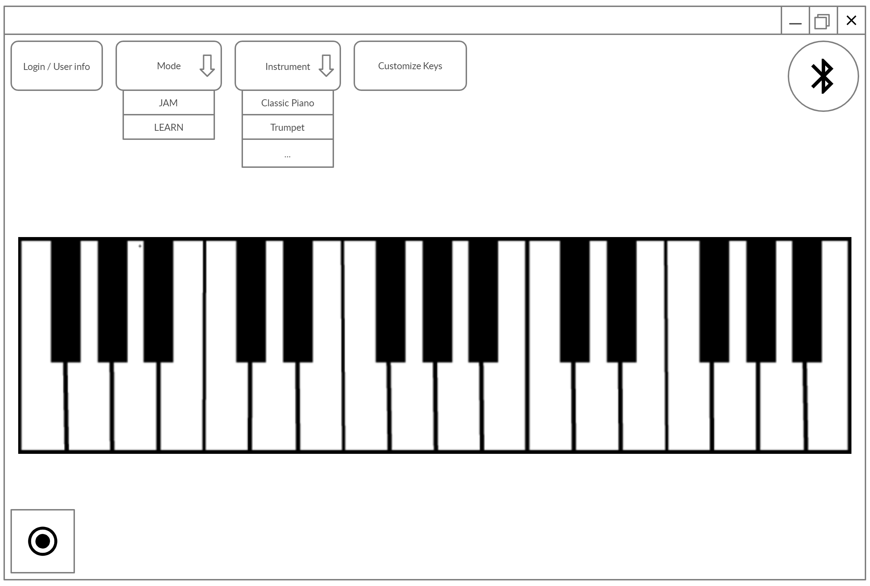
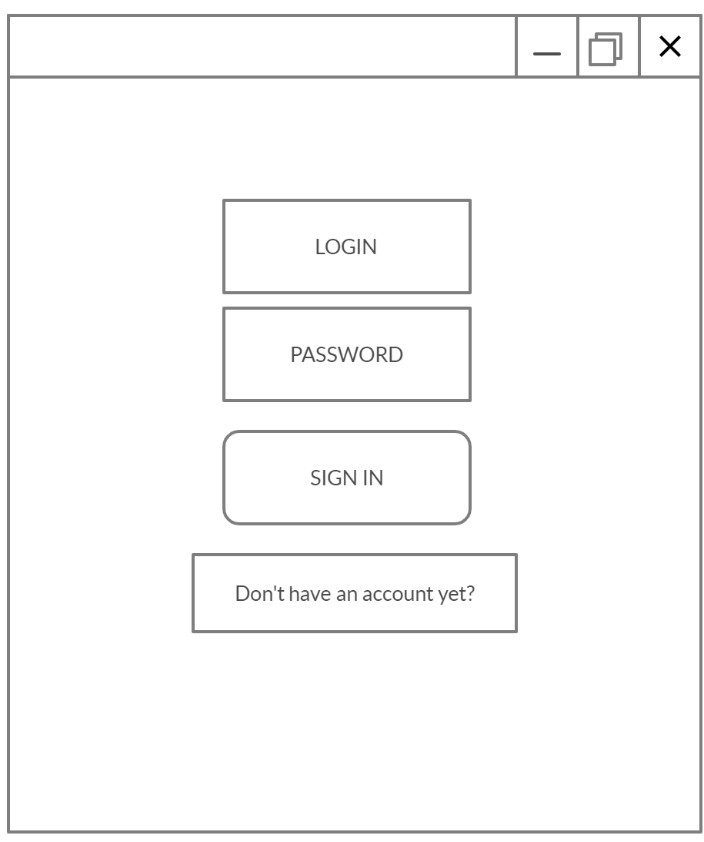
Software : Desktop App
Notes:
A
Firebase auth (misschien via google account)

Slide 9
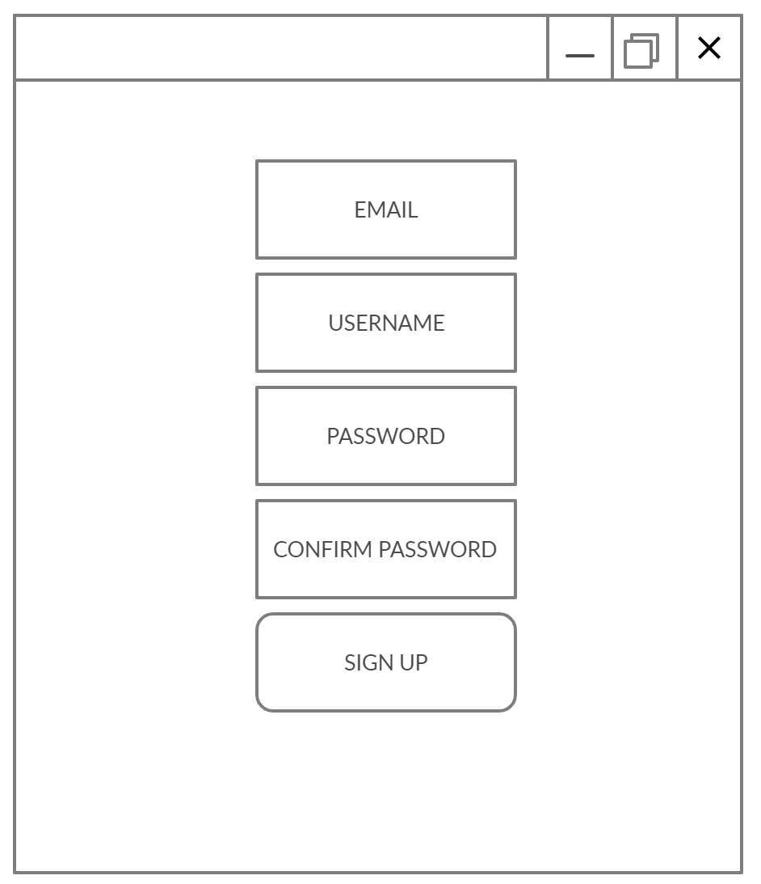
Software : Desktop App
Notes:
A

Slide 10
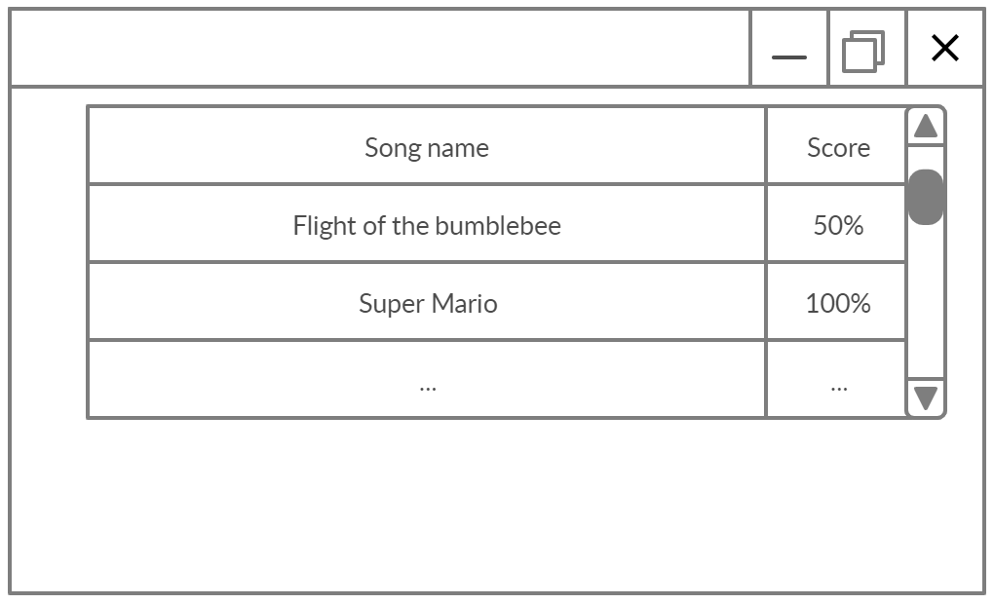
Software : Desktop App
Notes:
A
Songs in database (download all songs at app start)

Slide 11
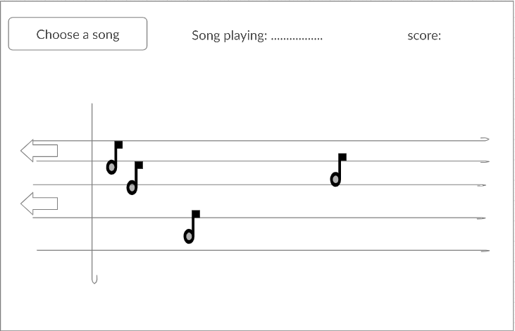
Software : Desktop App
Notes:
A
Aan GUI mogelijk
Noten van lied bewegen

Slide 12
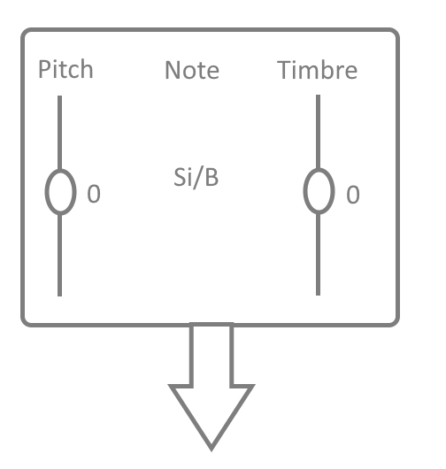
Software : Desktop App
Notes:
A
-explain all buttons

Slide 13
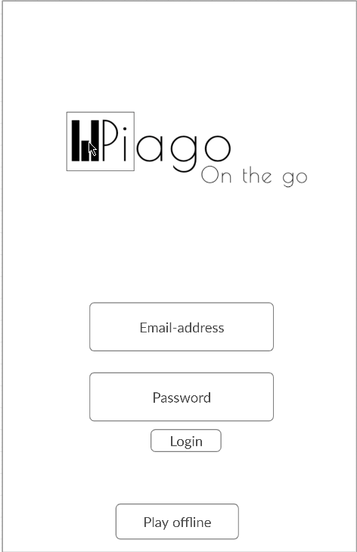
Software : Android App
Notes:
B

Slide 14
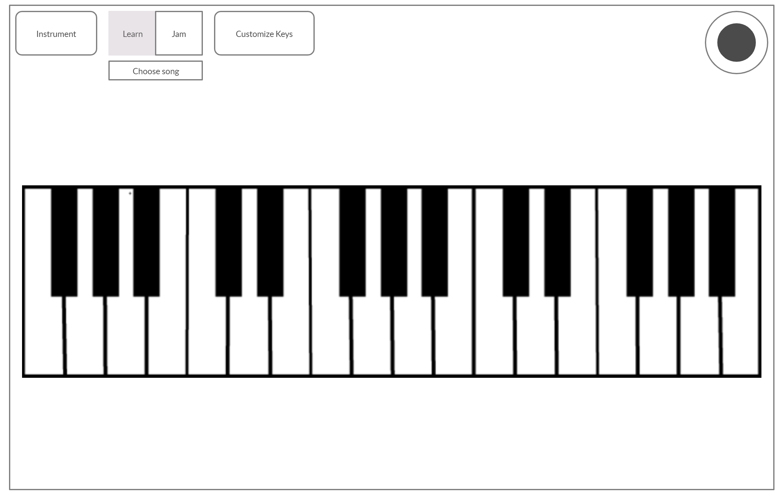
Software : Android App
Notes:
B
Uitleg buttons

Slide 15
Software : Android App
Notes:
B

Slide 16
Software : Android App
Notes:
B
Uitleg buttons

Slide 17
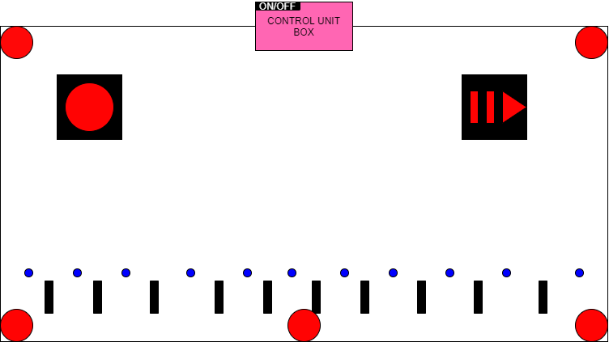
Hardware
Notes:
T

Slide 18
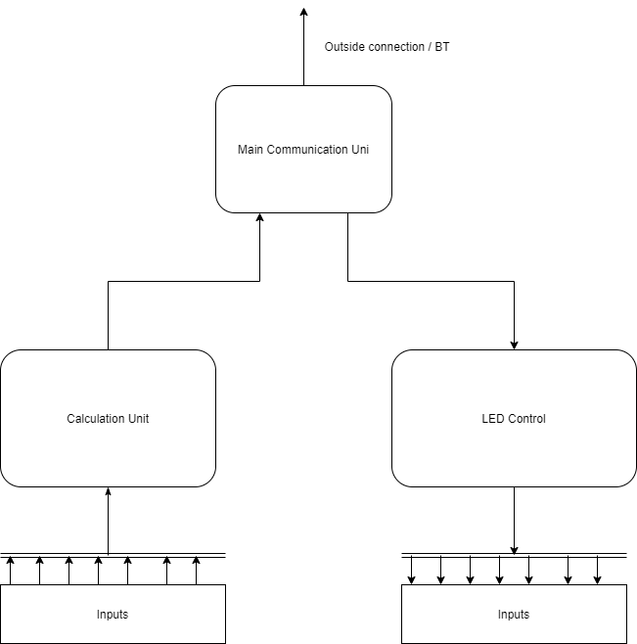
Notes:
T

Slide 19
Why our product?
Cheap
Portable
Versatile
Durable
Sound quality
Ease of use
Notes:
B

Slide 20
What’s next?
Interchangeable overlays
Daisy changing
Expandable song database
Expandable instrument database
Notes:
A

