Slide 1

Zordon
boYD Franken
Kenny Guldentops
Gillian lambrechts
Jeroen rietveld
Automating homes one by one

Slide 2
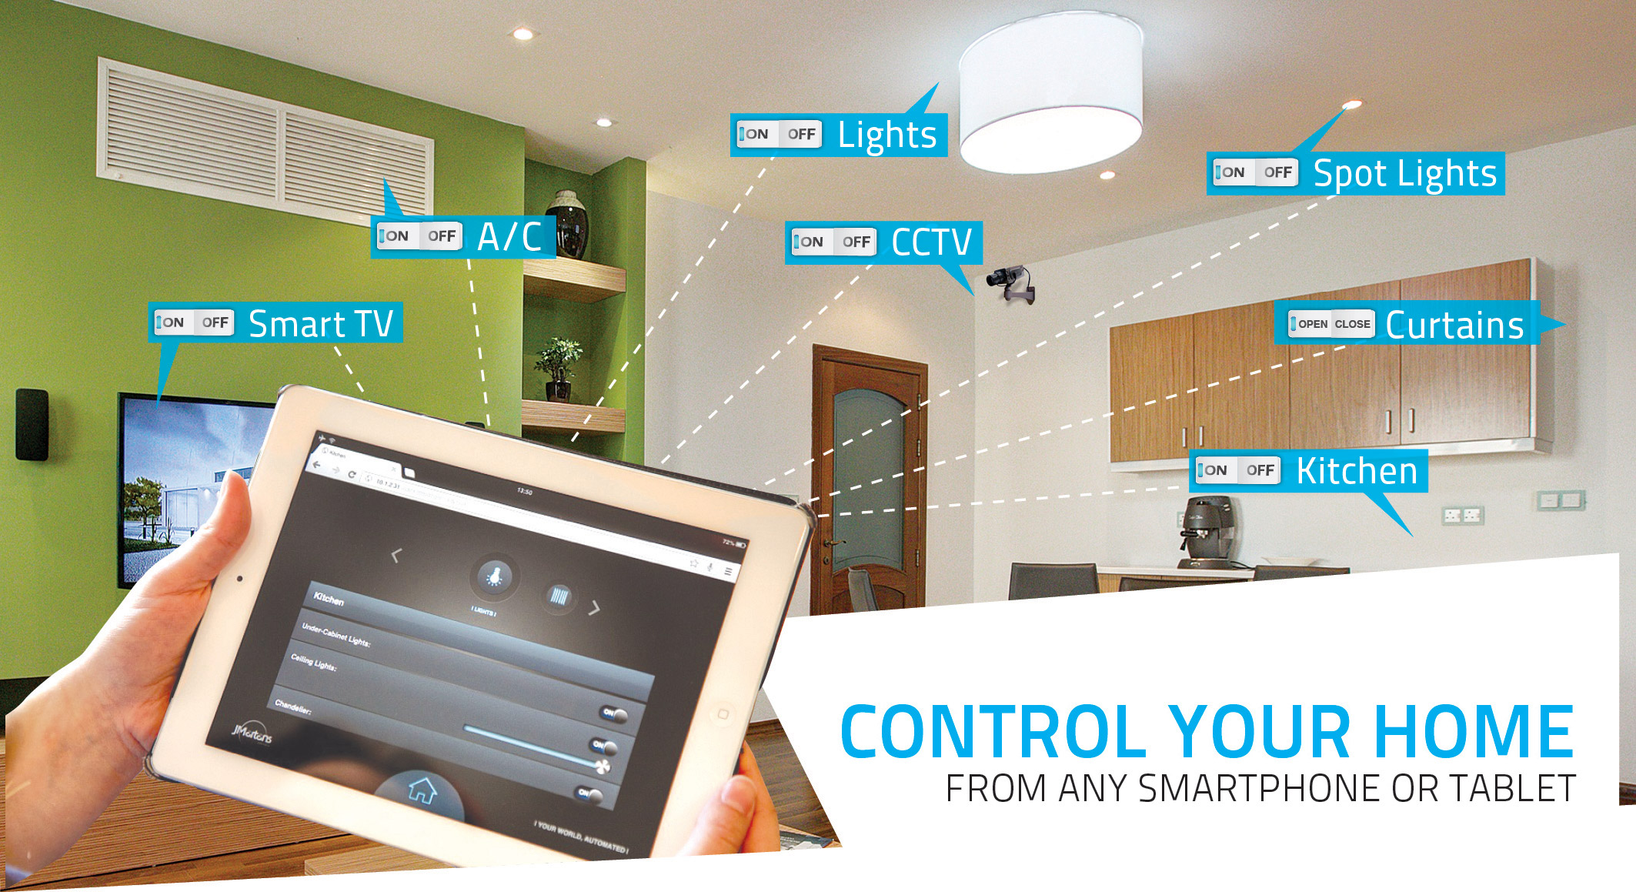

Slide 3


Slide 4
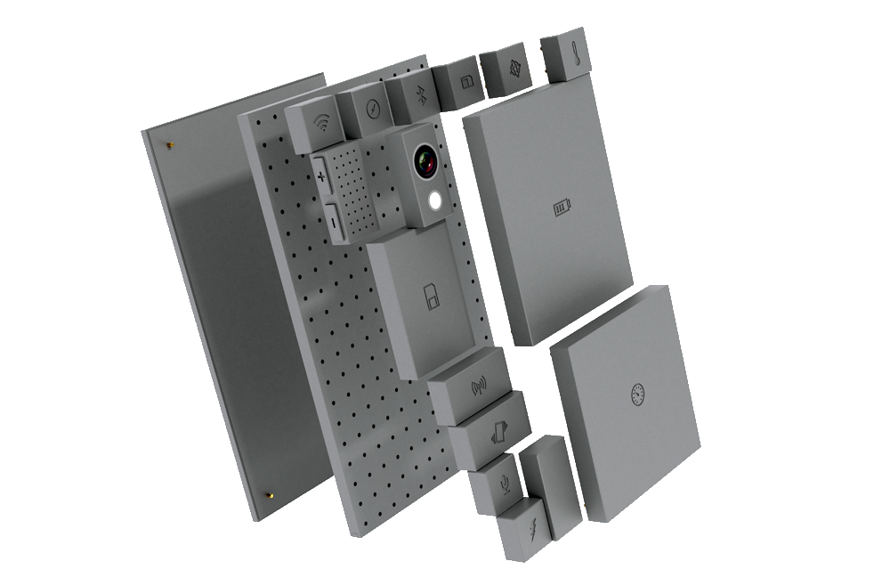
Modulair

Slide 5
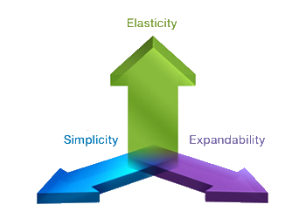
Scaleability

Slide 6

Cloud

Slide 7

Mobility

