Slide 1
Leave – It
Presentatie v3.0

Slide 2
Presteerde Werk
Rolverdeling en prestaties

Slide 3
Rolverdeling
2 Personen Conditionering : Wouter & Denny
Sensoren: Vochtigheidsgraad, temperatuur, pH-Waarde v/d grond + omgevingstemperatuur, omgevingslicht,
Data verstuurd naar database
Zorgen voor juiste sensor data
Ontwerp Dataset/backend web
1 Persoon beeldherkenning: Joris
Foto’s trekken van plant en versturen naar database
Herkennen welke plant in de bak zit
Plant analyseren a.d.h.v. getrokken foto’s
2 Personen Plant Robot: Robbe & Steven
Toevoer water, stroom, voedingsstoffen
Hardware connecties sensoren
PCB-ontwerp
Design plantenbak
1 Persoon PM/Web development: Melvin
Frontend web
Project management

Slide 4
Conditionering: Denny
As a user, I want to obtain data from the particle (dust) sensor
As a developer, I want a client-side connection between my devices and the cloud over MQTT
As a user, I want the "Leave It" unit to send data during a specific timeframe
As a developer, I need to make sure that all sensor data is correct
Gemiddelde berekenen van sensordata
As a developer, I need to make sure that the database can aquire all data sent from the master.
Presentatie

Slide 5
Conditionering: Wouter
As a developer I want a server-side connection between my devices and the cloud over MQTT
As a user I want all communication to happen even when the client isn't running
As a developer I want the sensors to be tested in practice cases
As a developer I want all sensor data to be sent in the correct JSON format
As a developer, I want documentation regarding the sensor data
Meegeholpen met IoT Hub in orde te krijgen, vanwege een uitgeschakeld account
Geleidingssensor probe

Slide 6
Beeldherkenning (+ backend): Joris
As a designer, I want to have an overview of all the available API endpoints.
As a developer I want a new picture to be taken automatically over a specific period of time.
As a developer I want organised API endpoints with documentation.
As a developer I want image's to be automatically uploaded to the API.
As a developer I want a central controller for image handling.
As a developer I want to remotely access the API.
As a user I want to automatically get the optimal environment for this specific plant.

Slide 7
Plant Robot: Robbe
As a user, I want the pot to have a lamp above the plant
Designen van circuits en PCB’s
Opzoekwerk betreffende de conductivity sensor en basiscircuit opgesteld
As a product designer I want to have transitors on electrical boards to turn certain parts on or off
As a user, I want an electrical circuit for tracking nutrient levels

Slide 8
Plant Robot: Steven
As a user, I want the pot to pump nutritious water to the plants
Stroomschema
Ziek gevallen (veel beterschap Steven!)

Slide 9
Project Management / Web Development: Melvin
As a user, I want the sensor data to be formatted to the simplest format possible
As a user, I want the sensor data shown on the dashboard to be real data received from my lab farm
As a user, I want to see what the minimum and maximum value for each sensor can be on my leave-it page
Meetings
As a user, I want to be able to add a new lab farm

Slide 10
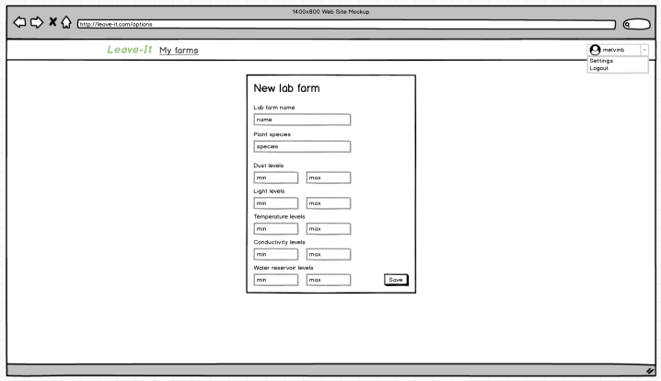
Mockup Add Labfarm
Op dit scherm kan u een nieuwe Labfarm aanmaken.

Slide 11
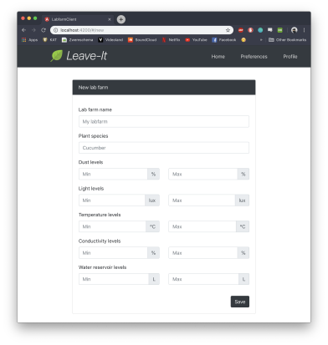
Add new LF
Op dit scherm kan u een nieuwe Labfarm aanmaken.

Slide 12
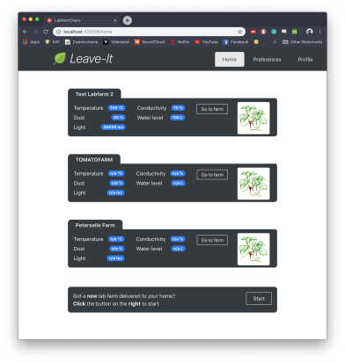
Overzicht
Op dit scherm kan u een volledig overzicht terugkrijgen van alle Labfarms in uw bezit.

Slide 13
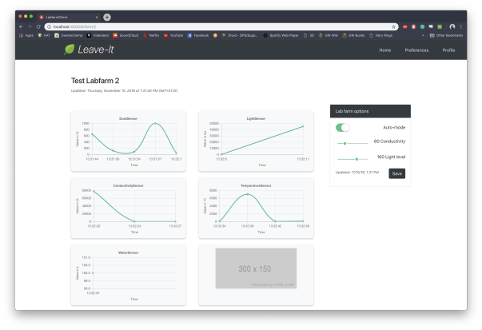
Overzicht van 1 Labfarm
Hier kan u het overzicht bekijken van 1 specifieke Labfarm.

Slide 14
Overzicht van 1 Labfarm
Hier kan u het overzicht bekijken van 1 specifieke Labfarm.

Slide 15
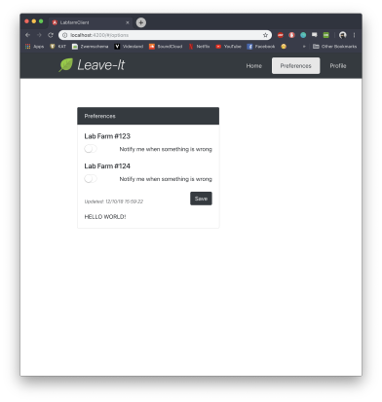
Settings
Hier kan u uw preferences veranderen.

Slide 16
Demo

Slide 17
Burndown Chart

Slide 18
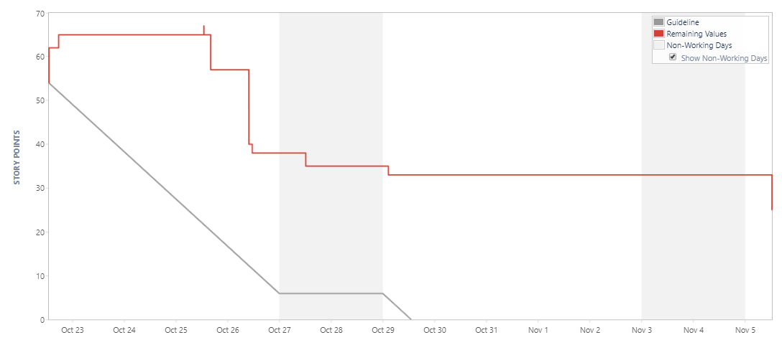
22/Oct/18 1:09 PM - 05/Nov/18 12:27 PM

Slide 19
COMPLETED
Key | Summary | Issue Type | Priority | Status | Story Points (34)
IOT18LF1-54 | As a user, I want the pot to have a lamp above the plant | Story | Medium | DONE | 3
IOT18LF1-94 | As a user I want all communication to happen even when the client isn't running | Story | Medium | DONE | 2
IOT18LF1-99 | As a user, I want the sensor data to be formatted to the simplest format possible | Story | Medium | DONE | 1
IOT18LF1-110 | As a developer I want a server-side connection between my devices and the cloud over MQTT | Story | Medium | DONE | 8
IOT18LF1-115 | As a developer, I want a client-side connection between my devices and the cloud over MQTT | Story | Medium | DONE | 8
IOT18LF1-116 | As a user, I want to obtain data from the particle (dust) sensor | Story | Medium | DONE | 2
IOT18LF1-126 * | As a developer I want a new picture to be taken automatically over a specific period of time. | Story | Medium | DONE | 8
IOT18LF1-140 * | As a designer, i want to have an overview of all the availabe API endpoints. | Story | Medium | DONE | 2

Slide 20
NOT COMPLETED
Key | Summary | Issue Type | Priority | Status | Story Points (22 → 25)
IOT18LF1-68 | As a user, I want to receive notifications when there's something wrong with my plants | Story | Medium | TO DO | 3
IOT18LF1-76 | As a user, I want to see what the minimum and maximum value for each sensor can be on my leave-it page | Story | Medium | TO DO | 3
IOT18LF1-103 | As a designer, I want a central power supply for all the components | Story | Medium | TO DO | 5 → 8
IOT18LF1-105 | As a designer, I want the camera to be protected in a case | Story | Medium | TO DO | 3
IOT18LF1-113 | As a user, I want the sensor data shown on the dashboard to be real data received from my lab farm | Story | Medium | TO DO | 3
IOT18LF1-123 | As a user i want my plant to be automatically recognized. | Story | Medium | IN PROGRESS | 5

Slide 21
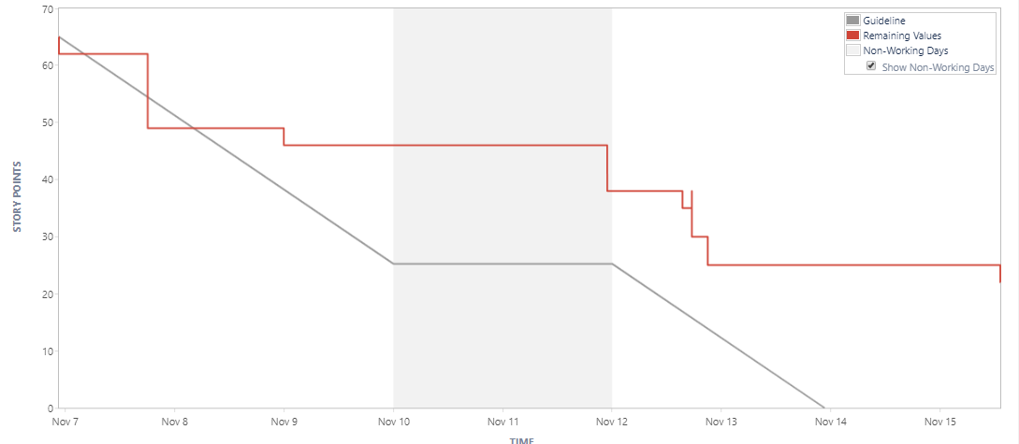
06/Nov/18 10:37 PM - 15/Nov/18 1:11 PM

Slide 22
COMPLETED
Key | Summary | Issue Type | Priority | Status | Story Points (43)
IOT18LF1-56 | As a user, I want the pot to pump nutritious water to the plants | Story | Medium | DONE | 5
IOT18LF1-76 | As a user, I want to see what the minimum and maximum value for each sensor can be on my leave-it page | Story | Medium | DONE | 3
IOT18LF1-113 | As a user, I want the sensor data shown on the dashboard to be real data received from my lab farm | Story | Medium | DONE | 3
IOT18LF1-147 | As a developer, I need to make sure that all sensor data is correct | Story | Medium | DONE | 5
IOT18LF1-149 | As a developer I want organised API endpoints with documentation. | Story | Medium | DONE | 13
IOT18LF1-151 | As a developer, I want documentation regarding the sensor data | Story | Medium | DONE | 3
IOT18LF1-152 | As a user, I want the "Leave It" unit to send data during a specific timeframe | Story | Medium | DONE | 3
IOT18LF1-154 | As a developer I want all sensor data to be sent in the correct JSON format | Story | Medium | DONE | 3
IOT18LF1-155 | As a developer I want the sensors to be tested in practice cases | Story | Medium | DONE | 5

Slide 23
NOT COMPLETED
Key | Summary | Issue Type | Priority | Status | Story Points (22)
IOT18LF1-52 | As a user, I want an electrical circuit for tracking nutrient levels | Story | Medium | IN PROGRESS | 8
IOT18LF1-68 | As a user, I want to receive notifications when there's something wrong with my plants | Story | Medium | TO DO | 3
IOT18LF1-105 | As a designer, I want the camera to be protected in a case | Story | Medium | TO DO | 3
IOT18LF1-148 | As a product designer I want to have transitors on electrical boards to turn certain parts on or off | Story | Medium | IN PROGRESS | 5
IOT18LF1-150 | As a developer I want to remotely access the API. | Story | Medium | IN PROGRESS | 3

Slide 24
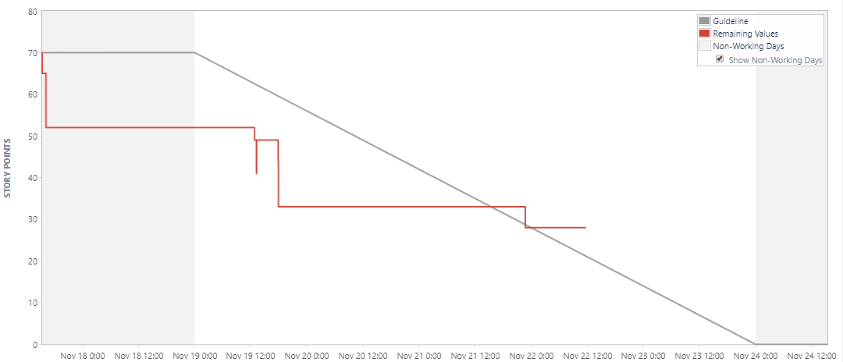
17/Nov/18 3:23 PM - 24/Nov/18 3:23 PM

Slide 25
COMPLETED
Key | Summary | Issue Type | Priority | Status | Story Points (42)
IOT18LF1-45 | As a user i want to automatically get the optimal environment for this specific plant. | Story | Medium | DONE | 8
IOT18LF1-52 | As a user, I want an electrical circuit for tracking nutrient levels | Story | Medium | DONE | 8
IOT18LF1-148 | As a product designer I want to have transitors on electrical boards to turn certain parts on or off | Story | Medium | DONE | 5
IOT18LF1-150 | As a developer I want to remotely access the API. | Story | Medium | DONE | 3
IOT18LF1-156 | As a user, I want to be able to add a new lab farm | Story | Medium | DONE | 5
IOT18LF1-167 | As a developer I want a central controller for image handling. | Story | Medium | DONE | 3
IOT18LF1-168 | As a developer i want image's to be automatically uploaded to the API. | Story | Medium | DONE | 5
IOT18LF1-169 | As a developer, I need to make sure that the database can aquire all data sent from the master. | Story | Medium | DONE | 5

Slide 26
TODO
Key | Summary | Issue Type | Priority | Status | Story Points (28)
IOT18LF1-161 | As a user, I want to be able to edit a labfarm | Story | Medium | TO DO | 5
IOT18LF1-170 | As a user, I want the Leave It unit to automatically create its account | Story | Medium | IN PROGRESS | 5
IOT18LF1-171 | As a developer I want to have a conductivity sensor with accurate conductivity values | Story | Medium | IN PROGRESS | 5
IOT18LF1-172 | As a developer I want the data to be standard european unit notation | Story | Medium | IN PROGRESS | 5
IOT18LF1-173 * | As a designer I want a complete list of items documented | Story | Medium | IN PROGRESS | 3
IOT18LF1-174 * | As a designer I want a schematic of the different power modes documented | Story | Medium | TO DO | 5

Slide 27
Analyse Update

Slide 28
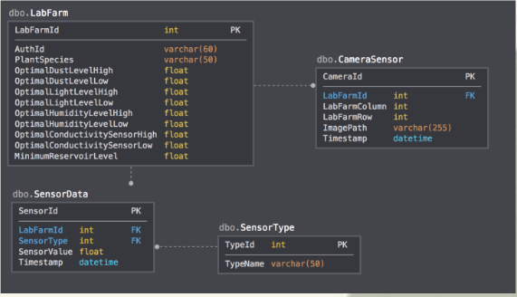
Conditionering | Oud database model

Slide 29
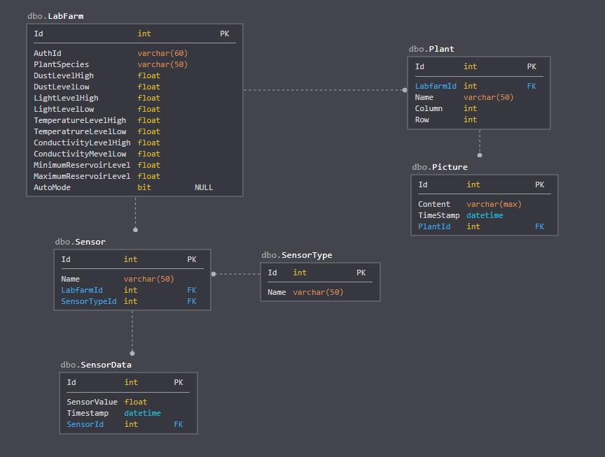
Conditionering | Nieuw database model

Slide 30
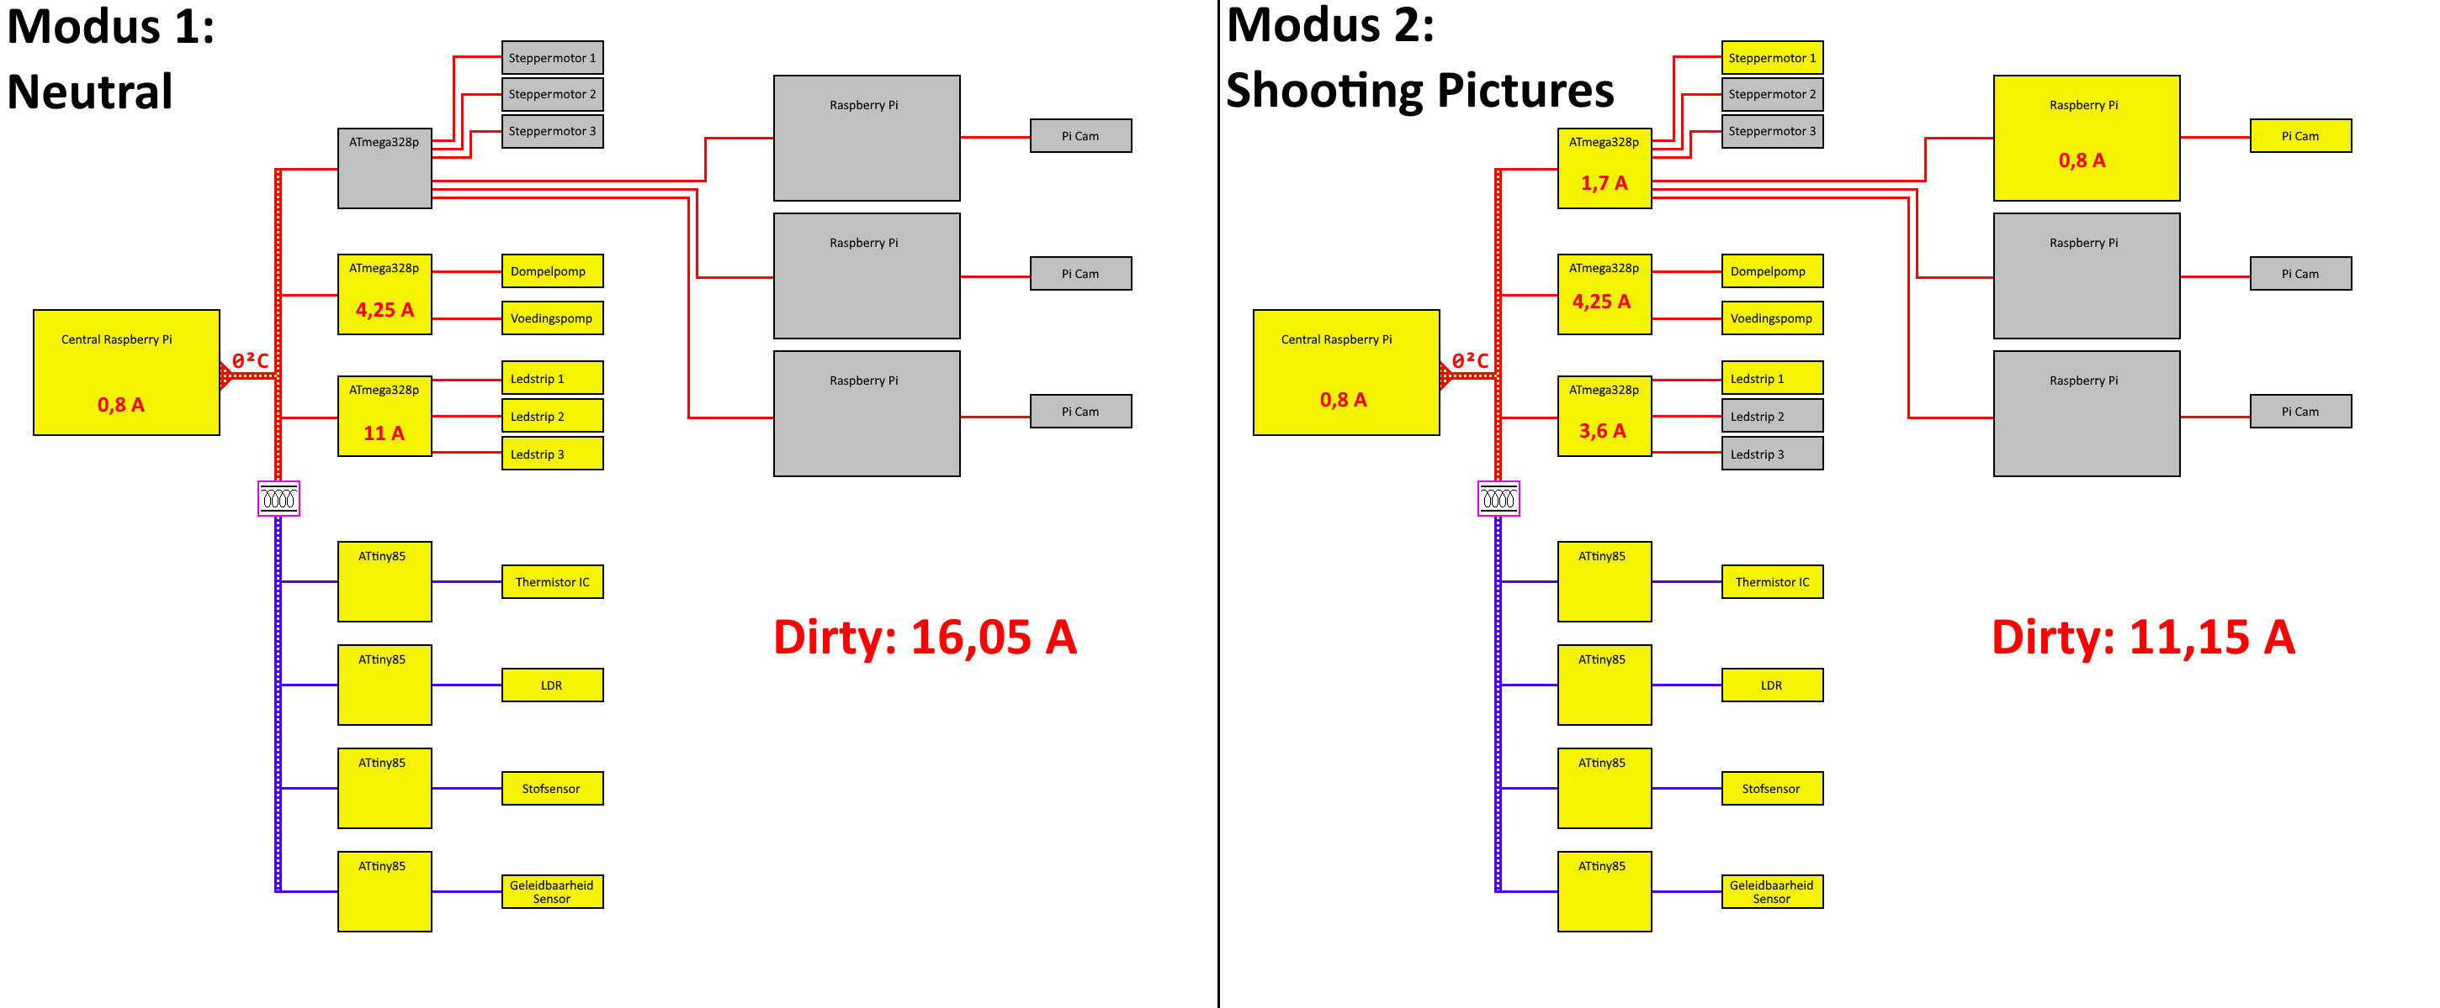
Labfarm | Verbruik

Slide 31
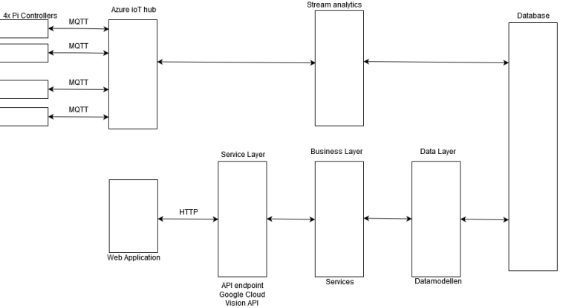
Labfarm | Algemene Architectuur

Slide 32
Planning

Slide 33
MILESTONES
PCB’s afwerken
Power Management systeem
Data flow onderhouden
Onderzoek doen naar standaardwaarden betreffende planten
Assemblage (als de buizen er zijn)
Integratie van de Google Cloud Vision API
Automatiseren van de Labfarm

