Slide 1
Leave – It
Presentatie v4.0

Slide 2
Presteerde Werk
Rolverdeling en prestaties

Slide 3
Rolverdeling
2 Personen Conditionering : Wouter & Denny
Sensoren: Conductiviteit, temperatuur + omgevingstemperatuur, omgevingslicht en waterniveau
Data verstuurd naar database
Zorgen voor juiste sensor data
Ontwerp Dataset/backend web
1 Persoon beeldherkenning: Joris
Foto’s trekken van plant en versturen naar database
Herkennen welke plant in de bak zit
Plant analyseren a.d.h.v. getrokken foto’s
2 Personen Plant Robot: Robbe & Steven
Toevoer water, stroom, voedingsstoffen
Hardware connecties sensoren
PCB-ontwerp
Design plantenbak
1 Persoon PM/Web development: Melvin
Frontend web
Project management

Slide 4
Conditionering: Denny
As a user, I want to receive values from the conductivity sensor
As a developer, I need to finalize the end-to-end communication using IoT Hub.
As a developer, I want the CORS settings to be correct
Research in calibrating and formatting conductivity sensor data
Testing out PCB’s and changing programs / pins where it’s necessary

Slide 5
Conditionering: Wouter
…

Slide 6
Beeldherkenning (+ backend): Joris
…

Slide 7
Plant Robot: Robbe
…

Slide 8
Plant Robot: Steven
…

Slide 9
Project Management / Web Development: Melvin
…

Slide 10
New web images here?

Slide 11
Demo

Slide 12
Burndown Chart

Slide 13
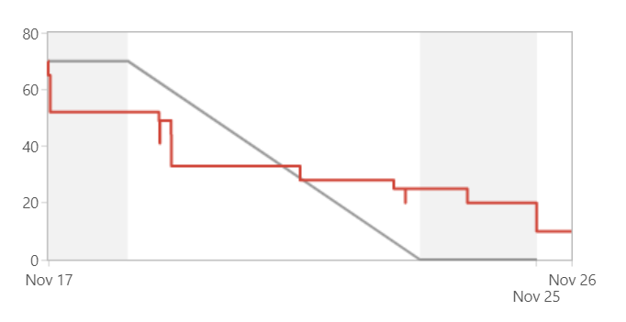
17/Nov/18 3:23 PM - 24/Nov/18 3:23 PM

Slide 14
COMPLETED
Key | Summary | Issue Type | Priority | Status | Story Points (60)
IOT18LF1-45 | As a user i want to automatically get the optimal environment for this specific plant. | Story | Medium | DONE | 8
IOT18LF1-52 | As a user, I want an electrical circuit for tracking nutrient levels | Story | Medium | DONE | 8
IOT18LF1-148 | As a product designer I want to have transitors on electrical boards to turn certain parts on or off | Story | Medium | DONE | 5
IOT18LF1-150 | As a developer I want to remotely access the API. | Story | Medium | DONE | 3
IOT18LF1-156 | As a user, I want to be able to add a new lab farm | Story | Medium | DONE | 5
IOT18LF1-161 | As a user, I want to be able to edit a labfarm | Story | Medium | DONE | 5
IOT18LF1-167 | As a developer I want a central controller for image handling. | Story | Medium | DONE | 3
IOT18LF1-168 | As a developer i want image's to be automatically uploaded to the API. | Story | Medium | DONE | 5
IOT18LF1-169 | As a developer, I need to make sure that the database can aquire all data sent from the master. | Story | Medium | DONE | 5
IOT18LF1-171 | As a developer I want to have a conductivity sensor with accurate conductivity values | Story | Medium | DONE | 5
IOT18LF1-172 | As a developer I want the data to be standard european unit notation | Story | Medium | DONE | 5
IOT18LF1-173 * | As a designer I want a complete list of electrical components | Story | Medium | DONE | 3

Slide 15
NOT COMPLETED
Key | Summary | Issue Type | Priority | Status | Story Points (10)
IOT18LF1-170 | As a user, I want the Leave It unit to automatically create its account | Story | Medium | IN PROGRESS | 5
IOT18LF1-174 * | As a designer I want a schematic of the different power modes documented | Story | Medium | IN PROGRESS | 5

Slide 16
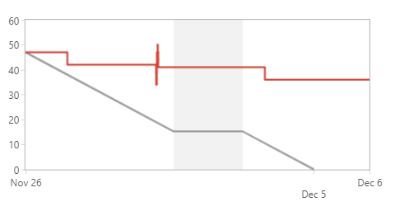
26/Nov/18 4:53 PM - 06/Dec/18 4:02 PM

Slide 17
COMPLETED
Key | Summary | Issue Type | Priority | Status | Story Points (30)
IOT18LF1-13 * | As a user, I want to be able to control the amount of nutrients from the web platform. | Story | Medium | DONE | 3
IOT18LF1-15 * | As a user, I want to control the pump from the web platform | Story | Medium | DONE | 3
IOT18LF1-90 | As a user I want to be able to change the status of the actuators through the API | Story | Medium | DONE | 5
IOT18LF1-93 | As a user I want the backend to automatically change the status of the actuators when asked through the API | Story | Medium | DONE | 3
IOT18LF1-178 | As a user, I want actual photos taken from the plants in my lab farm to be showed in the dashboard | Story | Medium | DONE | 5
IOT18LF1-182 | As a user, I want to receive values from the conductivity sensor | Story | Medium | DONE | 3
IOT18LF1-183 | As a user, I want to be able to login to my personal lab farm overview | Story | Medium | DONE | 5
IOT18LF1-185 | As a developer, I need to finalize the end-to-end communication using IoT Hub. | Story | Medium | DONE | 3

Slide 18
NOT COMPLETED
Key | Summary | Issue Type | Priority | Status | Story Points (36)
IOT18LF1-174 | As a designer I want a schematic of the different power modes documented | Story | Medium | IN PROGRESS | 5
IOT18LF1-176 | As a designer, I want a soldered PCB for prototyping | Story | Medium | TO DO | 18
IOT18LF1-189 * | As a developer I want to have a tool that analyses growth of the plant | Story | Medium | TO DO | 13

Slide 19
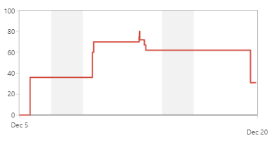
05/Dec/18 11:59 PM - 20/Dec/18 11:59 PM

Slide 20
COMPLETED
Key | Summary | Issue Type | Priority | Status | Story Points (39 → 49)
IOT18LF1-124 * | As a designer, I want a programmed microcontroller for controlling the stepper motors and communication with the camera | Story | Medium | DONE | 8
IOT18LF1-174 * | As a designer I want a schematic of the different power modes documented | Story | Medium | DONE | 5
IOT18LF1-176 * | As a designer, I want a soldered PCB for prototyping | Story | Medium | DONE | 18
IOT18LF1-194 * | As a designer, I want a PCB for controlling the pumps | Story | Medium | DONE | 8
IOT18LF1-196 * | As a developer, I want the CORS settings to be correct | Story | Medium | DONE | - → 5
IOT18LF1-198 * | As a user, I want to be notified when the conductivity sensor has to be cleaned | Story | Medium | DONE | - → 5

Slide 21
TODO
Key | Summary | Issue Type | Priority | Status | Story Points (21 → 31)
IOT18LF1-189 * | As a developer I want to have a tool that analyses growth of the plant | Story | Medium | TO DO | 13
IOT18LF1-195 * | As a designer, I want a PCB for controlling the stepper motors | Story | Medium | IN PROGRESS | 8
IOT18LF1-197 * | As a user, I want the data from the conductivity sensor to be formatted correctly | Story | Medium | IN PROGRESS | - → 5
IOT18LF1-199 * | As a user, I want to see how much my plant has grown | Story | Medium | TO DO | - → 5

Slide 22
Analyse Update

Slide 23
Planning

Slide 24
Planning

Slide 25
MILESTONES - TODO
PCB’s afwerken
Power Management systeem
Data flow onderhouden
Onderzoek doen naar standaardwaarden betreffende planten
Assemblage (als de buizen er zijn)
Integratie van de Google Cloud Vision API
Automatiseren van de Labfarm

Slide 26

Bedankt voor uw aandacht!

