Slide 1
HORO
Emyl Luyten, Yaro Helsen, Lowie Spriet, Rob Mertens, Michiel Vissers

Slide 2
H
O
HOLOLENS
R
O
ROBOT

Slide 3
PROEFOPSTELLING

Slide 4






Slide 5








Slide 6



ROBOT ARM

Slide 7
ROBOT ARM
PWM

Slide 8


INTEL REAL SENSE

Slide 9
Computer vision

Slide 10
UNDERSTANDING AN IMAGE

Slide 11
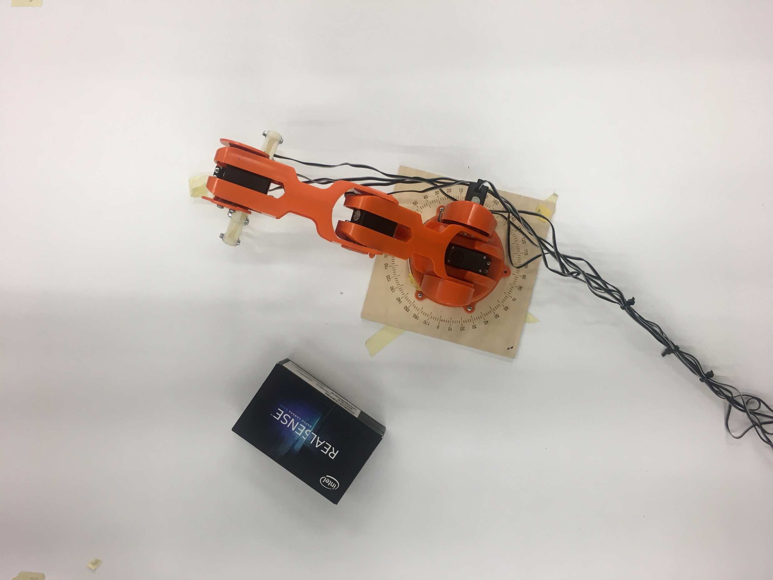
2m
1280px
720px
1,1m
PIXELS

Slide 12
BACKGROUND SEPARATION

Slide 13
RGB = R0 G0 B0
RGB = R255 G255 B255
REMOVE A RANGE OF COLORS => R0G0B0 – R25G25B25

Slide 14
TO REMOVE THE ROBOT ARM
(FROM THEMASK)
PAINT A WHITE RECTANGLE OVER IT
TO TRIC THE ALGORITHM

Slide 15
EDGE DETECTION

Slide 16
(MATRIX magic)

Slide 18
POSITION DETERMINATION

Slide 19
2m
1280px
2m = 1280px
1,1m = 720px
6,4px = 1cm
720px
1,1m
650px
320px = 50cm
320px
650px = 102cm

Slide 20
WHAT’S NEXT?

Slide 21
MASKING ALGORITHM
COLOR RANGE
BY DEPTH

Slide 22
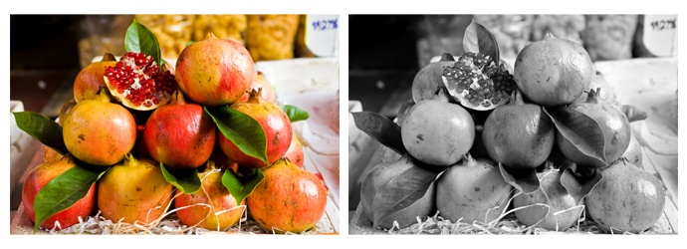

PERFORMANCE UPGRADE

Slide 23
OBJECT SEPERATION PROBLEM!

Slide 24


INTEL REAL SENSE
Object 1
Object 2
X, Y, Z, α
X, Y, Z, α
Object 3
X, Y, Z, α

Slide 25
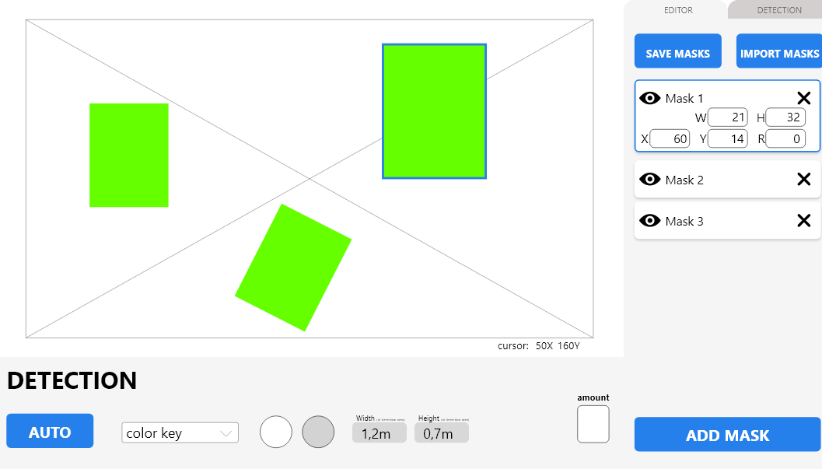

Slide 26


HOLOLENS

Slide 27
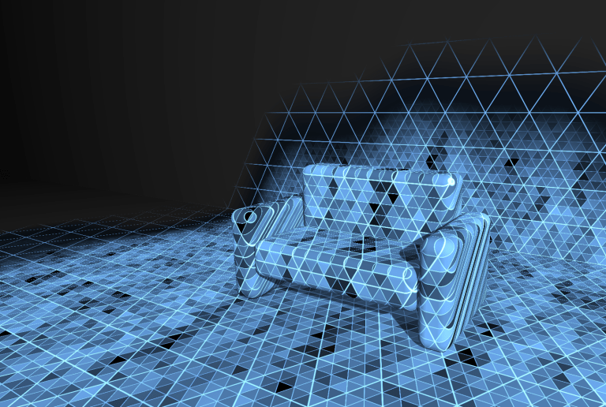
HOLOLENS

Slide 28
HOLOLENS
Object 2
Object 1
Object 3

Slide 29


HOLOLENS
UI

Slide 30
HOLOLENS SCREEN

Slide 31
VRAGEN?

