Slide 1


AP BIO
TOPIC 8.7:
Disruptions in Ecosystems

Slide 2
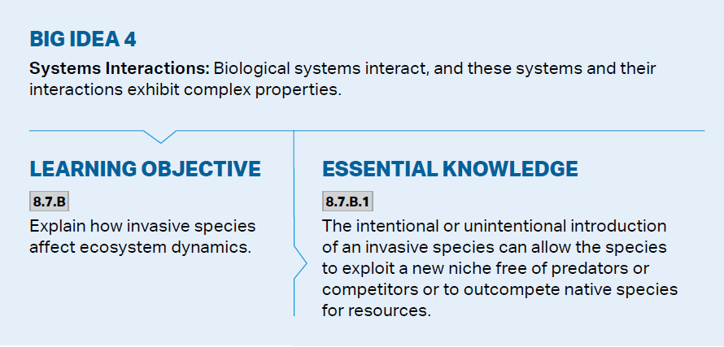
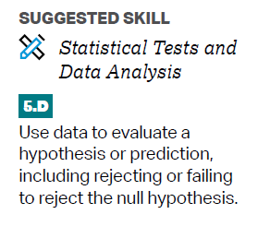
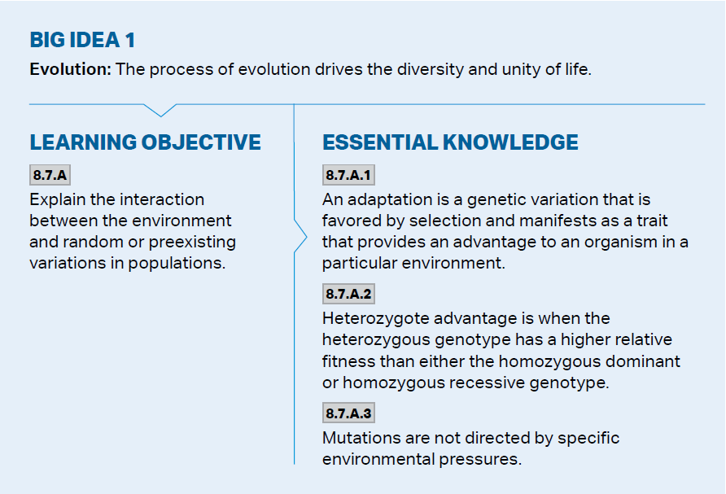
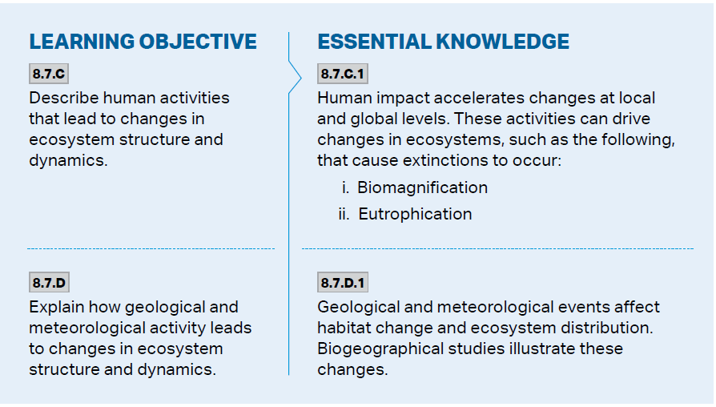
Objectives

Slide 3
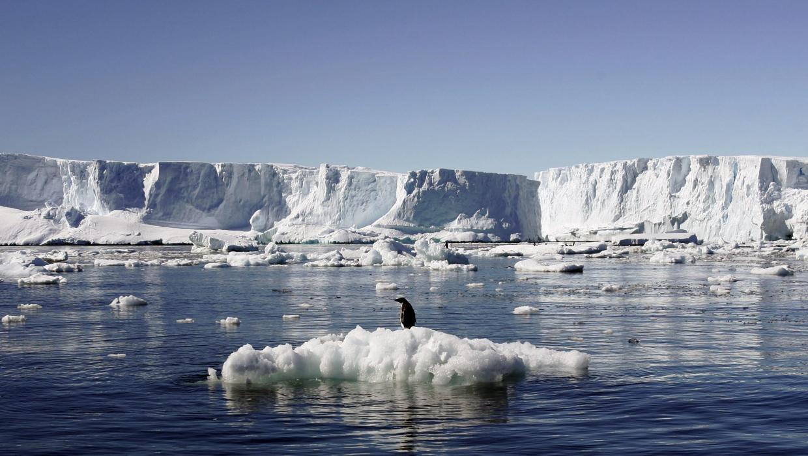
Ecosystems and Adaptations
There are variations in populations (both random and preexisting)
  Adaptations – a genetic variation favored by selection, provides an advantage to an organism
  Mutations are random but can be beneficial to an organism in an environment
Organisms are generally well adapted to their environments but can be at risk if the environment suddenly changes
  Natural changes and human driven changes

Slide 4
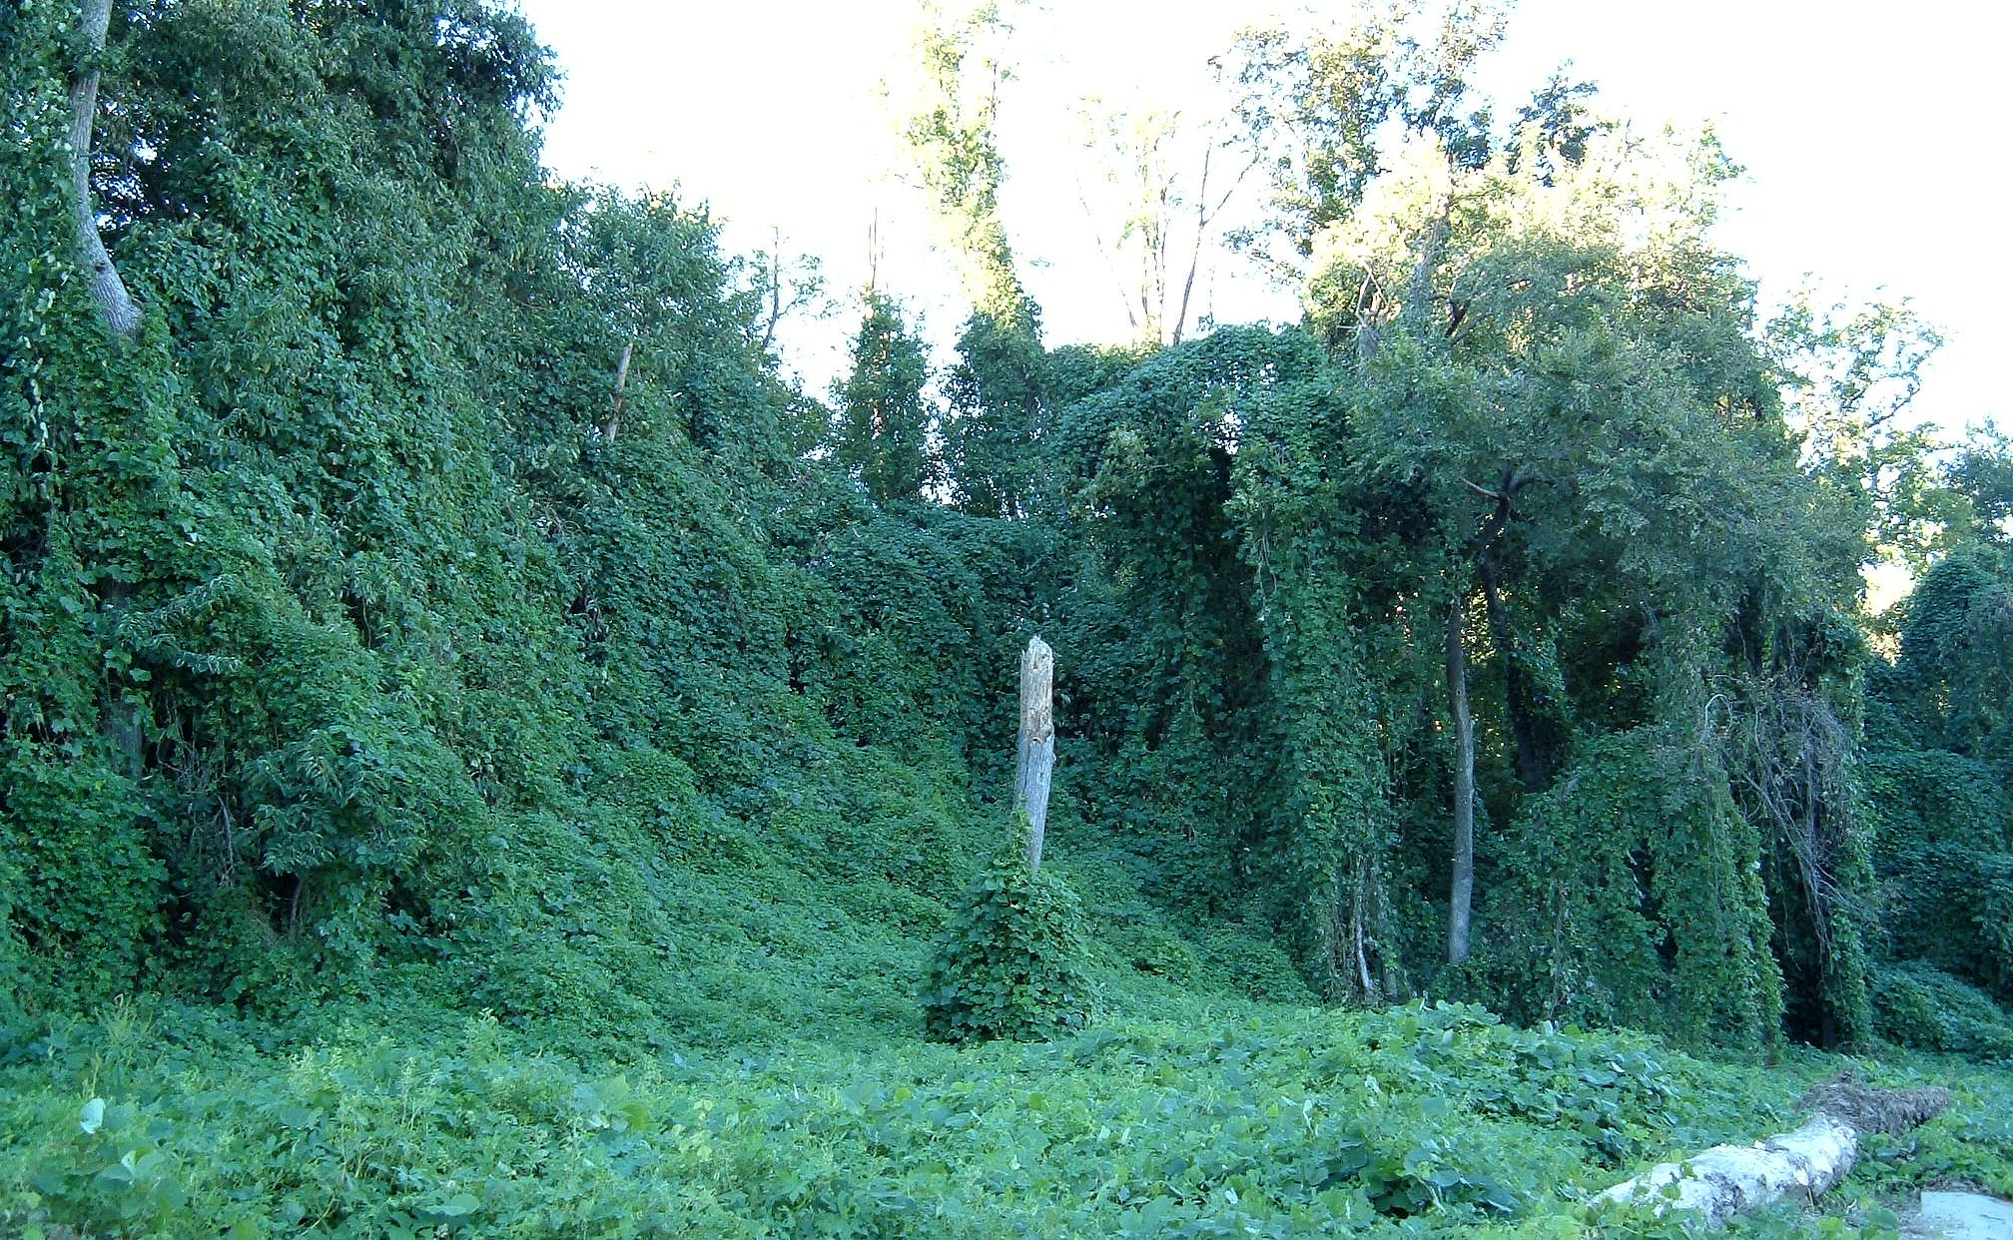
Invasive Species
Invasive species - non-native plants, animals, or pathogens that, when introduced to a new environment usually cause harm to the environment
  Exploit new niche – free from predators or able to outcompete native species
  Intentional and nonintentional introduction to environments
Notes:
Kudzu, scientifically known as Pueraria montana, is a fast-growing, invasive vine native to East Asia, and has become a significant problem in the Southeastern United States. It was introduced to the US in the late 19th century for erosion control and as a forage crop, but its rapid growth and ability to smother other vegetation have made it a major ecological and agricultural pest.

Slide 5
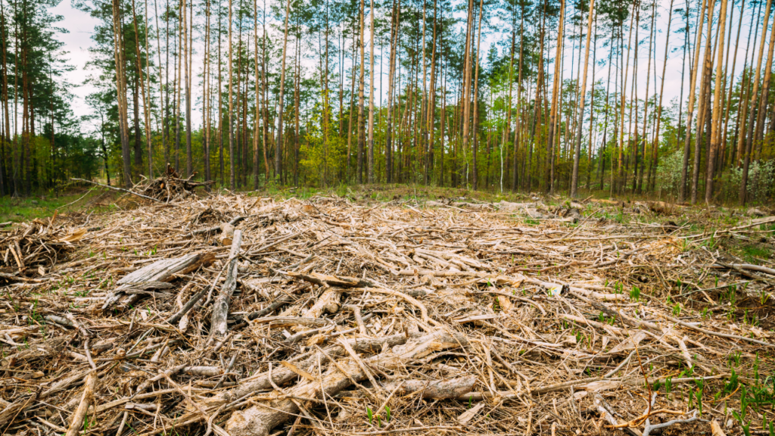
Habitat Loss
Habitat loss – mostly due to human activity – habitats are destroyed -> replaced by monocultures
  Low biodiversity = ecosystem is at risk
  Logging
  Urbanization
  Monocropping
  Habitat fragmentation – breaks up gene pools, lowers diversity

Slide 6
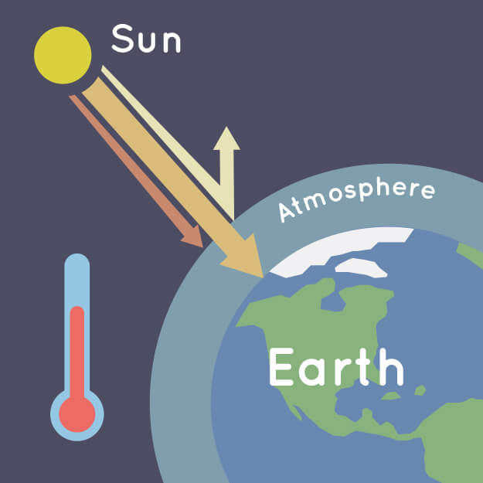
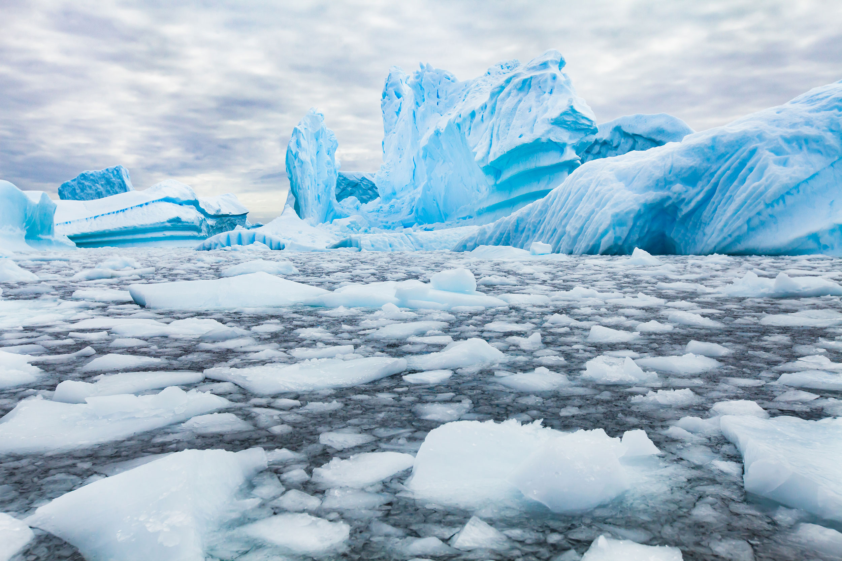
Climate Change
Global climate change – directional change in the global climate (warming), largely due to human activity releasing greenhouse gases into the atmosphere
  Leads to further habitat loss, changes in temperature, changes in soil composition

Slide 7
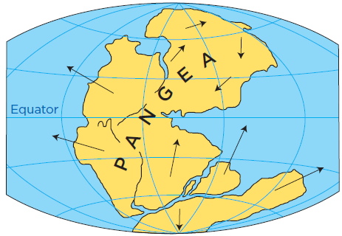
Geological and Meteorological Events
Geological and meteorological events affect habitat distribution
  El Nino – changing weather pattern
  Continental Drift – affects climate and species distribution
  Meteor impact on dinosaurs

Slide 8
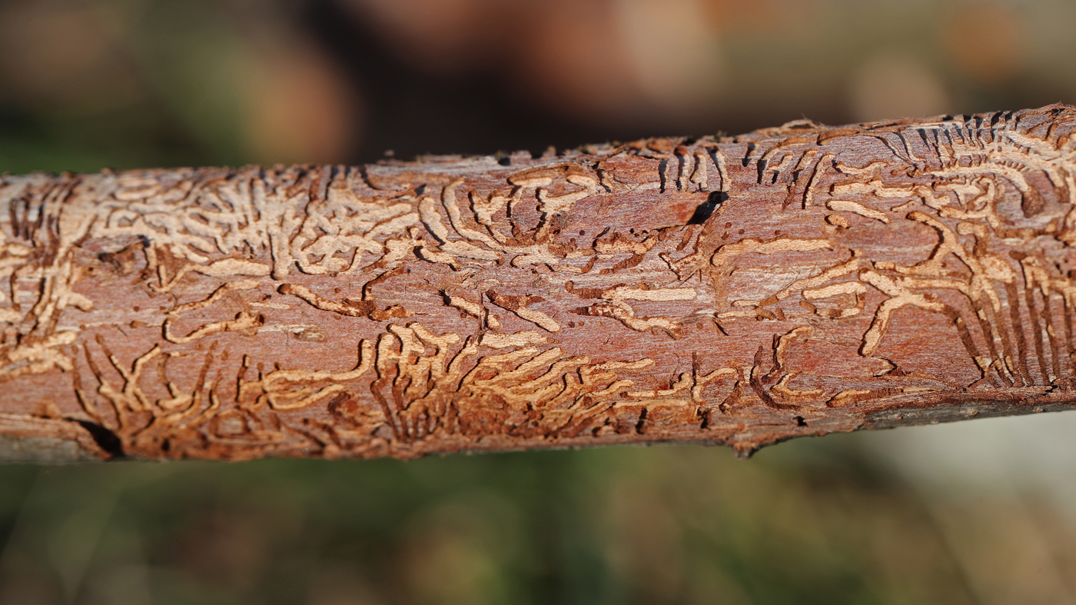
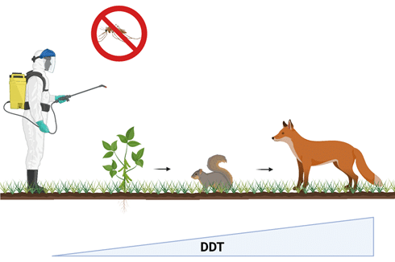
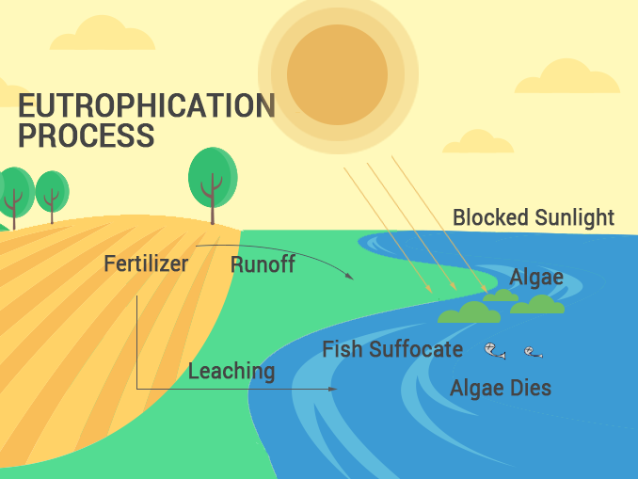
Extinction
Human activities can cause extinction and disrupt ecosystems
  Transmission of infection across the Atlantic by humans has resulted in Dutch Elm Disease in America and the Potato Blight in Europe
  Biomagnification – toxins that cannot be broken down biologically become more concentrated in successive trophic levels (DDT)
  Eutrophication - water bodies become excessively enriched with nutrients leading to harmful algal blooms and oxygen depletion, harming aquatic life (accelerated by agricultural runoff)

Slide 9
Disruptions in Ecosystems Review
Organisms are adapted to their environments
Invasive species, habitat loss, climate change
Humans can cause extinction (biomagnification, eutrophication)
Geological and meteorological events

