Slide 1


AP Bio
Unit 1:
Chemistry of life Review

Slide 2
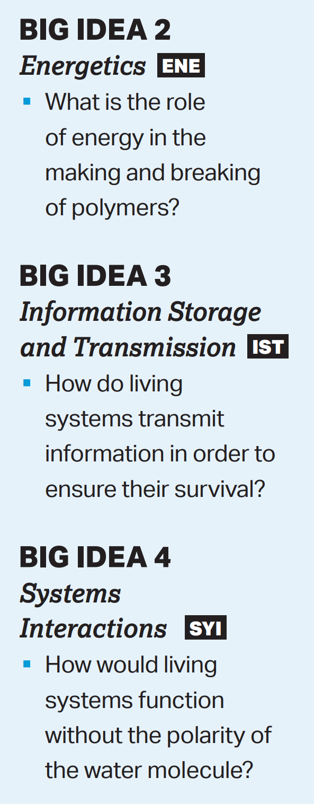
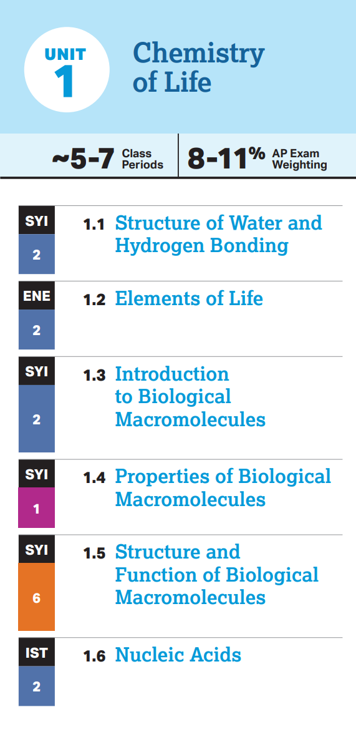
Unit 1: What You Need To Know
How carbon is the center of all life
The 4 kinds of macromolecules and their structures/functions
The differences between DNA and RNA
How monomers come together and break apart in the formation of polymers
The structure and properties of water

Slide 3
Review 1.1 (Bonds)
Covalent Bonds – sharing of electrons within the valence shell
Ionic Bonds – opposite charges attract
van der Waals – close interactions of electrons form weak bonds
Hydrogen Bonds – the polarity of water causes either side of the molecule to have partial charges
Oxygen atoms are electronegative
Notes:
Draw – use water as example for covalent

Slide 4
Review: 1.1 (Properties of Water)
Cohesion – attraction of like molecules (ex. water to water)
Surface tension
Adhesion – attraction of unlike molecules (ex. water to glass)
Meniscus and transpiration
High Specific Heat – water resists temp. change = can regulate temp.
Lower Density as a Solid – ice floats which protects ponds
Nearly Universal Solvent – water can dissolve any charged substances
Notes:
Focus on transpiration to showcase both cohesion and adhesion Include high heat of vaporization with high specific heat Explain the solvent process using random ions

Slide 5
Review: 1.2 (Carbon)
All major macromolecules of life contain carbon
Allows for many bonds to be formed
Compounds with carbon are organic
Rule of CHONP
4 major macromolecules: carbohydrates, lipids, nucleic acids, proteins
Notes:
Essential elements CHO, CHO, CHON, CHONP

Slide 6
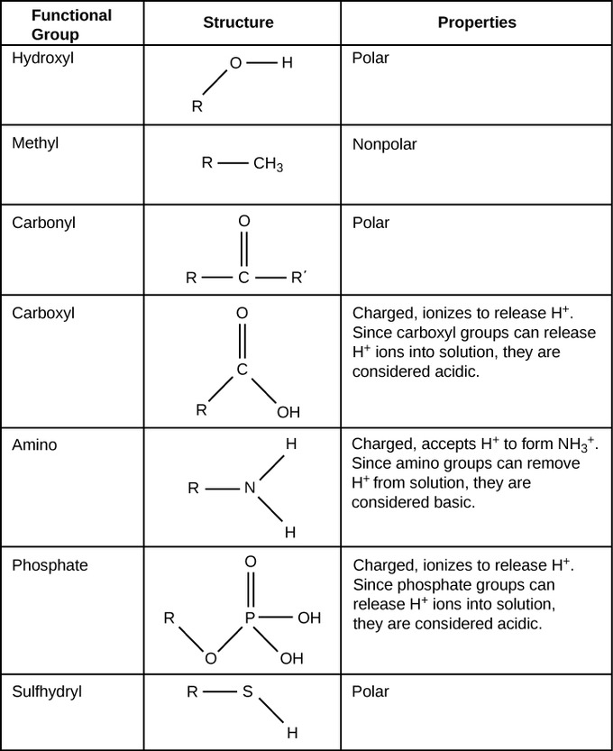
Review: 1.2 (Functional Groups)
Functional groups – additions to carbon backbones of molecules which give different properties
Notes:
Aldehydes vs ketones

Slide 7
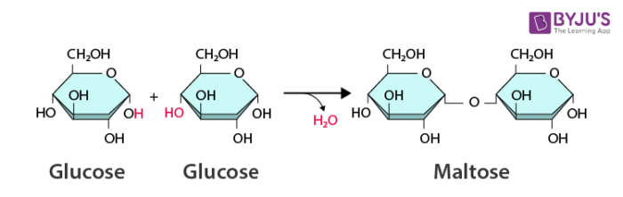
Review 1.3 (Dehydration Synthesis and Hydrolysis)
Monomers vs. Polymers (subunits vs. the whole)
Some monomers of carbohydrates and proteins form polymers through dehydration synthesis
The formed bonds can be broken through hydrolysis

Slide 8
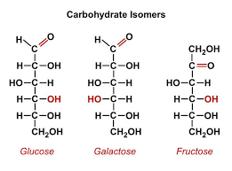
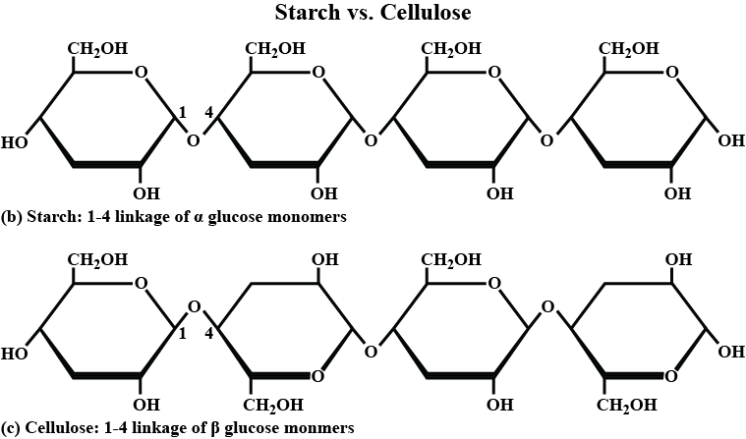
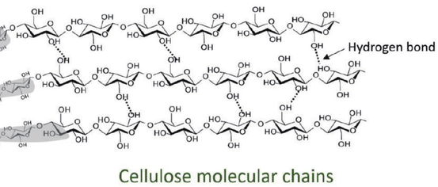
Review 1.4 (Carbohydrates)
The polymer is a monosaccharide while the polymer is a polysaccharide (ringed or branched)
Connected by dehydration synthesis through glycosidic linkages
They have isomers (structural and enantiomers)
Even a difference in positioning of ring can affect the carb. (alpha vs beta glucose)
Carbs are used for energy and structure
Starch, glycogen
Cellulose, chitin
How does AAA?
Notes:
CHO ratio, Definition of saccharide, disaccharide
Structural = bonds in diff places Enantiomers = mirror image
AAA = branch/ring = breaking off for energy

Slide 9
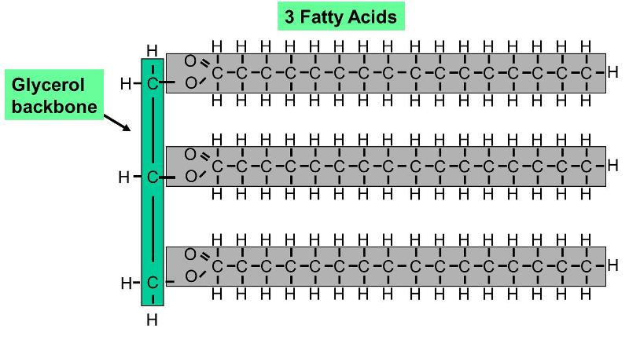
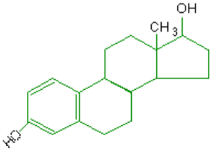
Review 1.5 (Lipids)
Lipids are non-polar
Fats (triglycerides): glycerol + 3 fatty acid hydrocarbon chains
Steroids: 4 carbon ring (hormones and cholesterol)
Phospholipids: phosphate group + 2 fatty acid chains (used in membranes)
Can be saturated (all hydrogens) or unsaturated (not all hydrogens)
Lipids store energy (long term), make up membranes, and act as hormones
How does AAA?
Notes:
Aaa = long energy storing chain
Ester linkages
Explain phospholipid polarity
Sat vs unsat and how that affects structure, trans fats

Slide 10
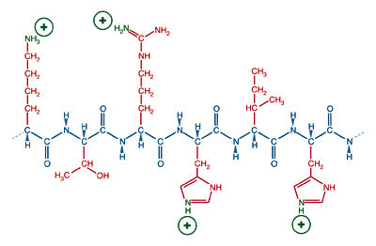
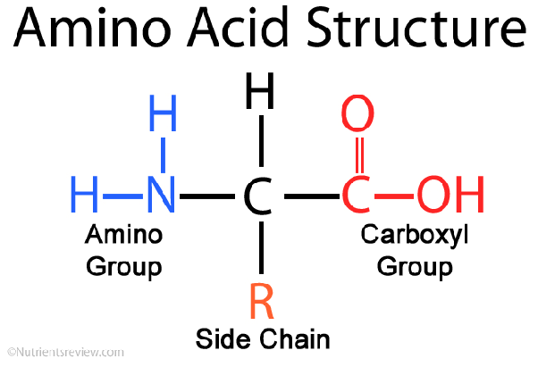
Review 1.7 (Amino Acids)
Proteins are made of amino acids, which all contain the same backbone but have different side groups
These amino acids are connected through peptide bonds
The side (R) groups can be acidic/basic and polar/nonpolar based on ions, functional group, and polar elements
Major protein uses include building/repairing the body, gene expression, movement, enzymatic activity, defense
How does AAA?
Notes:
“polypeptide”
AAA = change in the structure affects the shape = can change function

Slide 11
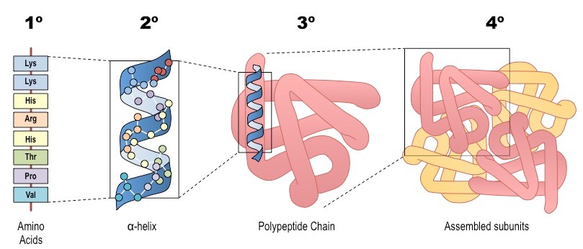
Review 1.7 (Protein Folding)
Primary | Secondary | Tertiary | Quaternary
The sequence of amino acids | Hydrogen bonding between the amino acid backbone Can either be in an α helix shape Or β pleated sheet shape | Folding of the polypeptide chain due to the side chains Ionic bonds, disulfide bridges, hydrogen bonds, and hydrophobic interactions – van der Waals forces Hydrophobic side chains want to curl inwards away from the aqueous solution | Multiple polypeptides attaching to each other through bonds such as in tertiary structure
When the bonds in secondary and tertiary structure break due to pH, salinity, or temp., the protein becomes denatured
Notes:
Explain each of the tertiary bonds
Disulfide bridges = between two sulfur
How change in primary affects all other structures
Primary structure cannot be denatured

Slide 12
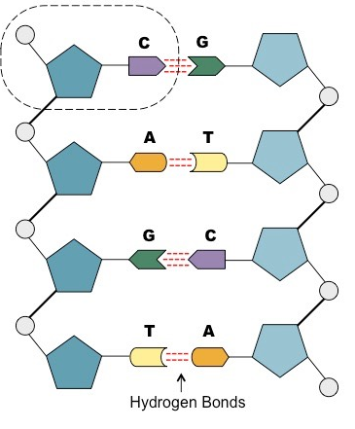
Review 1.6 (Nucleic Acids)
Nucleic acids (DNA and RNA) are formed from nucleotides which form strands when bonded covalently
All nucleotides contain:
A five-carbon sugar called a pentose
A phosphate group
A nitrogenous base (Adenine, Cytosine, Guanine, Thymine, Uracil) – pair A-T, C-G
A and G are 2 ringed = purines, C and T are 1 ringed = pyrimidines
Strands of DNA run antiparallel (each from 5¹ carbon to the 3¹ carbon
DNA’s purpose is to store/express genes
How does AAA?
Notes:
Hydrogen bonds between strands DNA two strand = easy to copy

Slide 13
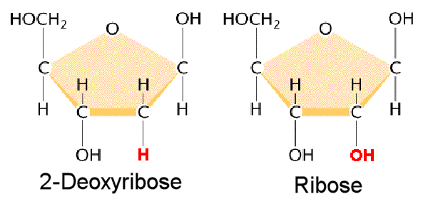
Review 1.6 (RNA)
RNA:
Single stranded
Nitrogenous bases are adenine, guanine, cytosine, uracil
Has a ribose sugar instead of a deoxyribose sugar
Helps DNA code for proteins by messaging the gene (mRNA), transcribing the gene into a protein (tRNA) and making ribosomes where the transcription can occur (rRNA)
Notes:
RNA one strand = can move easily out of nucleus cuz smaller and can be transcribed because missing half

