Slide 1


AP BIO
TOPIC 1.0:
CHEMISTRY FUNDAMENTALS

Slide 2
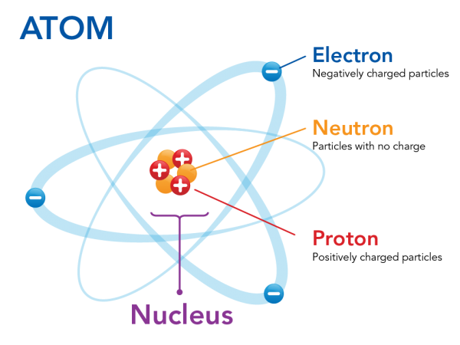
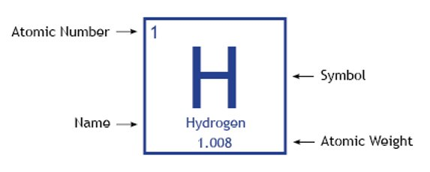
What You Need To Know: Atoms
Atoms are the building blocks of the universe (they compose molecules)
They contain protons (+), neutrons, and electrons (-)
Protons and neutrons are in the nucleus and the electrons fly around them in a cloud
Every element on the periodic table is a unique atom, defined by its amount of protons
Isotopes = same atom type but different number of neutrons
Ions = same atom, but an abnormal number of electrons (non-zero charge)
Notes:
Atomic weight = average weight of all the isotopes

Slide 3
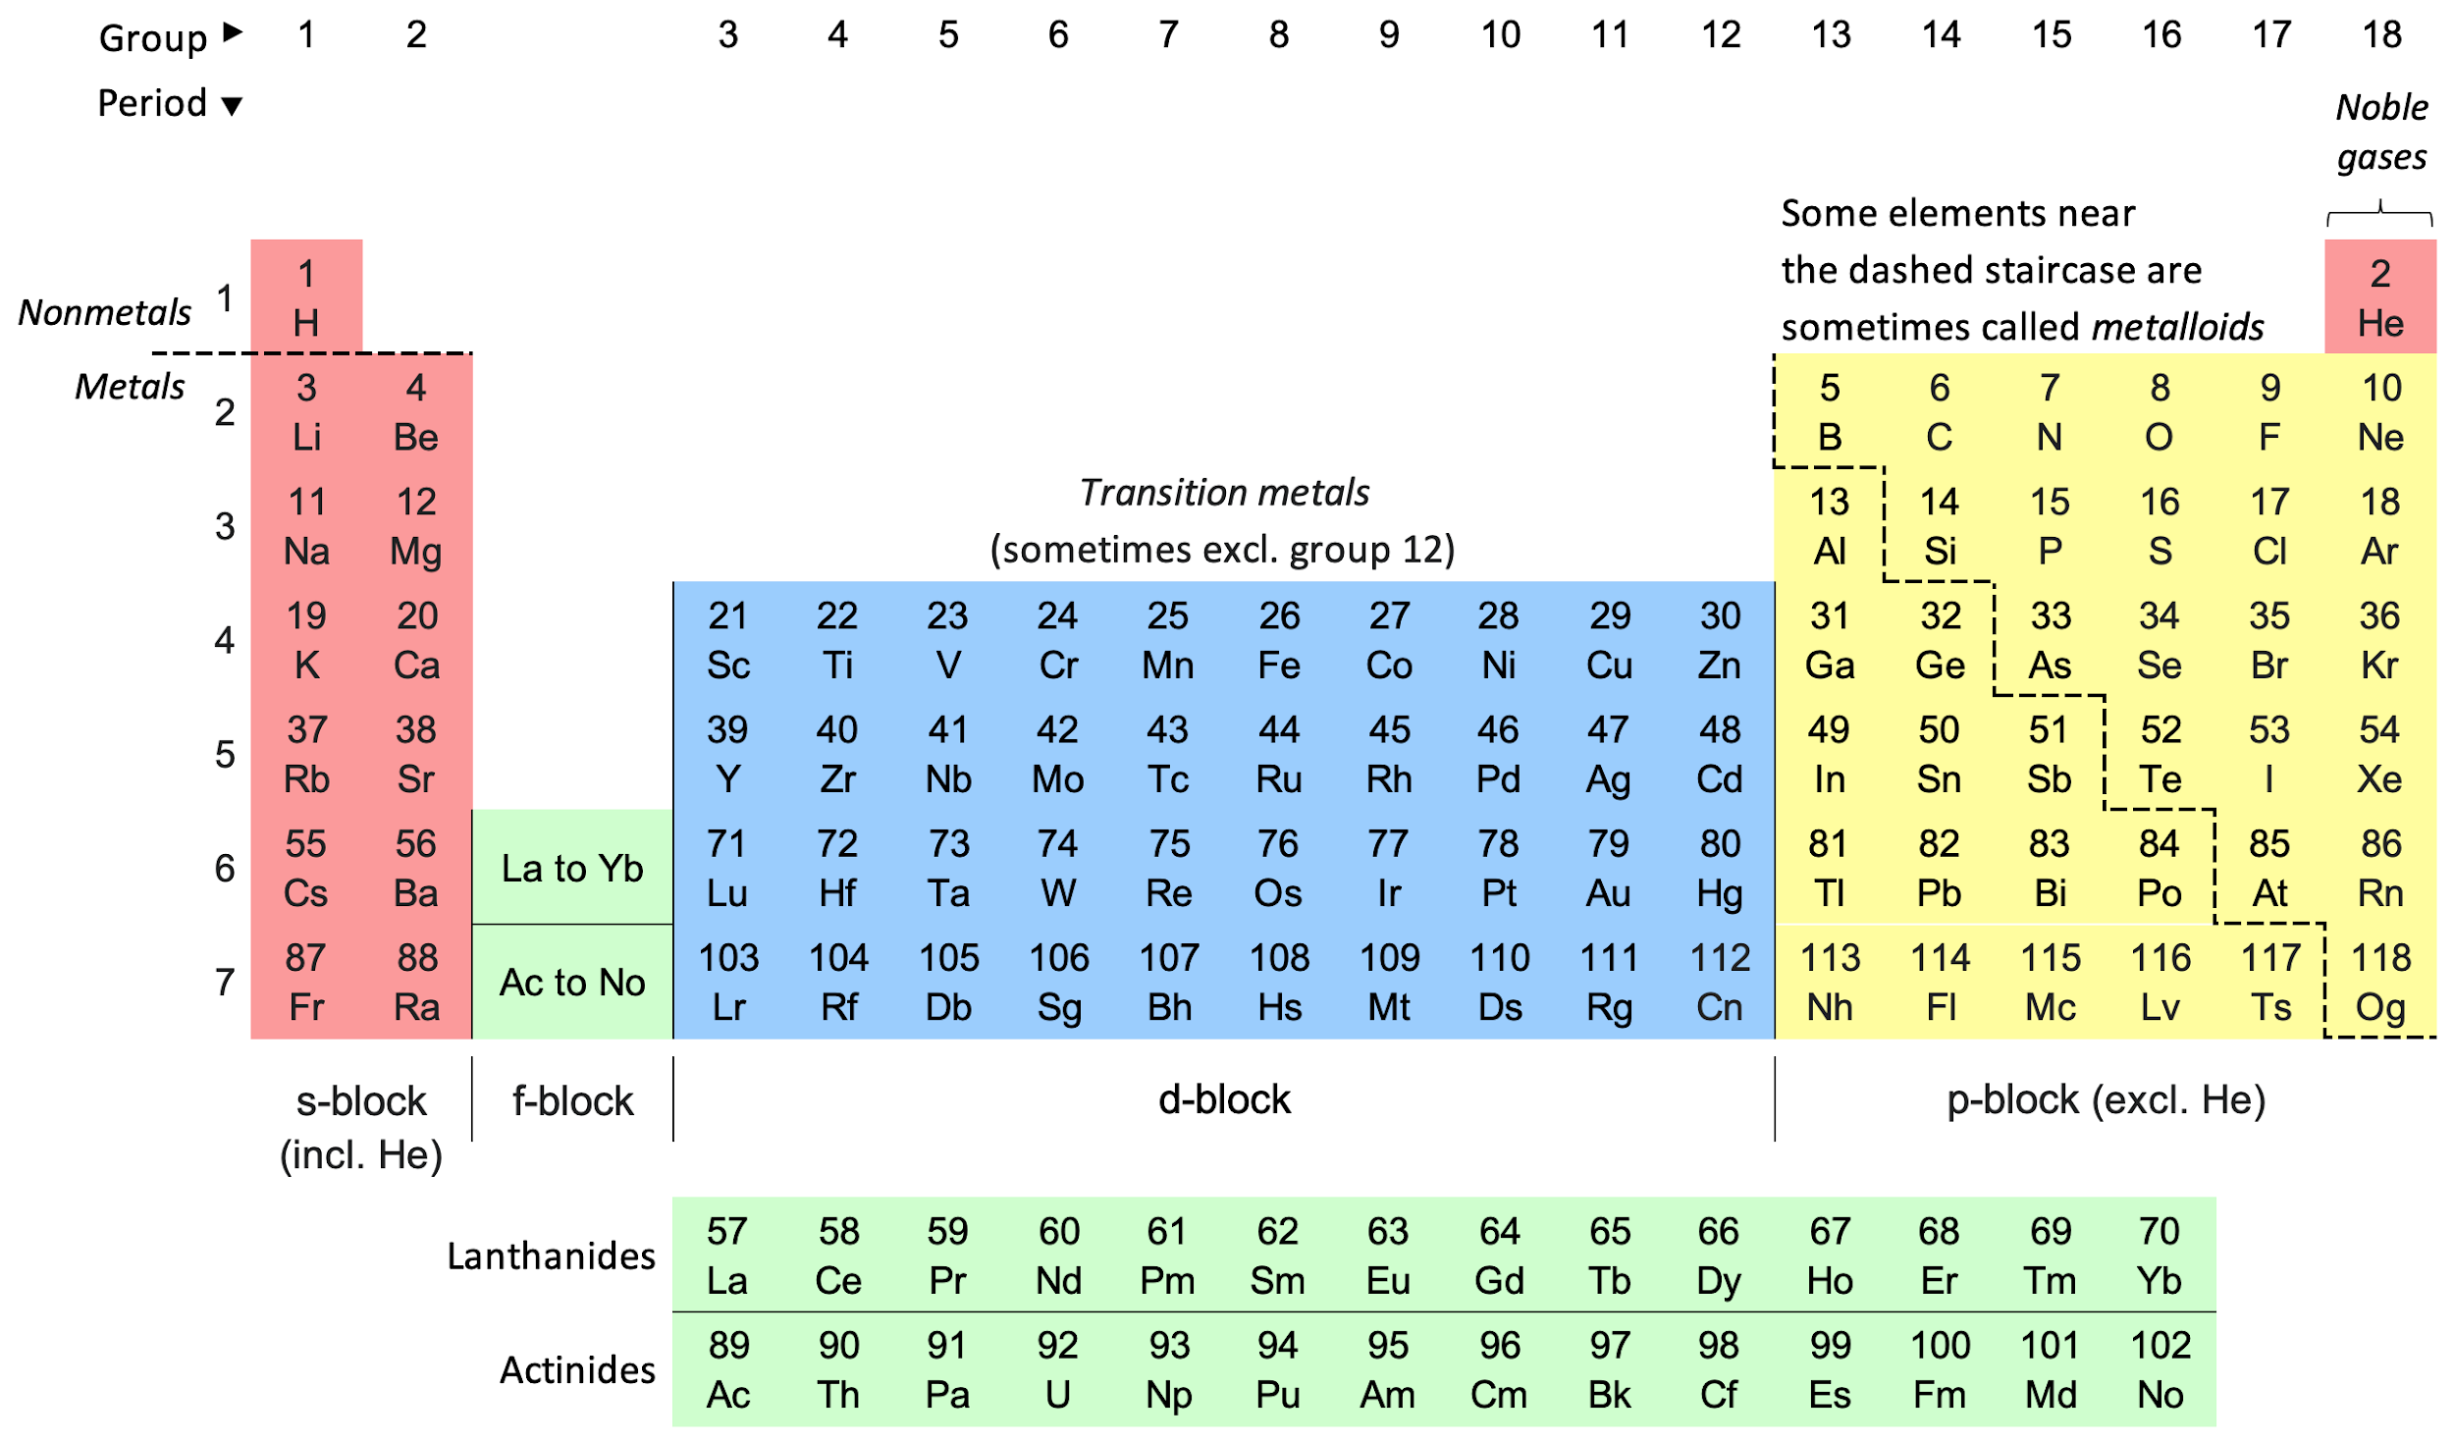
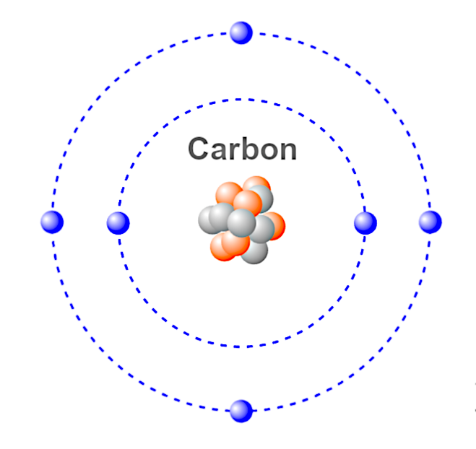
What You Need To Know: Valence
An element's position on the periodic table determines the element's valence
The valence is the amount of bonds an element can form, based on its outermost electron shell (valence shell)
It determines how an atom bonds

Slide 4
What You Need To Know: Bonding
Covalent Bonds – strong bonds between atoms where electrons are shared
Can be polar or non-polar
Exist in single, double, and even triple form
Ionic Bonds – strong bond between opposite ions
Positive ions are called cations
Negative ions are called anions

Slide 5
What You Need To Know: Bonding (Cont.)
Hydrogen Bonds – weak bonds between positively charged hydrogen atoms and a negatively charged atom
van der Waals Forces – weak electrical interactions between molecules/atoms very close to each other through electron movement

Slide 6
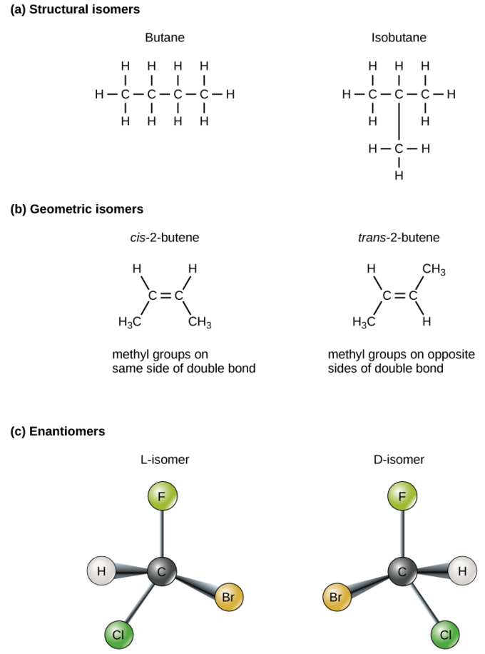
What You Need To Know: Isomers
An isomer is a molecule that has the same chemical formula as another molecule but a different structure
A structural isomer is an isomer that has a different shape
A cis-trans isomer is an isomer where the atoms attached to the double bonded carbons can be flipped around
If both sides are the same, then you have a cis isomer
If they are different, then a trans isomer is present
An enantiomer is an isomer that is mirrored

Slide 7
What You Need To Know: pH
Occasionally, a proton (hydrogen ion) dissociates, or leaves, a molecule, resulting in only the electron being left. This proton can then join other molecules, forming an ion.
A water molecule missing a proton is called a hydroxide ion (OH-)
A water molecule with an extra proton is a hydronium ion (H₃O+)

Slide 8
What You Need To Know: pH Calculation
In pure water only 1/554,000,000 hydrogen ions leave their molecule to join another => 10⁻⁷ of a mole of hydrogen ions per mole of water (mole is a value used to measure molecules)
pH = –log [H⁺] (H⁺ is the concentration of hydrogen ions) Inversely, H⁺ = 10^{-pH}
Plug that into the equation and we get pure water has a pH of 7

Slide 9
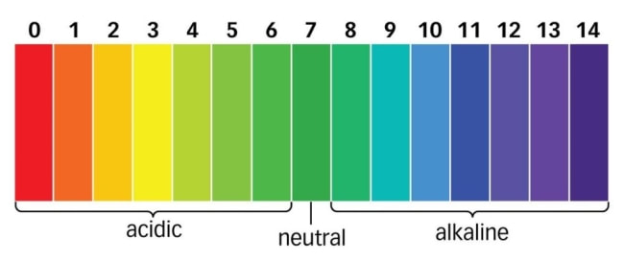
What You Need To Know: Acids and Bases
Acids have an excess of H⁺ ions
This lowers the pH below 7
Bases have a lack of H⁺ ions
This increases the pH above 7
(Acidic molecules donate H⁺ and basic molecules accept them)
Due to pH being calculated with a logarithm, a change in pH is a tenfold change in H⁺ ions (pH 6 is 100 more basic than pH 4)
Buffers – substances that minimize changes in pH (can both accept and donate H⁺)

Slide 10
Chemistry Fundamentals Review
Atoms
Isomers
Bonding
pH

