Slide 1



AP Bio
Topic 1.1:
Structure of Water and Hydrogen Bonding
Notes:
Welcome to AP Bio with AP Study! For most of you, this will be your first lesson. If you want some more background on chemistry before starting this unit, we have another video to help with that. Today we will be covering topic 1.1, all about water.

Slide 2
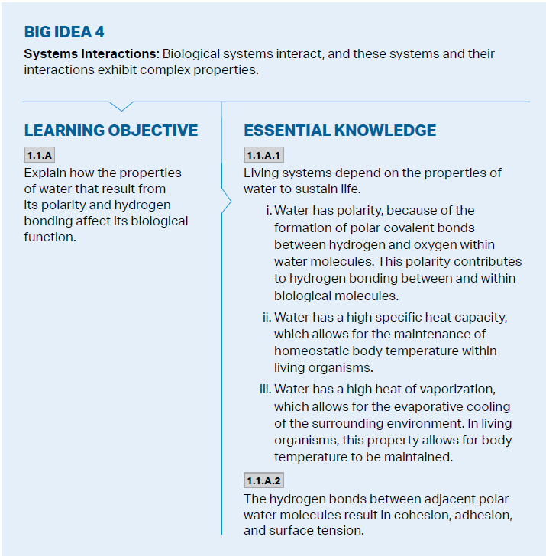
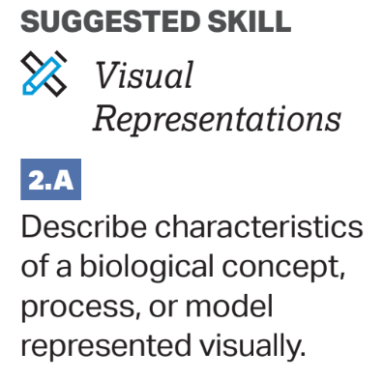
Objectives
Notes:
The main objectives of this lesson are the hydrogen bonds which form water molecules, and the reasons why life depends on water. The college board wants you to be able to use your knowledge of water and its properties to describe or model it.

Slide 3
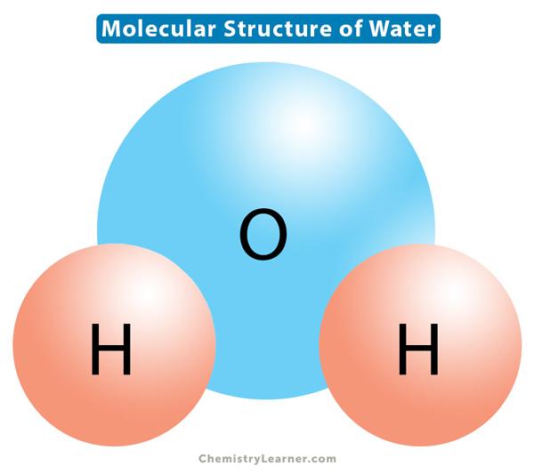
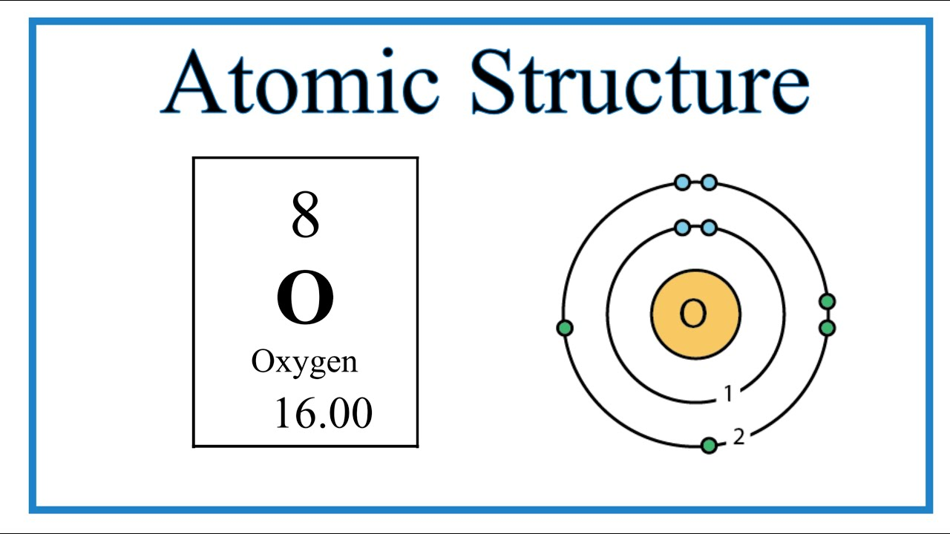
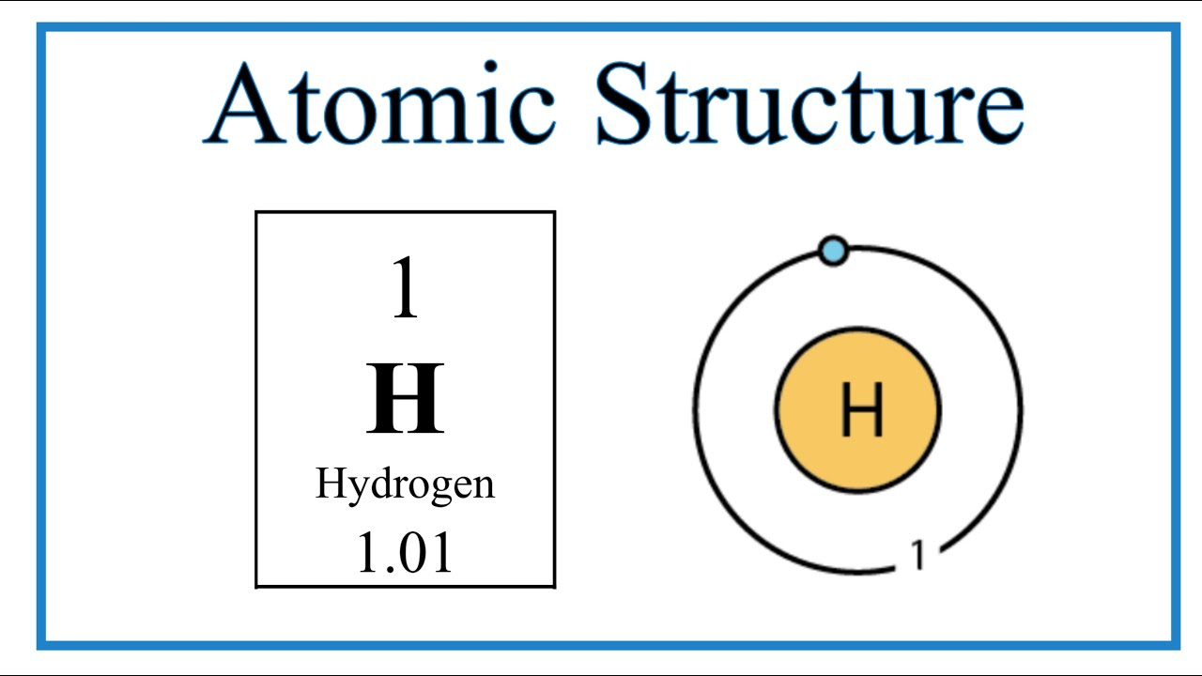
Structure of Water
H₂O
Covalently bonded oxygen to hydrogen
Oxygen is electronegative – hogs electrons due to its size
This causes partial charges to form making water a polar covalent molecule
Notes:
Molecular structure
Electronegativity/positivity
Polar covalent bonding
Explain diagram

Slide 4
Hydrogen Bonds
These partial charges lead to attraction between the positive and negative sides of the water molecules
The bonds these molecules form is called a hydrogen bond and it is very weak
One molecule can bond to 4 others
Notes:
Cause of hydrogen bonds
Explain quantity
Draw diagram of bonded water molecules

Slide 5
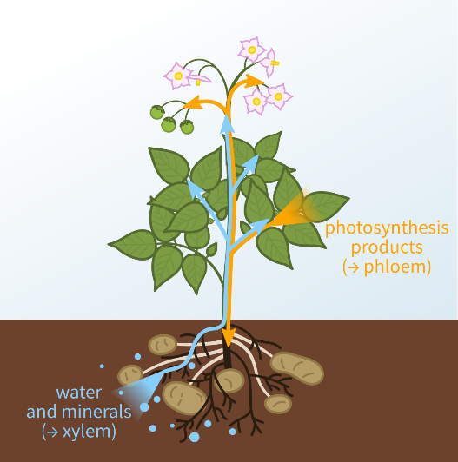
Properties of Water: Adhesion and Cohesion
Cohesion is the linking of like molecules (water-water)
Due to the cohesion of water, the tops of ponds/lakes form small film resulting in surface tension
Adhesion is the linking of different molecules (ex. water-glass)
This causes a meniscus in beakers and allows for plants to transport water against gravity
Transpiration – evaporation from plants through the xylem tube as a result of cohesion and adhesion (also called capillary action)
Notes:
Effects of hydrogen bonding
Surface Tension – connection stronk
Explanation of adhesion and cohesion bonding to polar molecules (transpiration and meniscus)
Transpiration due to evaporation

Slide 6
Properties of Water: High Specific Heat and High Heat of Vaporization
Water = high specific heat (amount of heat energy needed to raise 1g of water 1º C)
This takes a long time/more energy due to hydrogen bonds -> makes ocean temperatures more stable and means they change slower (good for the animals and the coastal cities)
The same applies to sweat (the hottest water molecules evaporate first) – known as evaporative cooling
Notes:
Cause of high specific heat (hydrogen bonds)
Effect of high specific heat (cooling and regulation of temperature)
Calorie = amount of energy need to heat up a gram of water 1 degree Celsius
Diagram? of bonds breaking/forming

Slide 7
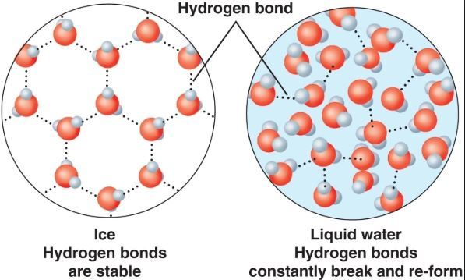
Properties of Water: Lower Density As A Solid
Water is less dense as a solid than liquid (unlike most substances) meaning ice floats
This is good for creatures that live in ponds/lakes/oceans
Notes:
Density in general
Effects of floating ice on animals
Diagram?
WATER DOES NOT SINK

Slide 8
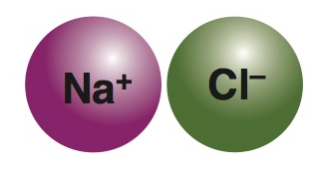
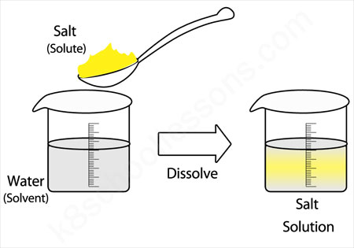
Properties of Water: Water as a Solvent
Water is an almost universal solvent (substance that can dissolve others) – what is being dissolved = solute and your result is a solution
Water can dissolve polar and ionic substances or those that are hydrophilic “water loving” – think charged substances
Non-polar and hydrophobic “water hating” substances cannot be dissolved in water (hence almost universal solvent)
Notes:
Solvent/solute examples and definitions
Draw graph of showing water separating NaCl
Explain hydrophilic, hydrophobic, and isotonic (tonocity)

Slide 9
Structure and Properties of Water Review
Water’s polarity
Hydrogen bonds
Cohesion and surface tension
Adhesion and meniscus
Transpiration
High specific heat and evaporative cooling
Density as a solid
Universal solvent
Notes:
Basic review
Next up: Carbon and its effects on life

