Slide 1


AP Bio
Topic 1.2:
Elements of Life
Notes:
Welcome back to AP Bio with AP Study! If you want some more background on chemistry for this lesson, we have a video to help with that. Today we will be covering topic 1.2, the elements of life.

Slide 2
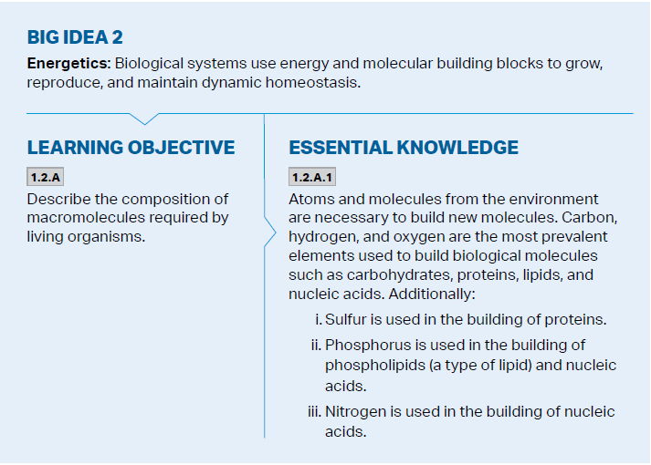
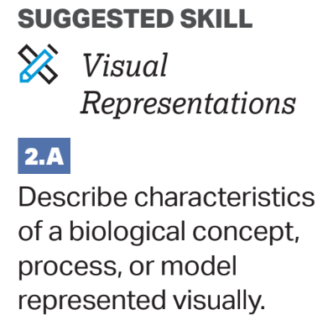
Objectives
Notes:
The main objectives of this lesson are the understanding of the movement of energy and atoms between organisms within the environment to build macromolecules, as well as the power of carbon. The college board wants you to be able to model this or recognize and use a model of this.

Slide 3
CHONP (and S)
The major elements of life: carbon, hydrogen, oxygen, nitrogen, phosphorus, and sulfur (CHON = 96% of our bodies) – these are called essential elements
Organic compounds – compounds which contain carbon “living compounds”
Most also contain hydrogen -> hydrocarbon chains
The four major macromolecules are made out of CHONP
Notes:
Main atoms of life: carbon, hydrogen, oxygen, nitrogen + examples
Oxygen 65%
Carbon 18%
Hydrogen 9.5%
Nitrogen 3%
Atmosphere
Secondary: phosphorous and sulfur
Organic compounds (include C) + examples
4 macromolecules + examples (draw double helix, carb, lipid, and protein fold)

Slide 4
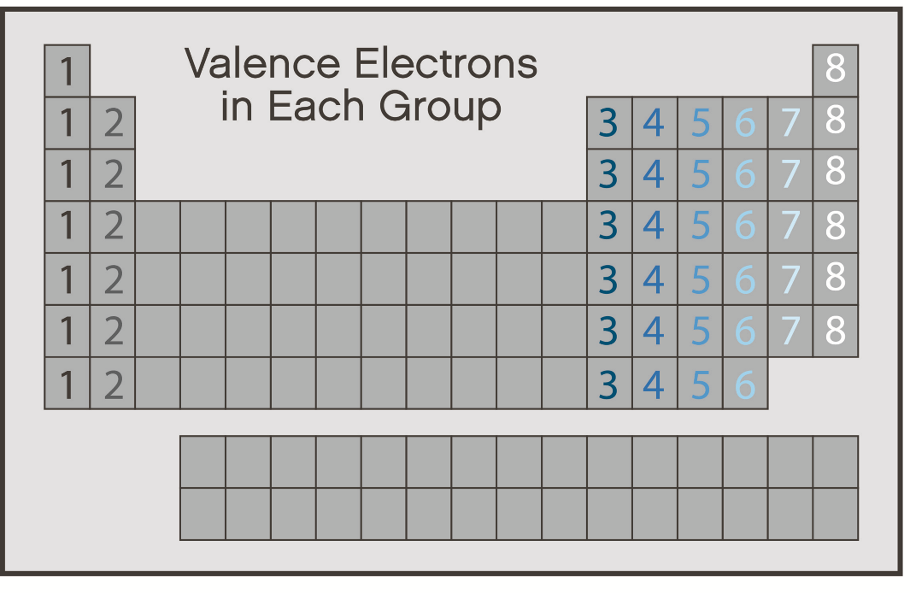
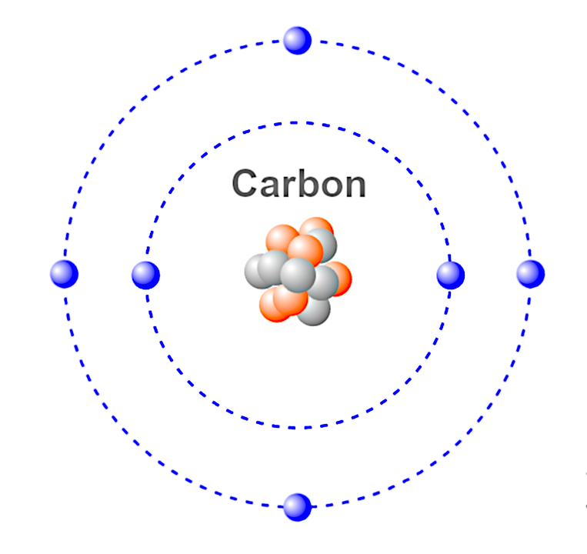
The Power of Carbon
Carbon is in Group 14 on the periodic table, meaning it has 4 valence => can form 4 covalent bonds
These bonds can be single, double, or triple
This allows carbon to form large molecules by connecting to other carbon compounds
Can be chains, rings, or branched
Notes:
Properties of Carbon:
4 valence = many bonding sites
Examples of double and triple bonds
Examples of carbon in molecules (nacromole)

Slide 5
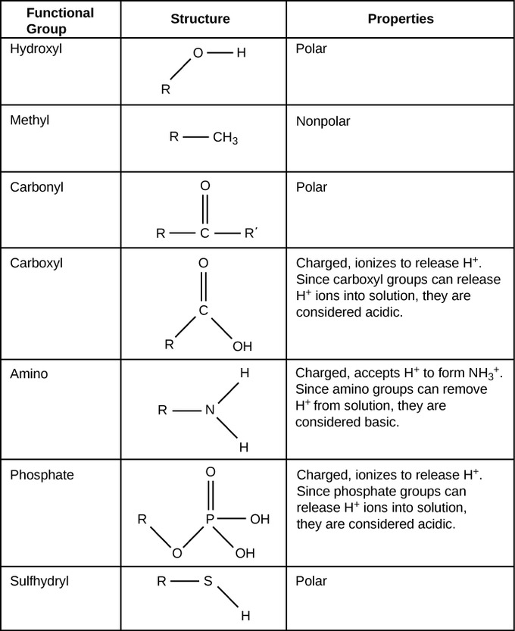
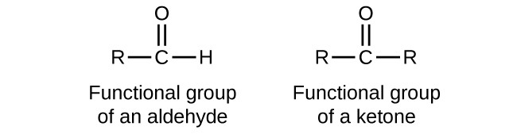
Functional Groups
Properties of an organic molecule don’t just depend on the carbon backbone; they also depend on functional groups attached to it which provide different properties (acidic/basic, polar/non-polar)
Notes:
Discuss every functional group on the list + at least 1 example

Slide 6
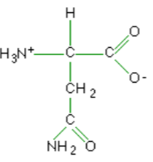
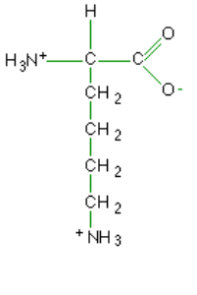
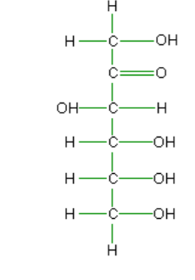
Functional Group Identification
Notes:
Identify every molecule and its functional group
1. amino acid (amine group = polar)
Just carb chain = non polar
2. carb (oxygen = partial polarity)
Ketone and hydroxyl group
3. amino acid (soon to be amine group)
Made from the ketone

Slide 7
Elements of Life Review
CHONP
Carbon’s 4 valence and its power as a result
Functional groups affect properties of compounds
Hydroxyl
Carbonyl (Aldehyde and Ketones)
Carboxyl
Amino
Phosphate
Sulfhydryl
Notes:
Review the important ideas and give at least 1 example of each

