Slide 1


AP Bio
Topic 1.3:
Introduction to Biological Macromolecules

Slide 2
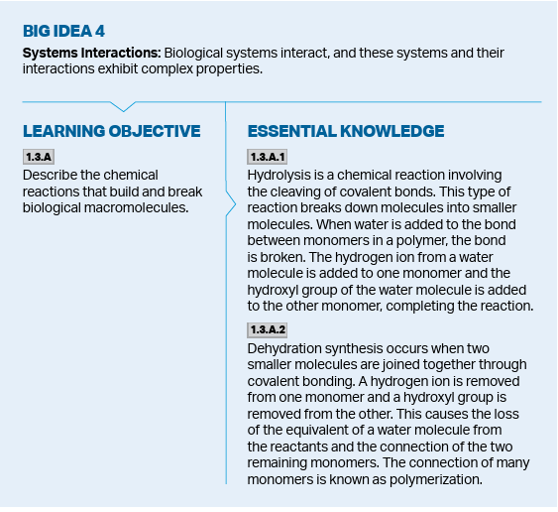
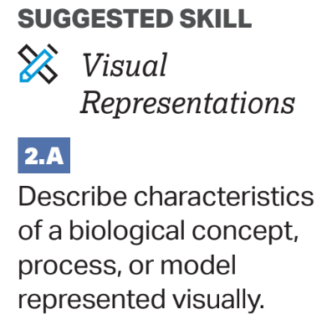
Objectives
Notes:
Hydrolysis and dehydration synthesis Can describe a model of these reactions

Slide 3
Monomers and Polymers
4 Major Macromolecules: Carbohydrates, Proteins, Nucleic Acids, and Lipids
Lipids technically aren't considered macromolecules
Macromolecules – large molecules which take part in necessary elements of life and which consist of monomers
Monomers are the building blocks which form polymers (the macromolecules)
Notes:
CHONP rule

Slide 4
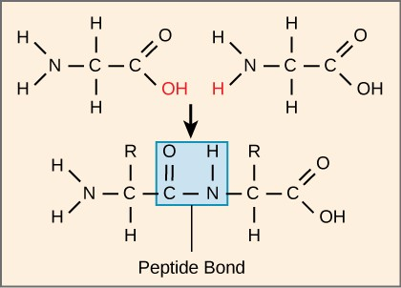
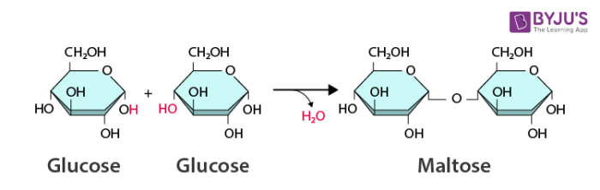
Dehydration Synthesis
Monosaccharides and monopeptides (amino acids) connect through covalent bonds formed through dehydration synthesis
Dehydration = removing water/Synthesis = make

Slide 5
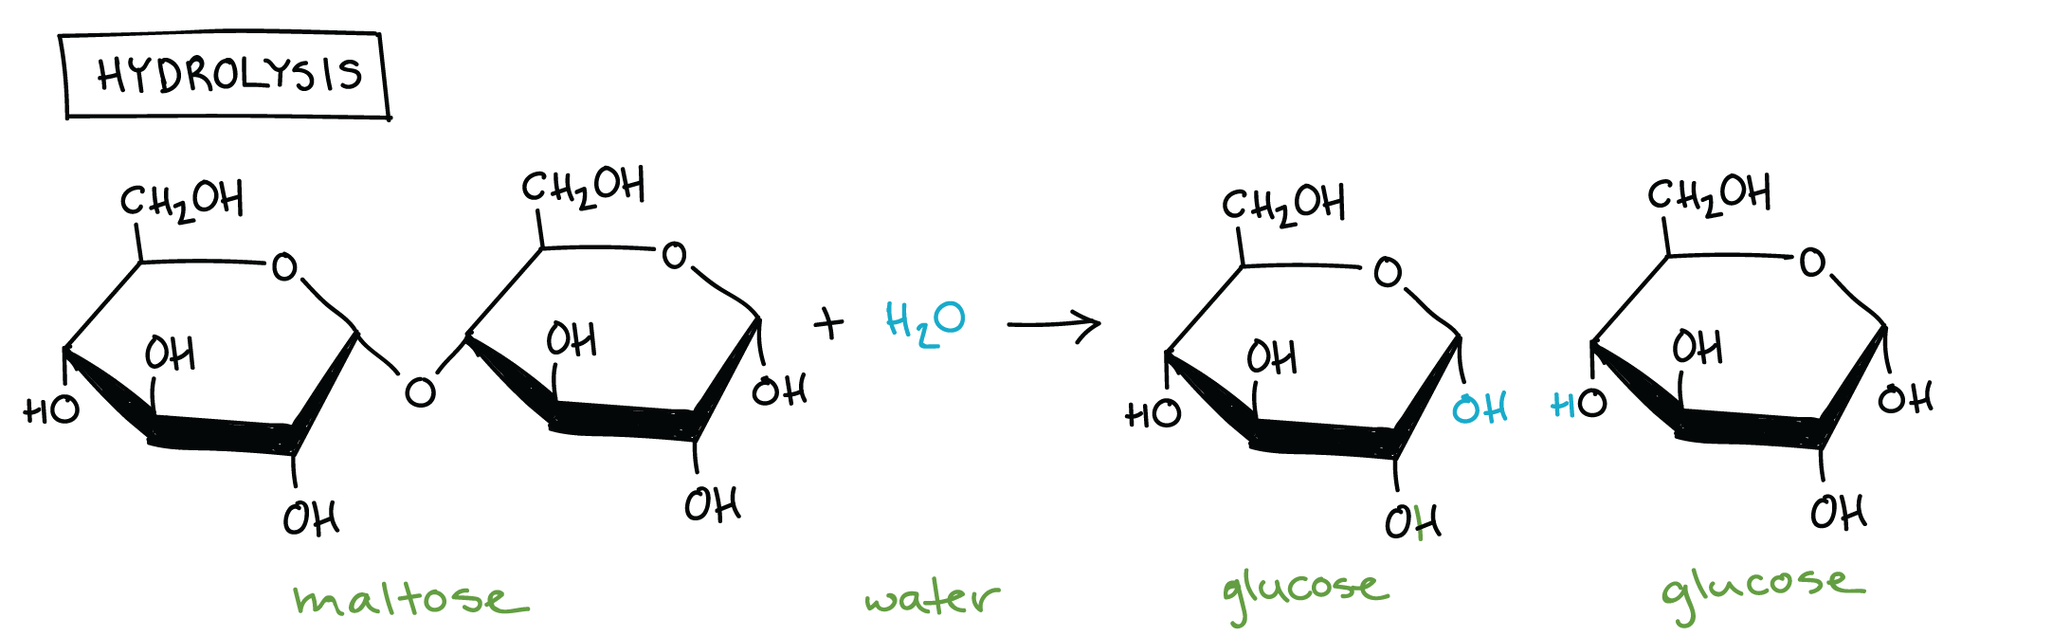
Hydrolysis
Hydrolysis acts as the opposite of dehydration synthesis -> you break bonds using water

Slide 6
Introduction to Biological Macromolecules Review
CHONP Rule
Dehydration synthesis and hydrolysis

