Slide 1


AP Bio
Topic 1.4:
Carbohydrates

Slide 2
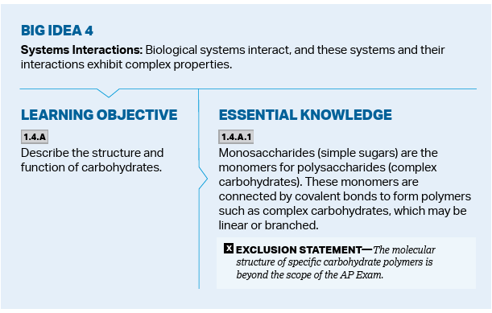
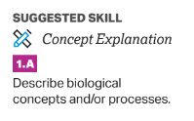
Objectives
Notes:
Describe properties of carbs, proteins, lipids, nucleic acids

Slide 3
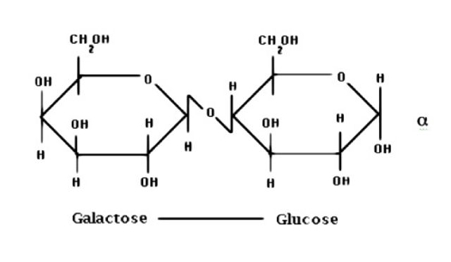
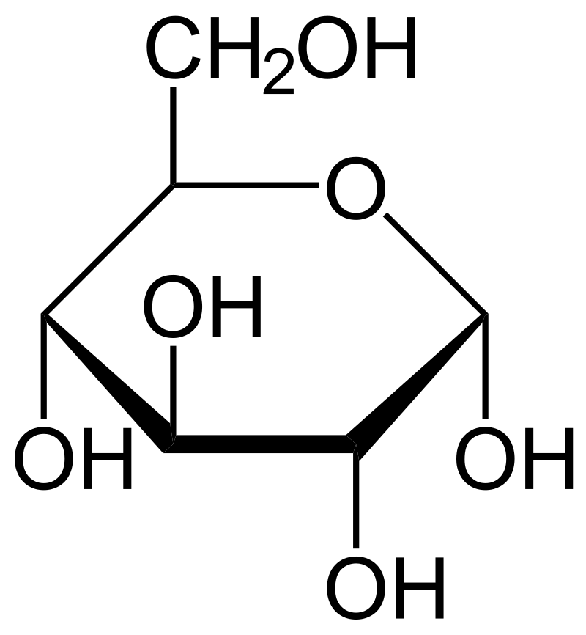
Monomers and Polymers of Carbohydrates (CHO)
Carbohydrates => sugars => "saccharide"
The monomer is a monosaccharide
The polymer is a polysaccharide
Monosaccharides are either a one ring or one carbon chain structures
Monosaccharides include glucose, galactose, and fructose
Disaccharides include lactose and maltose
Carbohydrates are connected together through covalent bonds called glycosidic linkages
Notes:
Also, disaccharide Glucose = C6H12O6 – CHO ratio

Slide 4
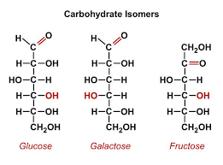
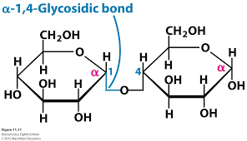
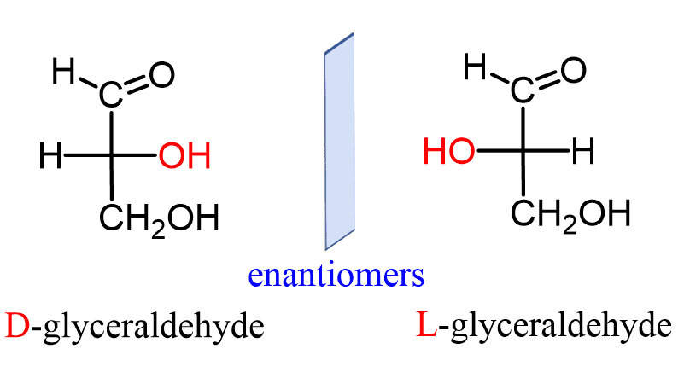
Properties of Carbohydrates
All carbs have a ratio of CH₂O (Glucose = C₆H₁₂O₆)
Carbohydrates can also have isomers including structural isomers (difference in the arrangement of the bonds), and enantiomers (mirror images)
Carbs can have different types of linkages
Cellulose and starch have 1-4
Amylopectin has 1-6
Notes:
Ratio of CHO
Types of isomers in carbs - Isomers have same chemical formula
Alpha vs Beta linkages - Explain that linkages connect on carbons

Slide 5
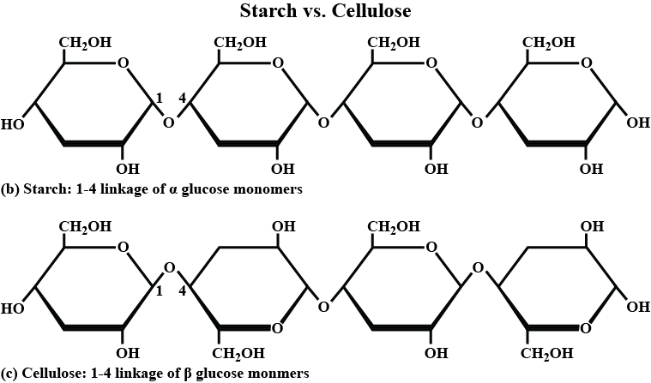
Alpha vs Beta Glucose
There are two ring structures for glucose, one where the hydroxyl group attached to the 1 carbon is either positioned up or down
(α) – hydroxyl group down (like in starch)
(β) – hydroxyl group up (like in cellulose), so the bonds switch every ring
Notes:
Another form of even same chemical formula AND structure resulting in different carbohydrates Formed by flipping the monosaccharide

Slide 6
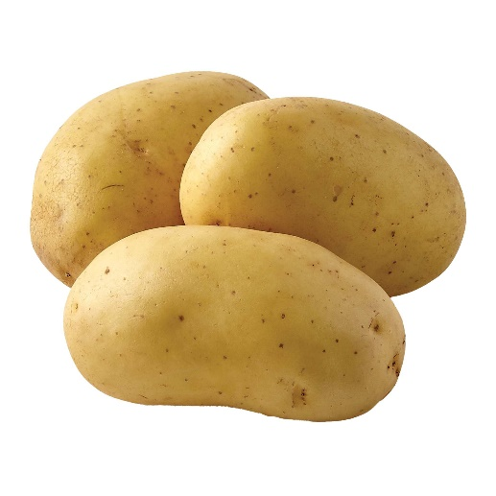



Functions of Carbohydrates
Carbohydrates do 2 things: store (short term) energy and support structure
Energy is stored in plants as starch and in animals as glycogen (both polymers of glucose)
Cellulose, another polymer of glucose is a major component in plant cell walls
Chitin makes up exoskeletons of lobsters, insects, and fungi

Slide 7
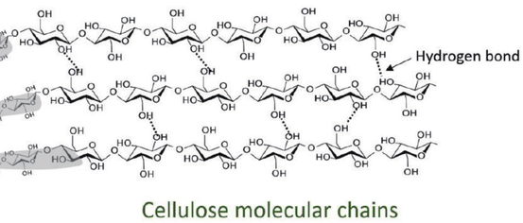
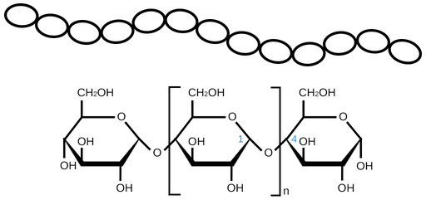
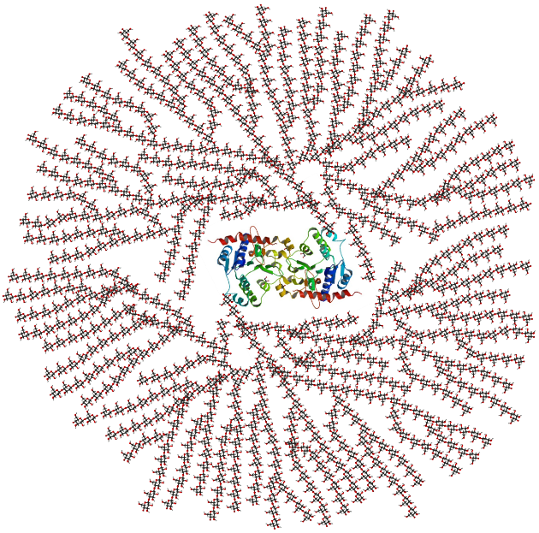

Illustrative Example: Cellulose vs Starch vs Glycogen
Cellulose | Starch | Glycogen
microfibrils
Triple AAA Rule:
Appearance Affects Activity
(Structure Affects Function)
(Form Follows Function)
Notes:
Cellulose = pic 1, strong Starch = in a row so bonds can easily be cleaved for energy Glycogen = extremely branched for easy energy break off

Slide 8
Carbohydrates Review
Structure of carbohydrates
Function of carbohydrates
AAA rule

