Slide 1


AP Bio
Topic 1.5:
Lipids

Slide 2
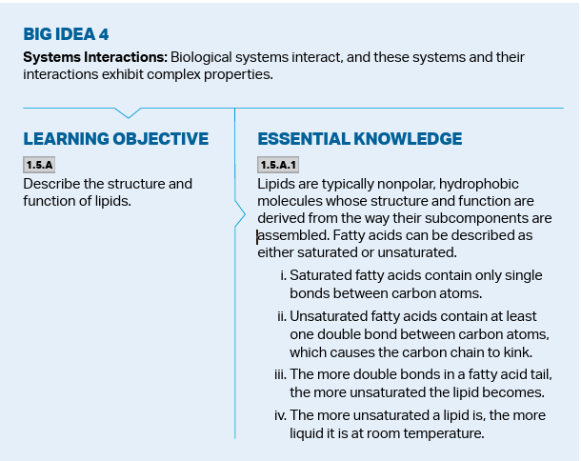
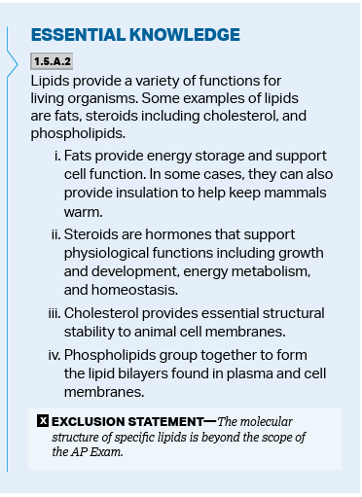
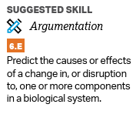
Objectives
Notes:
Directionality, antiparallel
Base pairs
Protein chains, protein folding
Carbs
Use a visual to make predictions

Slide 3
Lipids
Lipids do not have specific monomers that make them up, meaning they aren’t polymers (still multiple components)
They fall under the category of biological macromolecules because of their size and importance to life
They also consist of CHO
Notes:
All are hydrophobic

Slide 4
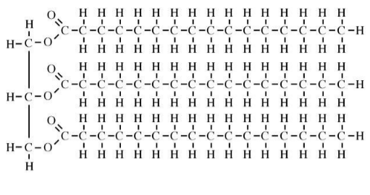
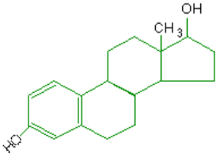
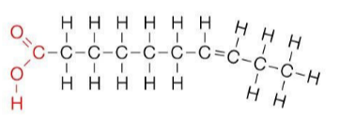
Types of Lipids
All lipids are hydrophobic
Types of lipids:
Fats (triglycerides)
Glycerol + 3 fatty acid chains
Fatty acid chains are just hydrocarbons
Steroids – 4 carbon rings
Hormones and cholesterol
Saturated fatty acids – all carbons hydrogenated (solids at room temp)
Unsaturated fatty acids – contains double bonds (liquids at room temp)
Notes:
Ester linkages and trans fats
Reasons for solidity/liquidity in saturated vs unsaturated

Slide 5
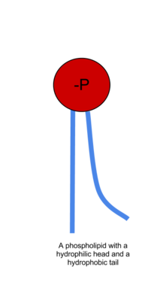
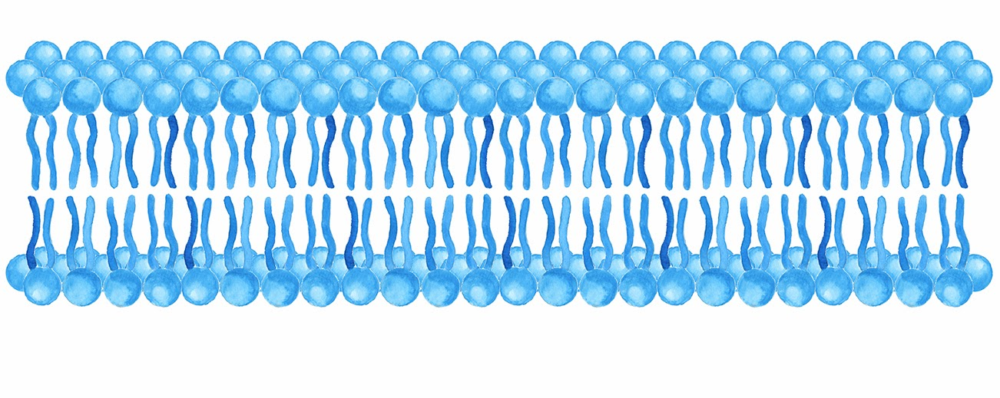
Phospholipids
Phospholipids:
The major component of cell membranes
Contain both a hydrophilic and hydrophobic region
Arranged in the shape of a bilayer
Notes:
Parts of phospholipids and how they form to make the membrane

Slide 6
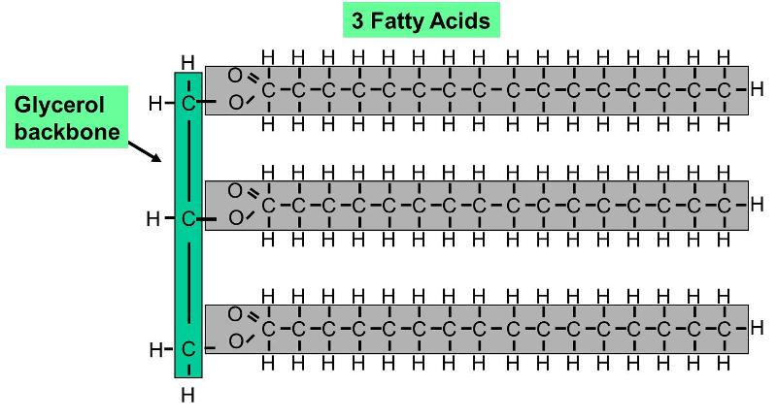
Functions of Lipids
Lipids store energy (a lot more than carbs) and provide insulation/protection for vital organs
They also make up membranes (phospholipids) and act as hormones (steroids)
Cholesterol is the base steroid from which hormones are derived.
How does Appearance Affect Activity?
Why are carbs used for short term energy instead of lipids?
Notes:
Lipids = big energy store lots of hydrocarbon chains but harder to break the bond = use carbs for short term

Slide 7
Lipids Review
Structure of lipids
Function of lipids
Types of lipids

