Slide 1


AP Bio
Topic 1.6:
Nucleic Acids

Slide 2
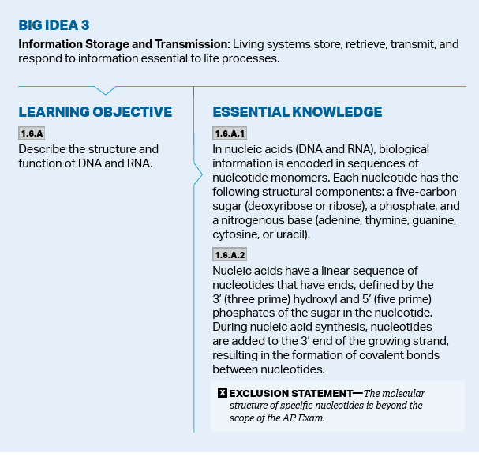
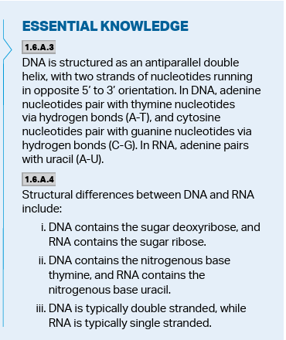
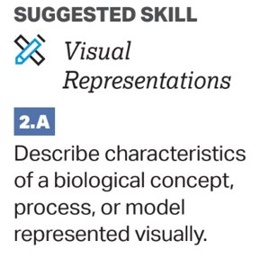
Objectives
Notes:
DNA vs RNA

Slide 3
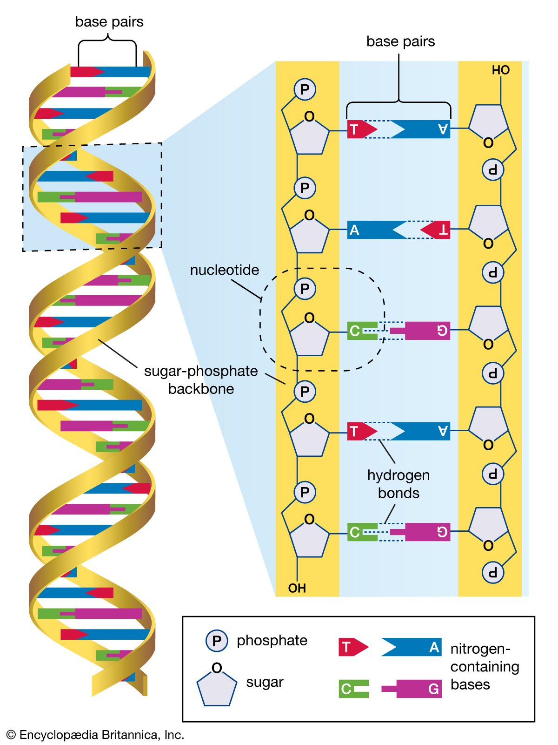
Monomers and Polymers of Nucleic Acids (CHONP)
There are 2 kinds of nucleic acids: DNA and RNA
These are formed from the monomer nucleotides
Nucleotides covalently bond to each other in single strands, and multiple strands attach together through hydrogen bonds
Notes:
Ladder example

Slide 4
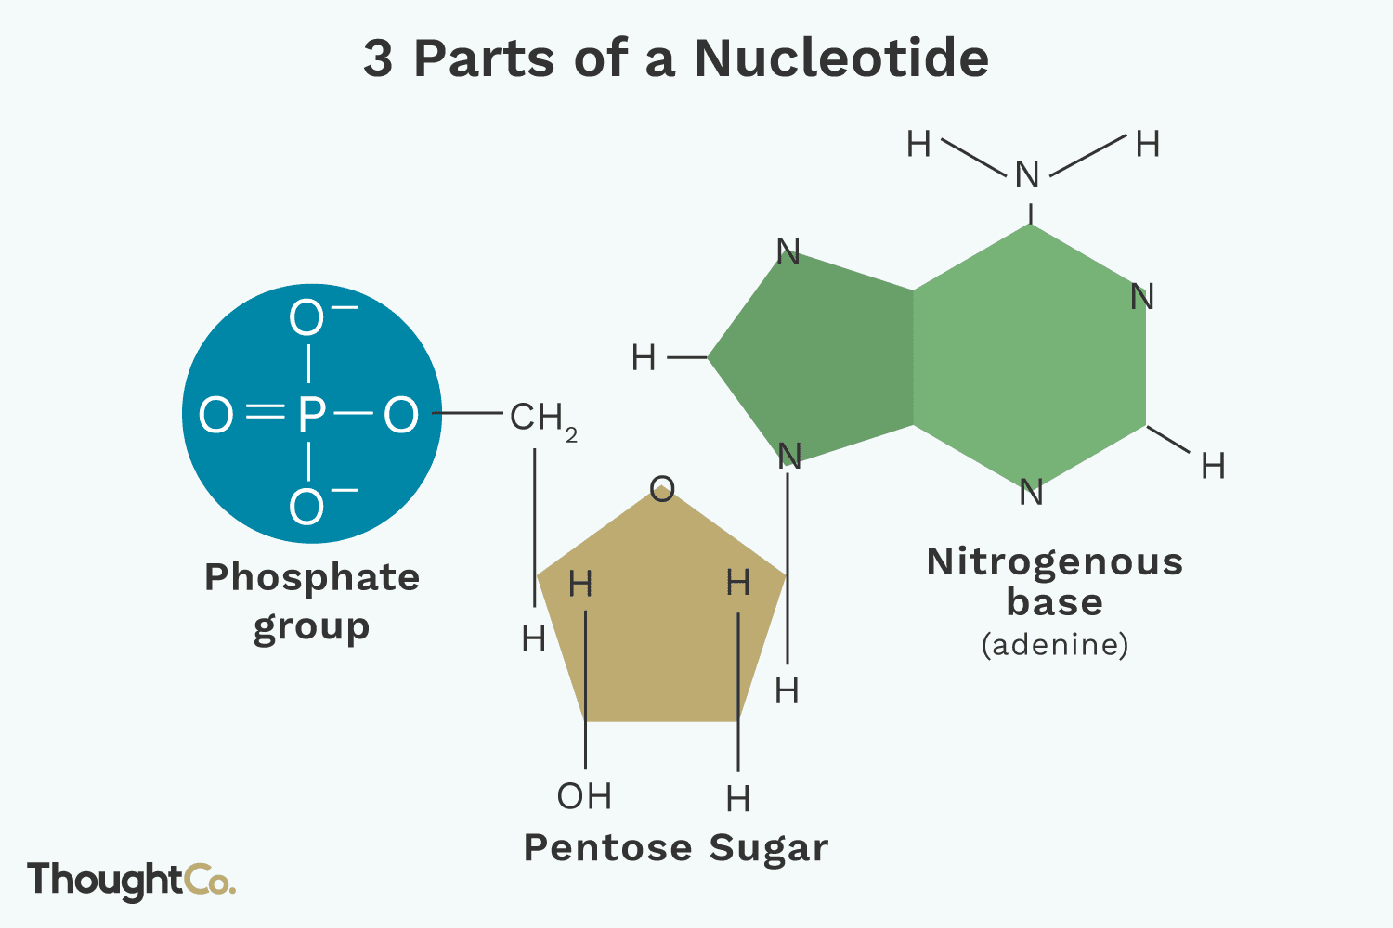
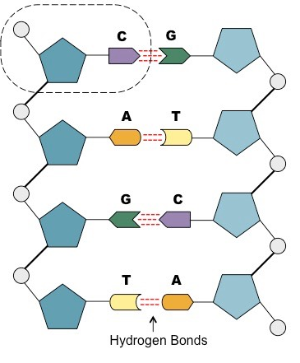
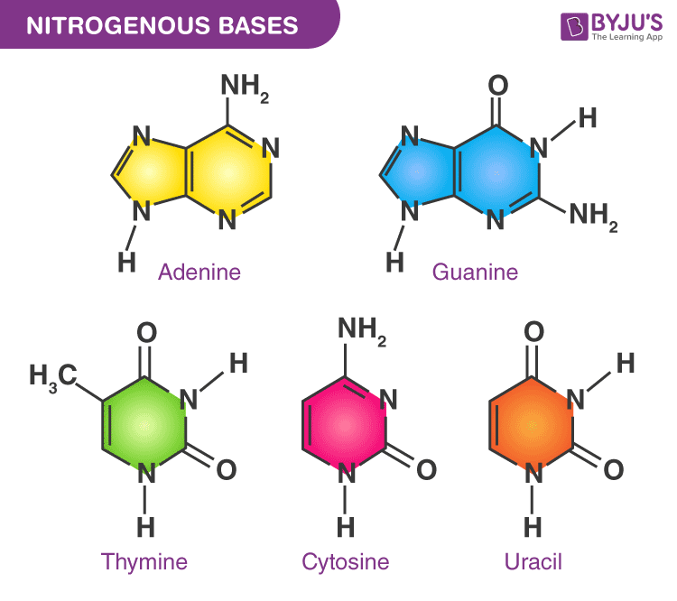
Nucleotides
Nucleotides consist of:
A five-carbon sugar (pentose)
Nucleic acid dependent
A phosphate group
A nitrogenous base
Adenine, Cytosine, Guanine, Thymine, Uracil
The phosphate and sugar form the backbone of the DNA/RNA (bonded covalently), while the bases are in the middle (bonded with hydrogen bonds)
Notes:
Nucleosides

Slide 5
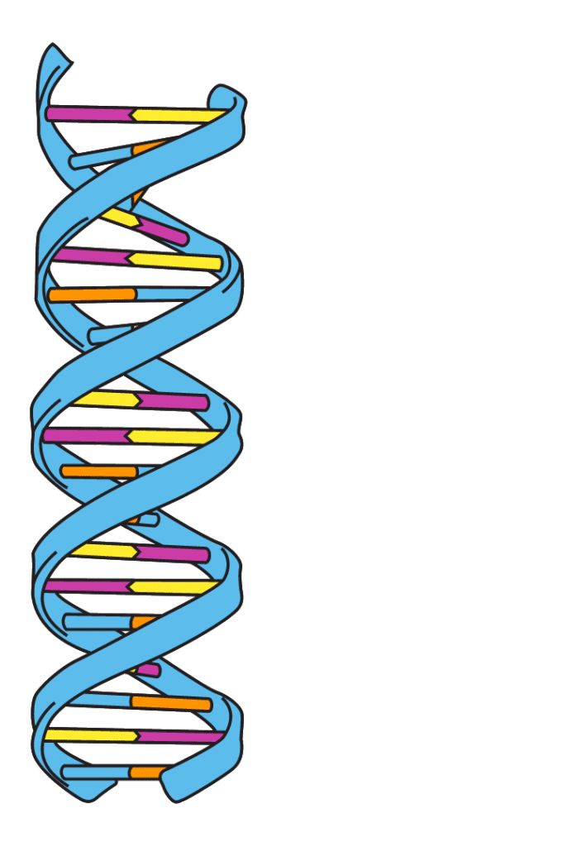
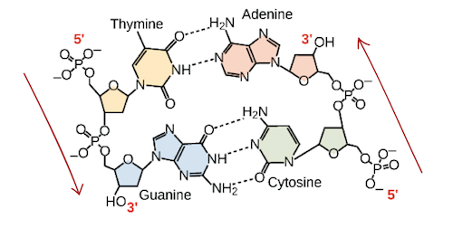
Structure and Function of Nucleic Acids
DNA strands run in the direction from the 5’ carbon to the 3’ carbon (called directionality)
DNA strands run antiparallel – parallel but in opposite directions
DNA = double helix and its strands are held together by hydrogen bonds
DNA has 4 nitrogenous bases: cytosine, guanine, adenine, and thymine which pair A-T and C-G (Apple-Tree/Car-Garage)
The two ringed bases are purines and pyrimidines are one ringed
The role of nucleic acids is to store and express genes
Notes:
Carbons counted starting from oxygen

Slide 6
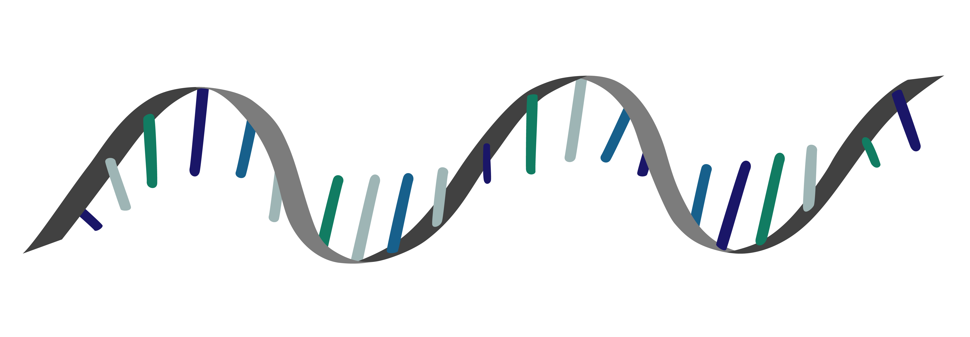
What Is RNA?
Ribonucleic Acid
Has multiple jobs related to using DNA to code for proteins from the genes
mRNA – what carries transcribed DNA to ribosomes to make proteins
tRNA – the series of RNA which helps turn mRNA into amino acids
rRNA – a component of ribosomes
Its nucleotides also contain a sugar, a nitrogenous base, and a phosphate group
Notes:
RNA single strand = smaller and can be replicated

Slide 7
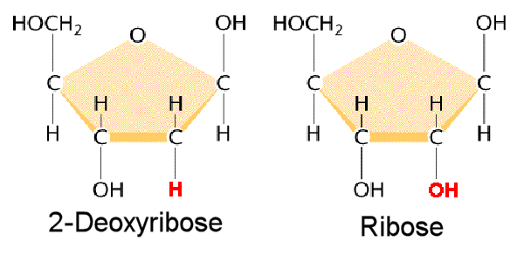
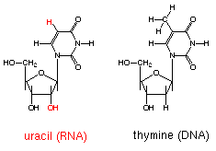
DNA vs RNA
DNA | RNA
Two strands (double helix, antiparallel) Deoxyribose sugar (missing oxygen) Bases are A-T, C-G | Single strand Ribose sugar Bases are A-U, C-G (uracil instead of thymine)

Slide 8
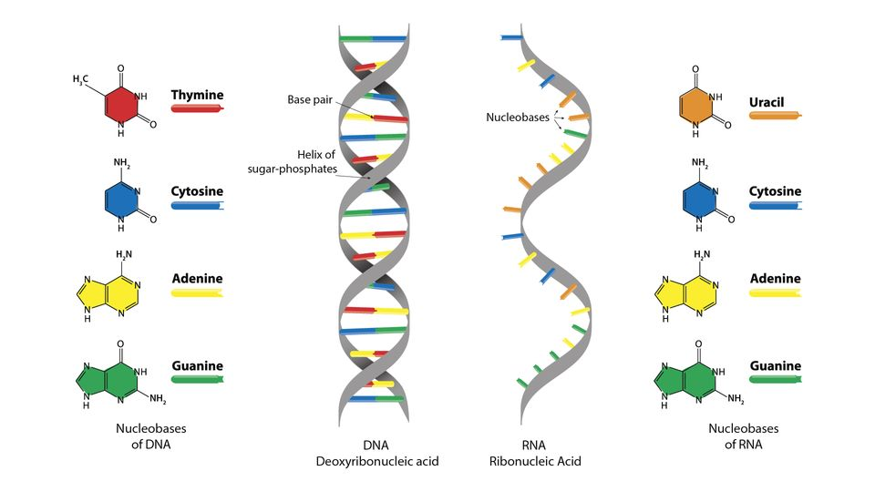
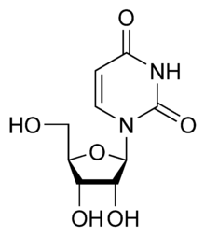
DNA vs RNA (Visual)

Slide 9
Nucleic Acids Review
Structure of DNA and RNA
Function of DNA and RNA
Differences between DNA and RNA

