Slide 1


AP Bio
Topic 1.7:
Proteins

Slide 2
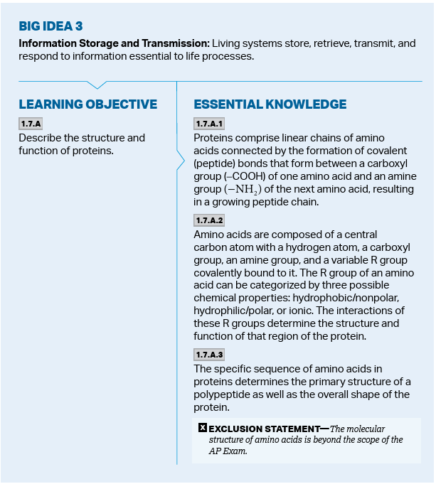
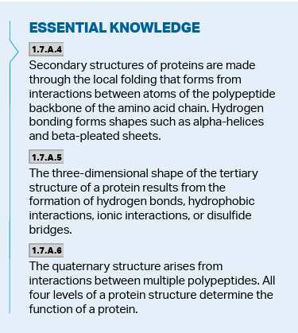
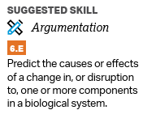
Objectives
Notes:
Directionality, antiparallel
Base pairs
Protein chains, protein folding
Carbs
Use a visual to make predictions

Slide 3
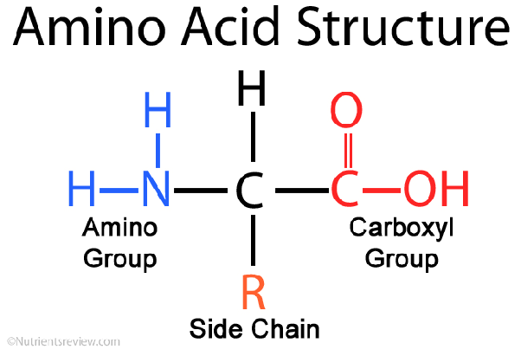
Monomers and Polymers of Proteins (CHON)
Proteins are polymers made up of amino acid monomers
All amino acids have:
Central carbon
Amino group
Carboxyl group
Hydrogen
R side chain
Amino acids are linked by peptide bonds (polypeptides)
Notes:
Also, dipeptides

Slide 4
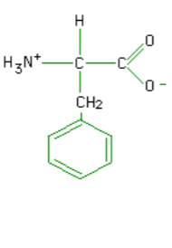
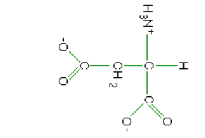
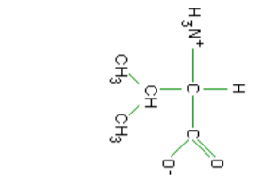
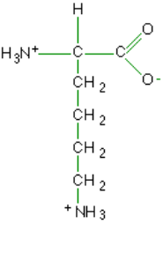
R Side Chains
R side groups of amino acids can be polar/nonpolar and basic/acidic
Look for 1) ions 2) electronegative elements 3) functional groups
These properties affect structure and function of the protein
Notes:
Explain where the backbone is 1. Nonpolar 2. Ionized and basic 3. Ionized and acidic 4. Nonpolar

Slide 5
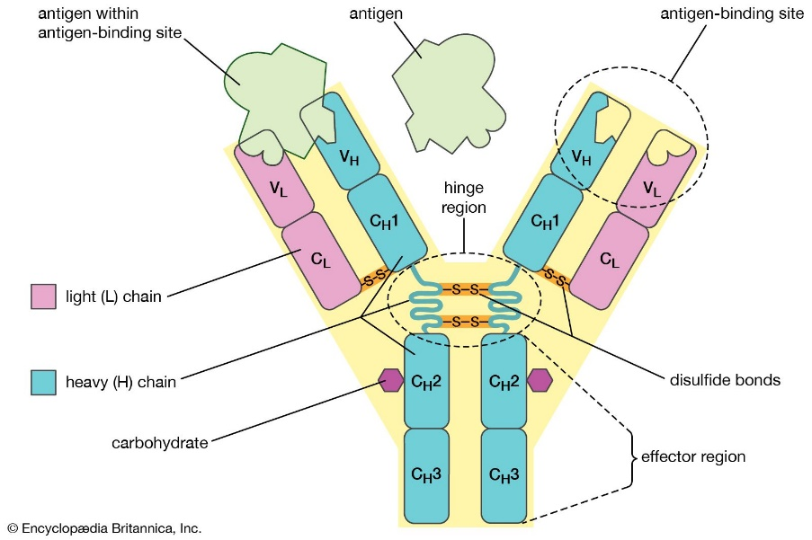
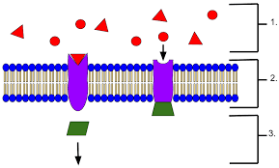
Functions of Proteins
Proteins have various functions including:
Acting as catalysts in chemical reactions
Storing amino acids
Coordinate an organism (such as hormones like insulin)
Movement (muscles)
Defense (antibodies)
Transport
Receptors
Support (collagen/keratin)
Build and repair parts of the body
Express genes
Notes:
Endorphin vs. morphine

Slide 6
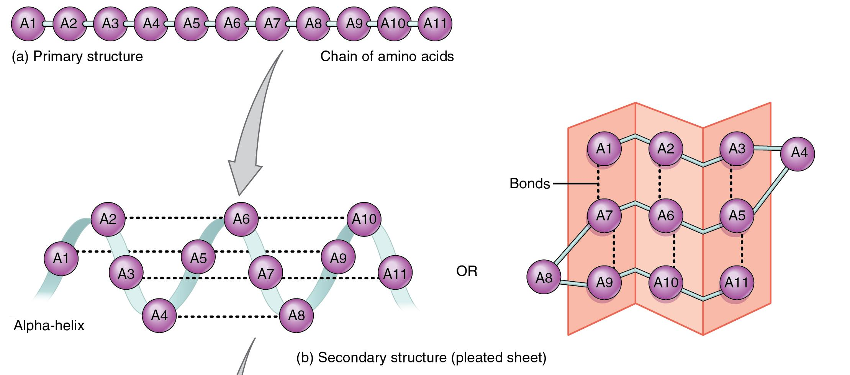
Protein Folding
Proteins have 4 levels of structure
Primary Structure: sequence of amino acids
Secondary Structure: segments of the polypeptide chain coiled or folded due to hydrogen bonds between the backbone
This can either be helical (α helix) or in a pleated sheet (β pleated sheet)

Slide 7
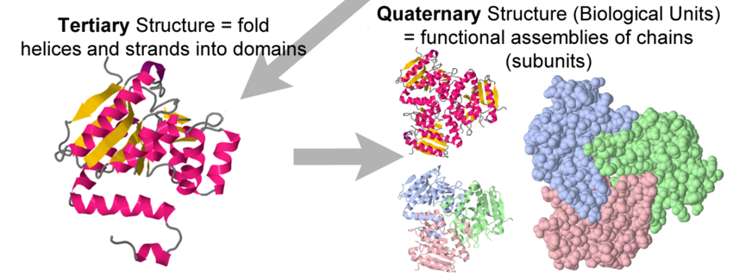
Protein Folding Cont.
Tertiary Structure: folding of the polypeptide chain due to interactions between the side chains (hydrophilic folds out to be near aqueous sol.)
(Ionic bonds, disulfide bridges, hydrogen bonds, and hydrophobic interactions – van der Waals forces)
Quaternary Structure: protein structure when multiple polypeptides attach to each other (uses same bonds as tertiary)

Slide 8
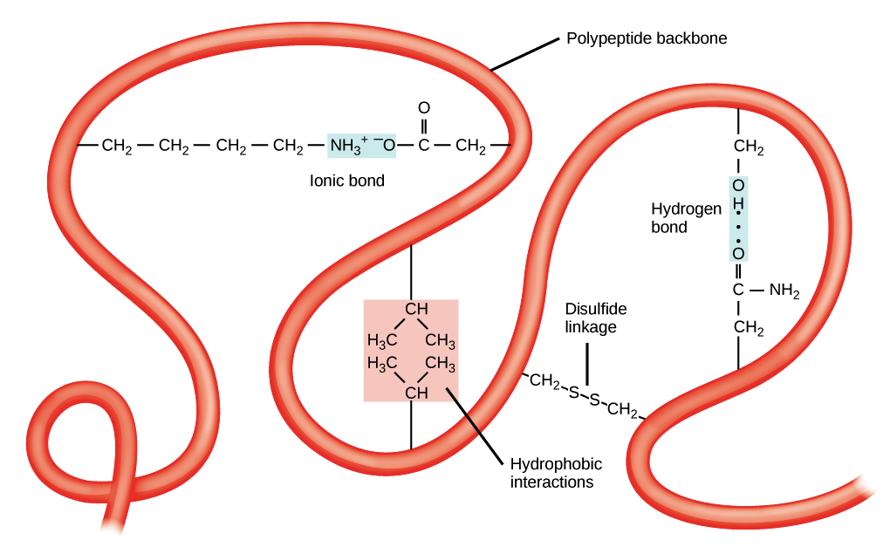
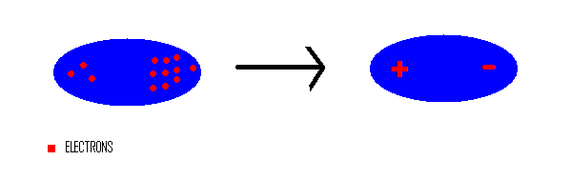
A Closer Look At: Tertiary Structure
Disulfide bridges: two sulfhydryl groups bond(-S-S-)
Hydrophobic interactions: formed when hydrophobic side groups are folded so tightly that van der Waals forces form
Van der Waals forces are when two atoms are so close to each other that the random movement of electrons around the atoms could result in charged sides, which attracts the two atoms

Slide 9
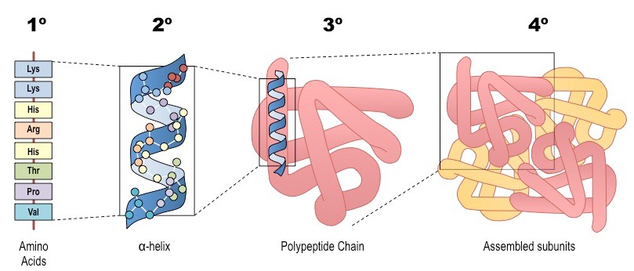
Protein Folding As A Whole
How does appearance affect activity? (AAA)
What can a change in primary structure do to the rest of the protein?
When secondary structure and tertiary structure bonds are broken due to pH, salt concentration, or temperature, the protein unfolds in a process known as denaturation
Notes:
Change in structure in primary = affects folding = affects structure = affects function

Slide 10
Proteins Review
Structure of proteins
Function of proteins

