Slide 1


AP BIO
TOPIC 2.10:
Origins of Cell Compartmentalization

Slide 2
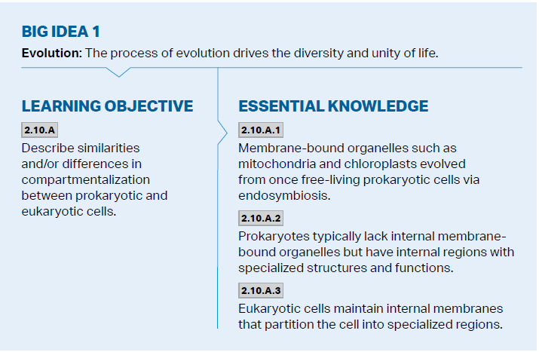
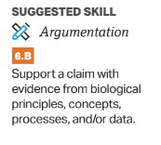
Objectives

Slide 3
Cell Complexity
While eukaryotes have membrane bound organelles, prokaryotes can divide their cytoplasm into certain sections to separate reactions
Cells come from other cells – so to maximize their ability to reproduce cells became more complex over time, and prokaryotes evolved to have membrane bound genetic information (nucleus)

Slide 4
The Endosymbiotic Theory
Endosymbiotic theory – organelles within cells evolved from free-living organisms
Energy producing and photosynthetic bacteria could have been taken up by the early eukaryote
Relationship – bacteria gets protection and nutrients, and the parent cell gets more energy
Eventually the bacteria becomes an organelle and part of the eukaryotic cell
Evidence: DNA within chloroplasts and mitochondria, double membranes of chloroplasts and mitochondria

Slide 5
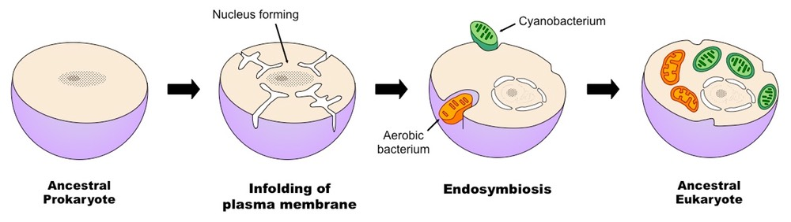
Endosymbiotic Theory Diagram

Slide 6
Origins of Cell Comartmentalization Review
Compartmentalization in eukaryotes vs. prokaryotes
The Endosymbiotic Theory

