Slide 1


AP BIO
TOPIC 2.2:
Cell Size

Slide 2
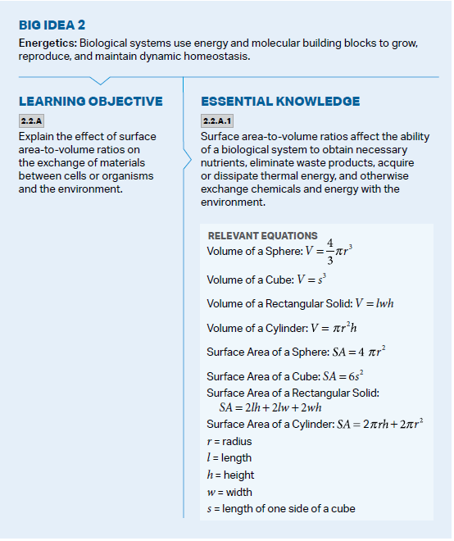
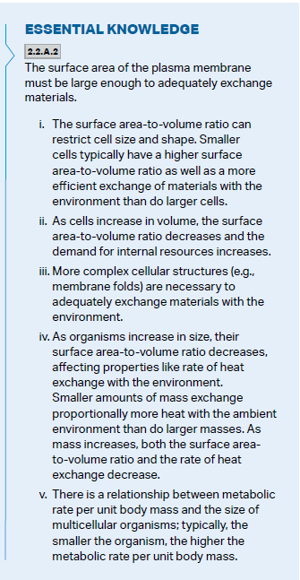
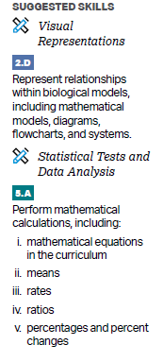
Objectives

Slide 3
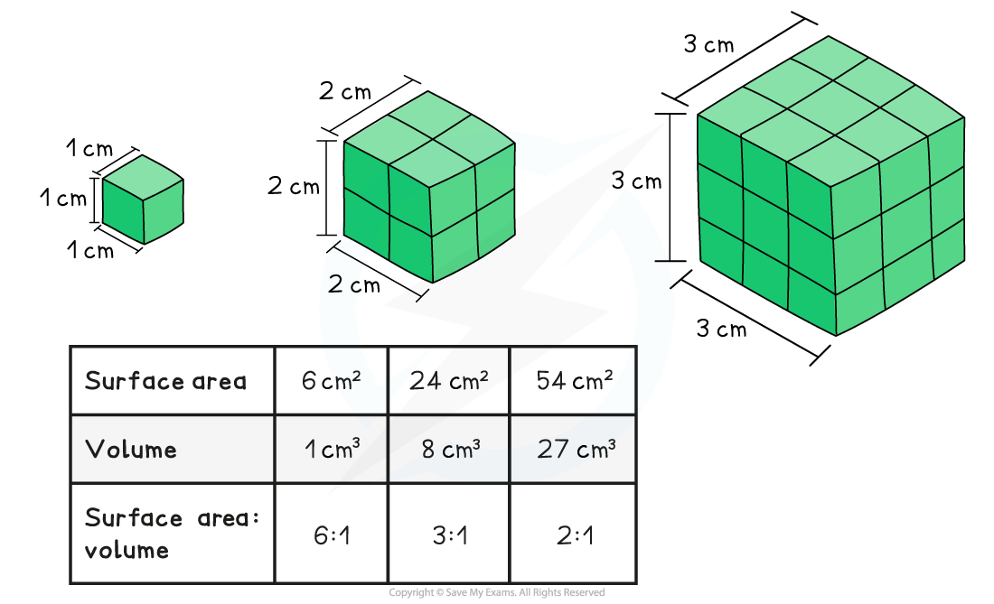
Calculating S.A. to V. Ratio
Volume = the amount of space an object occupies
Surface Area = the area of the outside part of an object
S.A. to V. Ratio - divide surface area by volume (tells you the amount of surface area per unit of volume)
Conclusion: smaller object has higher S.A. to V. Ratio
Notes:
Make sure to practice for other shapes
Do not confuse with volume:surface area ratio

Slide 4
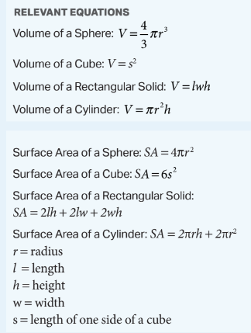
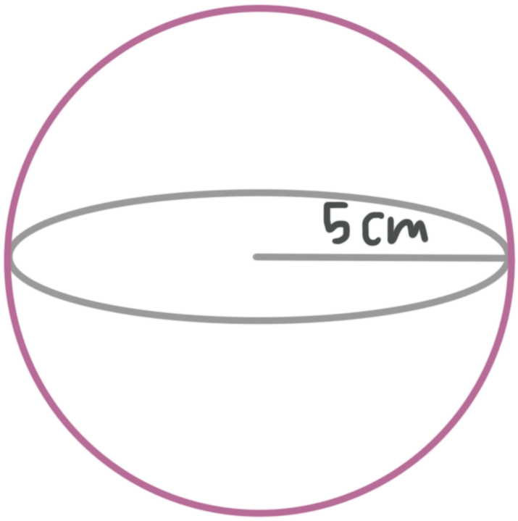
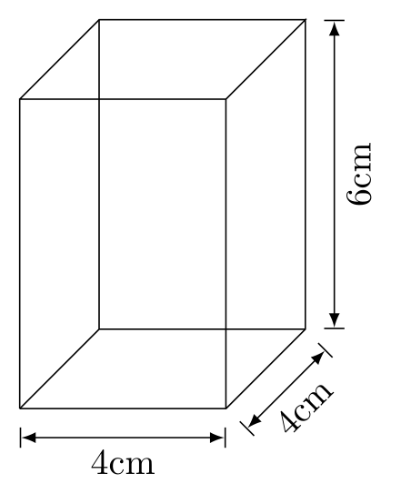
Calculation Practice
Sphere: 2. Rectangular Prism
S.A. _____ V. _____ S.A. _____ V. _____
S.A. to V. Ratio ______ S.A. to V. Ratio ______
Notes:
UNITS
Sphere
Sa 314.16cm2
V 523.6cm3
Sa V ratio 0.6:1
Prism
SA 128
V 96
Sa v ratio 1.33333333333333333333333333333333333:1

Slide 5
How does the S.A. to V. Ratio matter for cell size?
Plasma membrane allows for exchange of resources and energy (heat energy) between cells and the environment
Surface area of plasma membrane must be large enough for this exchange
As cells increase in volume (size) -> less relative surface area and more resources needed
So small cells have the best S.A. to V. ratio and exchange of resources with environment

Slide 6
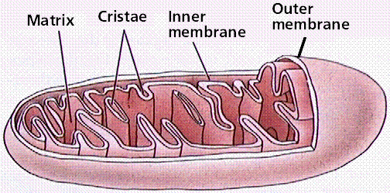
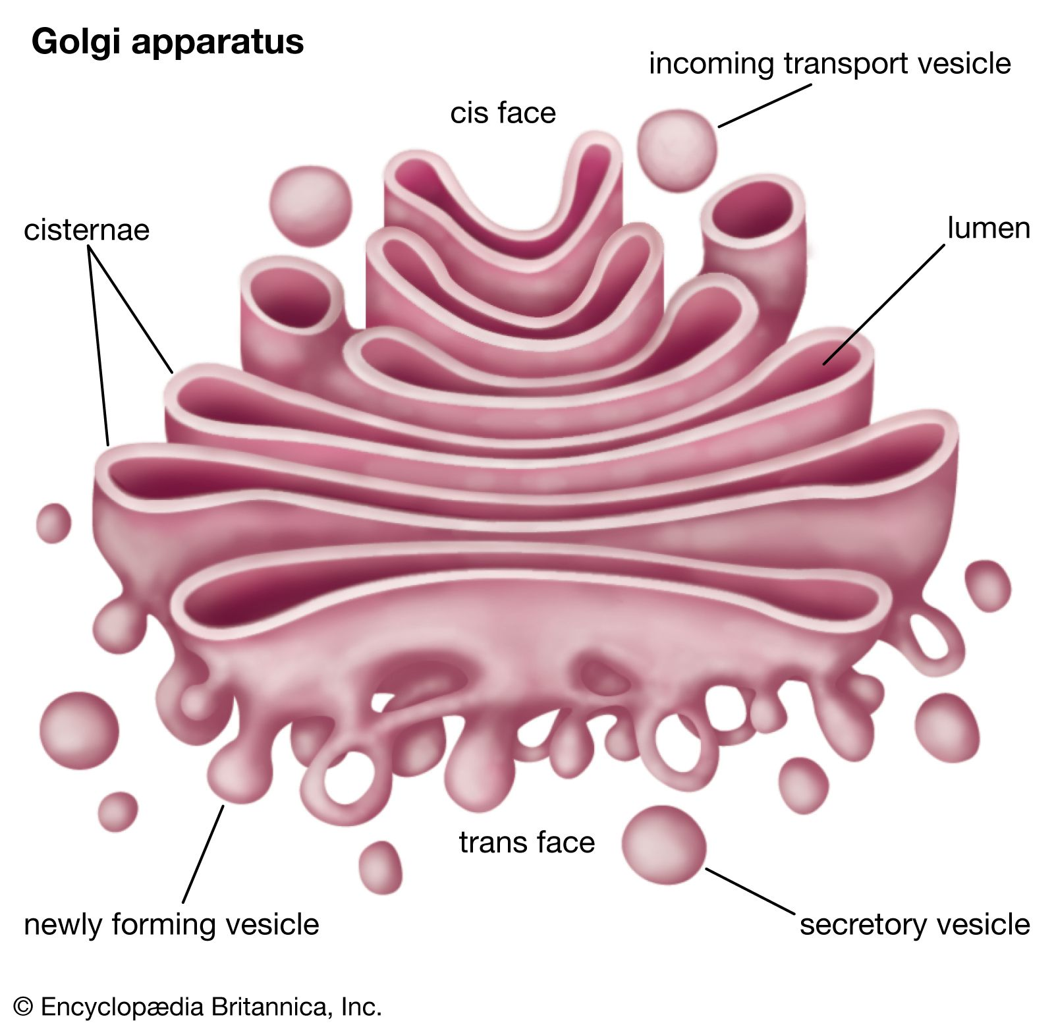
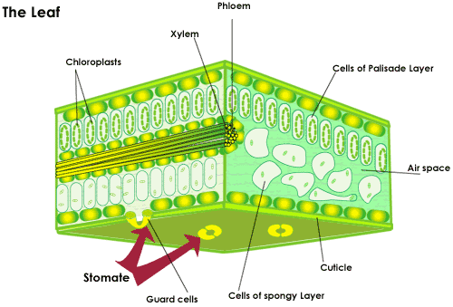
Structures and Strategies for Effective Exchange of Resources
Cells and organelles have structures that allow them to increase the surface area for the same amount of volume (increasing S.A. to V. Ratio) = membrane folds
Cells also have structures that help them exchange resources with the environment
Stomata – plant cell holes which allow gas and water exchange
Vacuoles – these can fuse with the membrane to deposit or take in resources into/from the environment

Slide 7
Cell Size Review
How to calculate surface area to volume ratio
Importance of having a large cell size in relation to volume
Different way organisms achieve a high surface area to volume ratio

