Slide 1


AP BIO
TOPIC 2.3:
Plasma Membrane

Slide 2
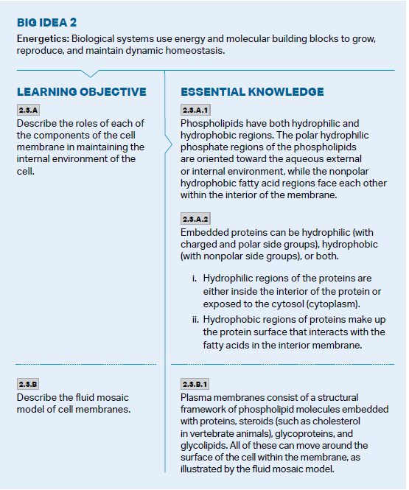
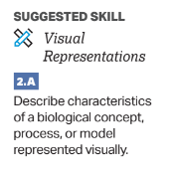
Objectives

Slide 3
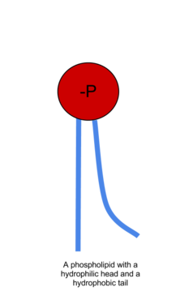
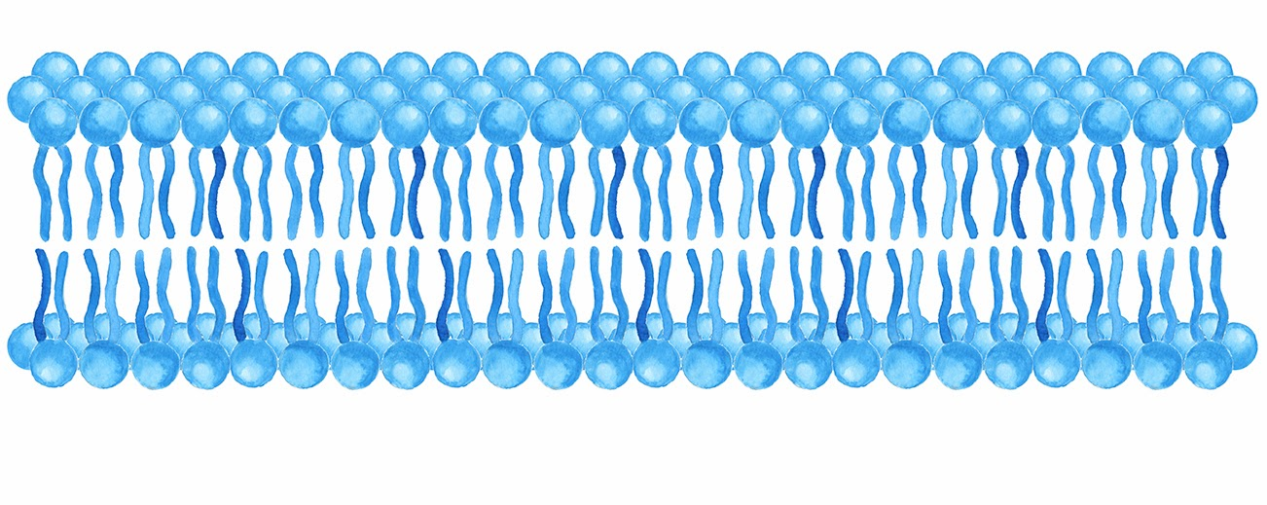
What is a Phospholipid?
What the cell membrane is primarily made out of
Has a hydrophilic phosphate head
Has a hydrophobic fatty acid tail
Arrange themselves in a bilayer – why?
Consider the environment in and outside of the cell

Slide 4
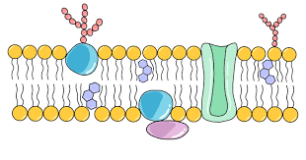
The Phospholipid Bilayer/Fluid Mosaic Model
Cell membrane: phospholipids + proteins, steroids (cholesterol – fluidity), glycoproteins, glycolipids – all can flow around the surface of the cell
Proteins can either pass through entire membrane (transmembrane or integral) or are only imbedded into the side (peripheral)
Amount of cholesterol can help control fluidity by changing membrane rigidity depending on the temperature and pH
Glycoproteins and glycolipids are used for signaling and cell to cell recognition
The protein side chains of the glycoproteins can be polar or nonpolar.

Slide 5
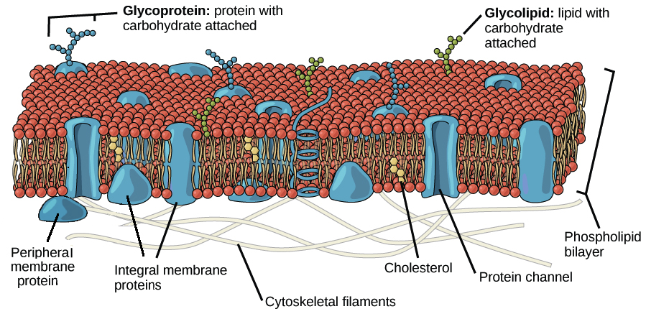
The Fluid Mosaic Model

Slide 6
Plasma Membrane Review
The structure and properties of the phospholipid bilayer/fluid mosaic model

