Slide 1


AP BIO
TOPIC 2.4:
Membrane Permeability

Slide 2
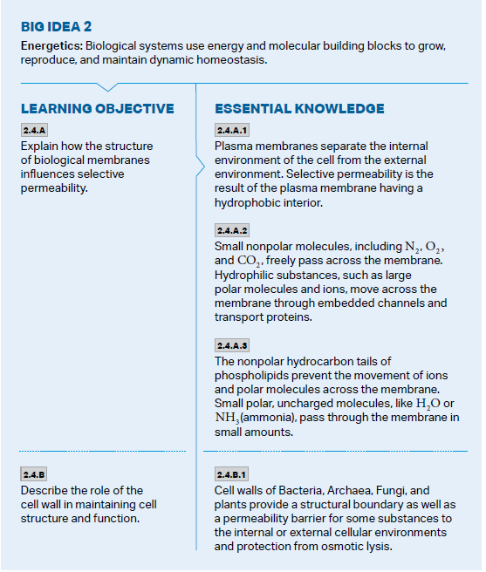
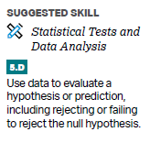
Objectives

Slide 3
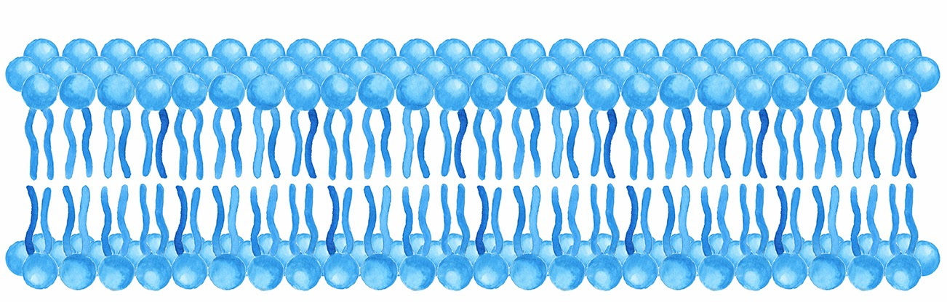
Selective Permeability
Cell membrane separates cell interior from environment
It has selective permeability – some things let in/out of the cell, some not – cell “chooses” by deciding which kinds of membrane proteins to make
The structure of the cell membrane (fluid mosaic model) results in this permeability
There are gaps in the membrane = objects of certain size can pass through
Phospholipids have both charged and uncharged sections = only objects of certain polarity can pass freely
Why permeability? To create livable conditions inside the cell through regulation

Slide 4
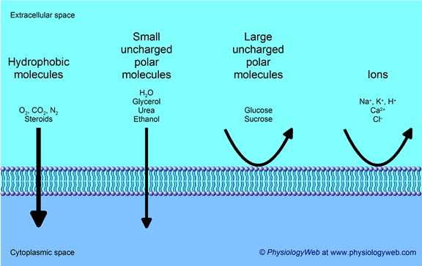
Effects of Membrane Permeability
What can pass through the membrane freely?
Small nonpolar molecules (N₂, O₂, CO₂)
Small polar uncharged molecules (H₂O)
What cannot pass through the membrane freely?
Hydrophilic substances: large polar molecules, ions
Require membrane proteins/embedded channels

Slide 5
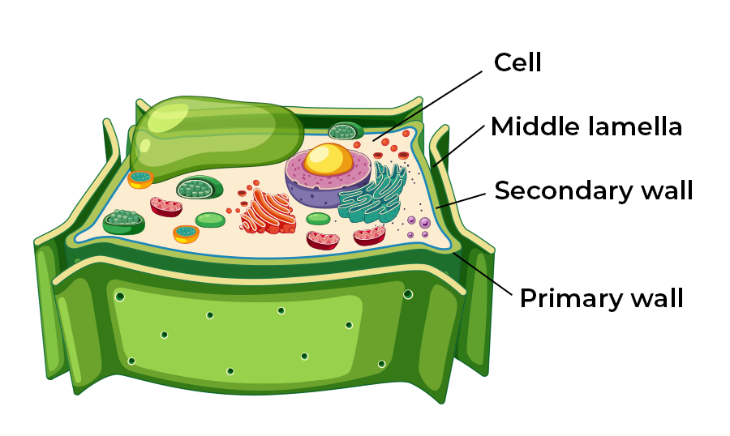

Cell Wall and Permeability
Cell walls for plants and fungi are made of complex carbohydrates (plants = cellulose)
They are used for structural support, provide a structural boundary, and can also take part in permeability and maintaining a barrier between internal and external environments
Plasmodesmata
Block large molecules

Slide 6
Membrane Permeability Review
Selective permeability and its effects
How the cell wall affects cell function

