Slide 1


AP BIO
TOPIC 2.5:
Membrane Transport

Slide 2
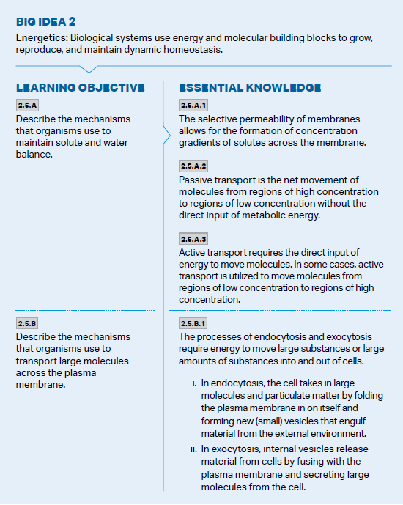
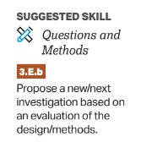
Objectives

Slide 3
Passive Transport
Cell transport for import of materials and export of waste
Passive transport (diffusion) –movement of solutes across membrane with concentration gradient (from an area of high concentration to low concentration – how they would move naturally)
No direct metabolic energy input involved
Simple diffusion – small nonpolar molecules, small uncharged polar molecules
Facilitated diffusion – large polar molecules and ions (through membrane proteins)
Notes:
Concentration gradient formed as a result of selective permeability/membrane structure

Slide 4
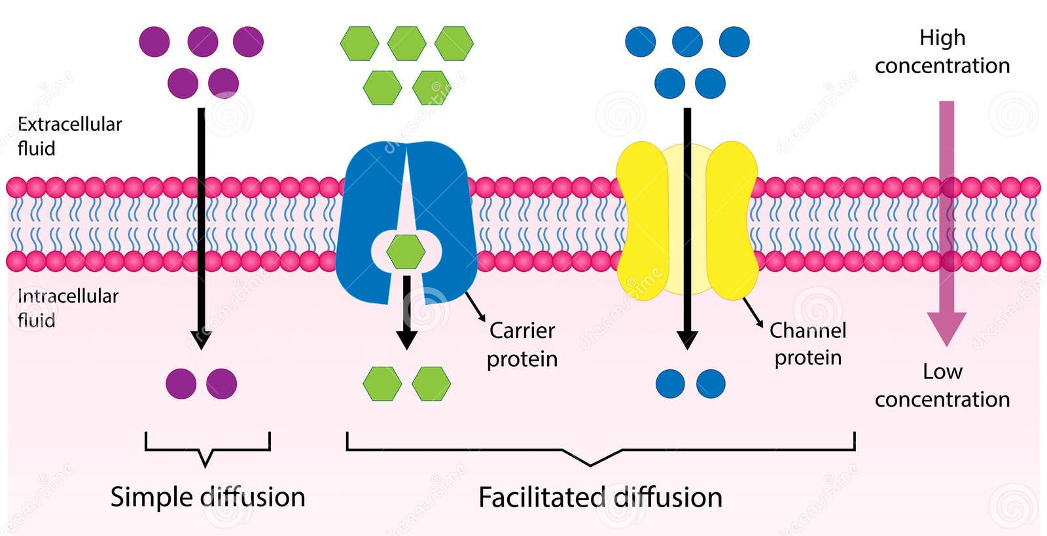
Passive Transport Diagram
Goal = movement until dynamic equilibrium

Slide 5
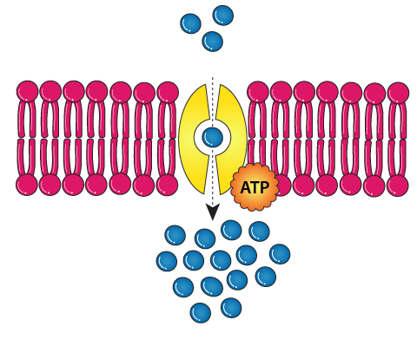
Active Transport
Active transport – movement of solutes across membrane against concentration gradient (low -> high), requiring a direct input of metabolic energy (ATP)
Can use membrane proteins which intake/expel resources when activated by ATP
Can also use energy from another solute’s movement with concentration gradient to power movement against

Slide 6
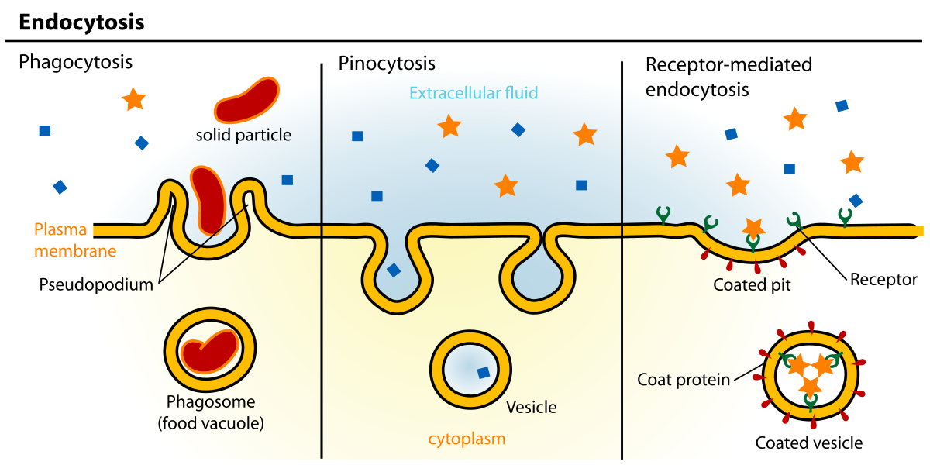
Types of Endocytosis and Exocytosis
For transporting large amounts of resources in and out of cell = endocytosis and exocytosis – uses folds of the plasma membrane
Endocytosis = intake, exocytosis = expel – all for large amounts
Types of endocytosis:
Phagocytosis – take in large molecules – membrane wraps around item, then pinch off to turn it into its own vesicle
Pinocytosis – take in water (and other substances) – create inward fold in membrane and suck in the resources
Receptor-Mediated Endocytosis – once signal binds to cell receptor -> endocytosis becomes activated

Slide 7
Membrane Transport Review
Concentration gradients
Passive vs. active transport
Types of endocytosis and exocytosis

