Slide 1


AP BIO
TOPIC 2.6:
Facilitated Diffusion

Slide 2
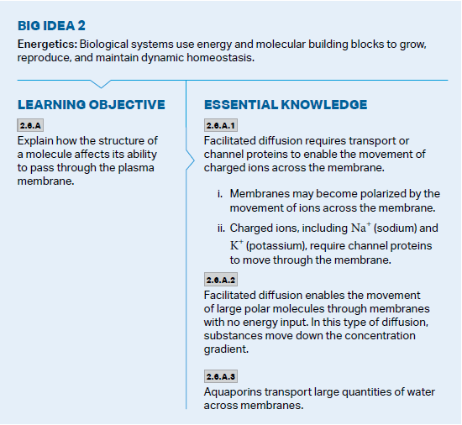
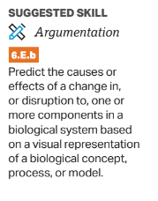
Objectives

Slide 3
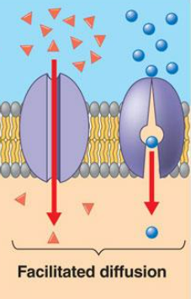
Types of Membrane Proteins
To transport large polar molecules/ions across the membrane = integral/transmembrane membrane proteins needed
This type of transport = facilitated diffusion (passive)
Channel proteins – allow passage of any substances of appropriate size/charge – like a “tunnel” (primarily for ions)
Aquaporins – channel proteins for the transport of water in large amounts across the membrane
Carrier proteins – bind to specific substances and move them across the membrane (primarily for molecules)

Slide 4
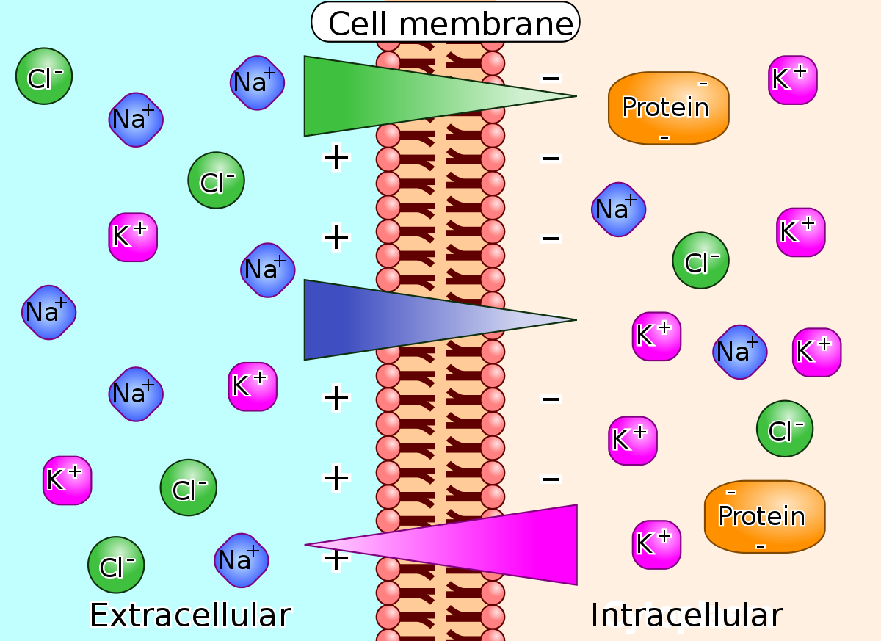
Membrane Proteins and Active Transport
Membrane proteins are also needed for active transport
Use ATP to transfer ions/molecules across cell membrane
Membrane potential – the electric potential caused by the ionic concentration gradient across a membrane (electrical charge due to ions)
In addition to chemical gradient

Slide 5
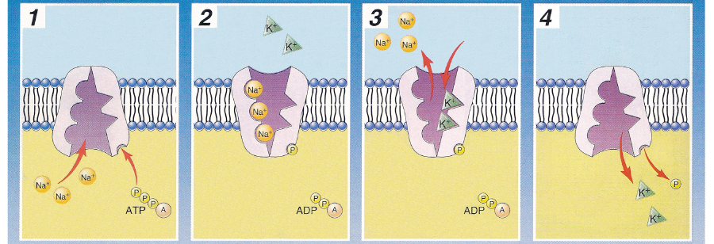
Sodium Potassium Pump
Form of active membrane protein transport using ATP to cause a change in the shape of the carrier protein and transport sodium and potassium across the cell membrane

Slide 6
Facilitated Diffusion Review
Membrane proteins
Their use in passive and active transport

