Slide 1


AP BIO
TOPIC 2.7:
Tonicity and Osmoregulation
Notes:
Welcome to AP Bio with AP Study! For most of you, this will be your first lesson. If you want some more background on chemistry before starting this unit, we have another video to help with that. Today we will be covering topic 1.1, all about water.

Slide 2
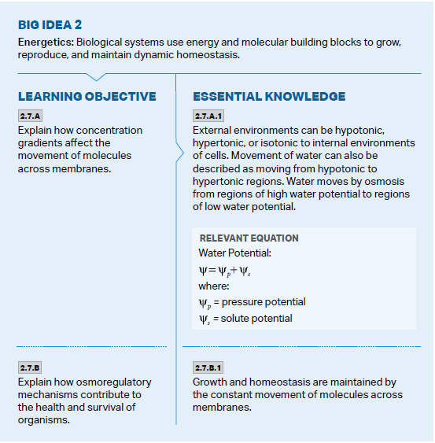
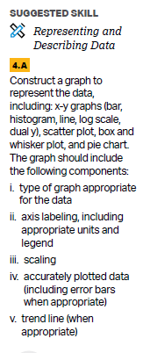
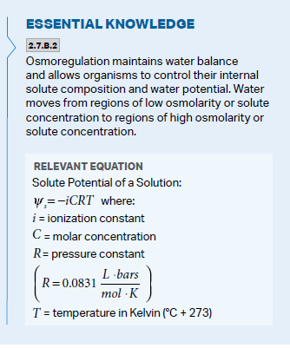
Objectives
Notes:
The main objectives of this lesson are the hydrogen bonds which form water molecules, and the reasons why life depends on water. The college board wants you to be able to use your knowledge of water and its properties to describe or model it.

Slide 3
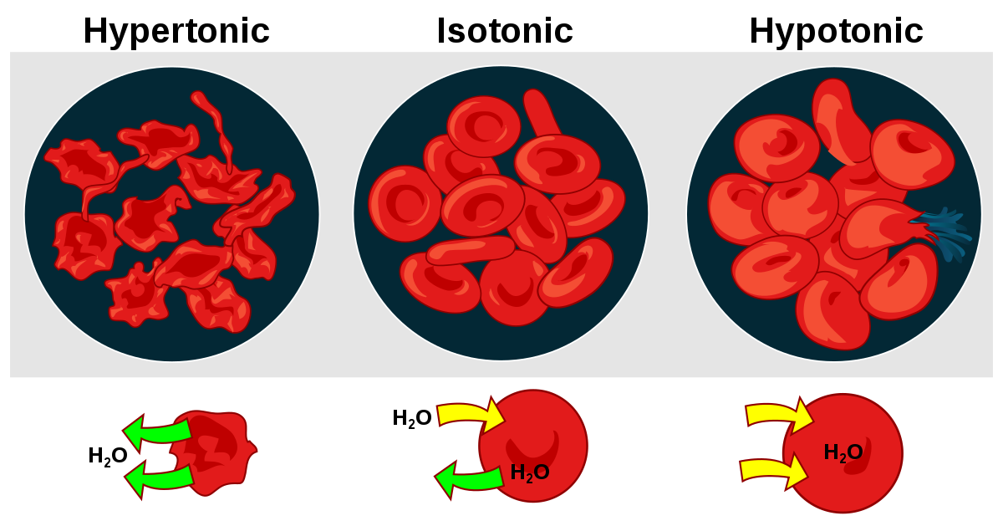
Hypertonic, Hypotonic, and Isotonic Environments
Diffusion of water = osmosis (requires aquaporin)
Water in the cell has a relationship with surrounding environment – amount of water is always proportional to solute
Isotonic solution – no net movement of water (equal amounts of solute)
Hypertonic solution – water moves out of cell (more solute in environment)
Hypotonic solution – water moves into cell (less solute in environment)

Slide 4
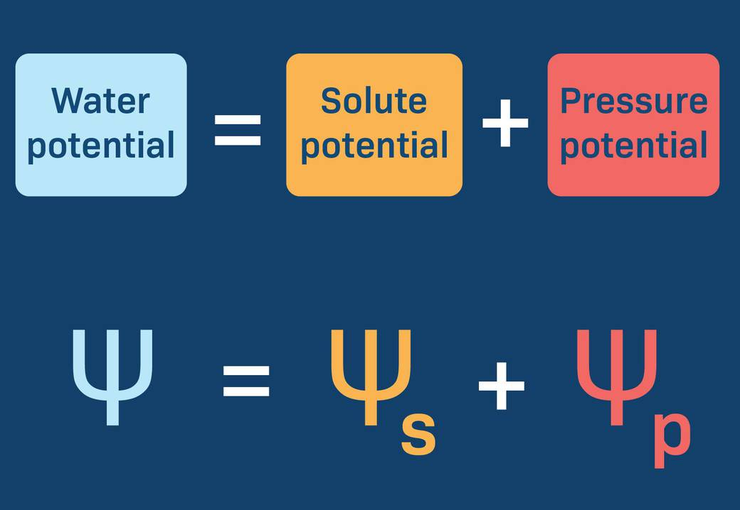
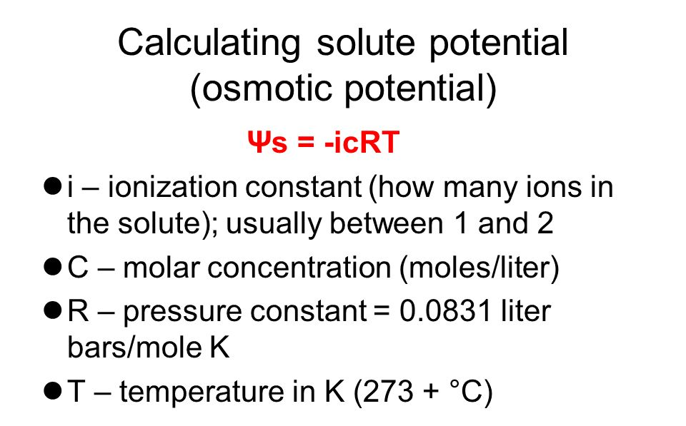
Water and Solute Potential Formulas
Water moves from areas of 1) high water potential 2) low osmolarity 3) lower solute concentration -> 1) low water potential 2) high osmolarity 3) higher solute concentration
Water potential – the ability of molecules to flow freely
Solute potential - the amount to which water potential is lowered by solvent
Ex: 1 molecule of sucrose with a molarity of 0.42 moles per liter at 25 degrees Celsius
Notes:
Sucrose = glucose + fructose

Slide 5
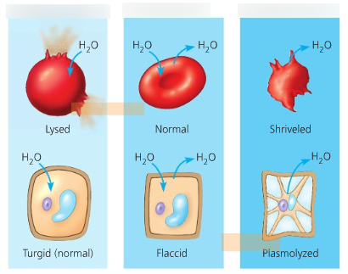
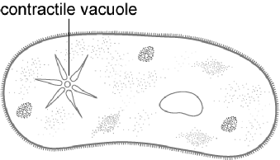
Examples of Tonicity
Tonicity in plant vs. animal cells:
Isotonic animal = normal
Isotonic plant = flaccid (plant cell likes pressure)
Hypotonic animal = lysed (boom)
Hypotonic plant = turgid (normal)
Hypertonic animal = shriveled
Hypertonic plant = plasmolyzed (membrane shrinks)
Contractile vacuoles – can pump water out of the cell

Slide 6
Tonicity and Osmoregulation Review
Osmosis
Hypertonic, hypotonic, isotonic
Water and solute potential
Notes:
Basic review
Next up: Carbon and its effects on life

