Slide 1


AP BIO
TOPIC 2.8:
Mechanisms of Transport

Slide 2
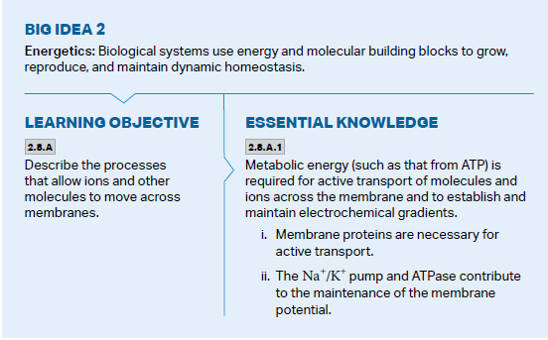
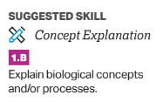
Objectives

Slide 3
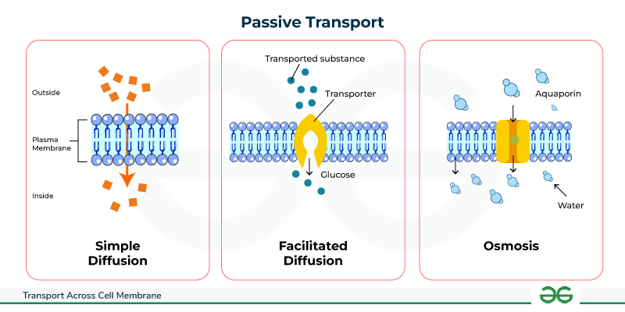
Passive Transport Review
The cell membrane has selective permeability
Hydrophilic and hydrophobic sections
Passive transport is movement of a solute across the membrane with the concentration gradient (high -> low) – no additional energy needed
Small hydrophobic molecules and small uncharged polar molecules can do this themselves
Larger polar molecules require membrane proteins – facilitated diffusion
Channel proteins – just let the compound pass through – usually for ions
Carrier proteins – grab specific molecules in specific concentrations
Aquaporins – help with the transport of water
Transport happens until dynamic equilibrium is reached

Slide 4
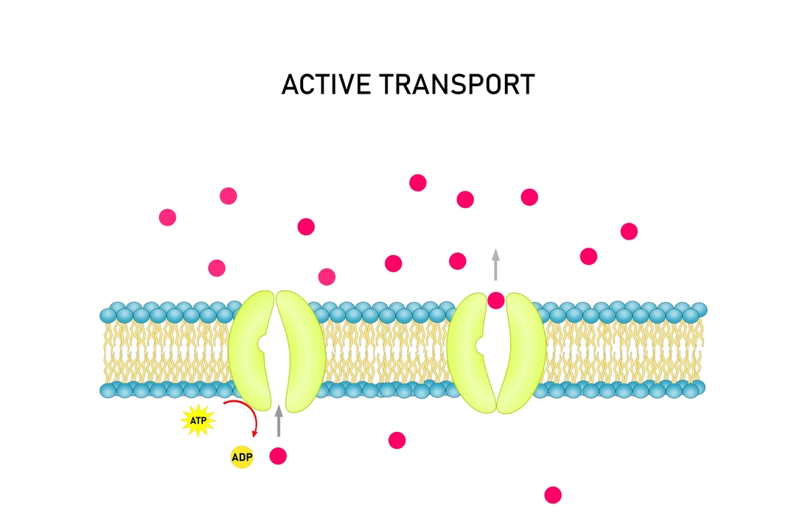
Active Transport Review
Movement of solutes across the membrane against the concentration gradient (low -> high) – additional energy required
Membrane proteins can also be used for active transport
For taking in large amounts of solute = endocytosis – uses folds of the membrane
Pinocytosis – take in water by creating an inward fold in the membrane
Phagocytosis – take in large molecules and the membrane forms a vesicle
Receptor-mediated endocytosis – endocytosis when receptor is activated by the right molecule
For expelling large amounts of solute = exocytosis

Slide 5
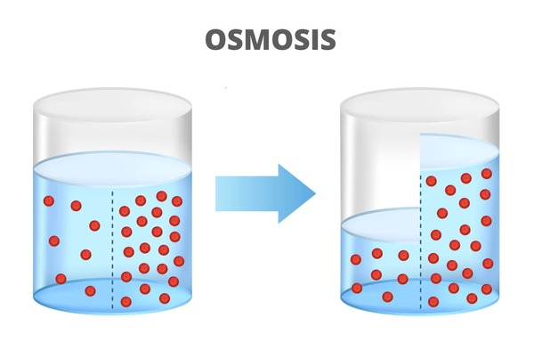
Osmosis Review
Water is going to move from
High water potential -> low water potential
Low osmolarity -> high osmolarity
Lower solute concentration -> higher solute concentration
Diffusion of water through aquaporins – amount of water always tries to be proportionate to solute on either side of the membrane
Isotonic solution – same amount of solute on either side = no net water movement
Hypertonic solution – more solute outside of cell = water out of cell
Hypotonic solution – more solute inside cell = water into cell
Animal cells can burst or shrink in non isotonic environments – some use contractile vacuoles to pump water out
Plant cells don’t burst due to cell walls, membrane still expands/shrinks, normal state is slightly turgid

Slide 6
Mechanisms of Transport Review
Passive and active transport
Osmosis
Notes:
Basic review
Next up: Carbon and its effects on life

