Slide 1


AP BIO
TOPIC 2.9:
Cell Compartmentalization

Slide 2
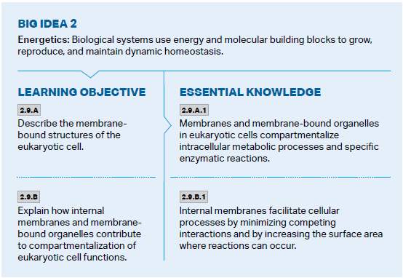
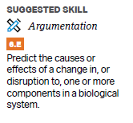
Objectives

Slide 3
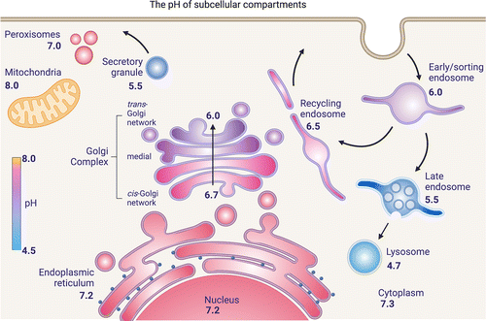
Separation of Reactions
Different reactions take place in different environments where they can happen efficiently = compartmentalization
Catabolic and anabolic reactions have to be separated
Allows for each enzyme and function of the cell to happen as efficiently as possible
Lysosomes
Compartmentalization applies to the whole body
Happens in eukaryotic cells via internal membranes (create folds and membranes of mitochondria and chloroplasts)

Slide 4
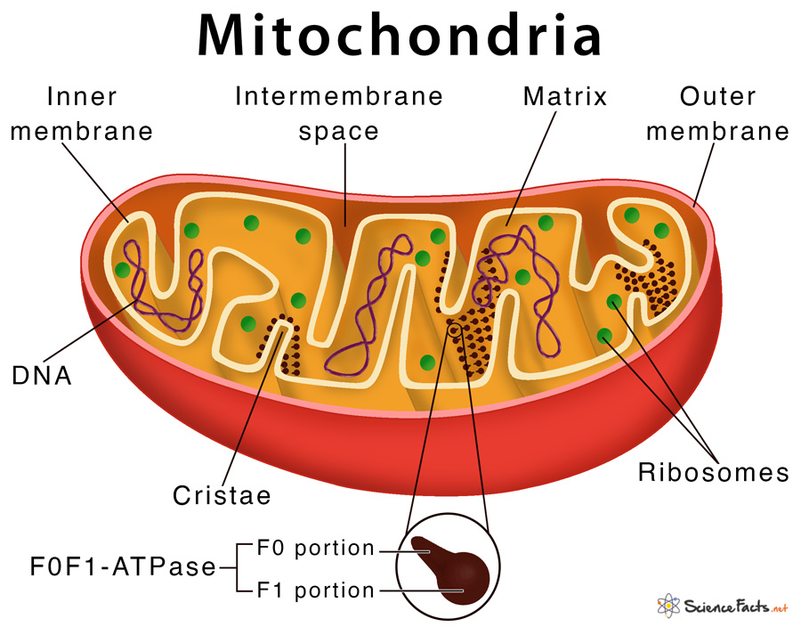
Increased Surface Area
Mitochondria and chloroplasts have double membranes which are also folded = huge increase in surface area
Leads to more resources being brought in and expelled, and more production of energy
Ion gradients can also be established using the inner membrane – it doesn’t affect the rest of the cell (pH)

Slide 5
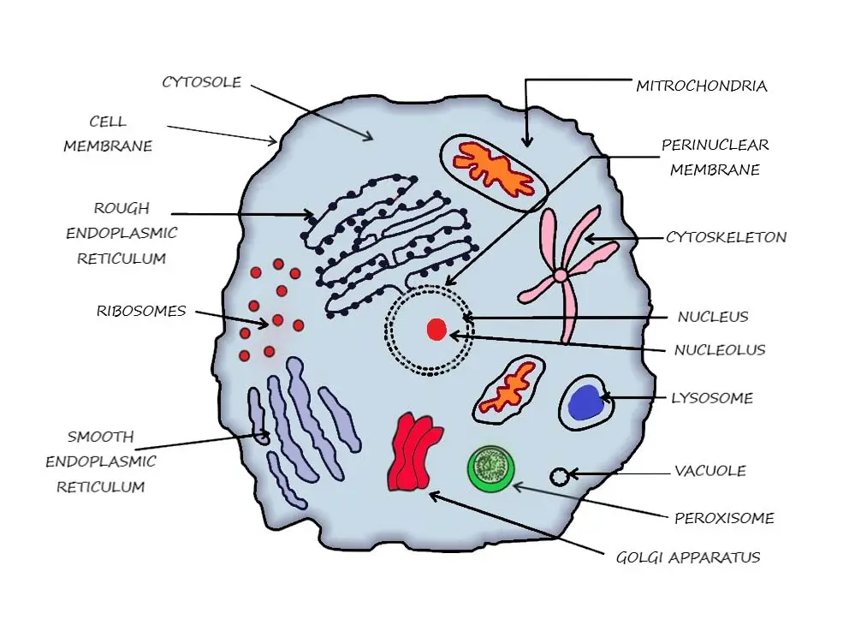
Means of Compartmentalization
Mitochondria and chloroplasts have their own DNA = regulate their internal environments
Proteins created in different parts of the cell get transported to different areas
Free vs. bound ribosomes
Cell division keeps compartmentalization

Slide 6
Cell Compartmentalization Review
Separation of reactions
Increase of surface area
Notes:
Basic review
Next up: Carbon and its effects on life

