Slide 1


AP Bio
Unit 3:
Cellular Energetics

Slide 2
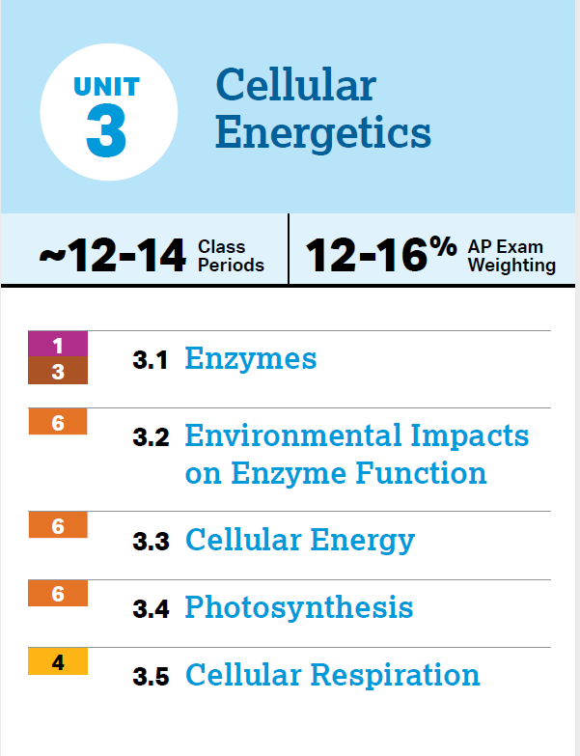
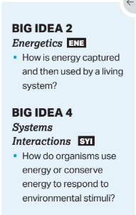
Unit 3: What You Need To Know
What are enzymes and how do they work?
Environmental effects on enzymes
Endergonic and exergonic reactions
ATP + Energy Coupling
Photosynthesis
Cellular Respiration
Fermentation

Slide 3
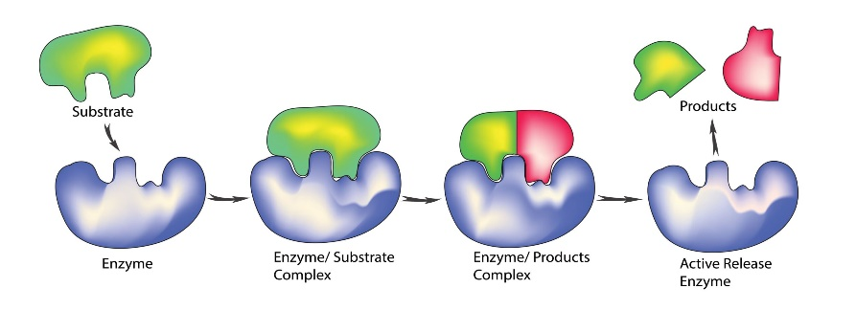
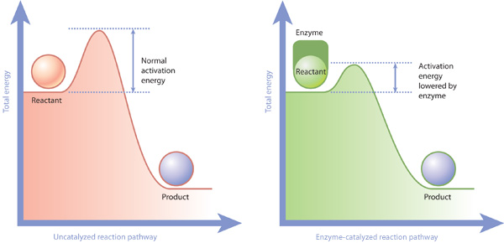
Review: Enzymes (3.1)
Enzymes – biological catalysts (change rate of reaction, aren’t used in the process)
Mostly proteins
Have protein folding structure
Greatly speed up reactions
Processes mostly reversible
Very specific
Enzymes lower the activation energy – the amount of energy needed to start a reaction
They act upon substrates (change, combine, separate) and bind to them through the active site, forming an enzyme-substrate complex

Slide 4
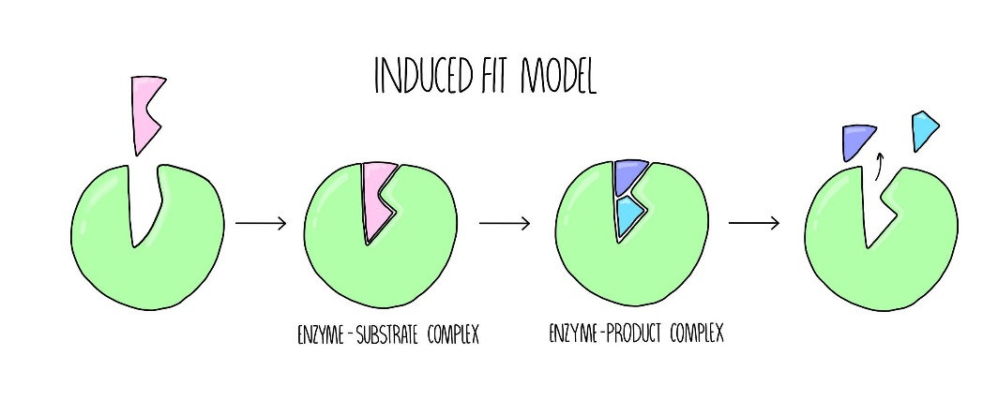
Review: Induced Fit Model (3.2)
Induced Fit Model – the substrate and active site have matching shapes/attracting charges, when the substrate is attracted into the active site the enzyme makes a conformational change to make them fit
Catabolic reaction – breaking a molecule (releases energy)
Conformational change of the enzyme places stress upon the bond = lowered activation energy
Anabolic reaction – making a molecules (consumes/stores energy)
Conformational change forces the two substrates together = lowered activation energy
Notes:
Amount of energy produced/consumed doesn’t change, just lowers activation energy

Slide 5
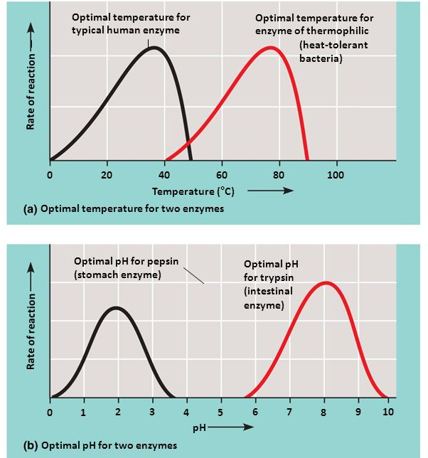
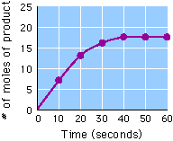
Review: Environmental Impacts on Enzyme Function (3.3)
Enzymes can be denatured (can be reversed) – each has optimal range of pH and temperature – reason for compartmentalization
Effects of enzyme and substrate concentration increases:
Notes:
Protein structure
Denaturation
Each enzyme has an optimal zone
Compartmentalization
Sometimes denaturation is reversible
Temperature increase = molecules move around
1. faster spike
2. more product

Slide 6
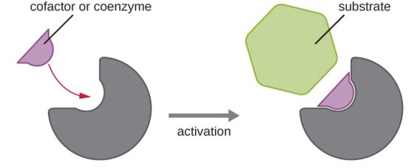
Review: Cofactors and Coenzymes (3.3)
Cofactors – non protein helpers that bind to the active site (metal ions such as zinc, iron, copper)
Coenzymes – organic cofactors that bind to the active site (vitamins)

Slide 7
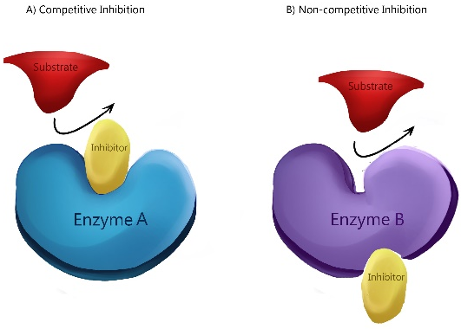
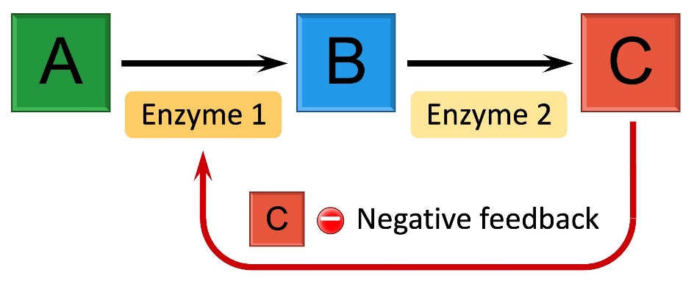
Review: Inhibition (3.3)
Competitive inhibitors – molecules that compete with the substrate for the active site on the enzyme – have the same shape as substrates
Can be irreversible
Noncompetitive inhibitors – molecules that impede with enzyme activity by binding to another part of the enzyme (allosteric site)
Causes a change in shape of the active site
Feedback inhibition – the end product of an enzymatic pathway can switch off the pathway by binding to the allosteric site of an enzyme in the pathway (for efficiency)
Notes:
Allosteric site can both inhibit and stimulate

Slide 8
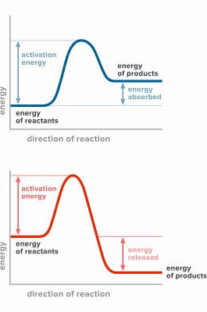
Review: Thermodynamics and Free Energy (3.4)
Metabolism – the totality of an organism’s chemical reactions
Energy = ability to do work – life requires a constant input
Thermodynamics – study of energy transfers in matter
1st Law: Energy cannot be created or destroyed
2nd Law: Every reaction reduces the amount of available usable energy (lost as heat)/Law of Entropy
Free energy – the part of a system’s energy that is able to perform work (ie. cause reactions ie. do things) - ΔG
Endergonic reaction – energy is stored through the formation of a bond = consumes free energy (ΔG > 0)
Exergonic reaction – energy is released through the breaking of bonds = releases free energy (ΔG < 0)
Notes:
Entropy – diffusion/disorder, energy will always move high to low
Endergonic on top, exergonic under
Reactants by themselves + input of energy (sun) = product with more energy than initial reactants – when reaction took place some sun energy was lost, and some was stored as chemical energy in glucose – you end with more than you started
This means a positive change in free energy – product has more energy than reactants
Exergonic has reactants with stored energy, some energy is used to break apart bonds, but more energy released than it took to break the bond – you end with less than you started because all energy has been released
Negative change in free energy – product has less energy than in reactants (all has been released)
Enzymes: lower activation energy, separate anabolic and catabolic, similar processes located near each other

Slide 9
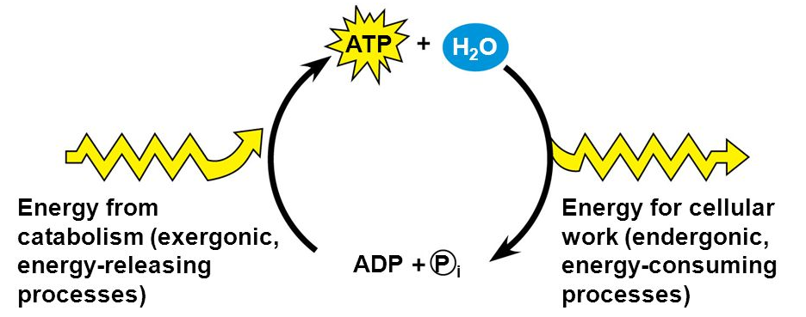
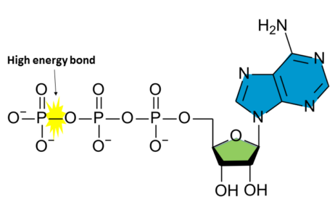
Review: ATP and Energy Coupling (3.4)
ATP (Adenosine Triphosphate) – primary source of energy for cells
Nucleic acid – adenine, ribose, 3 phosphates
3rd group especially unstable
Work in the cell is done through hydrolysis of ATP – energy is released in the exergonic reaction, forming ADP
This energy can be used for an endergonic reaction – energy coupling

Slide 10
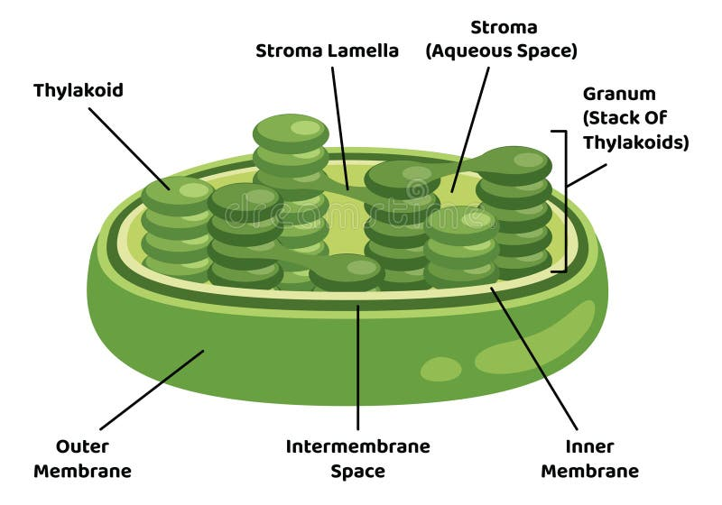
Review: What is Photosynthesis? (3.5)
Autotrophs vs. Heterotrophs
Cyanobacteria/early photosynthetic organisms created the oxygen in the atmosphere, joined eukaryotic cells and became chloroplasts through endosymbiosis
Chloroplast – site of photosynthesis in the plant cell
Photosynthesis equation: 6CO₂ + 6H₂O + Light energy → C₆H₁₂O₆ + 6O₂
Oxidation (lose electrons)-Reduction (gain electrons) reaction
Thylakoids contain chlorophyll
Notes:
Heterotrophs dependent on autotrophs for both food and oxygen
Stroma = inner gel
Thylakoids = membrane sacs, membranes used to establish gradients
Chlorophyll = pigment inside the thylakoids that absorbs light
Stomata = holes in the leaf through which carbon dioxide enters and oxygen and water vapor leave

Slide 11
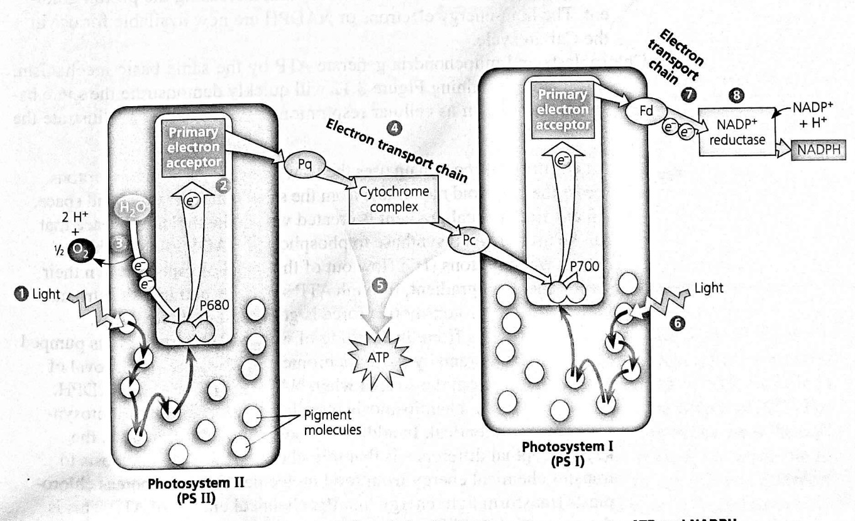
Review: Light Dependent Reactions (3.5)
Converts solar energy from the sun into chemical energy (ATP) that can be used to create glucose
Photosystem ΙΙ:
Photosystems – where photons absorbed by pigments
Light harvesting compound -> reaction center -> primary electron acceptor
Raises electron to higher energy state and transfers it
Replaced by splitting of water
Notes:
Starts in photosystem 2 (P680), electron eventually gets donated to the electron transport chain
The reaction center now needs replacement electrons, which it gets from breaking apart water
The oxygen from the water molecule is released as waste, while the hydrogen ions enter the thylakoid space (on the other side of the membrane)

Slide 12
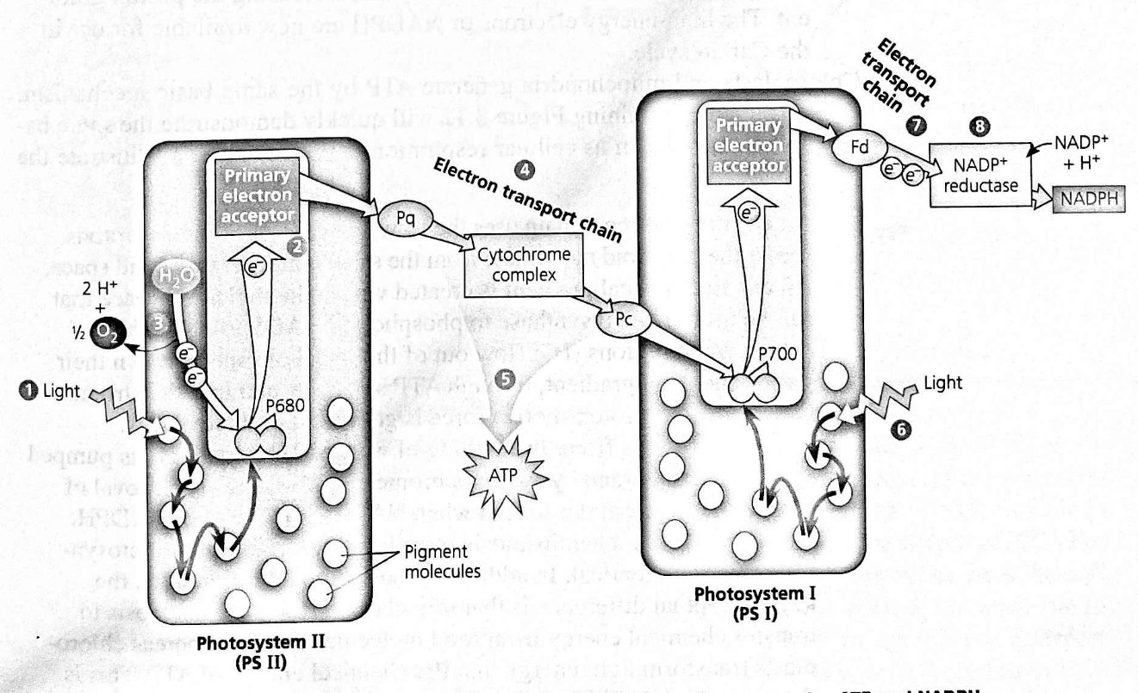
Review: Light Dependent Reactions Cont. (3.5)
ETC:
Electrons pass between photosystems on the electron transport chain
Cytochrome complex
Chemiosmosis
Protons pumped into thylakoid space, establishing gradient
Forced to pass through ATP Synthase
Photosystem Ι:
Activated same time
Electrons ultimately donated to NADP+ -> NADPH
Notes:
The energy the passage of the electron creates is used to pump protons (hydrogen ions) into the thylakoid space
This creates a gradient in which there is a lot of protons in the space, but they are unable to diffuse across the membrane because they are ions
To move across the membrane, the hydrogen ions are forced to pass through ATP Synthase which attaches a phosphate group to ADP when activated, creating ATP (Chemiosmosis
Photosystem 1 electrons replaced by ps 2 electrons
Creation of nadph This process also removes H+ from the stroma, helping increase the proton gradient in the thylakoid space

Slide 13
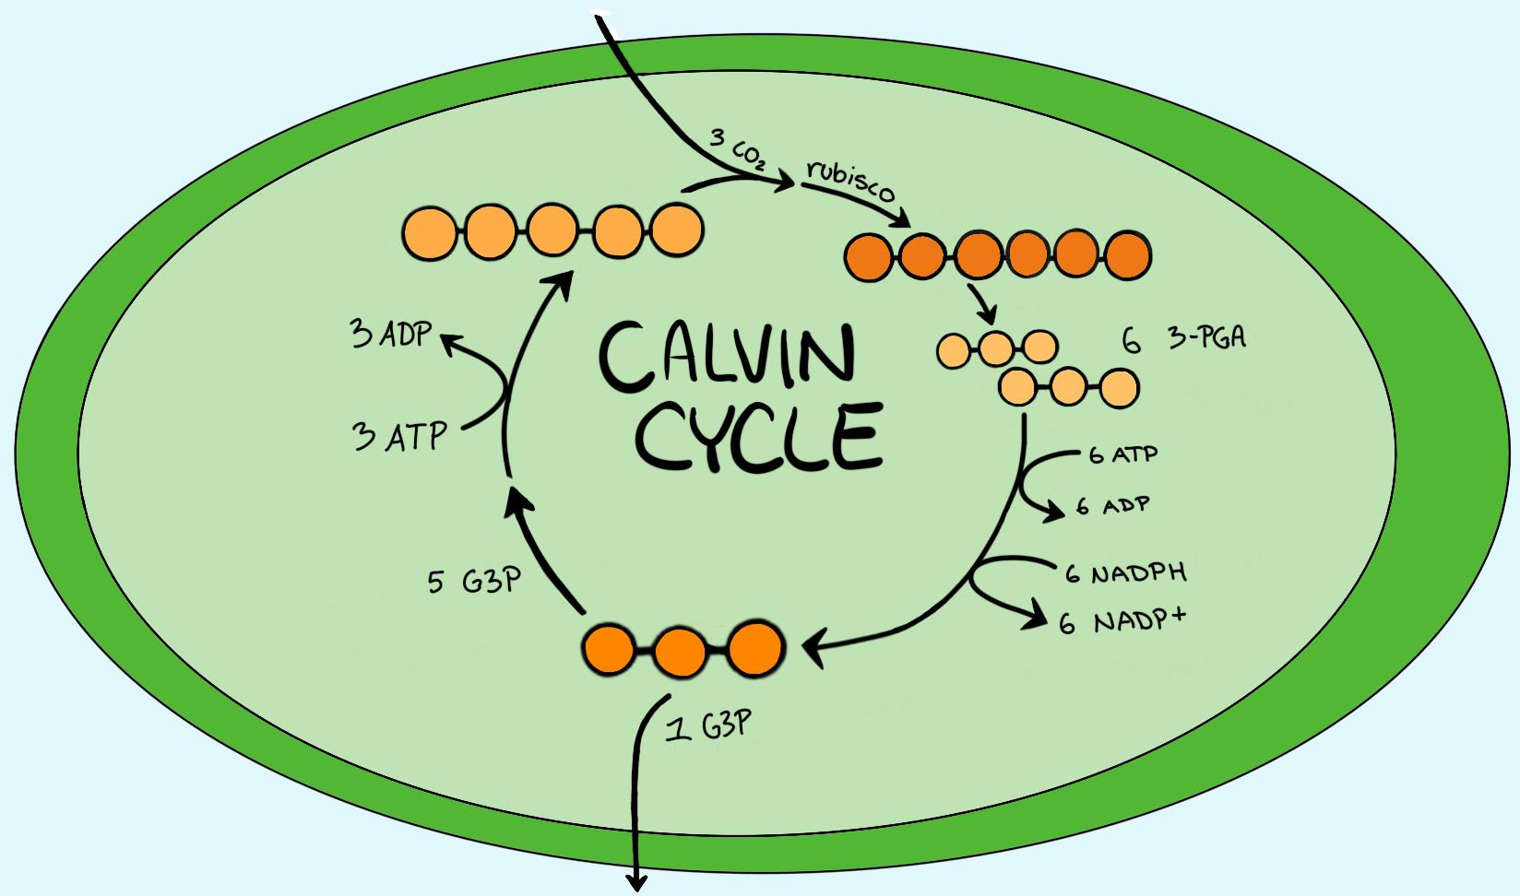
Review: Light Independent Reactions (3.5)
The ATP phosphorylates the compound, and it is reduced (electrons added) through NADPH
This forms glyceraldehyde 3-phosphate molecules (G3P) – one leaves the cycle, the other five are rearranged and reused in the cycle
To create one molecule of glucose, there must be 6 turns of the cycle to fix 6 molecules of CO₂
EVEN THOUGH ONLY 2 G3P NEEDED, 6 TURNS MUST HAPPEN
Happens in stroma, requires: CO₂, ATP, NADPH (Light unnecessary)
(3x) CO₂ enters the Calvin Cycle and is fixed (incorporated into an organic compound) to a five-carbon sugar (RuBP) through the use of the enzyme Rubisco
Notes:
Glucose = energy stored as food – can be used by both the plant and consumers of the plant
Takes place in stroma

Slide 14
Review: Cellular Respiration (3.6)
Cellular (Aerobic) respiration – uses oxygen, turns macromolecules into ATP (primarily glucose)
Exergonic release of energy from glucose used to phosphorylate ADP to turn it into ATP
Just like photosynthesis, it’s a redox reaction (reduction-oxidation) – tied to losing and gaining hydrogens
Cellular respiration equation: C₆H₁₂O₆ + 6O₂ --> 6CO₂ + 6H₂O + Chemical Energy (686 kcal/mol of glucose)
Notes:
Doesn’t have to be glucose

Slide 15
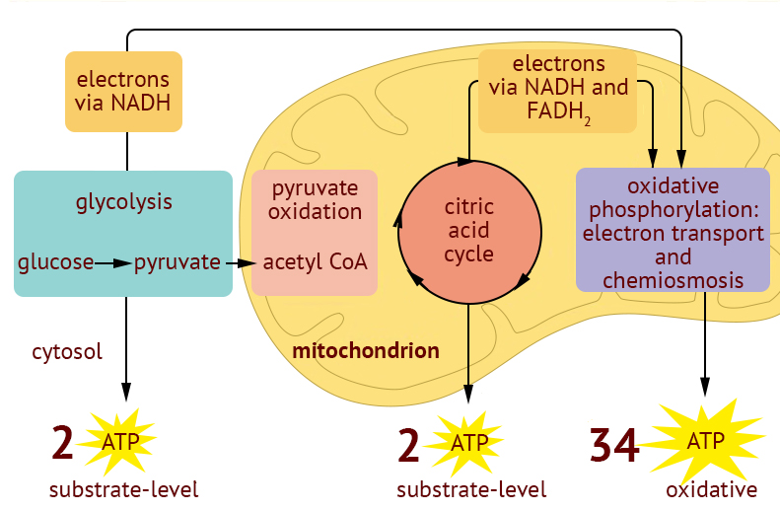
Review: Steps of Cellular Respiration (3.6)
Glycolysis – anaerobic, in cytosol
Net gain 2 ATP, fills 2 NAD+ -> NADH, splits 6 carbon glucose into 2x 3 carbon pyruvate
Link reaction – now in matrix
CO₂ removed from pyruvate, makes 2 more NADH, becomes acetyl-CoA
Krebs cycle – 2 turns for one glucose
All carbons lost as CO₂ (4 total)
2 ATP, 6 NADH, 2 FADH₂ (reduced FAD)
Notes:
Takes 2, gives 4
Substrate level phosphorylation
Why still not using it?
Allosteric regulator = turns off
Phosphofructokinase – allosteric regulator of glycolysis
Also known as pyruvate oxidation, citric acid cycle
4 carbon citric acid cycle
Co2 exhaled

Slide 16
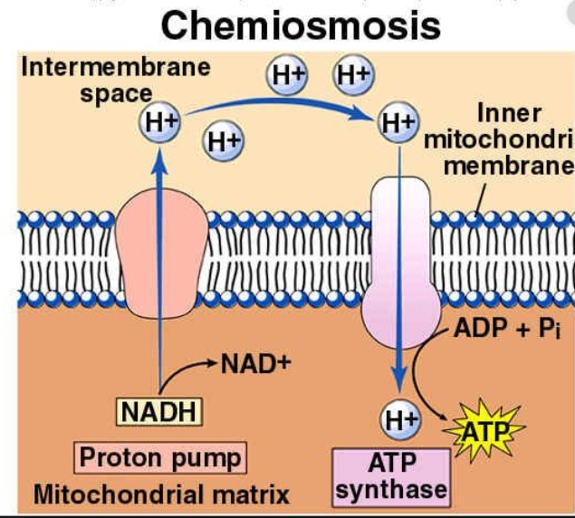
Review: Oxidative Phosphorylation (3.6)
In inner membrane of mitochondria (double membrane) there is an ETC (just like in photosynthesis) consisting of transmembrane proteins
Powered by electrons from carriers (NADH and FADH₂) -> pumps hydrogen ions across membrane from matrix to intermembrane space
Electrons are attracted to the final electron acceptor, the electronegative O₂, combination forms water
The hydrogen ions in the intermembrane space form an electrochemical gradient, can’t cross membrane because they are ions, but want to follow concentration gradient = have to go through the transmembrane protein ATP synthase
As protons travel through ATP synthase, it phosphorylates ADP into ATP
Total production: around 34 ATP, 6 H₂O
Notes:
2 membrane = endosymbiotic, taken up after oxygen in atmosphere
More energy from NADH (3 vs 2 atp) because enters etc sooner = enters at higher energy level and pumps more protons
nad+ and fad go back to be reused
H+ now back in matrix
Cell resp is inverse of photosynthesis
Equations are inverse
One produces oxygen, one consumes
One produces carbon dioxide, one consumes

Slide 17
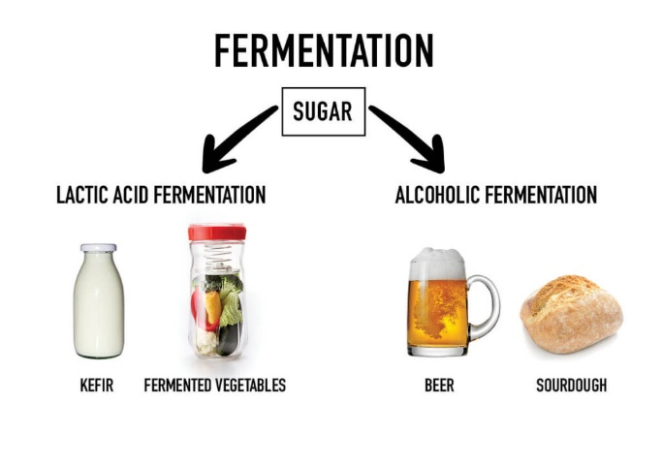
Review: Fermentation (3.6)
Fermentation uses the early evolved anaerobic process of glycolysis – gives little energy
Only issue is that NAD+ carriers get filled with electrons, not glycolysis can’t repeat
Alcohol fermentation – pyruvate converted to ethanol, releases carbon dioxide, and oxidizes NADH (like yeast)
Lactic acid fermentation – forms lactate as waste product, oxidizes NADH
Used in humans when out of breath
Notes:
Why you cramp when running

