Slide 1


AP BIO
TOPIC 3.1:
Enzymes

Slide 2
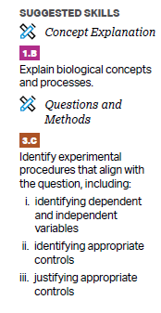
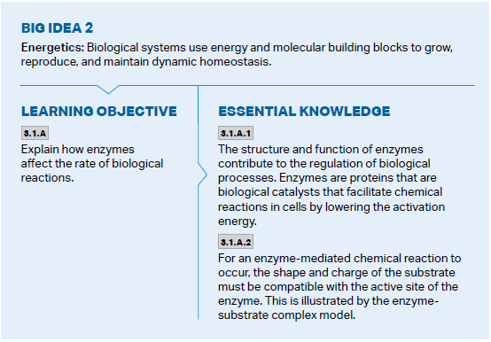
Objectives

Slide 3
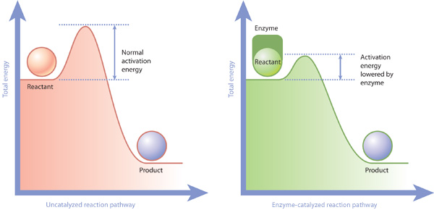
What is an enzyme?
Catalyst – substances that change the rate of a reaction, aren’t used up in the process
Enzyme – biological catalysts (mostly proteins)
Ribozymes
Properties of proteins
Enzymes lower the activation energy of a reaction – the amount of energy it takes to start a reaction

Slide 4
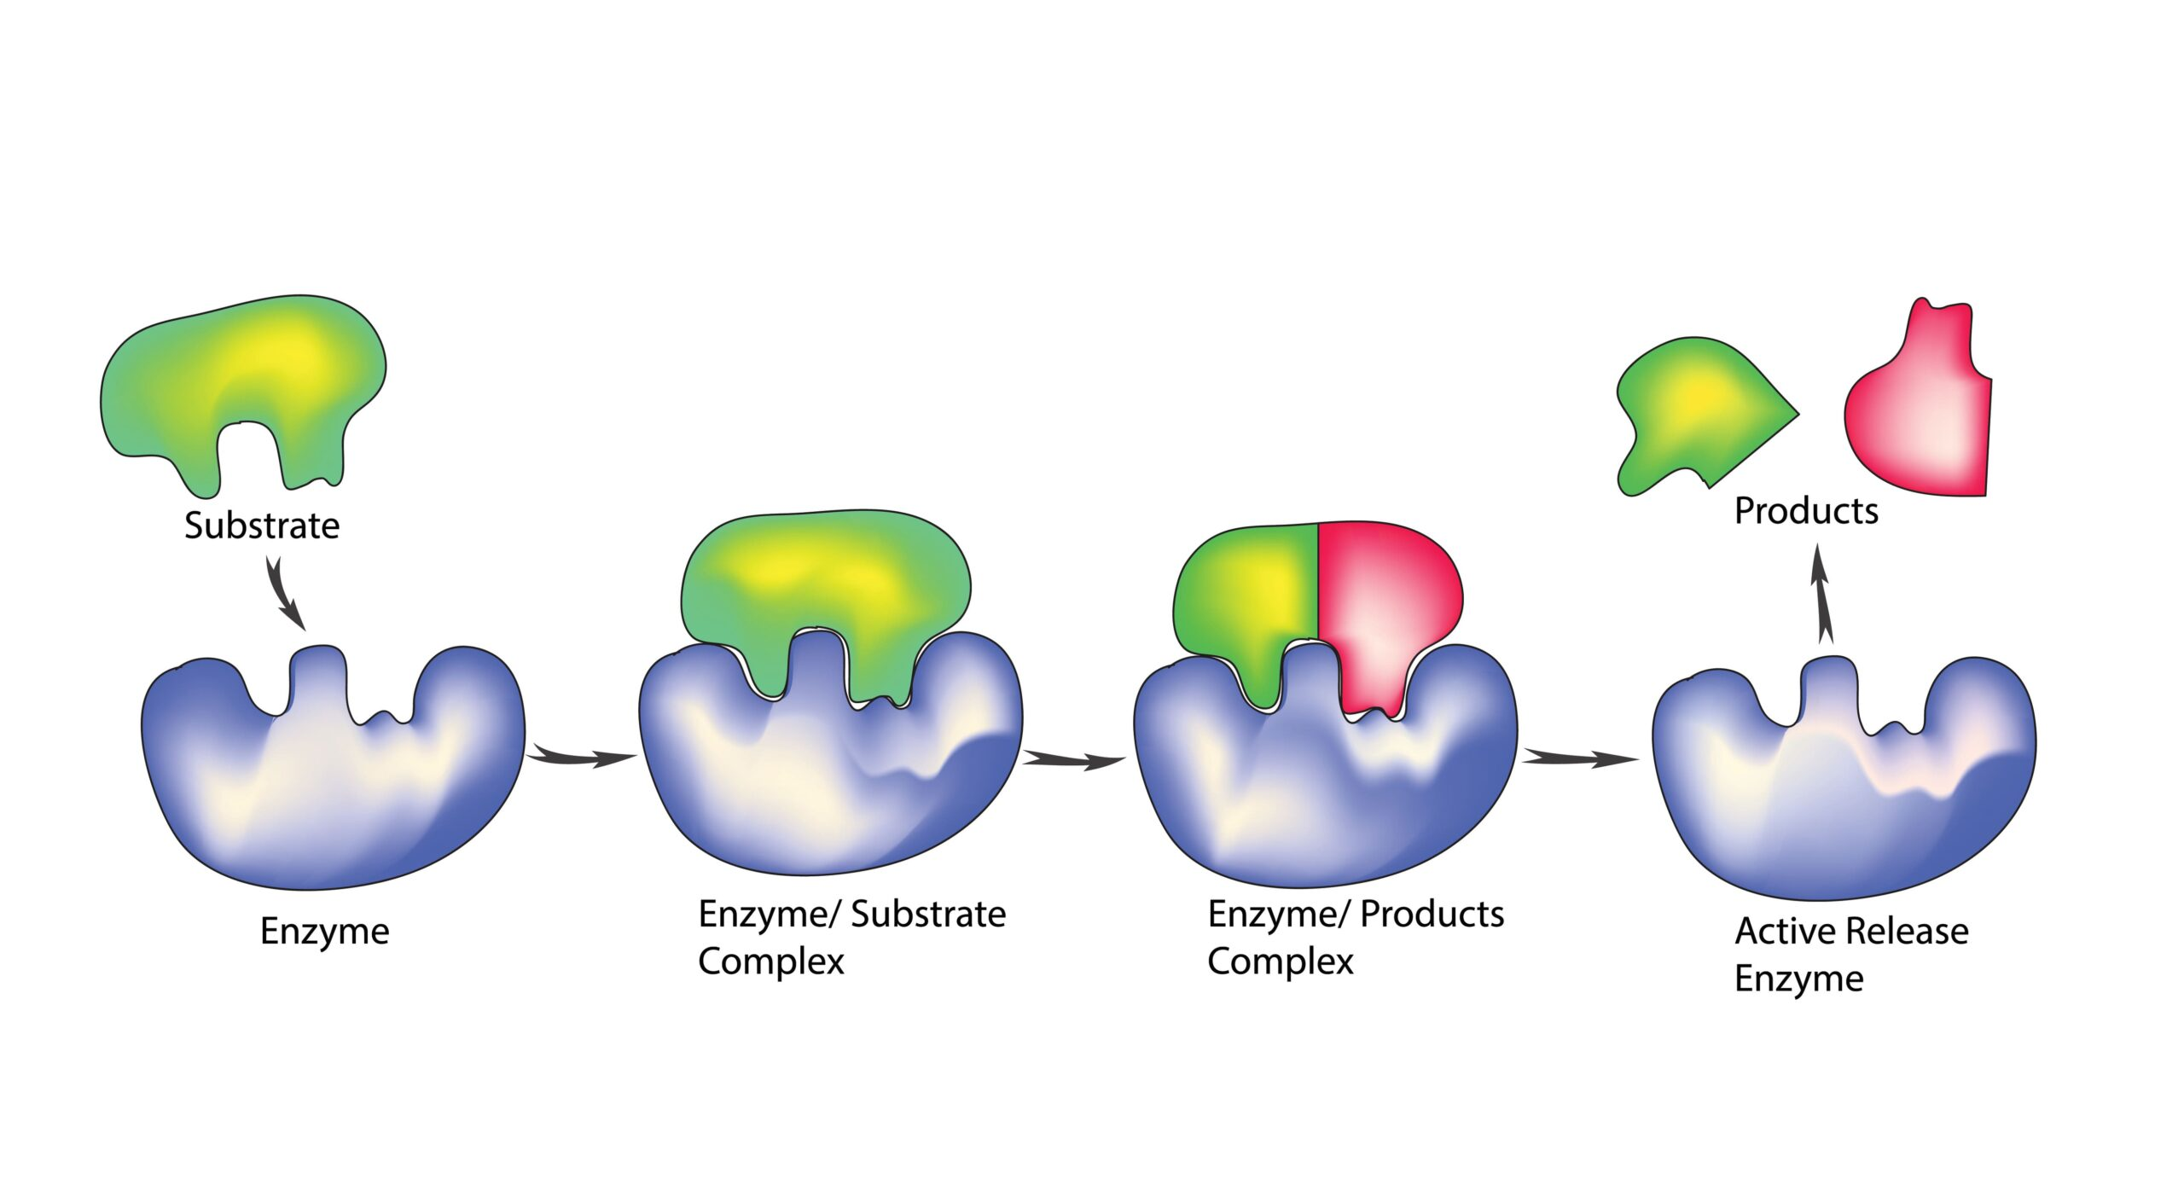
How do enzymes work?
Enzymes act upon substrates – combine, separate, change
The part of the enzyme that binds to the substrate is known as the active site -> forms enzyme-substrate complex
The enzyme is not used in the reaction

Slide 5
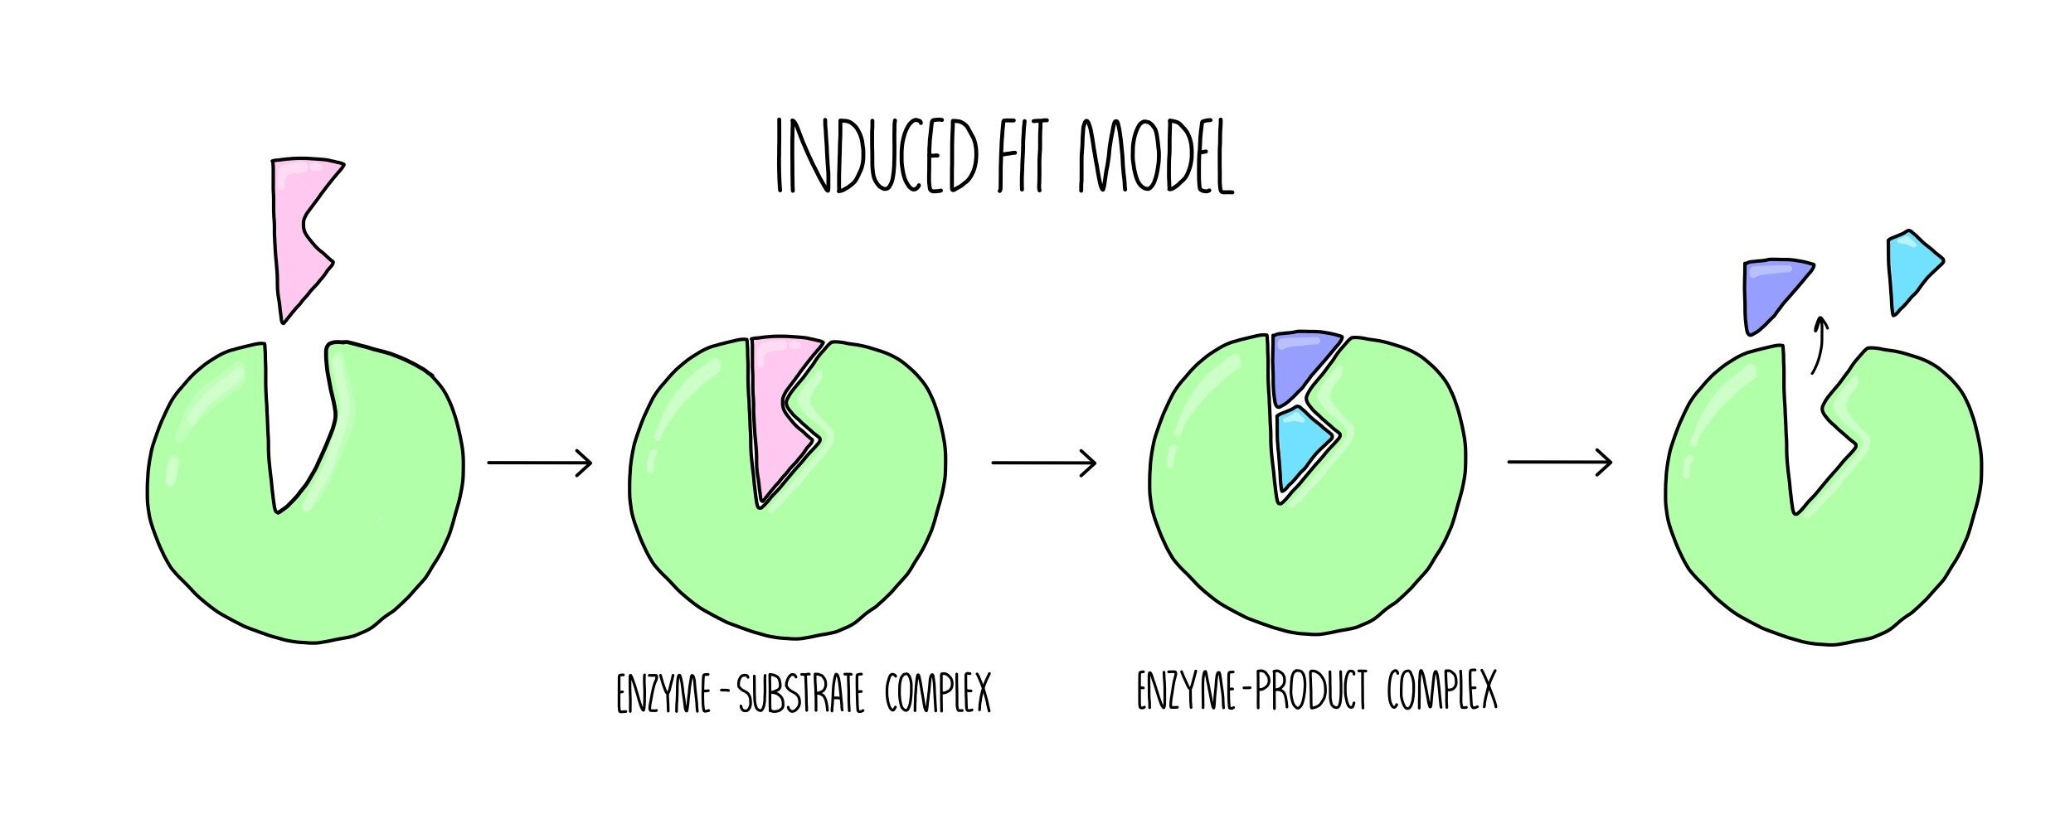
Induced Fit Model
Each enzyme has specific substrate(s) it can form an enzyme-substrate complex with
Induced Fit Model – the substrate and active site have matching shapes and attracting charges, and as the substrate is attracted into the active site, the enzyme will make a conformational change to make them entirely compatible

Slide 6
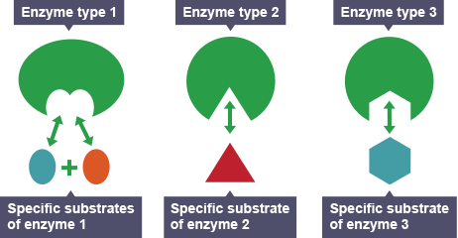
Properties of Enzymes
Enzymes largely speed up the process of reactions
Enzymes are specific – only certain substrate(s) can bind to specific enzyme active sites due to their shapes/charges
The catalytic reactions are reversible – regulation ability
Follow protein properties

Slide 7
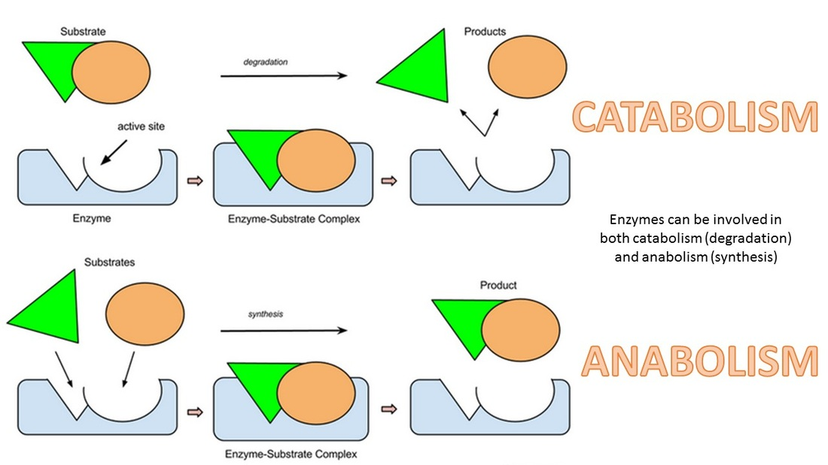
Types of Reactions
Catabolic reaction – breaking a molecule (releases energy as the bonds are broken = exergonic, exothermic)
Conformational change of the enzyme places stress upon the bond = lowered activation energy
Anabolic reaction – making a molecules (consumes/stores energy as the bonds are formed = endergonic, endothermic)
Conformational change forces the two substrates together = lowered activation energy
The overall change in energy whether or not enzymes are used is the same – enzymes just lower the activation energy

Slide 8
Enzyme Structure Review
What is an enzyme?
Properties of enzymes
Induced fit model

