Slide 1


AP BIO
TOPIC 3.2:
Environmental Impacts on Enzyme Function

Slide 2
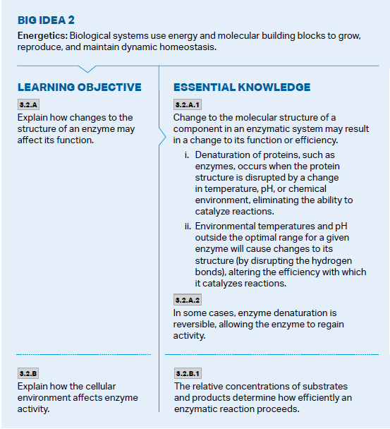
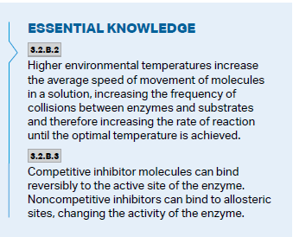
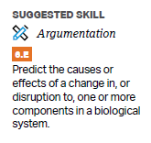
Objectives

Slide 3
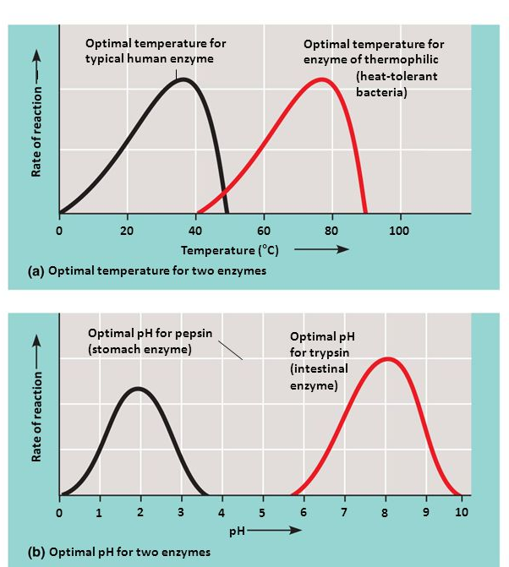
Temperature and pH
Enzymes are proteins with tertiary and quaternary structures = weak bonds that can be destroyed by pH and temperature
Denaturation
Each enzyme has an optimal zone
Compartmentalization
Sometimes denaturation is reversible
Notes:
Temperature increase = molecules move around

Slide 4
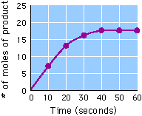
Enzyme Graphs
How would the graph change if enzyme concentration is increased?
If substrate concentration is increased?
Notes:
Faster spike
More product

Slide 5
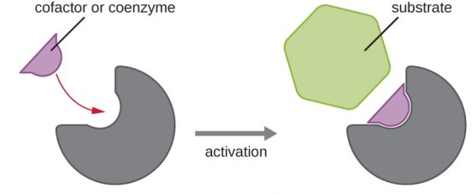
Cofactors and Coenzymes
Cofactors – non proteins helpers that bind to the active site (metal ions such as zinc, iron, copper)
Coenzymes – organic cofactors that bind to the active site (vitamins)

Slide 6
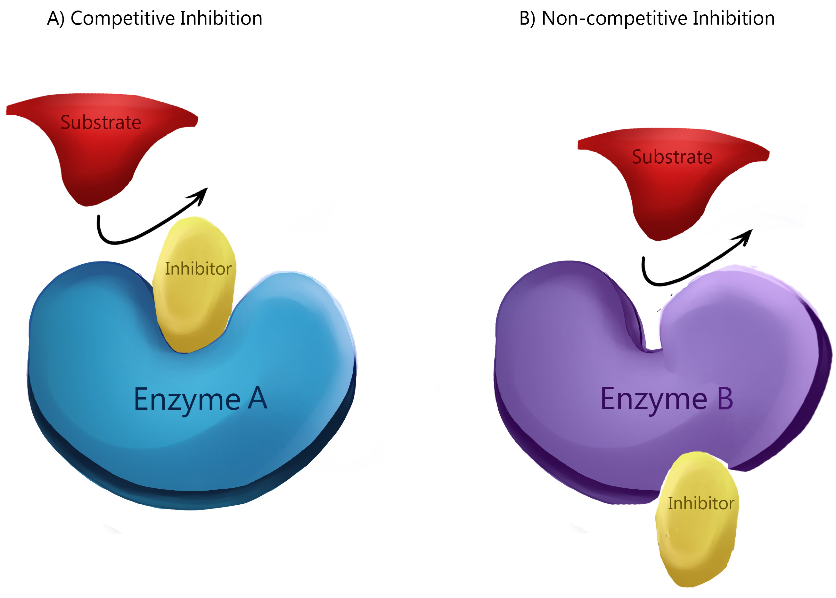
Inhibition
Competitive inhibitors – molecules that compete with the substrate for the active site on the enzyme
Can be irreversible
Poisons
Often have the same shape as substrates and can reduce reaction efficiency
Noncompetitive inhibitors – molecules that impede with enzyme activity by binding to another part of the enzyme (allosteric site)
Causes a change in shape

Slide 7
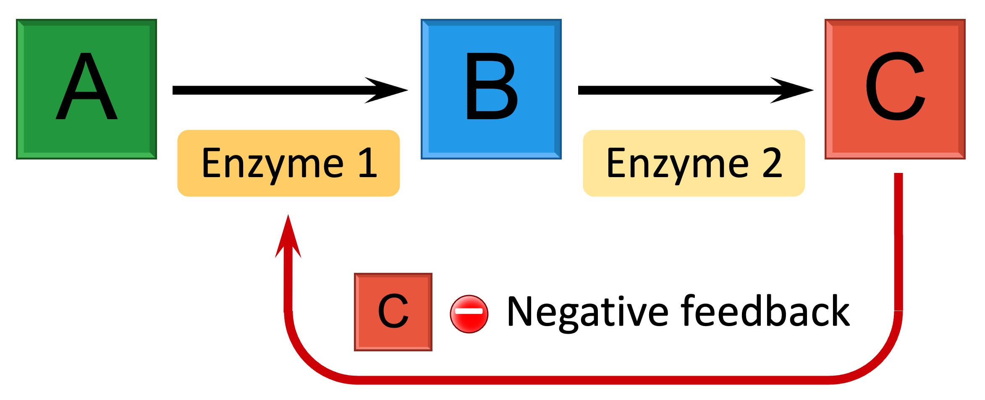
Enzyme Regulation
Substances that bind to the allosteric site can both inhibit and stimulate enzyme activity through the shape change it causes
Feedback inhibition – the end product of an enzymatic pathway can switch off the pathway by binding to the allosteric site of an enzyme in the pathway
Turns off pathway when enough of product is present in the cell = efficiency

Slide 8
Environmental Impacts on Enzyme Function Review
Enzyme denaturation and optimal ranges – pH and temperature
Effects of environmental temperature and concentration changes on enzyme activity
Enzyme regulation

