Slide 1


AP BIO
TOPIC 3.3:
Cellular Energy

Slide 2
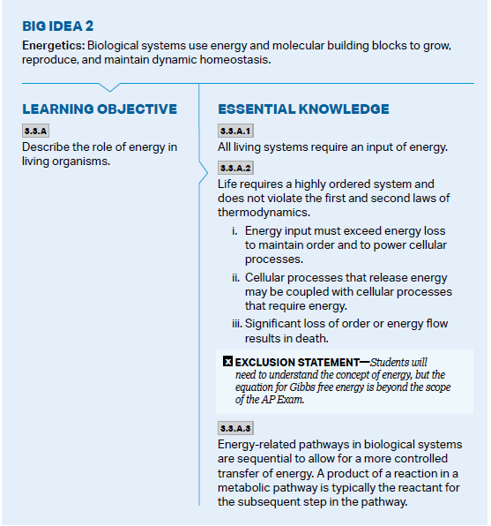
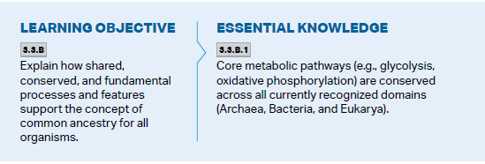
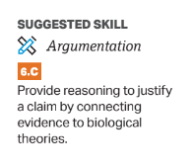
Objectives

Slide 3
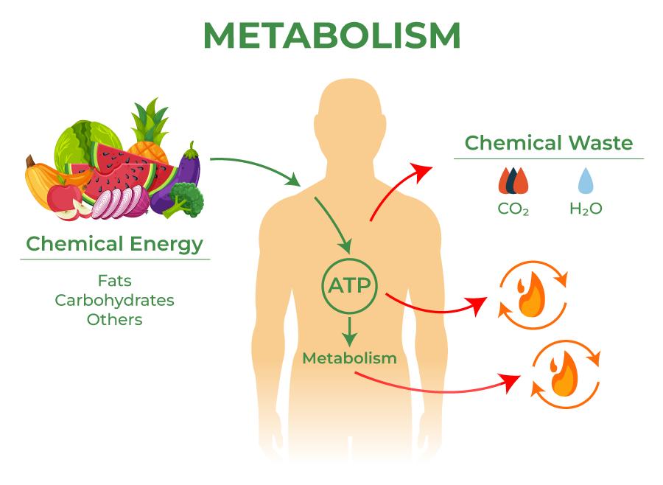
Energy and Thermodynamics
Metabolism – the totality of an organism’s chemical reactions
Energy = ability to do work
Life requires constant inputs of energy to survive
Energy is transferred through catabolic and anabolic pathways
Thermodynamics – study of energy transfers in matter
1st Law: Energy cannot be created or destroyed
2nd Law: Every reaction reduces the amount of available usable energy (lost as heat)
Entropy – energy always diffuses, “disorder”
Notes:
Moving energy low -> high requires additional input of energy so it moves high to low

Slide 4
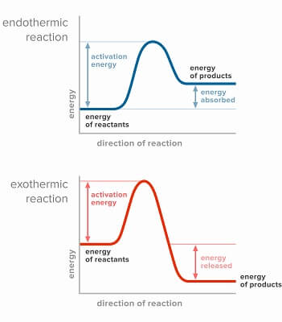
Free Energy and Types of Reactions
Free energy – the part of a system’s energy that is able to perform work (ie. cause reactions ie. do things)
Changes in free energy are notated with ΔG
Endergonic reaction – energy is stored through the formation of a bond = consumes free energy (ΔG > 0)
Exergonic reaction – energy is released through the breaking of bonds = releases free energy (ΔG < 0)
Enzymes assist in these processes
Notes:
Reactants by themselves + input of energy (sun) = product with more energy than initial reactants – when reaction took place some sun energy was lost, and some was stored as chemical energy in glucose – you end with more than you started
This means a positive change in free energy – product has more energy than reactants
Exergonic has reactants with stored energy, some energy is used to break apart bonds, but more energy released than it took to break the bond – you end with less than you started because all energy has been released
Negative change in free energy – product has less energy than in reactants (all has been released)
Enzymes: lower activation energy, separate anabolic and catabolic, similar processes located near each other

Slide 5
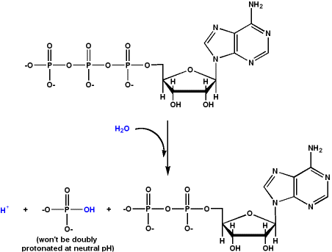
ATP
ATP (Adenosine Triphosphate) – primary source of energy for cells
Nucleic acid – adenine, ribose, 3 phosphates
3rd group especially unstable
Work in the cell is done through hydrolysis of ATP – energy is released in the exergonic reaction, forming ADP
This energy can be used for an endergonic reaction – energy coupling

Slide 6
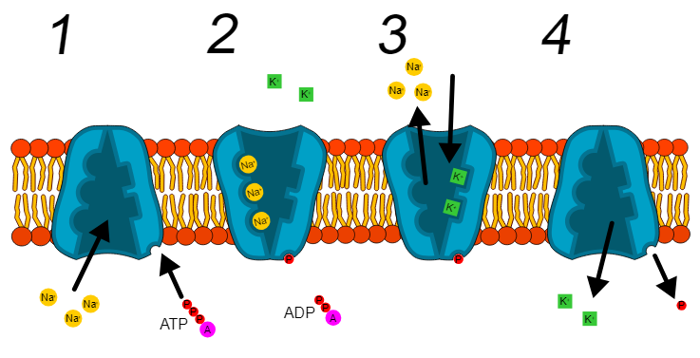
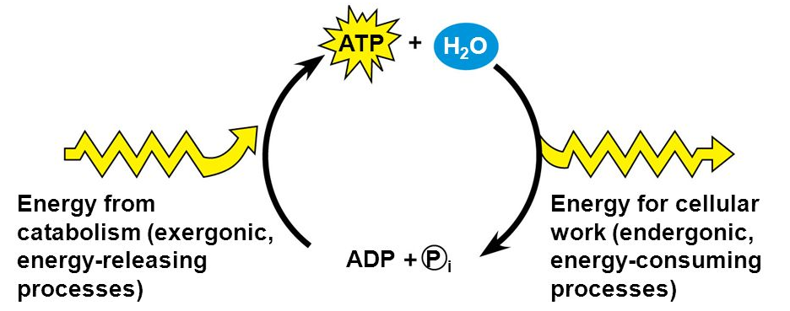
Energy Coupling
Notes:
Photosynthesis -> Cell Resp.
Sodium-Potassium pump – ATP used for active transport which is endergonic reaction, uses up energy and stores it

Slide 7
Cellular Energy Review
Laws of Thermodynamics
Gibbs Free Energy
ATP
Energy Coupling

