Slide 1
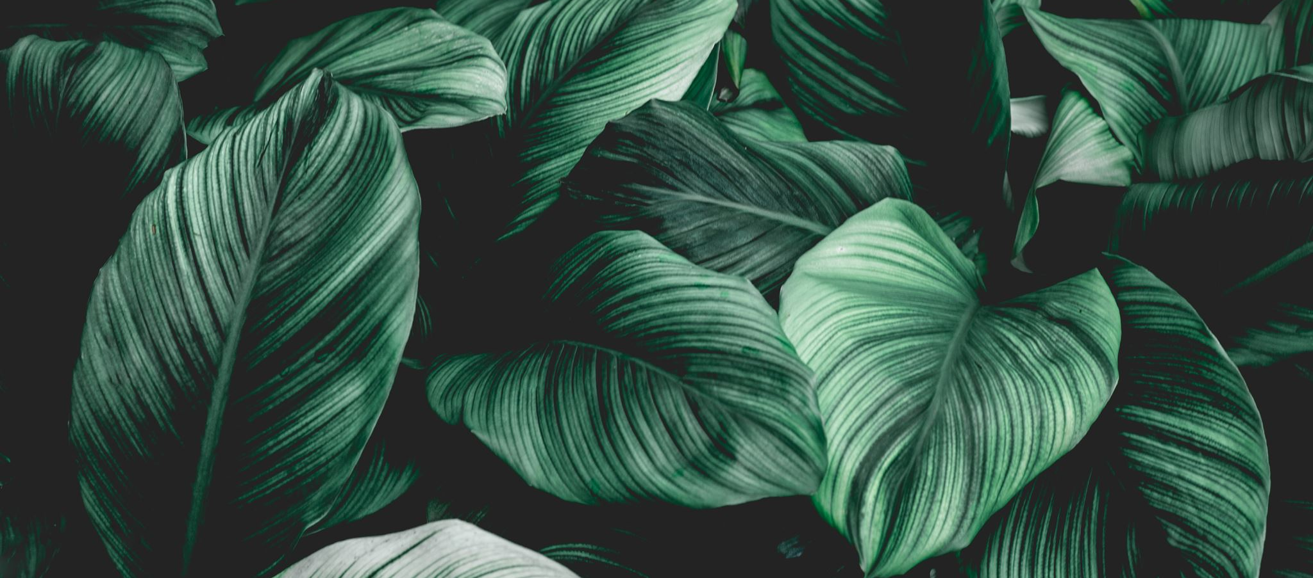

AP BIO
TOPIC 3.4:
Photosynthesis

Slide 2
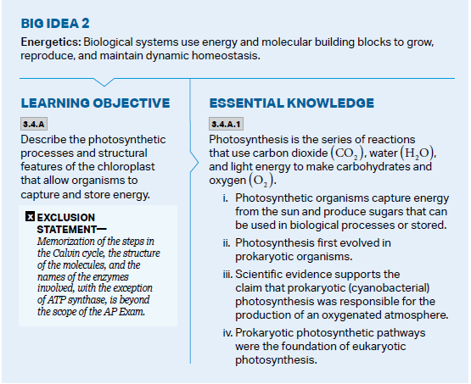
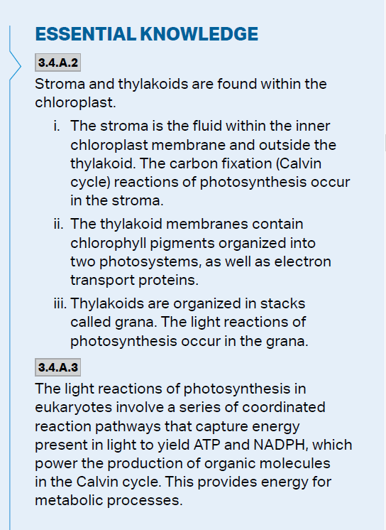
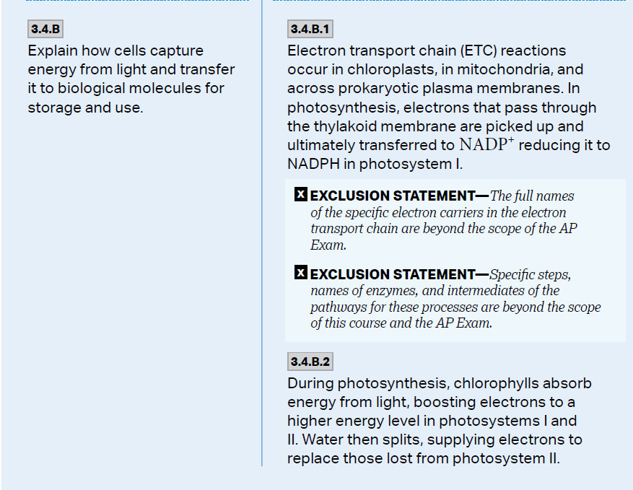
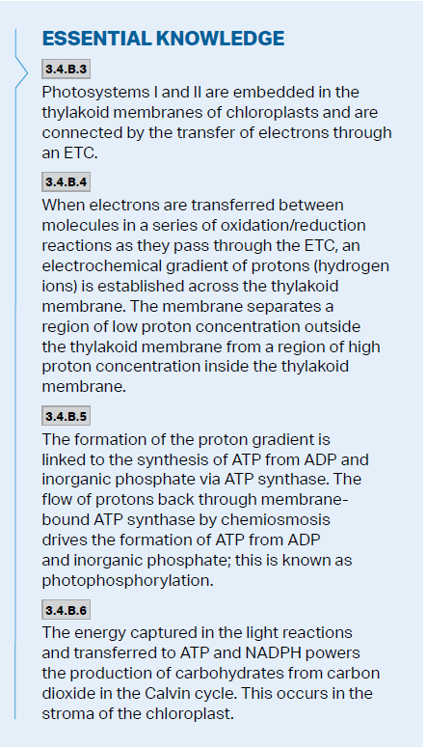
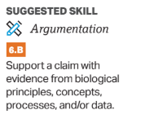
Objectives

Slide 3
Photosynthesis: Preview
Autotrophs vs. Heterotrophs
Heterotrophs dependent on autotrophs for both food and oxygen
Cyanobacteria/early photosynthetic organisms created the oxygen in the atmosphere, joined eukaryotic cells and became chloroplasts through endosymbiosis
Chloroplast – site of photosynthesis in the plant cell
Photosynthesis equation: 6CO₂ + 6H₂O → C₆H₁₂O₆ + 6O₂
Requires energy from the sun
Oxidation (lose electrons)-Reduction (gain electrons) reaction
Notes:
Carbon reduced
Water oxidated

Slide 4
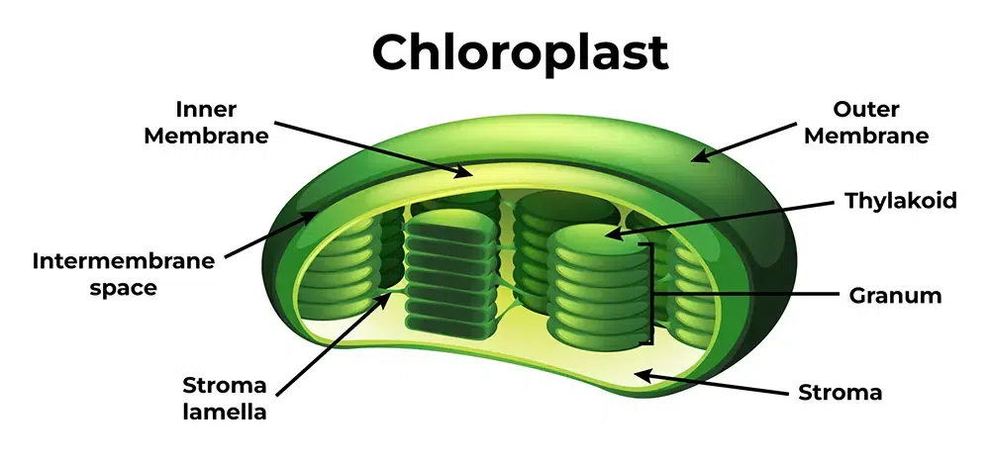
The Chloroplast
Stroma = inner gel
Thylakoids = membrane sacs, membranes used to establish gradients
Chlorophyll = pigment inside the thylakoids that absorbs light
Stomata = holes in the leaf through which carbon dioxide enters and oxygen and water vapor leave
Notes:
Thylakoid stack = granum

Slide 5
Light Dependent Reactions: Energy Production
Converts solar energy from the sun into chemical energy (ATP) that can be used to create glucose
Light is made up of photons, and it is absorbed by pigments such as chlorophyll
Action and absorption spectrums show the efficiency of different light wavelengths and pigments for photosynthesis (chlorophyll absorbs red and blue light and reflects green, and plants use more energy from red and blue light)
Photons absorbed in thylakoid membranes through groups of pigment molecules called photosystems (chlorophyll + carotenoids)

Slide 6
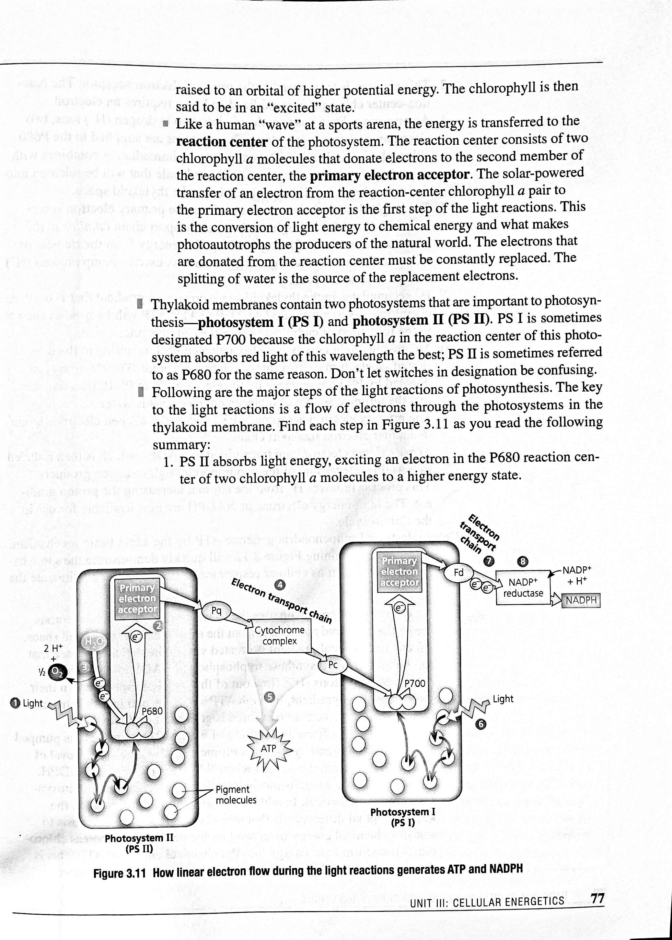
Photosystem 11
Light-harvesting compound – group of pigments – when light absorbed, one electron raised to a higher energy state
Energy transferred to the reaction center of the photosystem -> primary electron acceptor
Starts in photosystem 2 (P680), electron eventually gets donated to the electron transport chain
The reaction center now needs replacement electrons, which it gets from breaking apart water
The oxygen from the water molecule is released as waste, while the hydrogen ions enter the thylakoid space (on the other side of the membrane)

Slide 7
ETC
The electron passes from PS ΙΙ to PS Ι through an electron transport chain, consisting of cytochrome transmembrane proteins
The energy the passage of the electron creates is used to pump protons (hydrogen ions) into the thylakoid space
This creates a gradient in which there is a lot of protons in the space, but they are unable to diffuse across the membrane because they are ions
To move across the membrane, the hydrogen ions are forced to pass through ATP Synthase which attaches a phosphate group to ADP when activated, creating ATP (Chemiosmosis)

Slide 8
Photosystem 1
Meanwhile, PS Ι has also been activated, and more electrons have been donated (these are replaced with the one traveling down the ETC from PS ΙΙ)
These donated electrons travel along another ETC until they are transmitted to the electron carrier NADP+ (which is reduced to NADPH) – NADPH can be used in the Calvin Cycle
This process also removes H+ from the stroma, helping increase the proton gradient in the thylakoid space
Notes:
PS1 same time as PS2
Chemiosmosis from 3 places : water, ETC, creation of NADPH

Slide 9
Total Light Dependent Reactions
Total photosynthesis equation:
6CO₂ + 6H₂O → C₆H₁₂O₆ + 6O₂
Uses: light energy, water
Produces: ATP, NADPH, oxygen

Slide 10
Light-Independent Reactions (Glucose Production)
These reactions do not rely on solar energy, but need the ATP (chemical energy) and NADPH from the light-dependent reactions, and carbon dioxide from the outside environment
(3x) CO₂ enters the Calvin Cycle and is fixed (incorporated into an organic compound) to a five-carbon sugar (RuBP) through the use of the enzyme Rubisco
The ATP phosphorylates the compound, and it is reduced (electrons added) through NADPH
This forms glyceraldehyde 3-phosphate molecules (G3P) – one leaves the cycle, the other five are rearranged and reused in the cycle (once two leave the cycle, one molecule of glucose is formed)
To create one molecule of glucose, there must be 6 turns of the cycle to fix 6 molecules of CO₂

Slide 11
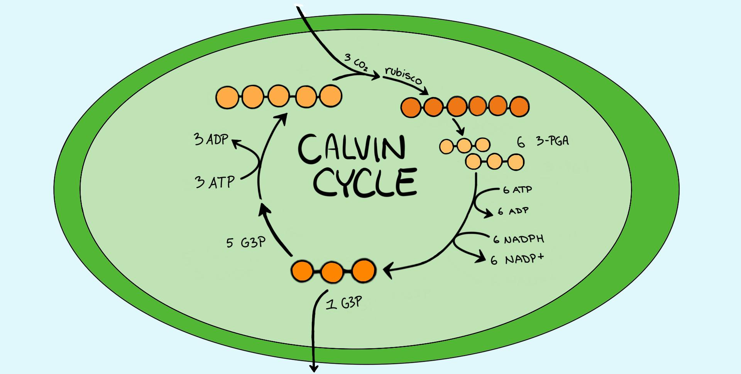
The Calvin Cycle
Uses: carbon dioxide, NADPH, ATP
Produces: glucose, NADP+, ADP
Glucose = energy stored as food – can be used by both the plant and consumers of the plant
Takes place in stroma

Slide 12
Photosynthesis Review
Parts of a chloroplast
Photosynthesis equation: 6CO₂ + 6H₂O → C₆H₁₂O₆ + 6O₂
Light-dependent reactions
Light-independent reactions

