Slide 1


AP BIO
TOPIC 3.5:
Cellular Respiration

Slide 2
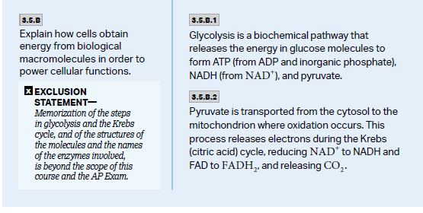
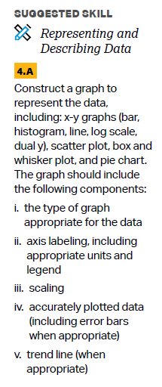
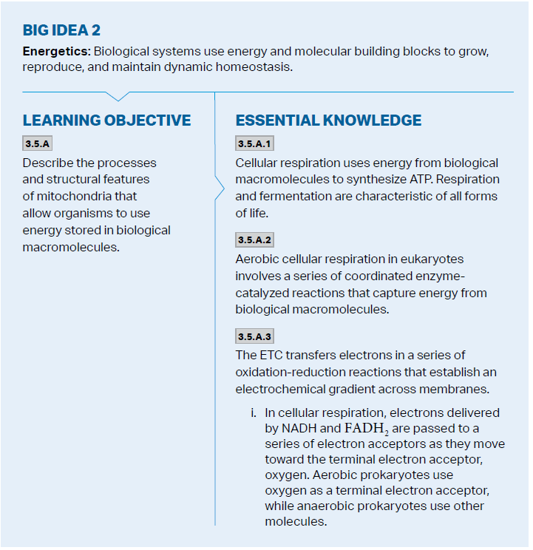
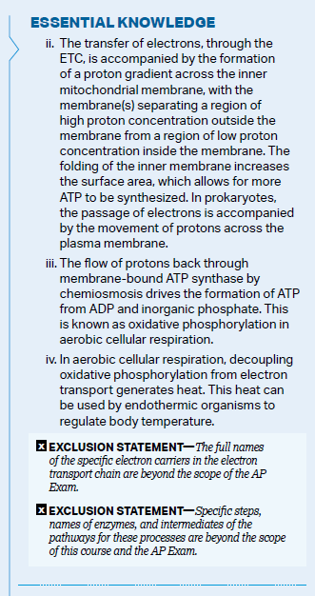
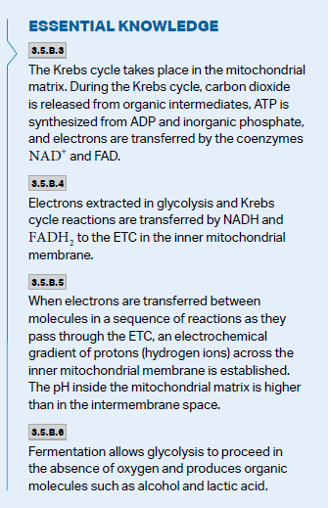
Objectives

Slide 3
What is cellular respiration?
For living organisms to gain energy: 2 catabolic pathways used
Fermentation – partial degradation of sugars, no oxygen
Cellular (Aerobic) respiration – uses oxygen, turns macromolecules into ATP (primarily glucose)
Exergonic release of energy from glucose used to phosphorylate ADP to turn it into ATP
Just like photosynthesis, it’s a redox reaction (reduction-oxidation) – tied to losing and gaining hydrogens
Cellular respiration equation: C₆H₁₂O₆ + 6O₂ --> 6CO₂ + 6H₂O + Chemical Energy (686 kcal/mol of glucose)
Notes:
Doesn’t have to be glucose

Slide 4
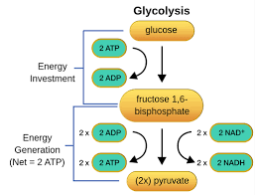
Glycolysis
Glycolysis – occurs in cytosol and is anaerobic, evolved first, pre oxygen in atmosphere
Requires an input of 2 ATP, gain 4 ATP
Fills 2 NAD+ electron carriers (reduces them) to NADH (NOT NADPH)
Turns the 6-carbon glucose into 2x 3 carbon pyruvate
Phosphofructokinase – allosteric regulator of glycolysis
Total production = 2 pyruvate, 2 ATP, 2 NADH
Notes:
Substrate level phosphorylation
Why aren’t we still using it?
Allosteric regulator = turns off

Slide 5
Link Reaction and Krebs Cycle
The pyruvate is moved through the membrane of the mitochondria into the matrix
From each pyruvate, a CO₂ molecule is removed, electrons are used to reduce more NAD+ to NADH, and the remaining two carbon structure becomes acetyl-CoA
Total production = 2 acetyl-CoA, 2 CO₂, 2 NADH
The molecules now enter the Krebs cycle, where the breakdown is complete by converting the acetyl-CoA into carbon dioxide
(Two turns for one molecule of glucose – 2 acetyl-CoA)
More NAD+ and FAD become reduced
Total production = 4 CO₂, 6 NADH, 2 FADH₂, 2 ATP
Notes:
Also known as pyruvate oxidation, citric acid cycle
4 carbon citric acid cycle
Co2 exhaled

Slide 6
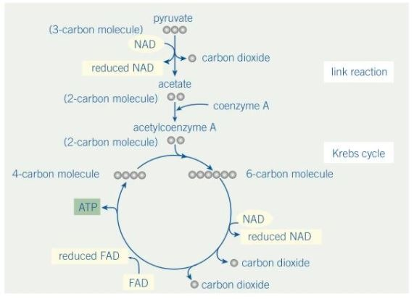
Link Reaction and Krebs Cycle Diagram
All 6 carbons from the glucose have been released as CO₂
Where does the energy come from?

Slide 7
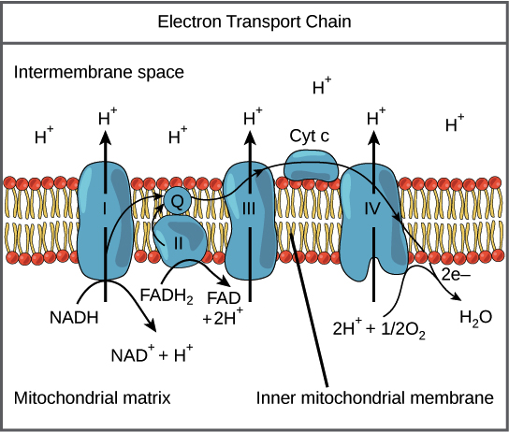
Oxidative Phosphorylation: ETC
In inner membrane of mitochondria (mitochondria is double membraned organelle) there is an electron transport chain (just like in thylakoid membranes) consisting of transmembrane proteins
Powered by electrons from carriers (NADH and FADH₂) -> powers pumping of hydrogen ions across membrane from matrix to intermembrane space
Electrons are attracted to the final electron acceptor, the electronegative O₂, combination forms water
Why oxygen is necessary for cellular respiration
Notes:
2 membrane = endosymbiotic, taken up after oxygen in atmosphere
More energy from NADH (3 vs 2 ATP) because enters ETC sooner = enters at higher energy level and pumps more protons

Slide 8
Oxidative Phosphorylation: Chemiosmosis
The hydrogen ions in the intermembrane space form an electrochemical gradient, can’t cross membrane because they are ions, but want to follow concentration gradient = have to go through the transmembrane protein ATP synthase
As protons travel through ATP synthase, it phosphorylates ADP into ATP
Oxidative phosphorylation = ETC + chemiosmosis
Total production: around 34 ATP, 6 H₂O
Notes:
NAD+ and FAD go back to be reused
H+ now back in matrix

Slide 9
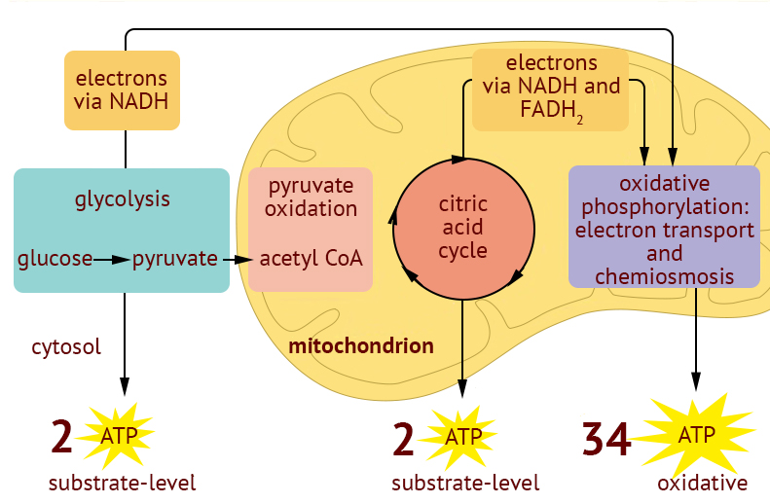
Cellular Respiration Overview
C₆H₁₂O₆ + 6O₂ --> 6CO₂ + 6H₂O + Chemical Energy (686 kcal/mol of glucose)
Total production: about 38 ATP (ranges from 30-38, different sources say different things, usually 36-38 range)

Slide 10
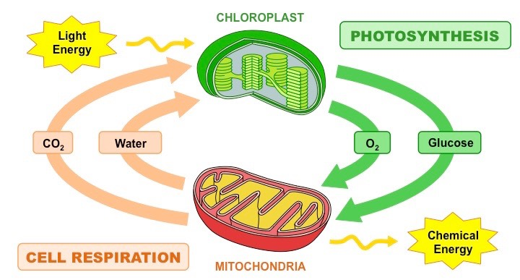
Comparison to Photosynthesis
Equations are inverse
One produces oxygen, one consumes
One produces carbon dioxide, one consumes
Notes:
Evolution

Slide 11
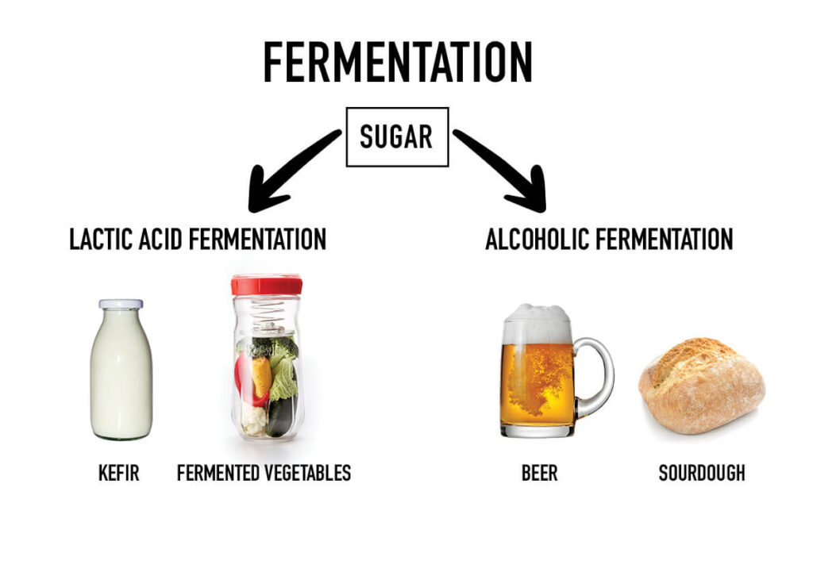
Anaerobic Respiration (Fermentation)
Fermentation uses the early evolved anaerobic process of glycolysis – gives little energy
Only issue is that NAD+ carriers get filled with electrons, not glycolysis can’t repeat
Alcohol fermentation – pyruvate converted to ethanol, releases carbon dioxide, and oxidizes NADH (like yeast)
Lactic acid fermentation – forms lactate as waste product, oxidizes NADH
Used in humans when out of breath
Notes:
Why you cramp when running

Slide 12
Cellular Respiration Review
Equation: C₆H₁₂O₆ + 6O₂ --> 6CO₂ + 6H₂O + Chemical Energy (686 kcal/mol of glucose)
Glycolysis
Krebs Cycle
Oxidative Phosphorylation
Fermentation

