Slide 1


AP Bio
Unit 4:
Cell Communication and Cell Cycle

Slide 2
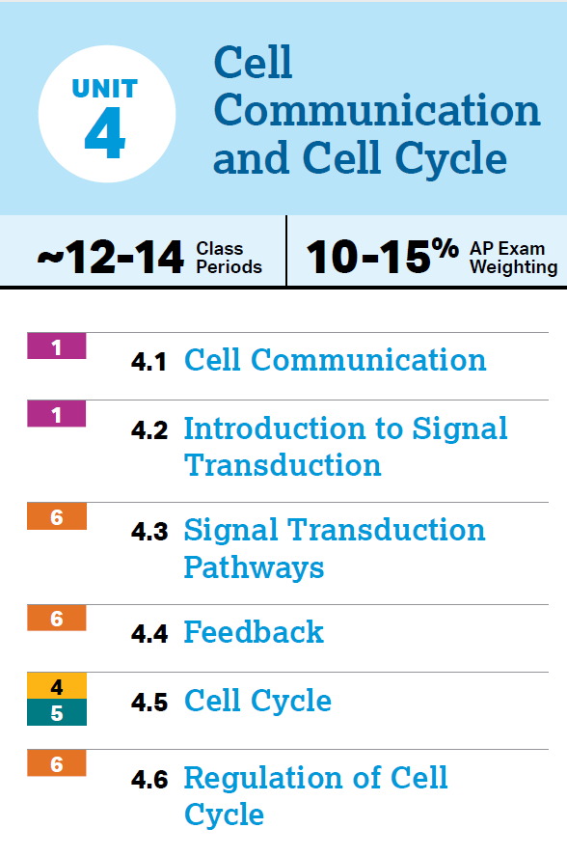
Unit 4: What You Need To Know
Signal Transduction Pathway
Types of receptors
Types of signaling pathways
How changes of the pathway affect the response
Positive vs negative feedback
Cell cycle
Mitosis
Regulation of cell cycle

Slide 3
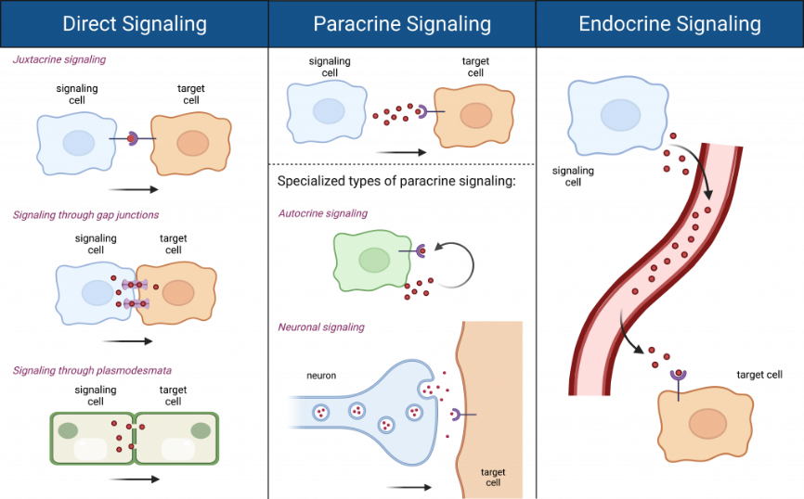
Types of Cell Signaling (4.1)
Autocrine – chemical signal affects sender
Juxtacrine – signals that travel by cell contact
Plasmodesmata, gap junctions
Immune system – helper T cells are trained through contact, killer T cells kill infected cells through contact
Paracrine – short distances (coordinate with neighbors)
Quorum sensing – bacteria determine population density of the species
Synaptic signaling – release of neurotransmitters between neurons
Endocrine – long distance, through bloodstream, hormones
Insulin – regulates blood glucose levels
Estrogen + Testosterone
Notes:
Ligand, autocrine, paracrine, juxtacrine, endocrine

Slide 4
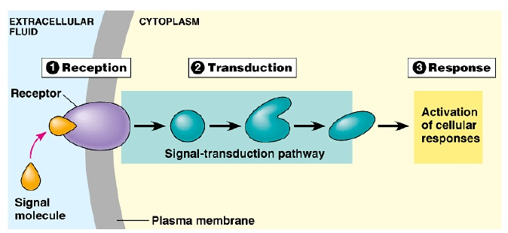
Signal Transduction Pathway (4.2)
Signal transduction pathway – the stages in which cells receive, amplify, and respond to chemical signal (ligands)
Bind only to specific target cells that have receptors that can take in ligand shape

Slide 5
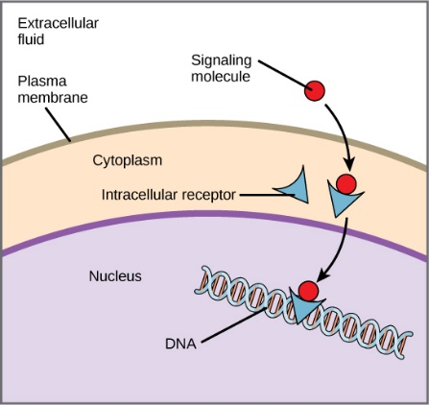
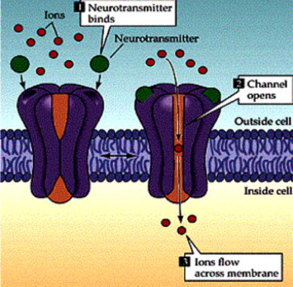
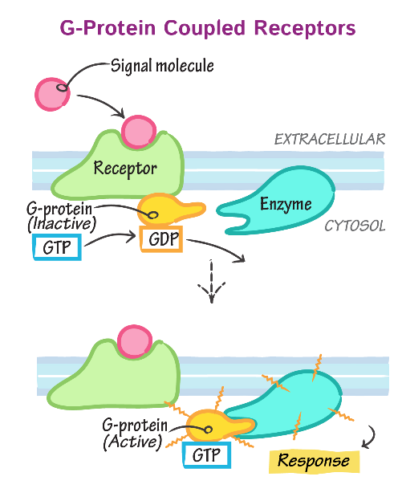
Types of Receptors (4.2)
Intracellular – bound to by steroid hormones –> gene expression
Cell Surface Receptors – binding outside of the cell with an intracellular domain
Ligand-gated ion channels – when ligand attaches, gate opens (/closes) allowing ions to pass through
G protein-coupled receptors – transmit signal through G protein – bind GTP (active) or hydrolyzed to GDP (inactive) – ligand activates
Receptor tyrosine kinases – enzyme linked receptor that transfers phosphate groups to tyrosine (bind to growth factors)
Notes:
Steroid = hydrophobic
Steroid and intracellular
Cell surface – ligand gated ion channel, g coupled protein receptor, receptor tyrosine kinases

Slide 6
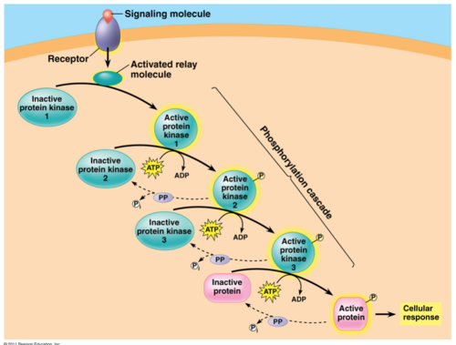
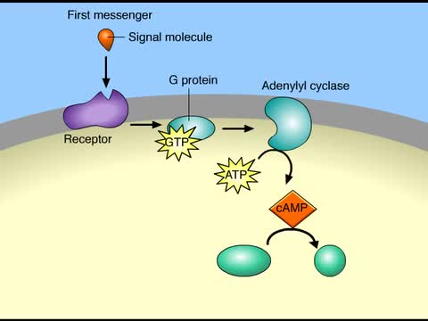
Phosphorylation Cascade + Second Messengers (4.2)
Signal now amplified and carried through cell
Phosphorylation cascade – one way to activate proteins in a chain, through addition of phosphate group (adds negativity)
Transfer of phosphate is catalyzed by kinase
Removed by phosphatases
Second messengers – small non-protein molecules that pass along the signal
Calcium ions (Ca²⁺) – not many in cell, proteins have binding sites for the ions -> changes their shape
Cyclic adenosine monophosphate (cyclic AMP or cAMP) – can activate protein kinase A (PKA), phosphorylating its targets
Notes:
Kinase, phosphatase
cAMP, calcium ions

Slide 7
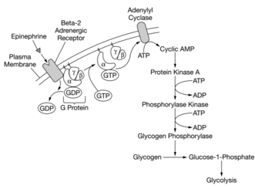
Cellular Response to Signal Transduction (4.3)
Gene expression: many pathways ultimately regulate protein synthesis (transcription factors)
Changes in environment resulting in signal transduction can alter phenotype
Metabolic response: in cytoplasm pathways affect protein activity (enzymes)
Apoptosis – programmed cell death, systematically and prevents damage to neighboring cells
Epinephrine = adrenaline – stimulates break down of glycogen to increase blood glucose as part of “flight or fight”
Notes:
Gene expression
Metabolic response
Apoptosis
Apoptosis triggered by signals that activate cascade of suicide proteins - necessary for nervous, immune system, morphogenesis of hands and feet

Slide 8
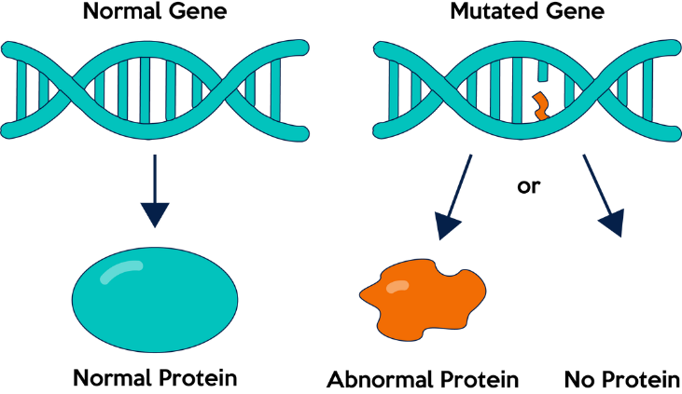
Changes in Signal Transduction Pathways (4.3)
pH and temperature can affect the proteins – receptors, kinases –> denaturation
Mutations in genes can also affect the proteins of the pathway (change in the DNA sequence) -> changes protein synthesis and what proteins are being produced
Made out of enzymes – can be inhibited (either in active site or allosteric site) – inhibitor/activator
Notes:
Mutations, denaturation
Inhibitors and activators

Slide 9
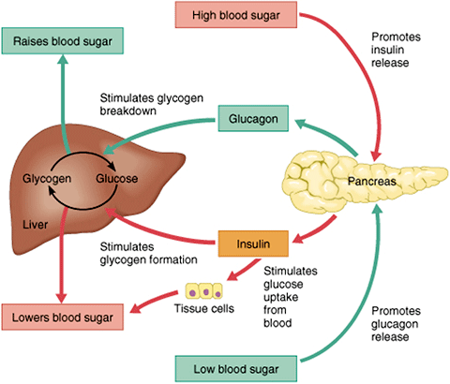
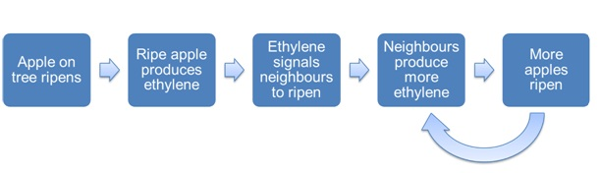
Feedback (4.4)
Homeostasis – the tendency to resist change in order to maintain a steady and stable environment
Negative feedback loops – oppose stimulus
Most systems have two negative loops
Positive feedback loops amplify the signal and move away from the set point
Onset of labor in childbirth
Ripening of fruit (ethylene)
Notes:
Homeostasis
Negative feedback – insulin, glucagon, diabetes
Positive feedback – ethylene, childbirth
Insulin – causes blood sugar to be taken up, glucose converted to glycogen
Glucagon – causes glycogen to be released to increase blood sugar
Diabetes = not enough insulin production or body doesn’t react to it -> cells don’t get fuel, increased urination and thirst

Slide 10
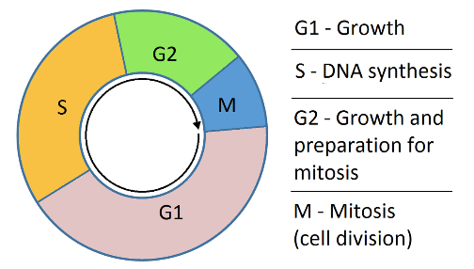
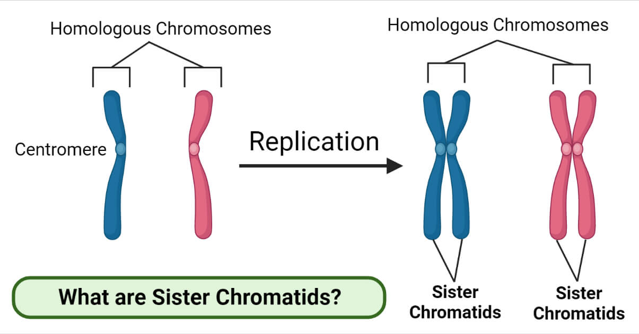
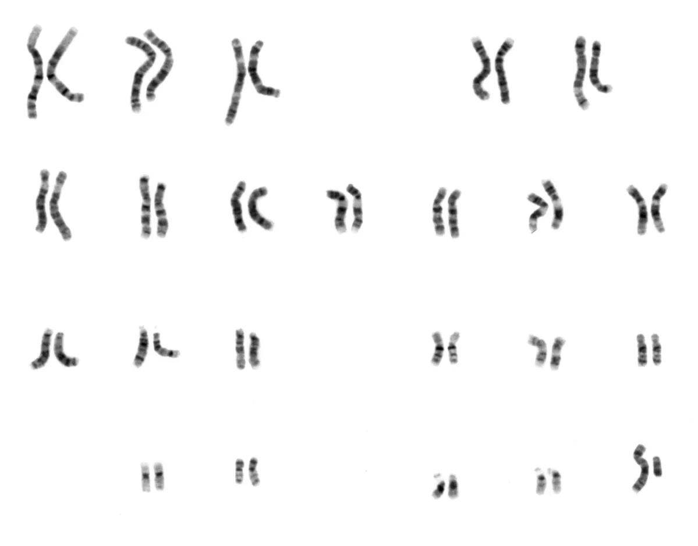
Cell Cycle (4.5)
Cell cycle – the life of a cell from formation (from a dividing parent cell) until it divides itself
90% of the cell cycle (which doesn’t involve dividing) is known as interphase
G1 phase – cell grows and carries out cellular function
S phase – duplicates its chromosomes (its genome – genetic information) - each chromosome will become two sister chromatids attached by a centromere
G2 phase – cell continues growth
Notes:
Interphase, g1, s phase, g2
G0
Diploid, haploid, centromere, sister chromatids, chromosomes
Somatic cells – 46 chromosomes (23 pairs)

Slide 11
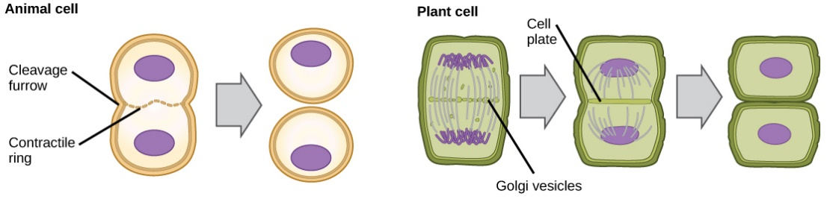
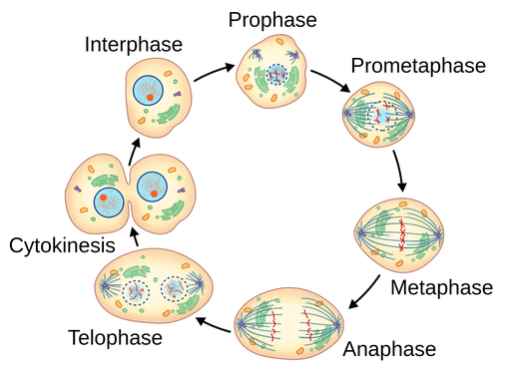
Mitosis (4.5)
Mitosis is involved in growth, tissue repair, and asexual reproduction
Mitosis – the division of the cell’s nucleus (followed by cytokinesis – division of the cell’s cytoplasm)
Cytokinesis happens via cleavage furrow or cell plate
Binary fission – prokaryote division; 1 strand of DNA duplicates, then division
Prophase – chromatin -> chromosomes, nucleus fragments, mitotic spindle forms (microtubules from spindle attach to kinetochores of chromatids)
Metaphase – all chromosomes are lined up in center at metaphase plate
Anaphase – sister chromatids get separated by the microtubules
Telophase – Nuclei reform
Notes:
Mitosis, cytokinesis
Binary fission
PMAT mitotic spindles, kinetochore

Slide 12
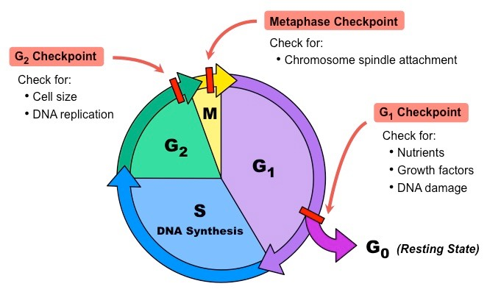
Regulation of Cell Cycle (4.6)
There are certain checkpoints during the cell cycle that check whether certain conditions are met before the next stage can occur
G1 phase checkpoint – is the DNA correct; can the cell keep growing and have enough energy to continue in the cycle?
G2 phase checkpoint – has all DNA been replicated properly?
M phase checkpoint – have all chromatids been attached to microtubules properly?
If G1 checkpoint failed, cell gets sent to G0 - where it no longer moves through the cell cycle
Some cells can leave G0 and continue through the cell cycle if necessary (liver cells) while others can’t (muscle, neural)
Notes:
G1, s, g2 checkpoints
CDK
Density dependent
Anchorage
Growth factors

Slide 13
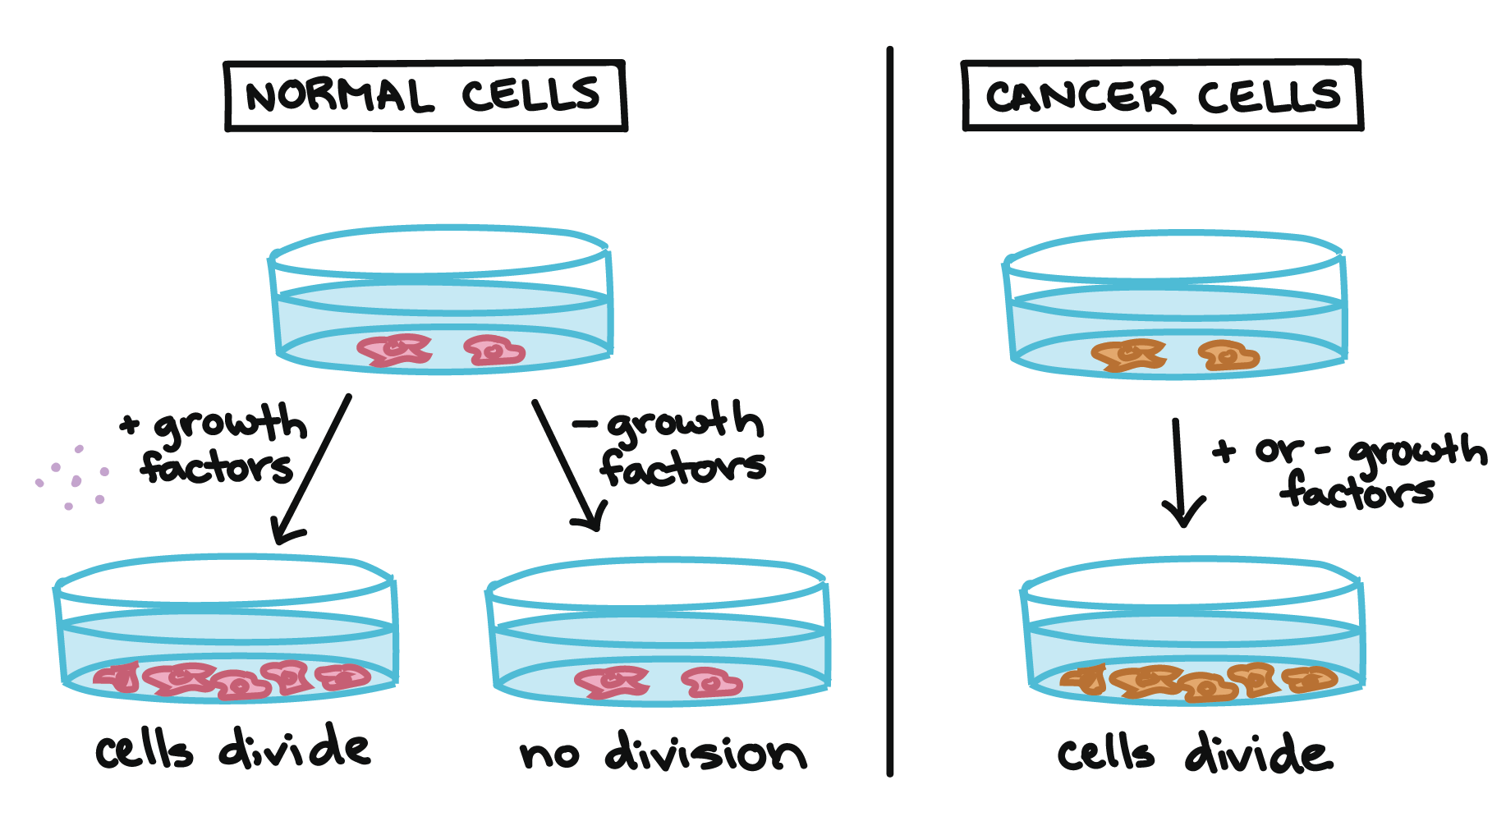
Cancer (4.6)
Cell cycle controlled by cyclin-dependent kinases – active only when connected to cyclin proteins
If growth factors are present, then other cells will be stimulated to divide – enough nutrients
Density-dependent inhibition – crowded cells stop dividing
Anchorage dependency – normal cells must be anchored to something to divide
Cancer cells have no limits on division – are not density dependent, don’t care about anchorage, will divide even if DNA mutations, will steal resources from other cells to divide
Tumor – mass of abnormal cells within normal tissue – benign or malignant
Metastasis – when malignant tumor travels
Notes:
Tumor, benign, malignant, metastasis

