Slide 1


AP BIO
TOPIC 4.1:
Cell Communication
Notes:
Welcome to AP Bio with AP Study! For most of you, this will be your first lesson. If you want some more background on chemistry before starting this unit, we have another video to help with that. Today we will be covering topic 1.1, all about water.

Slide 2
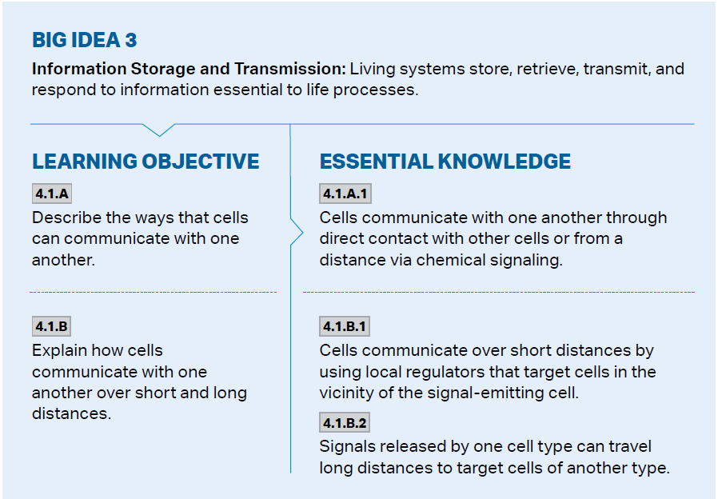
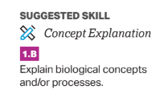
Objectives
Notes:
The main objectives of this lesson are the hydrogen bonds which form water molecules, and the reasons why life depends on water. The college board wants you to be able to use your knowledge of water and its properties to describe or model it.

Slide 3
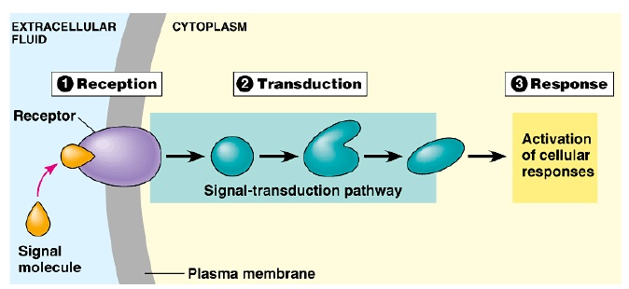
Cellular Communication
Signal Transduction Pathway – reception, transduction, response
Cells have receptor proteins which fit a specific type of signaling molecule (ligand)
When the ligand enters the receptor, reactions begin to transfer the signal to the nucleus (transduction)
The nucleus then initiates a response
Notes:
The binding of signaling molecule changes intracellular domain of receptor protein allowing transduction to start – converts signal to something that can bring about cellular response

Slide 4
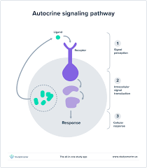
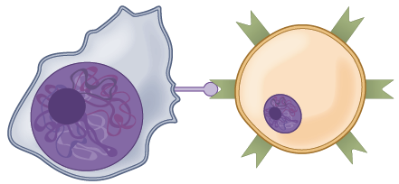
Autocrine and Juxtacrine Signaling
Autocrine – chemical signal affects the cell it was sent out from
Helps reinforce role of the cell during development, plays key role in metastasis
Juxtacrine – signals that travel by cell-to-cell contact
Plasmodesmata, gap junctions – allow intracellular mediators to diffuse between the cells, creates coordination between cells
Two cells can also bind due to complementary proteins -> one gets changed – used by immune cells to mark “self” cells
Notes:
In the immune system, helper T cells are trained by contact with antigen-presenting cells (APCs), killer T cells kill infected cells with direct contact

Slide 5
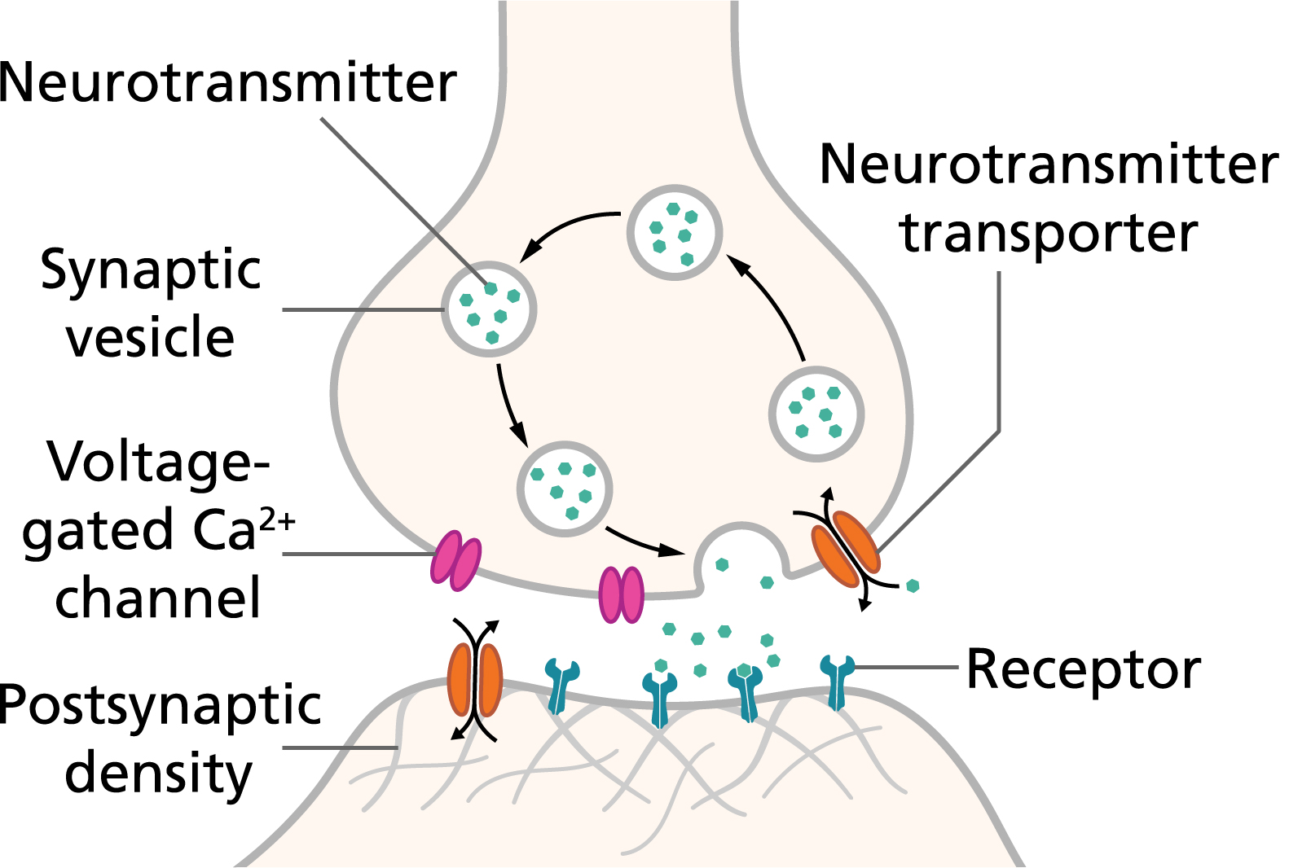
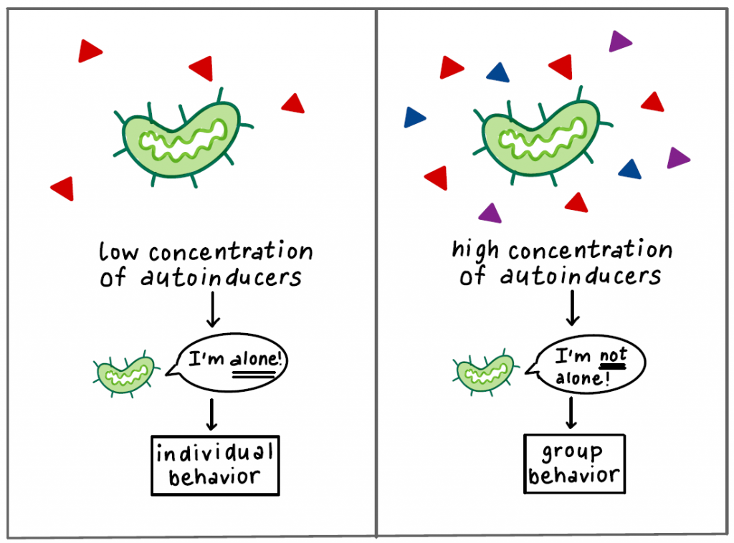
Paracrine Signaling
Paracrine – communication across short distances (locally coordinate activities with neighbors)
Synaptic signaling – release of ligands called neurotransmitters between neurons – when received cause change of electric potential
Quorum sensing – bacteria release autoinducers to determine pop. density of the species in local area
Morphogens – signaling molecules in embryonic development – influence cell behavior of embryo based on their concentration in different areas

Slide 6
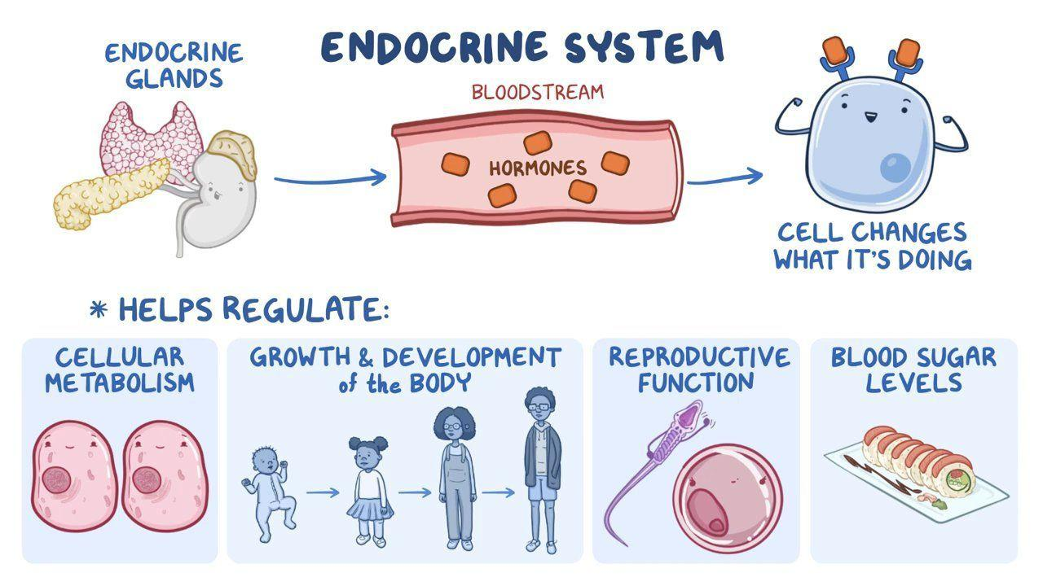
Endocrine Signaling
Endocrine – long distance cell communication through the use of hormones – travel through bloodstream
Insulin (pancreas) – regulates glucose levels – when a lot of glucose, insulin released, promoting storage of glucose as glycogen in the liver and glucose importations from the bloodstream
Human growth hormone – grows skeleton and cartilage, promotes cell division
Thyroid hormones
Estrogen + Testosterone

Slide 7
Cell Communication Review
Steps of the signal transduction pathway
Autocrine, juxtacrine, paracrine, and endocrine signaling pathways
Notes:
Basic review
Next up: Carbon and its effects on life

