Slide 1


AP BIO
TOPIC 4.2:
Introduction to Signal Transduction

Slide 2
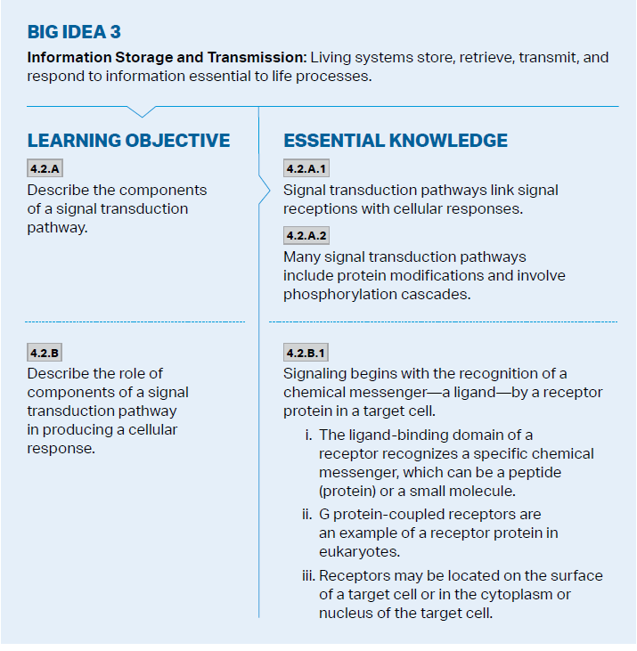
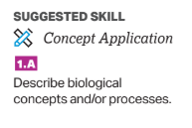
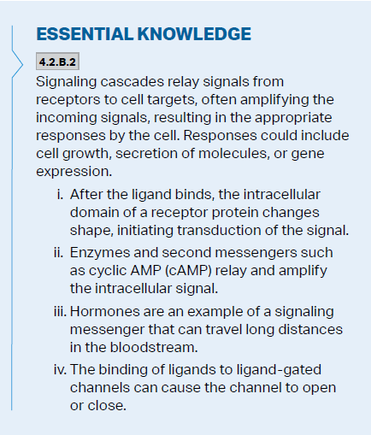
Objectives

Slide 3
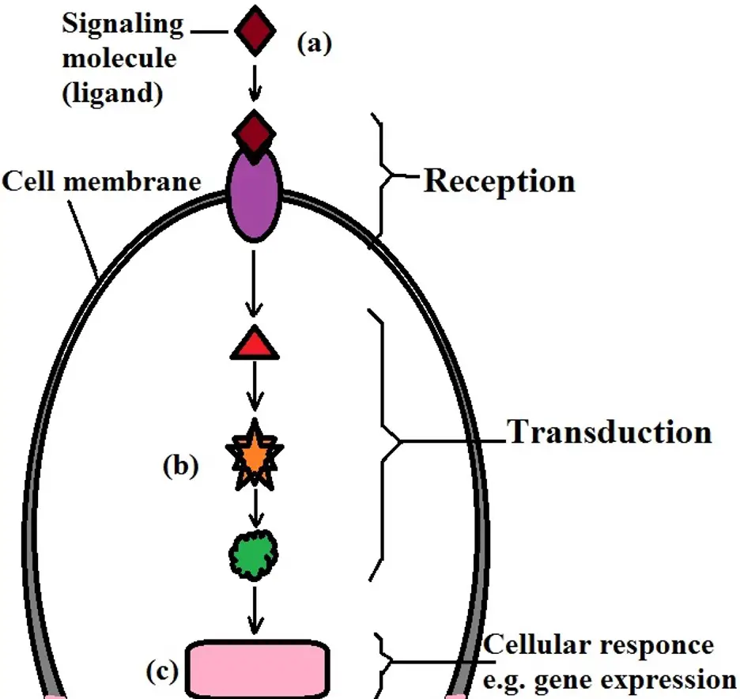
Signal Transduction Pathway Review
Signal Transduction Pathway: reception, transduction, response
Ligand can only bind to very specific receptor on target cell (only target cell expresses the genes to make the receptor protein)

Slide 4
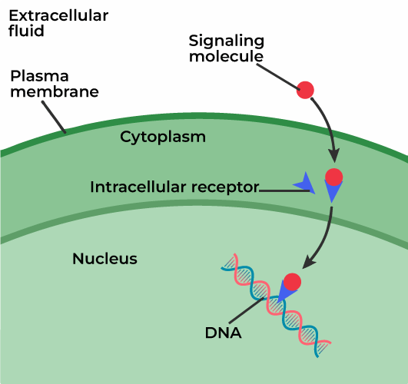
Types of Receptors
Intracellular – bound to by small hydrophobic ligands (steroid hormones) – directly affect nucleus and gene expression
Cell Surface Receptors – binding outside of the cell (hydrophilic, charged ligands - peptide), has intracellular domain that transmits signal
Ligand-gated ion channels – when ligand attaches, gate opens (/closes) allowing ions to pass through
G protein-coupled receptors – transmit signal through G protein – bind GTP (active) or hydrolyzed to GDP (inactive) – ligand activates
Receptor tyrosine kinases – enzyme linked receptor that transfers phosphate groups to tyrosine (bind to growth factors)
Notes:
Ligand gated – voltage-based channels, ion binding enzymes
Enzyme linked receptor = receptor acts on enzyme
Kinase = enzyme that phosphorylates

Slide 5
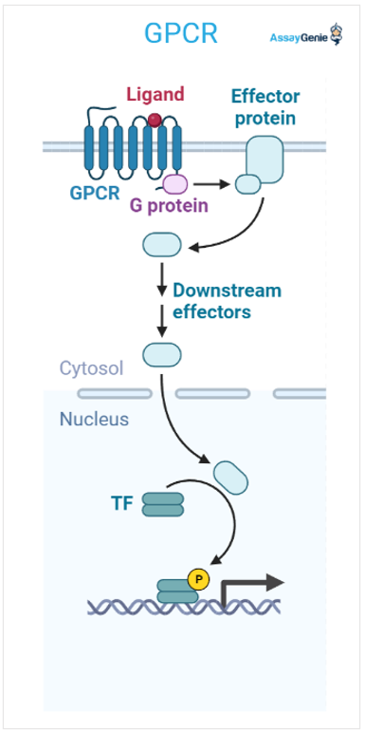
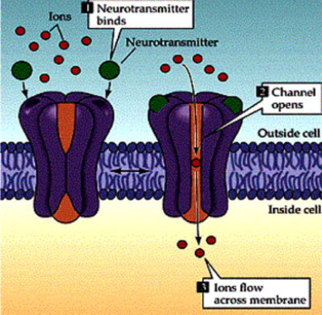
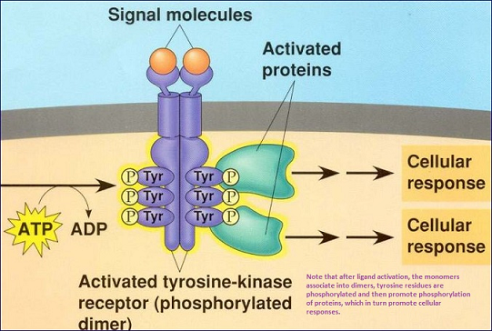
Types of Receptors Visual
Notes:
Tyrosine receptors dimerize

Slide 6
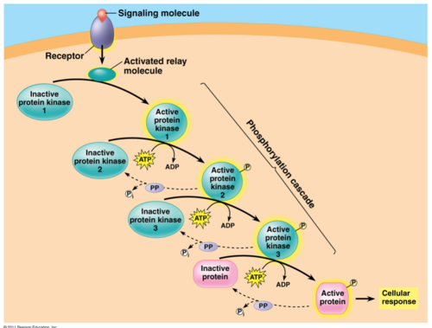
Phosphorylation Cascade
Binding of a ligand will change the intracellular domain, allowing a pathway to begin that will relay the signal to its final destination
Phosphorylation cascade – one way to activate proteins in a chain, through addition of phosphate group (adds large negativity)
Transfer of phosphate is catalyzed by kinase
Removed by phosphatases
Amplifies the signal
Notes:
Phosphorylation can stimulate (usually) but some deactivates

Slide 7
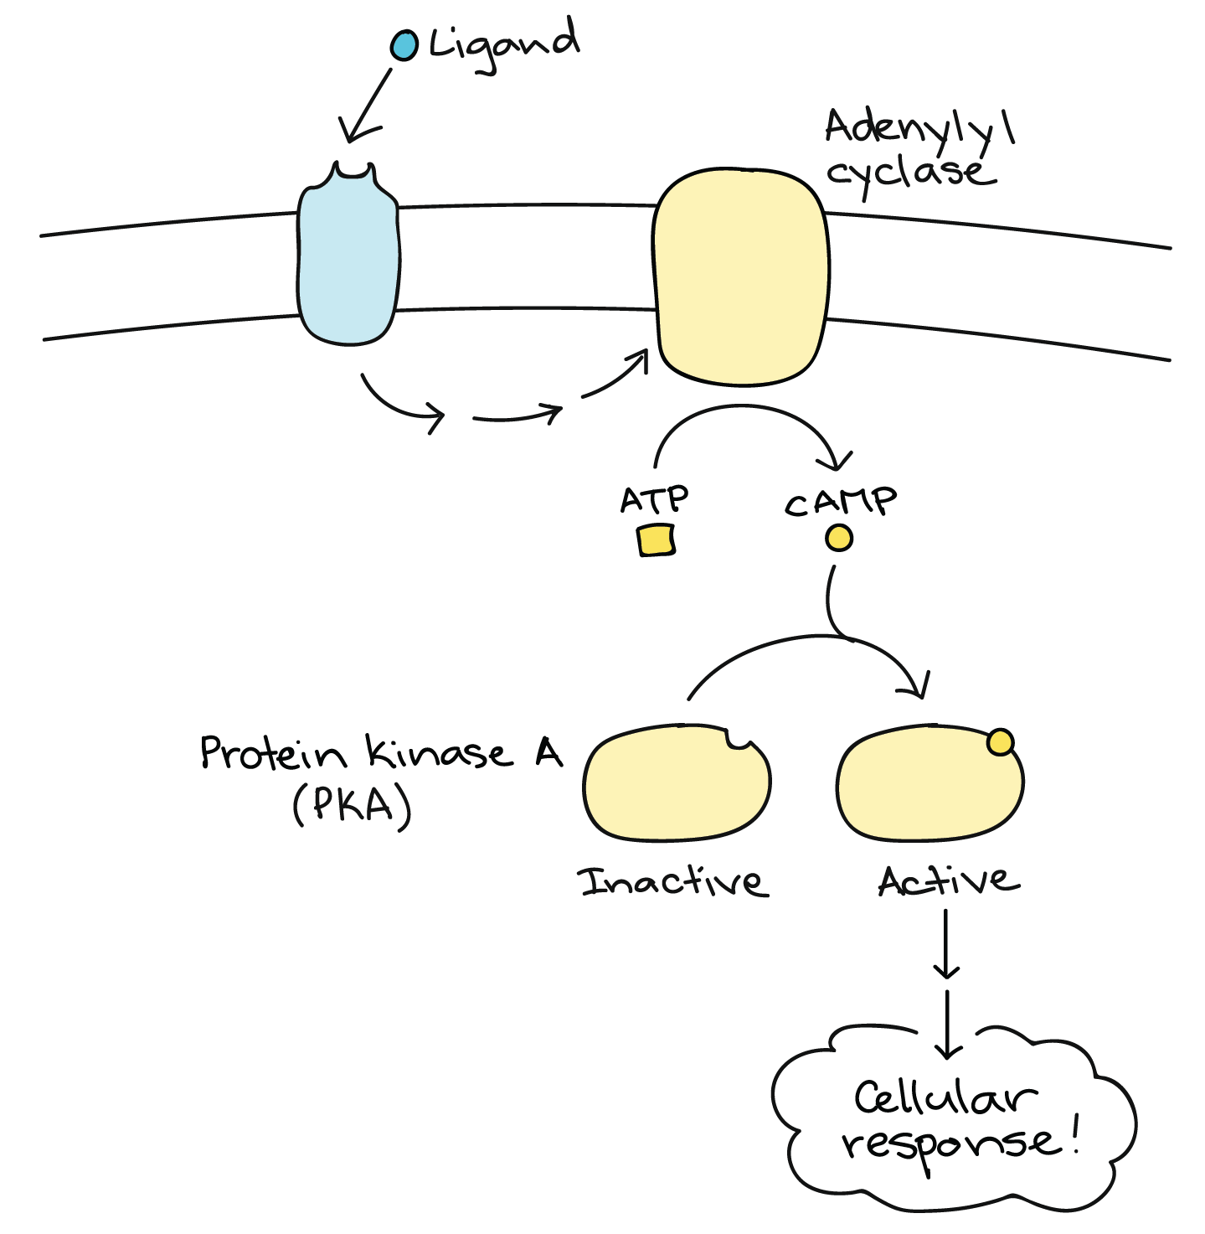
Second Messengers
Second messengers – small non-protein molecules that pass along the signal
Calcium ions (Ca²⁺) – not many in cell, ligand-gated ion channel allows in, proteins have binding sites for the ions -> changes their shape
Cyclic adenosine monophosphate (cyclic AMP or cAMP) – can activate protein kinase A (PKA), phosphorylating its targets
Notes:
Adenylyl cyclase converts ATP to cAMP
PKA can have different targets = diff results

Slide 8
Introduction to Signal Transduction Review
Types of signal receptors
Types of transduction pathways

