Slide 1


AP BIO
TOPIC 4.3:
Signal Transduction

Slide 2
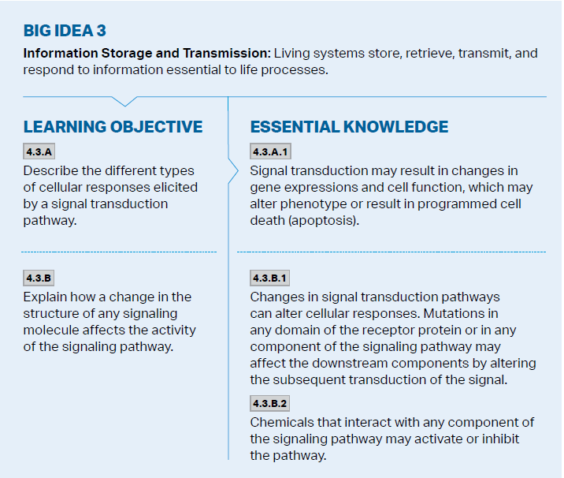
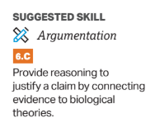
Objectives

Slide 3
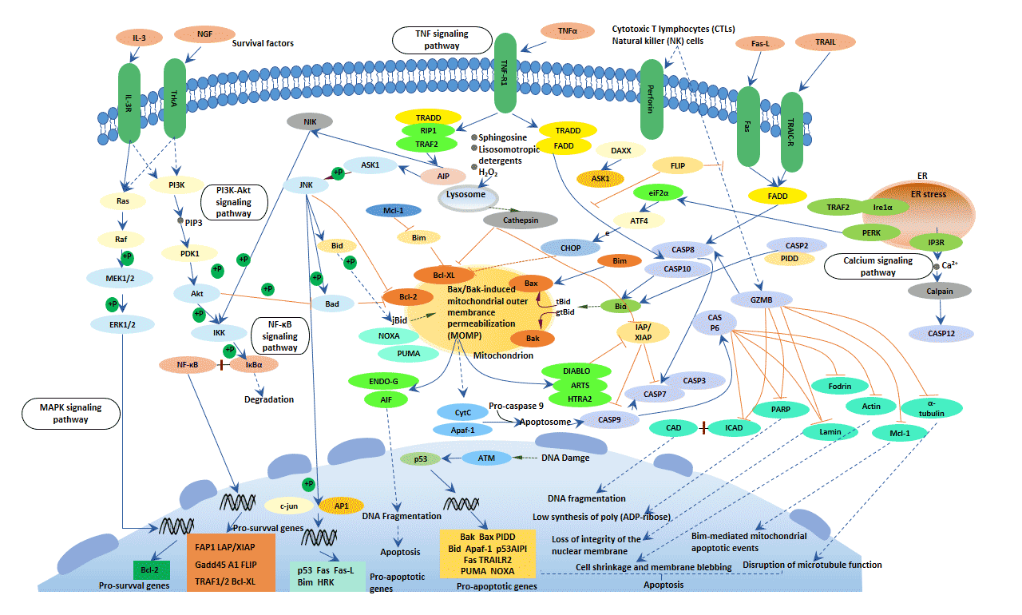
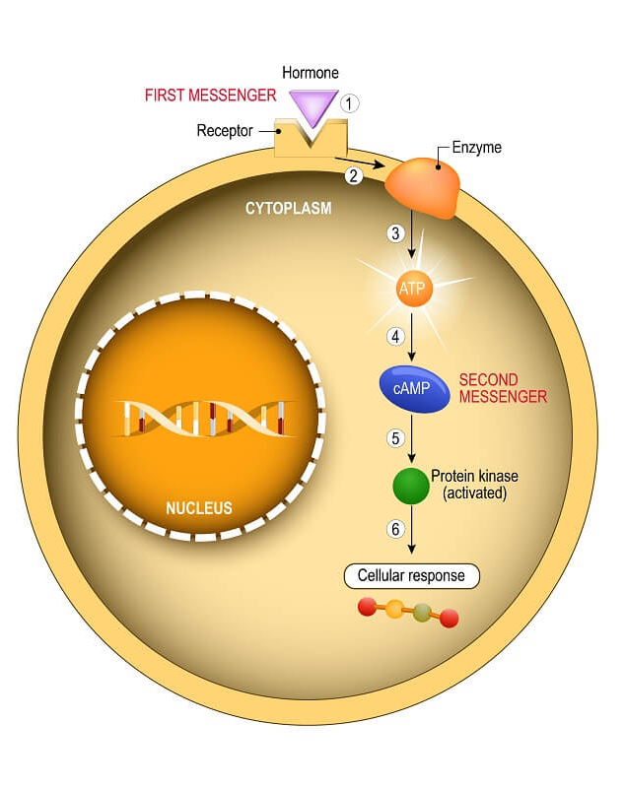
Effects of Signal Transduction
Signal Transduction Pathway: reception, transduction, response
Gene expression: many pathways ultimately regulate protein synthesis (transcription factors)
Changes in environment resulting in signal transduction can alter phenotype
Metabolic response: in cytoplasm pathways affect protein activity (enzymes)
Apoptosis – programmed cell death, systematically and prevents damage to neighboring cells
Notes:
Receptors bind ligand inside or outside of the cell, signal is then amplified and relayed by phosphorylation or second messengers
Turn specific genes on or off
Affect protein activity = regulation
Apoptosis triggered by signals that activate cascade of suicide proteins - necessary for nervous, immune system, morphogenesis of hands and feet

Slide 4
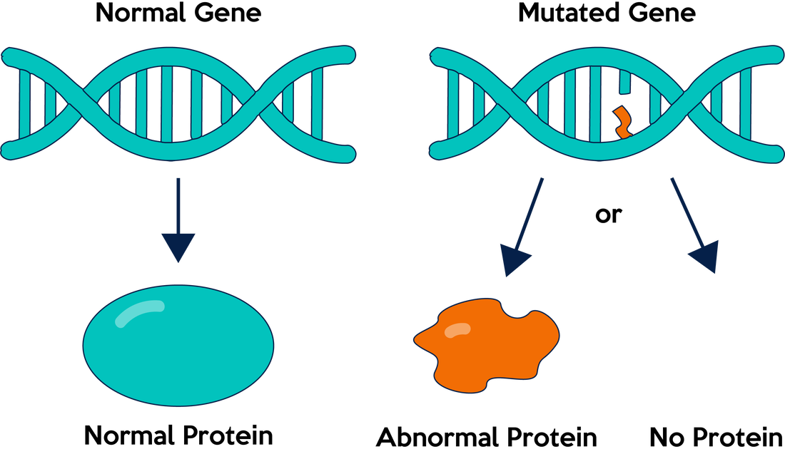

Environmental and Genetic Influences on Signal Transduction
Signal Transduction Pathway is made up of proteins – receptors, cascade
pH and temperature can affect the proteins – denaturation
Mutations in genes can also affect the proteins of the pathway (change in the DNA sequence) -> changes protein synthesis and what proteins are being produced

Slide 5

Inhibitors and Activators of Signal Transduction
Signal Transduction Pathways are made out of enzymes – can be inhibited (either in active site or allosteric site) - inhibitor
Can also activate elements of the pathway - activator
Insecticides activates rapid firing of neurons in insect’s brain
Notes:
Competitive vs noncompetitive
Draw enzyme inhibition

Slide 6
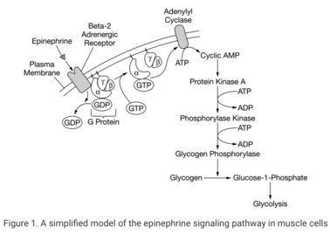

Example of a Pathway: Epinephrine
Epinephrine = adrenaline – stimulates break down of glycogen to increase blood glucose as part of “flight or fight”
Example of signal transduction response to environment
cyclic AMP phosphodiesterase
Notes:
Epinephrine (hormone) binds
Causes phosphorylation of GTP (G protein coupled receptor) -> activates adenylyl cyclase
cAMP (second messenger) produced from ATP -> activates protein kinase A (PKA)
Begins phosphorylation cascade
Activates glycogen phosphorylase which breaks down glycogen into glucose
Body now has energy and is ready for fight/flight
“enzymes activating other enzymes”
“cyclase accelerates production of second messenger”
“catabolic process of energy release”
cyclic AMP phosphodiesterase changes cAMP to other – if inhibited

Slide 7
Signal Transduction Review
Effects of signal transduction: apoptosis, change in phenotype, gene expression
Be able to identify parts of a signal transduction pathway, justify predictions, and answer questions
Mutations can affect signal transduction pathways
Inhibitors and activators can affect signal transduction pathways

