Slide 1


AP BIO
TOPIC 4.4:
Feedback

Slide 2
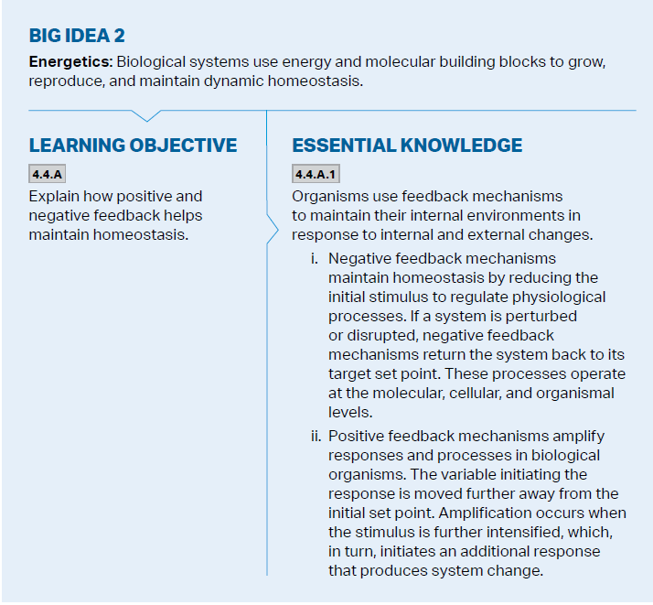
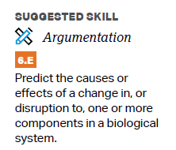
Objectives

Slide 3
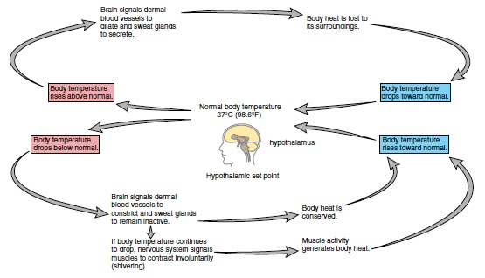
Homeostasis and Negative Feedback
Homeostasis – the tendency to resist change in order to maintain a steady and stable environment
Negative feedback loops – counteract changes of values from their set points – oppose stimulus
Most systems have two negative loops
Can affect behavior
Notes:
Too high vs too low
Enzymes also use feedback inhibition – happens at molecular level

Slide 4
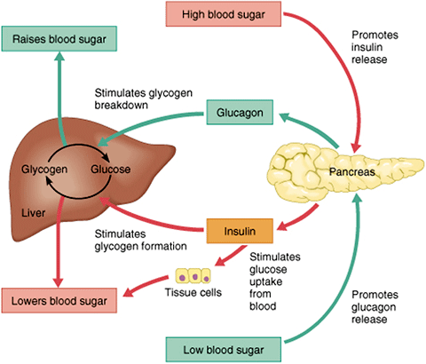
Control of Blood Sugar
Insulin – causes blood sugar to be taken up, glucose converted to glycogen
Glucagon – causes glycogen to be released to increase blood sugar
Diabetes = not enough insulin production or body doesn’t react to it -> cells don’t get fuel, increased urination and thirst

Slide 5
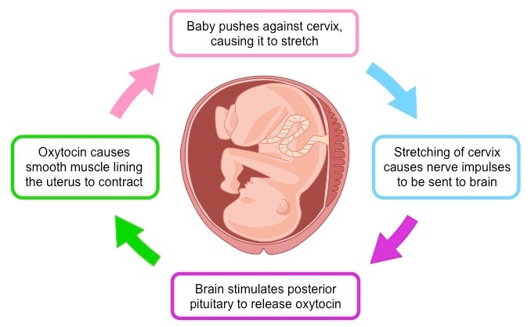
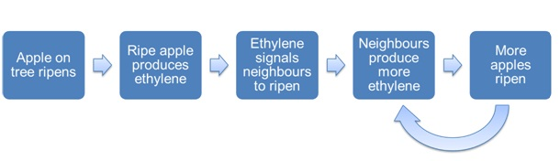
Positive Feedback
Positive feedback loops amplify the signal and move away from the set point
Onset of labor in childbirth
Ripening of fruit (ethylene)

Slide 6
Feedback Review
What is homeostasis?
Negative feedback
Positive feedback

