Slide 1


AP BIO
TOPIC 4.5:
Cell Cycle

Slide 2
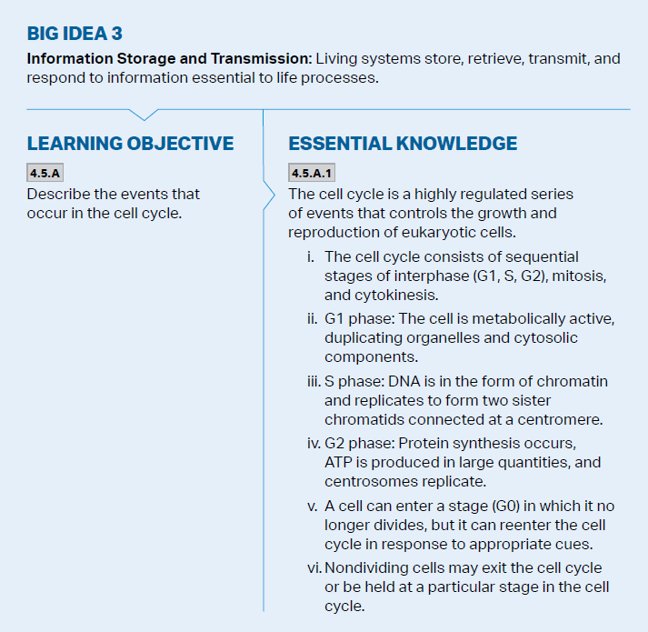
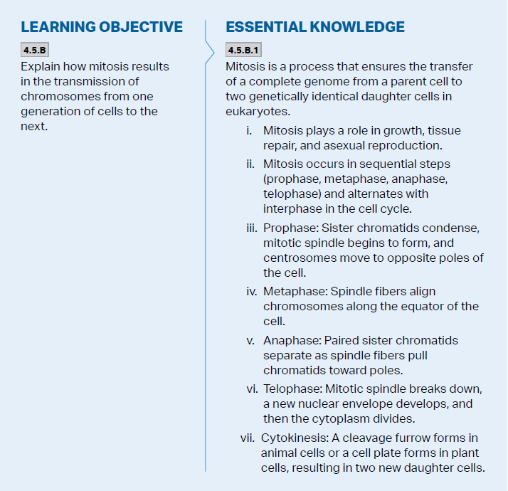
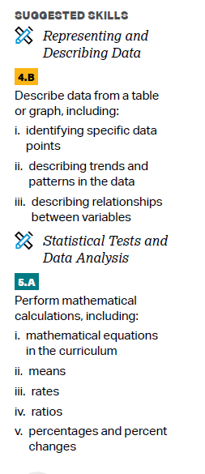
Objectives

Slide 3
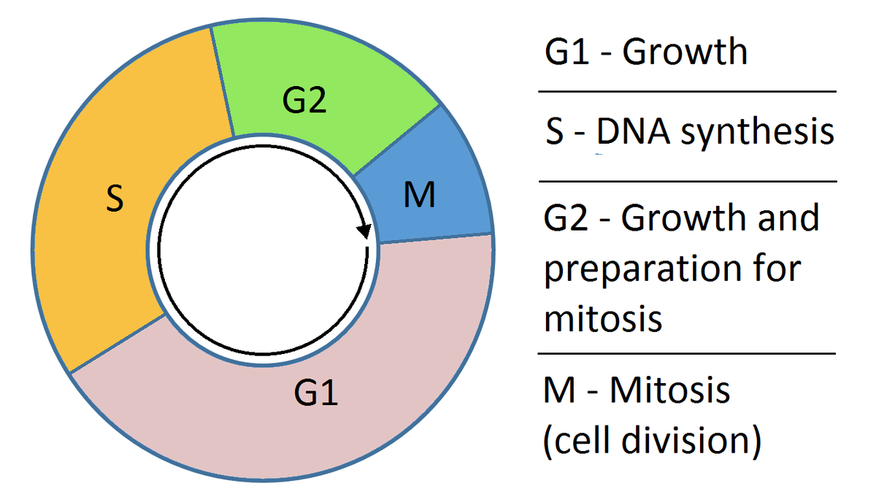
Cell Cycle
Cell cycle – the life of a cell from formation (from a dividing parent cell) until it divides itself
90% of the cell cycle (which doesn’t involve dividing) is known as interphase
G1 phase – cell grows and carries out cellular function
S phase – duplicates its chromosomes (its genome – genetic information)
G2 phase – cell continues growth
The cell needs to have enough resources to double all of its organelles in preparation for division and synthesize proteins

Slide 4
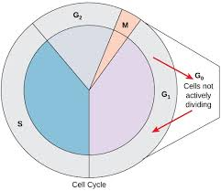
G0
A cell can enter G0, where it no longer moves through the cell cycle
Some cells can leave G0 and continue through the cell cycle if necessary (liver cells)
Muscle cells and neurons

Slide 5
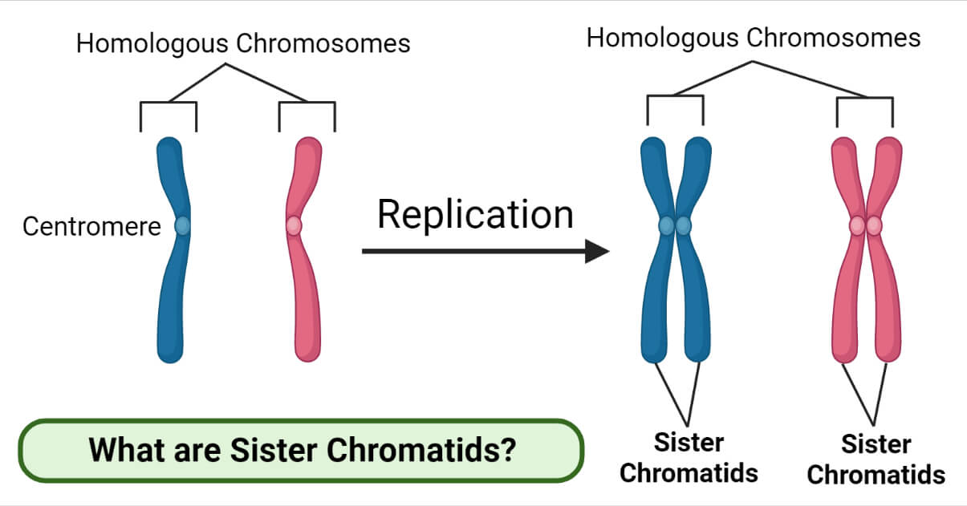
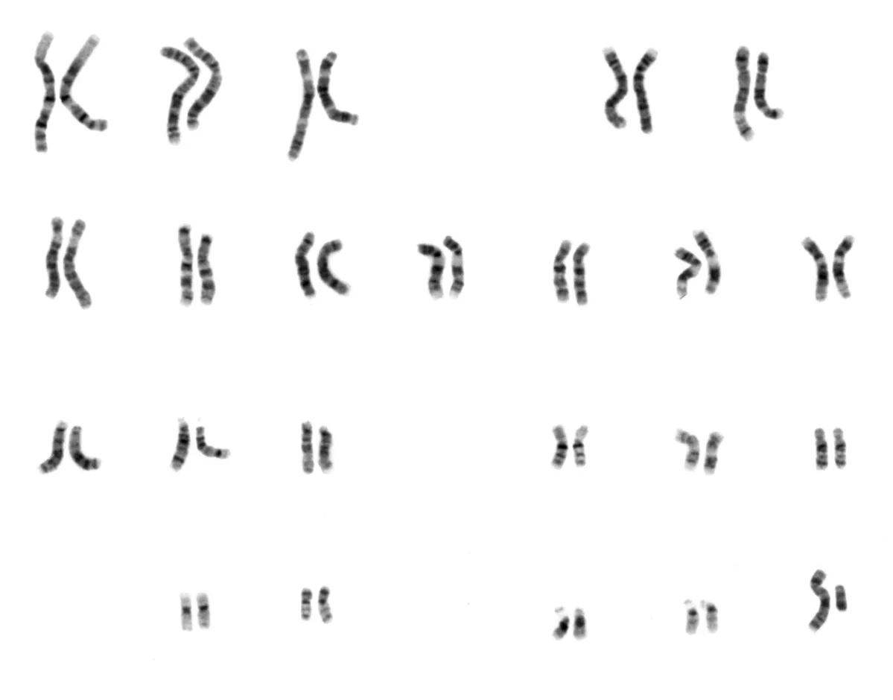
DNA Replication
Mitosis is involved in growth, tissue repair, and asexual reproduction (forming an exact copy of parent)
Human somatic cells (non sex cells) all have 46 chromosomes (diploid cell) -> cells that emerge from mitosis will also have 46
Sex cells (gametes) have 23 chromosomes – haploid cells
During S phase, each chromosome will become two sister chromatids attached by a centromere
Notes:
Chromosome has two chromosomes which become technically 4 sister chromatids

Slide 6
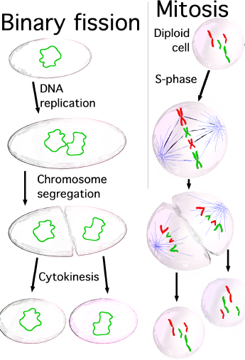
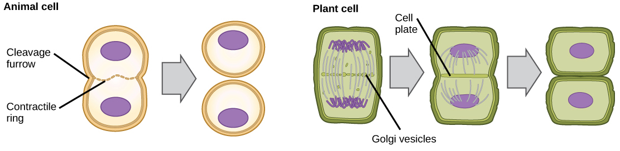
Mitosis: Overview
Mitosis – the division of the cell’s nucleus (followed by cytokinesis – division of the cell’s cytoplasm)
Cytokinesis happens via cleavage furrow or cell plate
Binary fission – prokaryotes divide via this method; the one strand of DNA duplicates, cell just elongates and then cytokinesis
Notes:
Cleavage furrow = animal cell, cell plate = plant cell

Slide 7
Mitosis: Steps
Prophase – chromatin -> chromosomes, nucleus fragments, mitotic spindle forms (microtubules from spindle attach to kinetochores of chromatids)
Metaphase – all chromosomes are lined up in center at metaphase plate attached to microtubules
Anaphase – sister chromatids get separated by the microtubules -> two equal genomes on each side of cell
Telophase – Nuclei reform and then cytokinesis
Notes:
PMAT

Slide 8
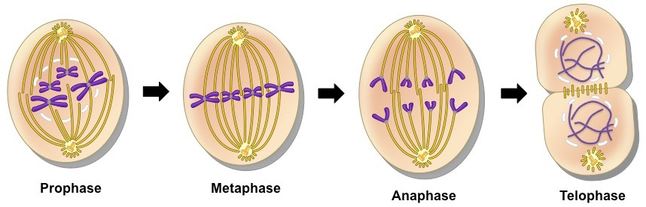
Mitosis: Steps Diagram
Notes:
PMAT

Slide 9
Cell Cycle Review
Cell cycle
G0
Mitosis

