Slide 1


AP BIO
TOPIC 4.6:
Regulation of Cell Cycle

Slide 2
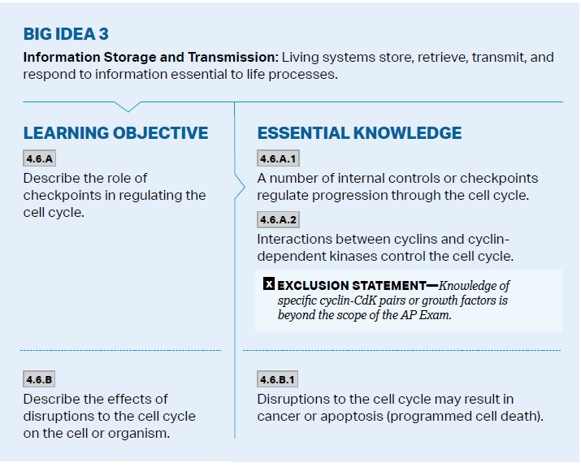
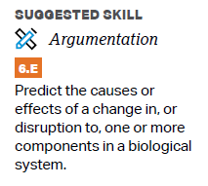
Objectives

Slide 3
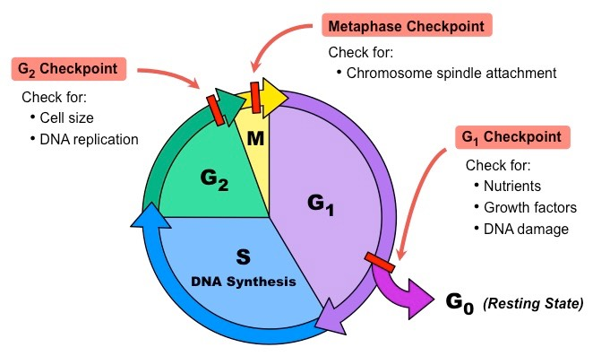
Cell Cycle Control System
There are certain checkpoints during the cell cycle that check whether certain conditions are met before the next stage can occur
G1 phase checkpoint – is the DNA correct; can the cell keep growing and have enough energy to continue in the cycle?
G2 phase checkpoint – has all DNA been replicated properly?
M phase checkpoint – have all chromatids been attached to microtubules properly?
If G1 checkpoint failed, cell gets sent to G0

Slide 4
CDK and Growth Factors
Cell cycle controlled by cyclin-dependent kinases – active only when connected to cyclin proteins
Specific CDK complexes give the go ahead at G1 and G2 checkpoints
If growth factors are present, then other cells will be stimulated to divide – enough nutrients for more cells
Density-dependent inhibition – crowded cells stop dividing
Anchorage dependency – normal cells must be anchored to something to divide

Slide 5
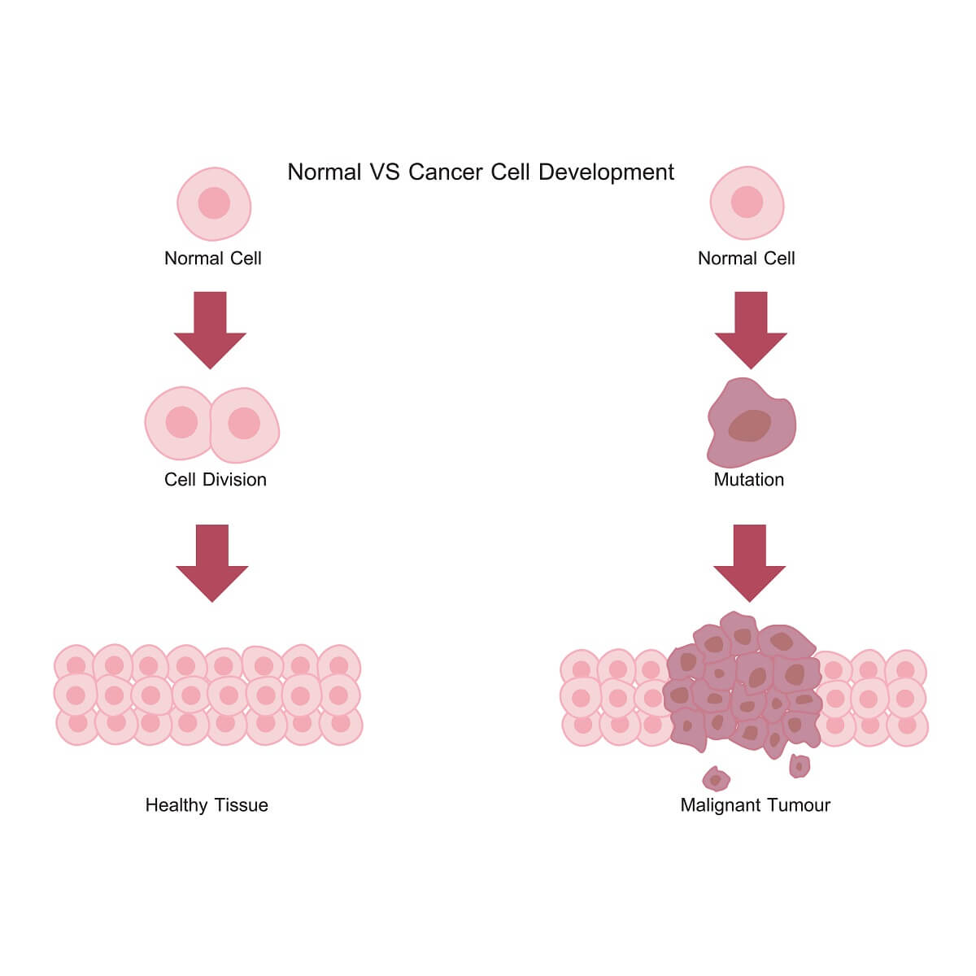
Cancer
Cancer cells have no limits on division – are not density dependent, don’t care about anchorage, will divide even if DNA mutations, will steal resources from other cells to divide
Tumor – mass of abnormal cells within normal tissue
If remain at original site = benign
If can invade and survive at new sites = malignant
Metastasis – when cells separate from malignant tumor and travel to other parts of the body

Slide 6
Regulation of Cell Cycle Review
Checkpoints
CDK Cycle
Cancer cells and why they’re “immortal”

