Slide 1


AP Bio
Unit 5:
Heredity

Slide 2
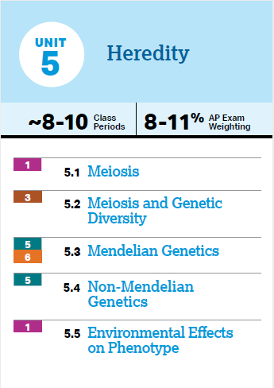
Unit 5: What You Need To Know
Meiosis and how it contributes to genetic variation
Mendelian genetics, laws of independent assortment and segregation
Different forms of dominance, linked genes, sex linked genes, pedigrees
Phenotypic plasticity

Slide 3
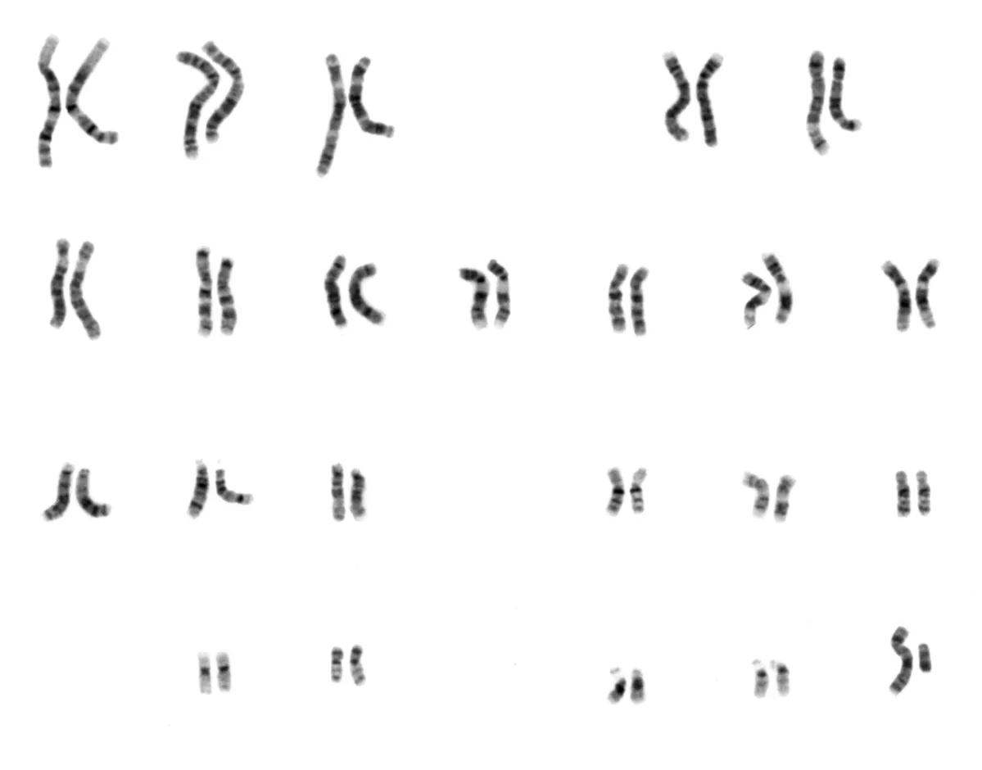
Genes and Chromosomes (5.1)
Genes – segments of DNA that code for heredity (are transferred generationally)
Reproductive cells that transmit genes are gametes (opposed to somatic)
Sexual reproduction – 2 parents contribute genes to the offspring -> genetic variation – egg and sperm come together during fertilization to form a zygote
Homologous chromosomes – similar chromosomes (1 from each parent)
22 pairs of autosomes, 1 pair of sex chromosomes (XY or XX)
Human somatic cells (non sex cells) all have 46 chromosomes (diploid cell) -> cells that emerge from mitosis will also have 46
Sex cells (gametes) have 23 chromosomes – haploid cells
During meiosis one chromosome of each pair is given to a gamete randomly (so each gamete cell has half the genome)

Slide 4
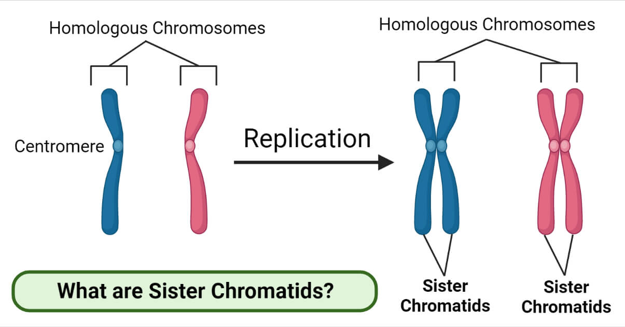
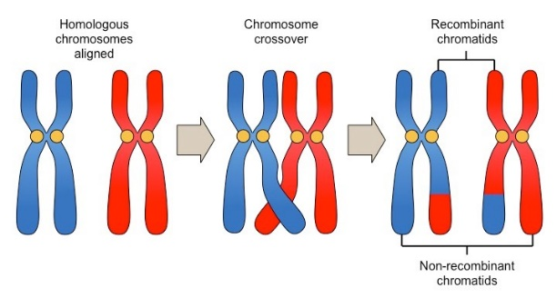
Prophase 1 (5.1)
Begins with replication of DNA during S phase
2 stages of division, 4 genetically different gametes are result – starting with a diploid cell
Prophase 1
chromosomes condense
Synapsis – homologous chromosomes attached -> crossing over – DNA from one homolog cut and exchanged with the exact portion from the other homolog – forms crisscrossed regions called chiasmata

Slide 5
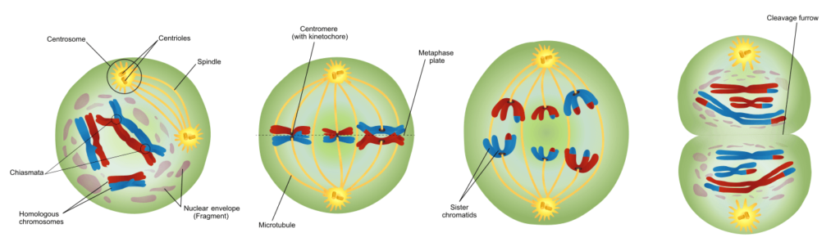
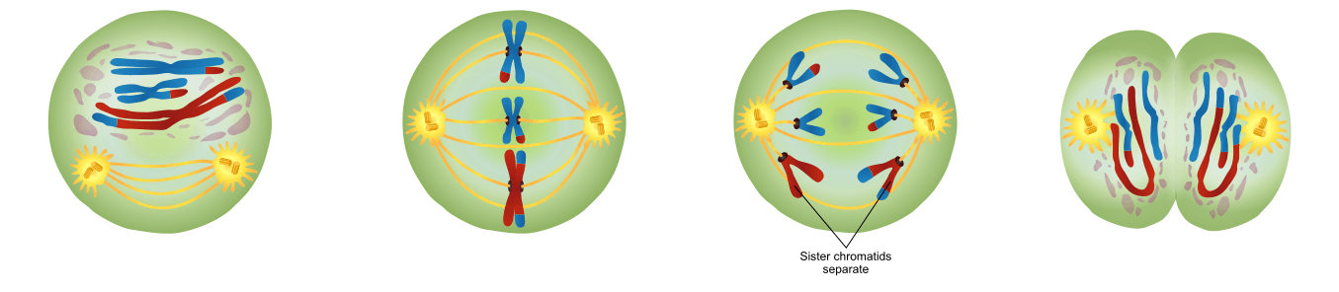
Meiosis 1 and 11 (5.1)
Prophase I | Metaphase I | Anaphase I | Telophase I
Begins with diploid cell Synapsis Crossing over | Line up at metaphase plate -> Independent assortment | Homologous pairs separate | Reach opposite sides and cytokinesis occurs
Prophase II | Metaphase II | Anaphase II | Telophase II
Begins with haploid cells | Sister chromatids align at metaphase plate | Individual chromosomes separate | Reach opposite sides, cytokinesis, 4 haploid cells
Mitosis vs. Meiosis:
Synapsis and crossing over only in meiosis
Homologous pairs vs replicated chromosomes at metaphase plate
Sister chromatids stay attached during anaphase I

Slide 6
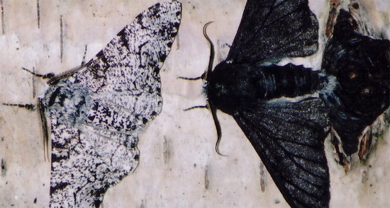
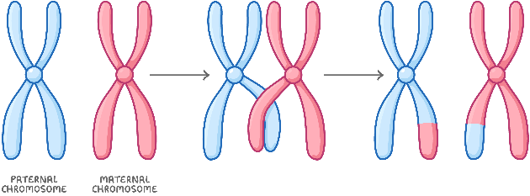
Meiosis and Genetic Diversity (5.2)
Each diploid cell contains two different versions (or allele) of the gene because of the two sets of chromosomes it contains
Sexual reproduction causes these alleles to be mixed up and produce varying offspring, which helps survival
Meiosis increases genetic variation through:
Crossing over – all chromatids that make up tetrad are now unique, increasing variation
Independent assortment – 50% chance to get maternal or paternal chromosome -> 223 or 8.2 million combos
Random fertilization – each combo of egg and sperm is unique -> 70 trillion combos (223 * 223)

Slide 7
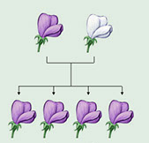
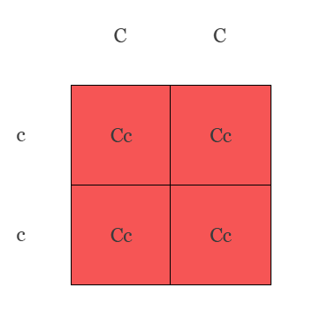
Mendel’s Observations (5.3)
Genetic information is carried by DNA and RNA -> outward traits of organism
The genotype affects the phenotype
Heredity – chance of offspring inheriting traits of parents
Mendel made discoveries about genetic inheritance through breeding peas
Alleles – alternative versions of the same gene (like pea color – slightly different DNA = purple and white peas) – one per parent
Homozygous organisms have two of the same allele for a trait – could be dominant or recessive (dominant will be expressed)
Heterozygous organisms have two different traits for an allele
This can be represented in a Punnett square

Slide 8
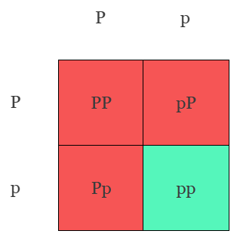
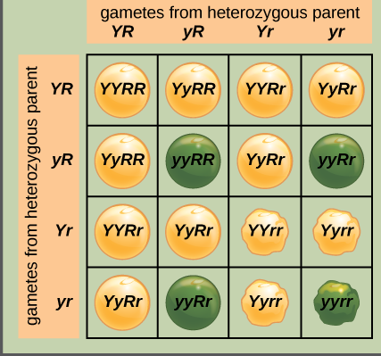
Mendel’s Laws (5.3)
Law of Segregation –each offspring has a 50% chance of inheriting either allele from the parent
Test cross – determine if organism is heterozygous or homozygous dominant by crossing with a recessive organism
Monohybrid cross – one trait, all heterozygous
Always 1:2:1 genotype, 3:1 phenotype
Dihybrid cross – cross to study multiple characteristics
9:3:3:1 phenotypic ratio
Law of Independent Assortment – each pair of alleles will segregate separately during gamete formation (alleles for different genes aren’t linked)
Multiplying vs adding for probability
Notes:
If you cross AABb and AaBb what is prob of AABB
½ * ¼ = 1/8

Slide 9
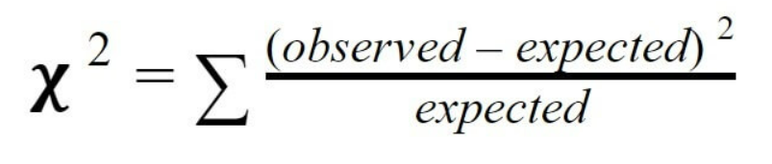
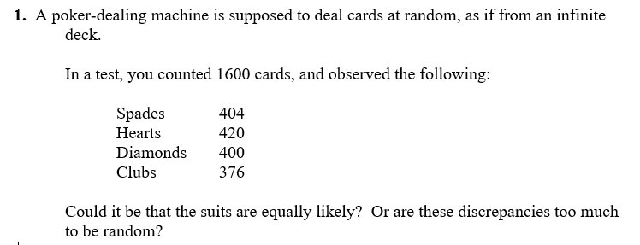
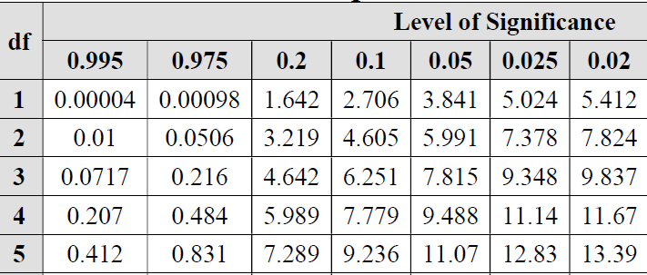
Chi-Square (5.3)
Chi-square helps you compare expected to observed values in your data in order to determine if there is a significant difference between the two = fails to reject null hypothesis
Sum all values and check table at 0.05 level of significance = 95% confidence, degrees of freedom = n-1 (classes -1)
If result is larger than critical value, then there is a significant difference
Notes:
expected
expected
observed
(percent)
(counts)
z
404
0.25
400
0.200
420
0.25
400
1.000
400
0.25
400
0.000
376
0.25
400
-1.200
chi-square->
2.480
critical value->
7.815
Compute each z from its own row as (observed-expected)/sqrt(expected). Be sure to use the counts in this formula, not the percentages. The chi-square statistic is the sum of the squares of the z-values.
The number of degrees of freedom is 3 (number of categories minus 1).
The critical value is from a table you’ll have on the exam (using α = 0.05).

Slide 10
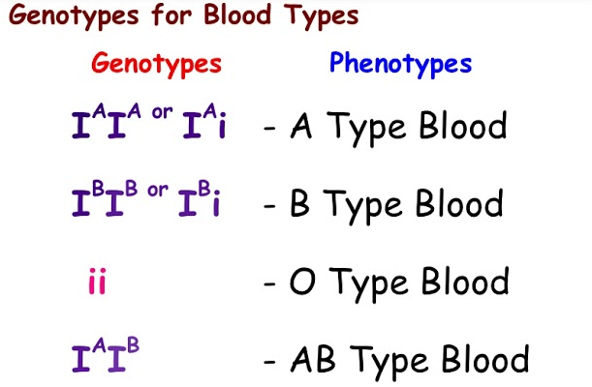
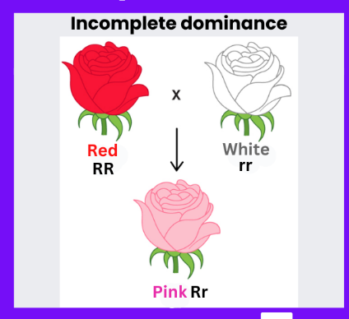

Types of Dominance (5.4)
Complete dominance – homozygous dominant and heterozygous are indistinguishable -> dominant always takes control
Incomplete dominance – heterozygous organisms demonstrate a phenotypic mix between dominant and recessive alleles
Codominance – two alleles are dominant and affect the phenotype in two different but equal ways
Multiple alleles – genes which exist in more than two allele forms
Human blood types – I^{A} I^{B} i
Polygenic inheritance – two or more genes have an additive effect on a single character in phenotype (height, skin color)

Slide 11
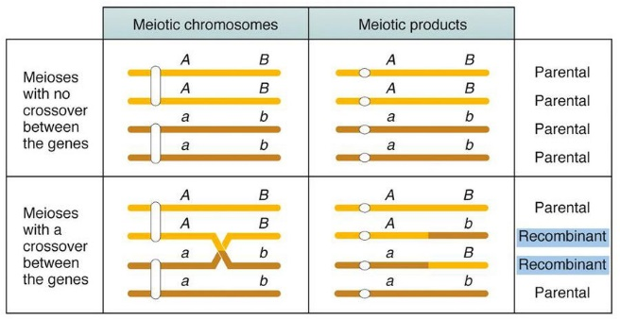
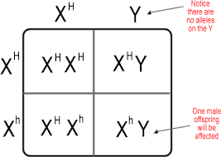
Linked and Sex-Linked Genes (5.4)
Genes have specific locations on chromosomes
Linked genes are on the same chromosome and tend to be inherited together during cell division
When offspring inherit phenotype of parents, they are considered parental types, and otherwise recombinants
Genes that are further apart from each other have a higher chance of recombining (through crossing over)
A sex-linked gene is one located on a sex chromosome
Humans have X and Y chromosomes – XX and XY
Sex linked genes are either X-linked or Y-linked – X traits can be recessive or dominant in daughters, but always represented in sons
Fathers pass X linked genes to their daughters but not their sons (sons will get maternal X and paternal Y)

Slide 12
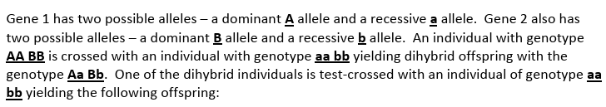
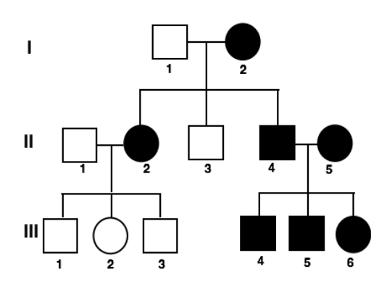
Linked Genes and Pedigree Practice (5.4)
411 | AaBb
97 | Aabb
103 | aaBb
389 | aabb
1. % recombinant/parental?
2. Linked or not?
3. # of map units?
Pedigree – a diagram that shows the relationship between parents and offspring across two or more generations
Circles = females, squares = males
Shaded = expresses trait
Can help predict the genome of future offspring
What kind of trait is this?
Notes:
A map unit = 1% recombination frequency
Rf = combinants/total offspring X 100
17%

Slide 13
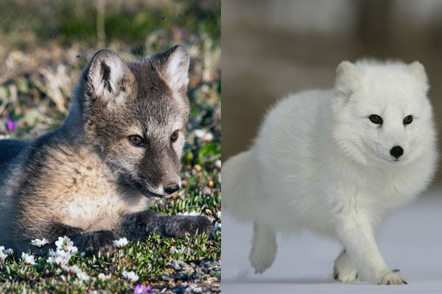
Phenotypic Plasticity and Nonnuclear Inheritance (5.5)
Phenotypic plasticity – individuals of a population have the same genotype but different phenotypes in different environments
Skin tone – melanin
Height and weight in humans
Flower color based on soil pH
Seasonal fur color in arctic animals
Nonnuclear inheritance – mitochondria and chloroplasts contain genetic information; mitochondrial DNA is not passed down through meiosis – passed down by egg

