Slide 1


AP BIO
TOPIC 5.1:
Meiosis

Slide 2
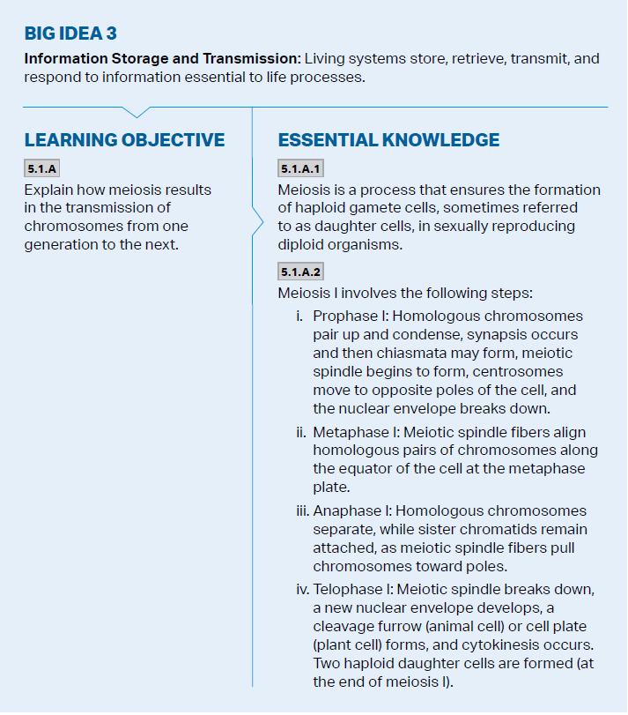
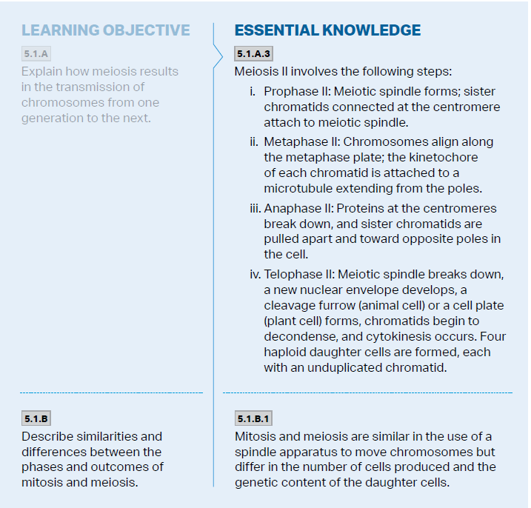
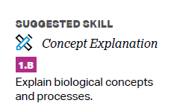
Objectives

Slide 3
Genetic Transfer
Genes – segments of DNA that code for heredity (are transferred generationally)
Reproductive cells that transmit genes are gametes (opposed to somatic)
Asexual reproduction – single parents passes whole genome to offspring (mitosis)
Sexual reproduction – 2 parents contribute genes to the offspring -> genetic variation

Slide 4
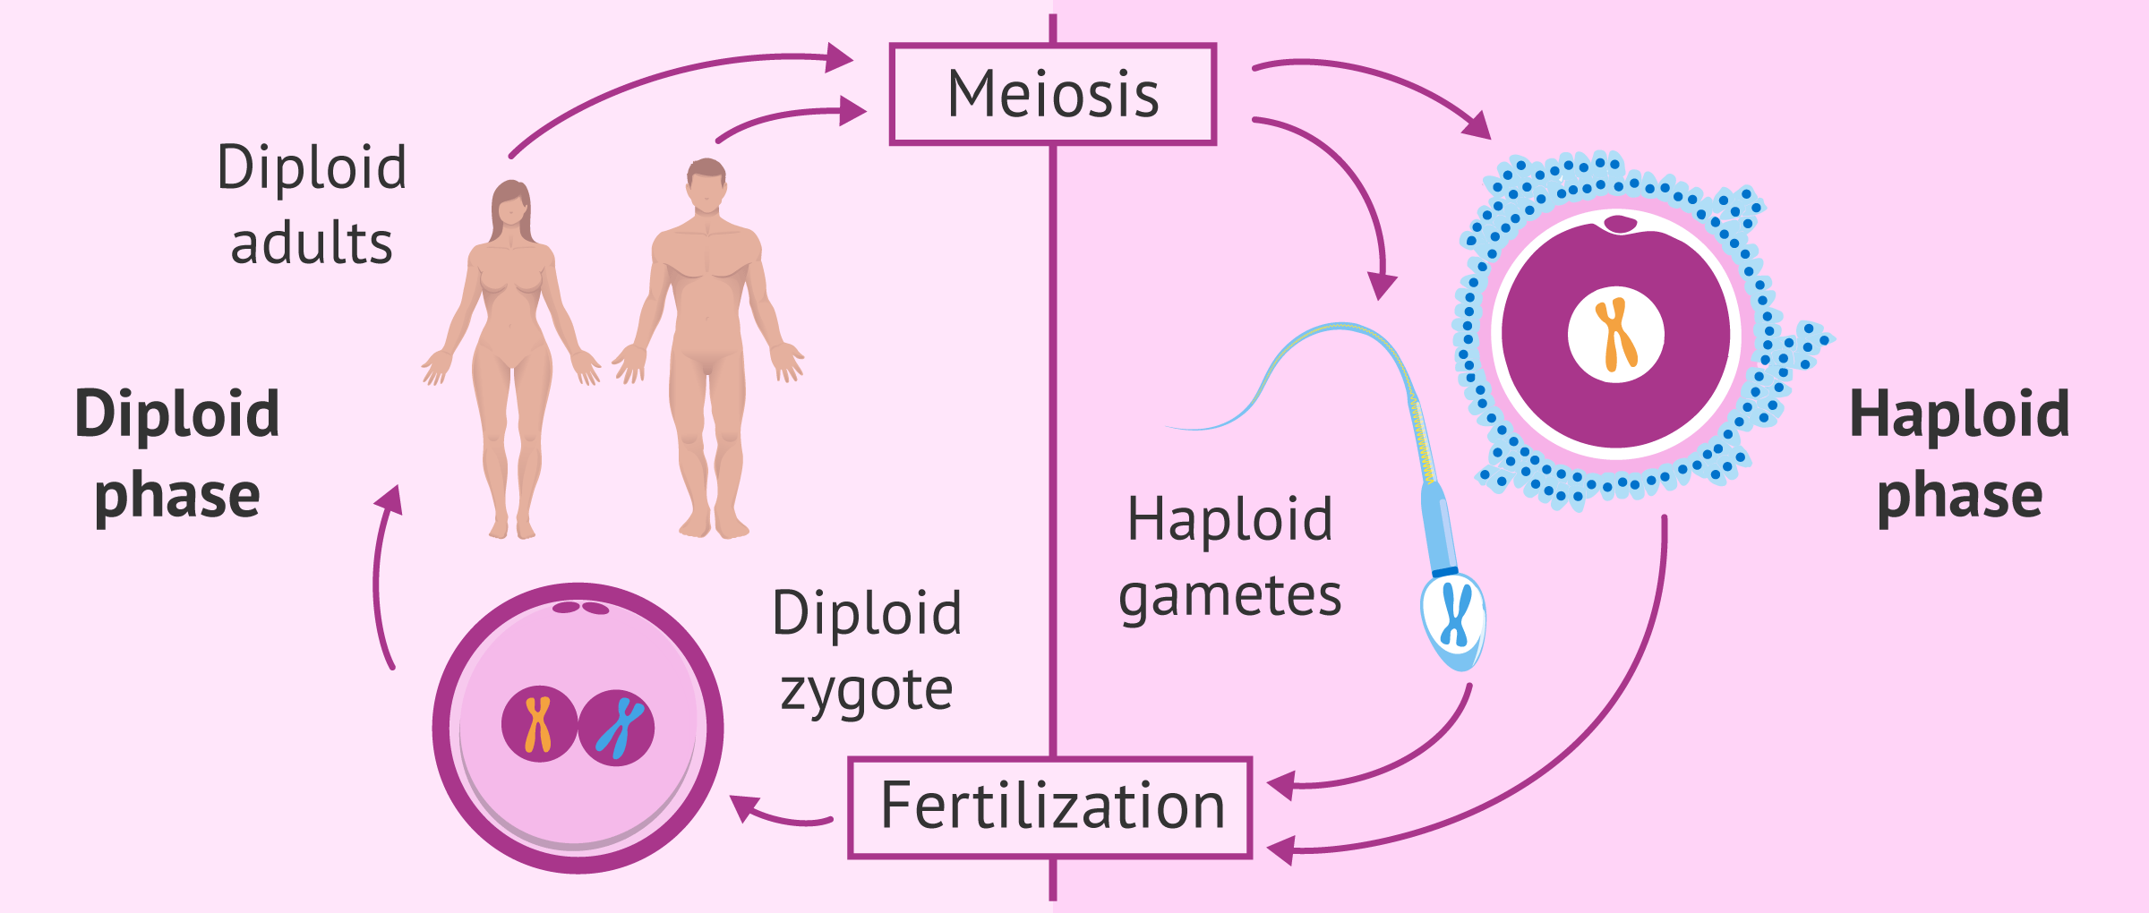
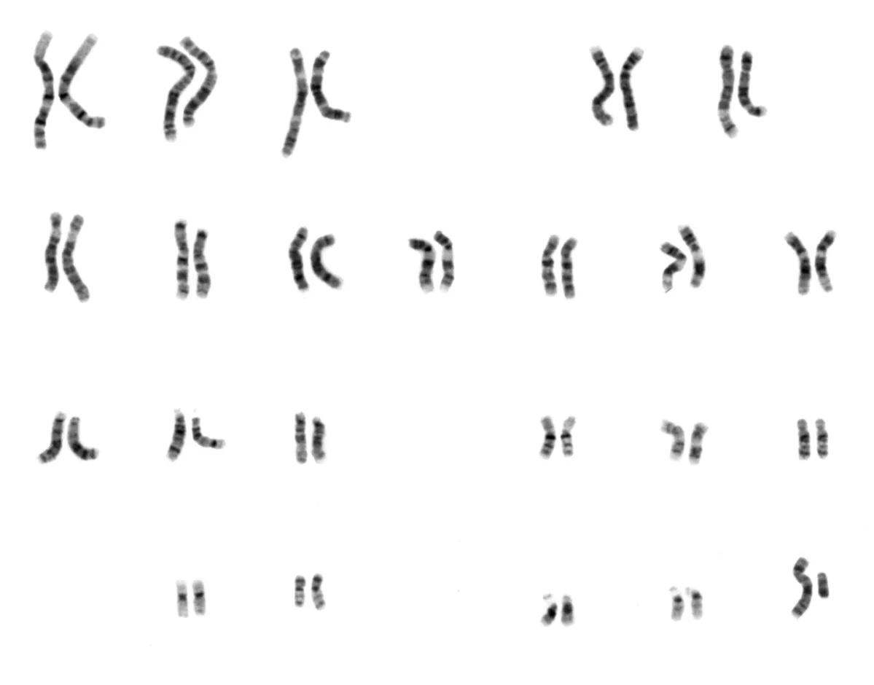
Chromosomes
Homologous chromosomes – similar chromosomes (1 from each parent)
Seen in karyotypes
22 pairs of autosomes, 1 pair of sex chromosomes (XY or XX)
Human somatic cells (non sex cells) all have 46 chromosomes (diploid cell) -> cells that emerge from mitosis will also have 46
Sex cells (gametes) have 23 chromosomes – haploid cells
During meiosis one chromosome of each pair is given to a gamete randomly (so each gamete cell has half the genome)
Fertilization – egg + sperm come together to form a fertilized diploid zygote
Notes:
Chromosome has two chromosomes which become technically 4 sister chromatids

Slide 5
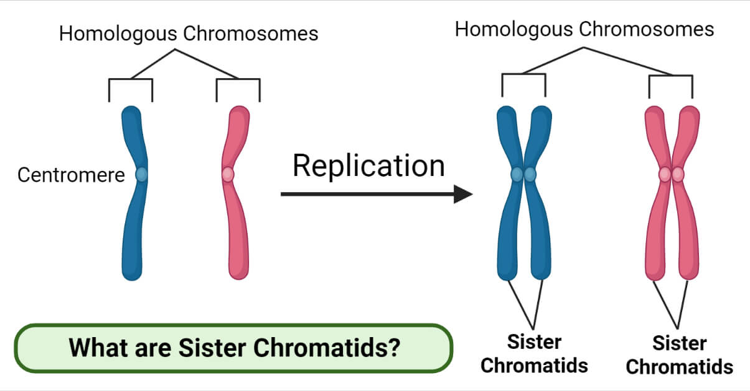
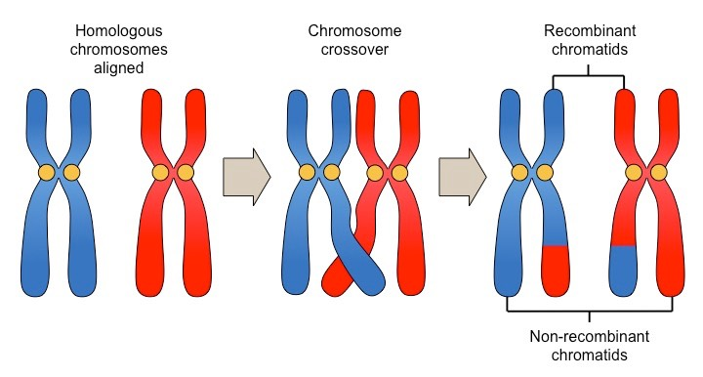
Steps of Meiosis: Meiosis 1
Begins with replication of DNA during S phase
But TWO stages of cell division which result in FOUR daughter cells
Meiosis 1 begins with a diploid cell
Prophase 1
chromosomes condense
Synapsis – homologous chromosomes attached -> crossing over – DNA from one homolog cut and exchanged with the exact portion from the other homolog – forms crisscrossed regions called chiasmata

Slide 6
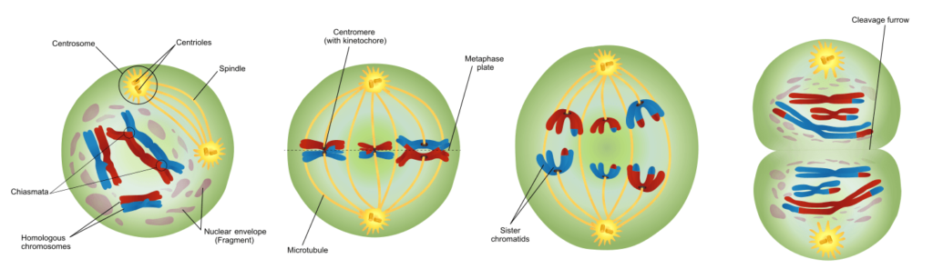
Steps of Meiosis: Meiosis 1 Cont.
Metaphase 1 – all homologous chromosome pairs line up at metaphase plate (independent assortment – mom or dad side)
Anaphase 1 – homologous pairs separate and move toward the poles (sister chromatids stay connected)
Telophase 1 – reach opposite poles and cytokinesis occurs
Now we have haploid cells (half genes, but WITH sister chromatids)

Slide 7
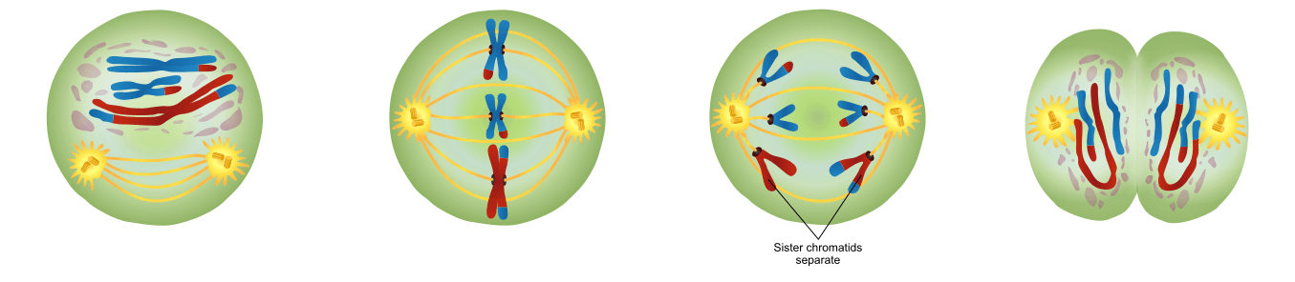
Steps of Meiosis: Meiosis 11
Begins with haploid cell
Prophase II – sister chromatids move toward metaphase plate
Metaphase II – arranged on metaphase plate, sister chromatids not genetically identical
Anaphase II – individual chromosomes move to opposite ends of cell
Telophase II – nuclei reform, cytokinesis, 4 daughter haploid cells, all genetically different

Slide 8
How Meiosis Increases Genetic Variation
Crossing over – all chromatids that make up tetrad are now unique, increasing variation
Independent assortment – 50% chance to get maternal or paternal chromosome -> 2²³ or 8.2 million combos
Random fertilization – each combo of egg and sperm is unique -> 70 trillion combos (2²³ * 2²³)

Slide 9
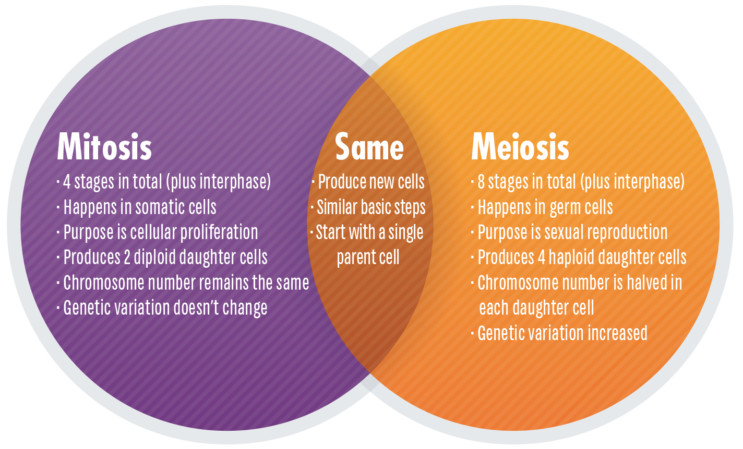
Meiosis vs. Mitosis
Synapsis and crossing over – no formation of tetrad and no genetic swapping
At metaphase plate, homologous pairs are positioned, not individual replicated chromosomes like in mitosis (allows for indep. assortment)
Sister chromatids stay attached during 1st round of anaphase

Slide 10
Meiosis Review
Steps of meiosis
How meiosis increases genetic variation
Meiosis vs. mitosis

