Slide 1


AP BIO
TOPIC 5.2:
Meiosis and Genetic Diversity

Slide 2
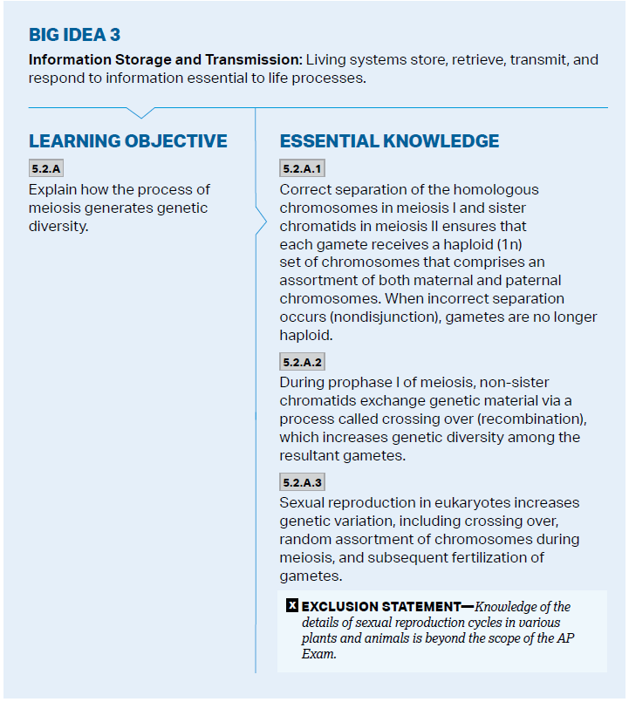
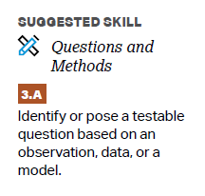
Objectives

Slide 3
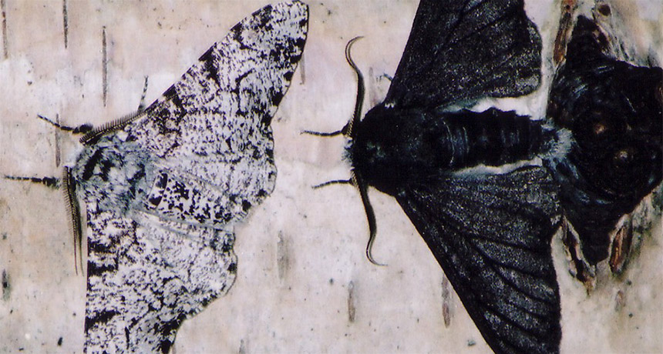
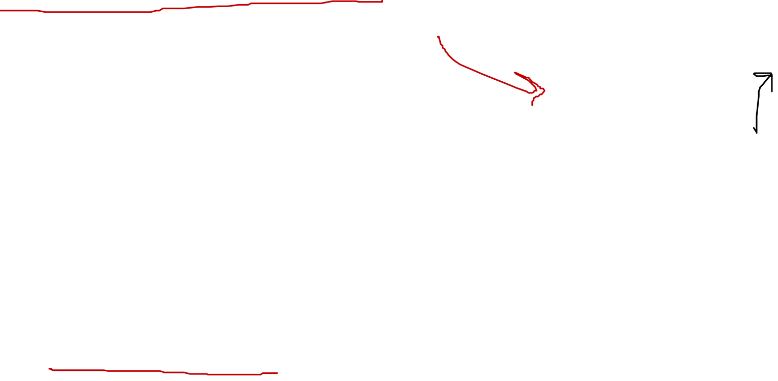
Why genetic diversity?
Diploid organisms carry two alleles from each gene, one from the father and one from the mother – the genotype of these organisms, which then contributes to the phenotype (outward appearance)
Sexual reproduction causes these alleles to be mixed up and produce varying offspring
If an entire population consisted of organisms with the same genotype/phenotype, it would not be able to survive an environmental change – if the change affects one organism it could affect all, because they are all the same
Notes:
Ir moth change color

Slide 4
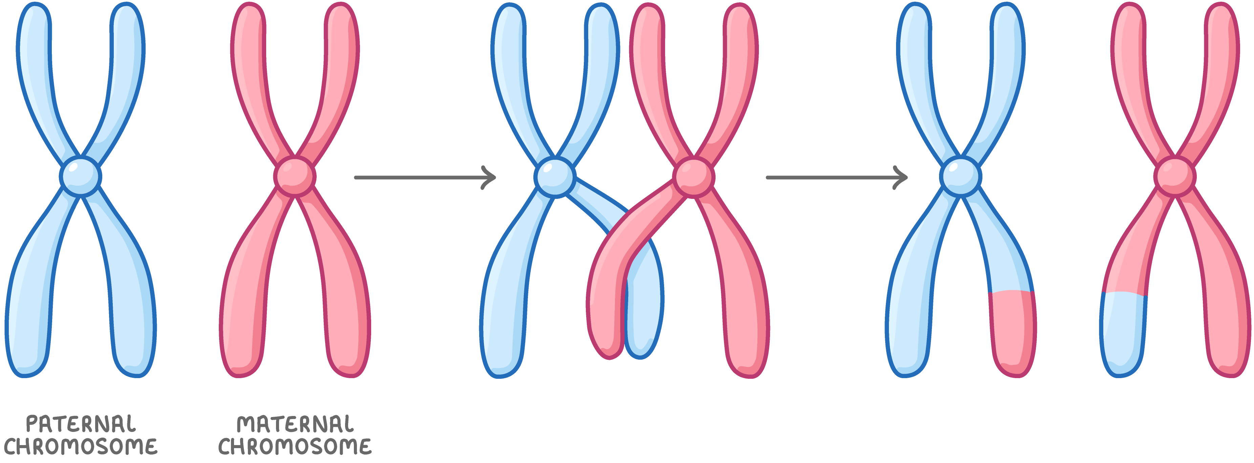
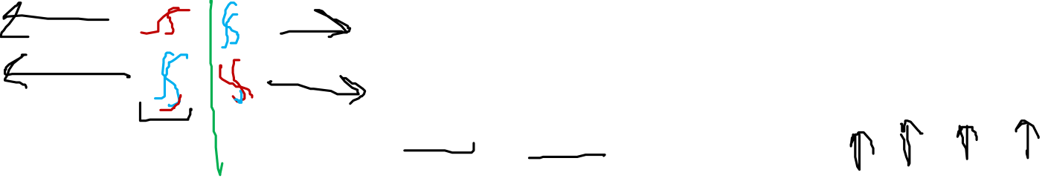
How Meiosis Increases Genetic Variation
Crossing over – all chromatids that make up tetrad are now unique, increasing variation
Ends in 4 non identical chromatids passed down to the 4 daughter cells
Independent assortment – 50% chance to get maternal or paternal chromosome -> 2²³ or 8.2 million combos
Random fertilization – each combo of egg and sperm is unique -> 70 trillion combos (2²³ * 2²³)
Notes:
4 non identical chromatids
So when separation of chromatids each one is unique = increasing variation

Slide 5
Meiosis and Genetic Diversity Review
How meiosis increases genetic diversity

