Slide 1


AP BIO
TOPIC 5.3:
Mendelian Genetics

Slide 2
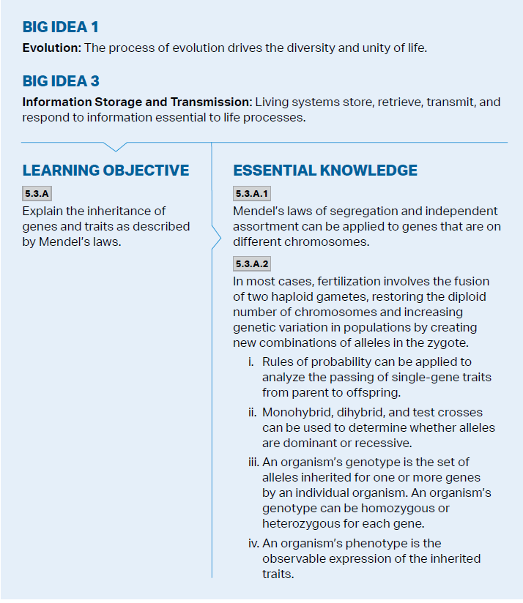
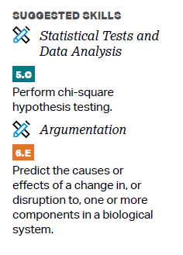
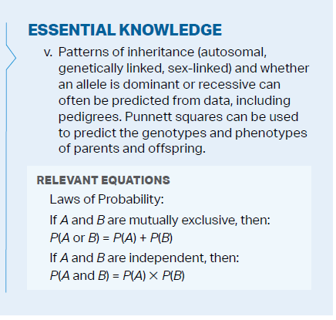
Objectives

Slide 3
Heredity
Genetic information is carried by DNA and RNA – DNA codes for production of proteins -> outward traits of organism
The genotype affects the phenotype
Similarity in genome across universe suggests common ancestor
Heredity – chance of offspring inheriting traits of parents
Notes:
Similar metabolic pathways
Ribosomes
98% of same genome of pigs

Slide 4
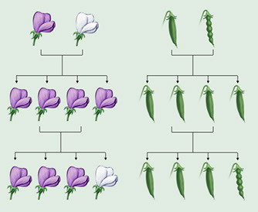
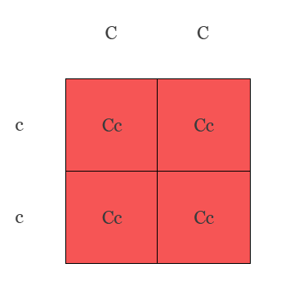
Mendel’s Observations
Mendel made discoveries about genetic inheritance through breeding peas
Alleles – alternative versions of the same gene (like pea color – slightly different DNA = purple and white peas)
Every sexually reproducing organism inherits one allele from each parent
The dominant allele will be expressed phenotypically (capital letter)
Homozygous organisms have two of the same allele for a trait – could be dominant or recessive
Heterozygous organisms have two different alleles for a trait
This can be represented in a Punnett square
Notes:
Parental
F1
F2 generations

Slide 5
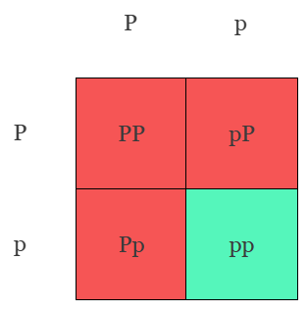
Mendel’s Laws
Law of Segregation – If parent has 2 of the same alleles, then the offspring will all get that version of the gene, but if the parent has two different alleles, each offspring has a 50% chance of getting 1 of the 2 alleles
Test cross – determine if organism is heterozygous or homozygous dominant
Make Punnett square with homozygous recessive – if homozygous dominant then all offspring will show dominant trait
Monohybrid cross – one trait, all heterozygous
Always 1:2:1 genotype, 3:1 phenotype

Slide 6
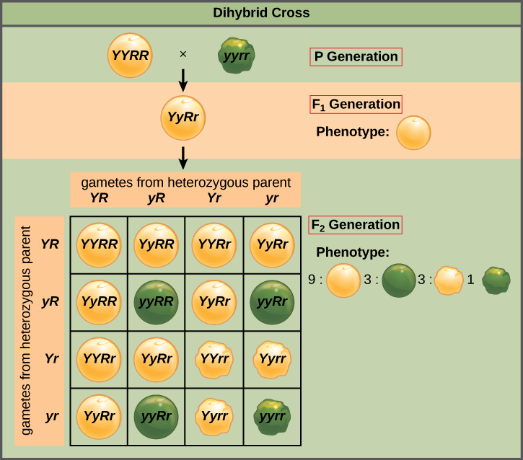
Mendel’s Laws Cont.
Dihybrid cross – cross to study multiple characteristics
9:3:3:1 phenotypic ratio
Law of Independent Assortment – each pair of alleles will segregate separately during gamete formation – this means the allele a cell receives for one gene does not influence the allele it receives for another gene
Probability rules:
Multiple events in specific combo – multiply probabilities
Probability of 2 events exclusively occurring, add probabilities
Notes:
If you cross AABb and AaBb what is prob of AABB
½ * ¼ = 1/8

Slide 7
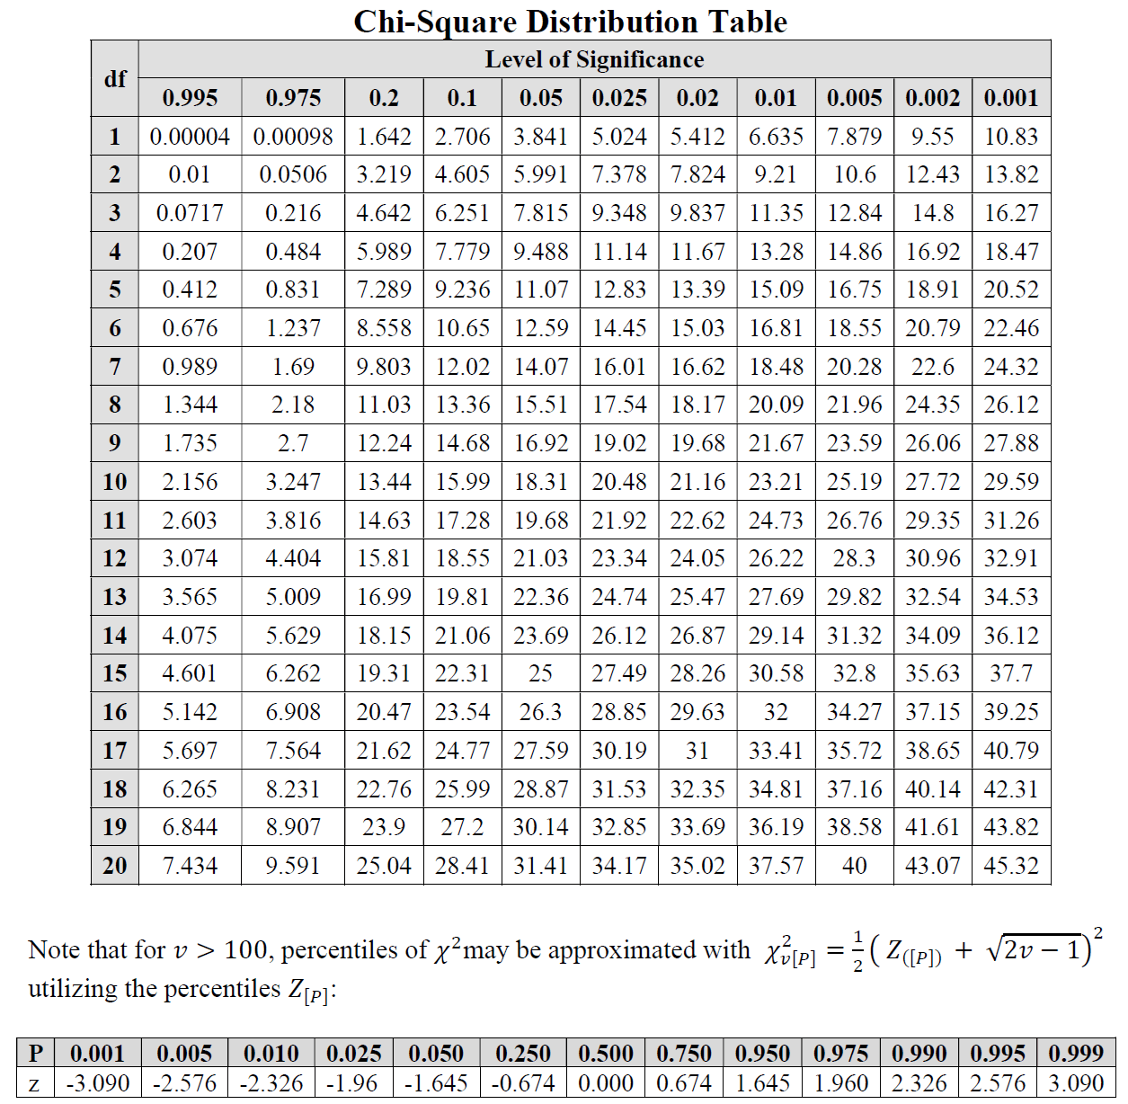
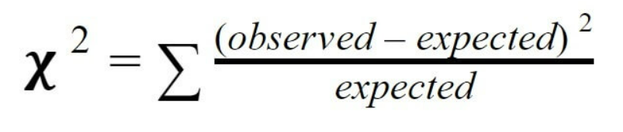
Chi-Square
Chi-square helps you compare expected to observed values in your data in order to determine if there is a significant difference between the two = fails to reject null hypothesis
Sum all values and check table at 0.05 level of significance = 95% confidence, degrees of freedom = n-1 (classes -1)
If gotten value larger than critical value, then there is a significant difference between the observed and expected data

Slide 8
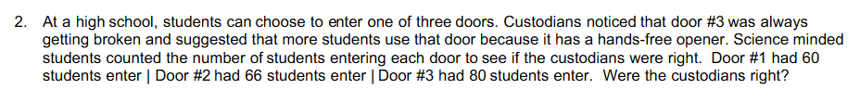
Chi-Square Practice
Null Hypothesis:
Degrees of Freedom:
Result:
Door # | Observed | Expected | (o-e)²/e
1 | 60
2 | 66
3 | 80
Notes:
1.0946
0.1038
1.8694
Null = no statistically different, no door preference
Accept the null, custodians wrong
68.67 students

Slide 9
Mendelian Genetics Review
Alleles and their properties
How to set up a Punnett square
Laws of segregation and independent assortment
Chi-square

