Slide 1


AP BIO
TOPIC 5.4:
Non-Mendelian Genetics

Slide 2
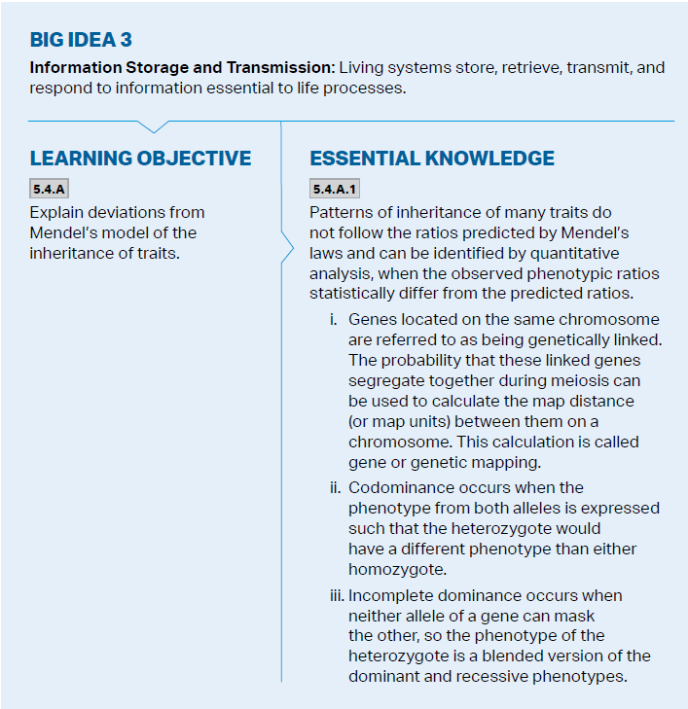
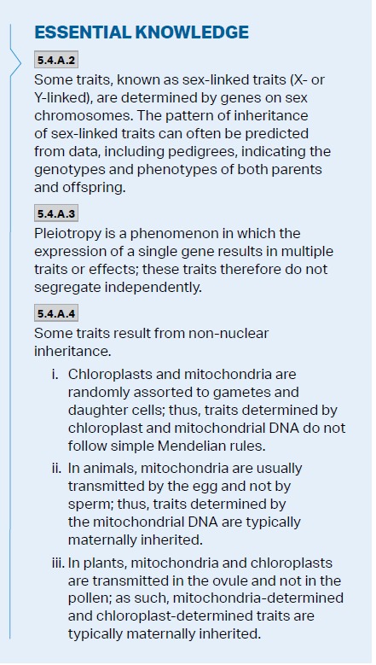
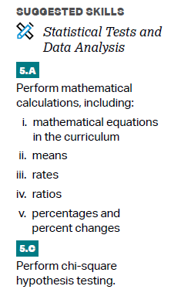

Objectives

Slide 3
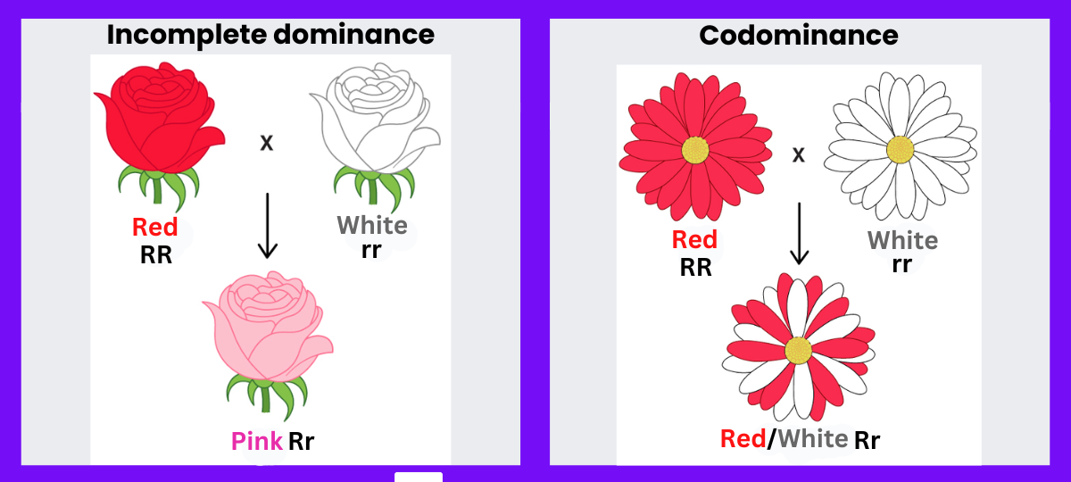
Incomplete Dominance and Codominance
Complete dominance – homozygous dominant and heterozygous are indistinguishable -> dominant always takes control
Incomplete dominance – heterozygous organisms demonstrate a phenotypic mix between dominant and recessive alleles
Codominance – two alleles are dominant and affect the phenotype in two different but equal ways

Slide 4
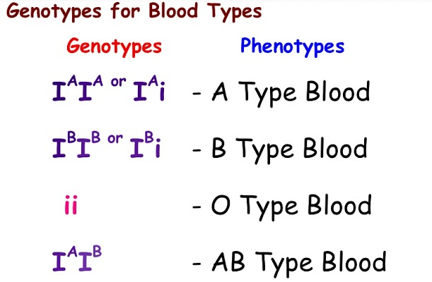
Multiple Alleles
Multiple alleles – genes which exist in more than two allele forms
Human blood types – I^{A} I^{B} i

Slide 5
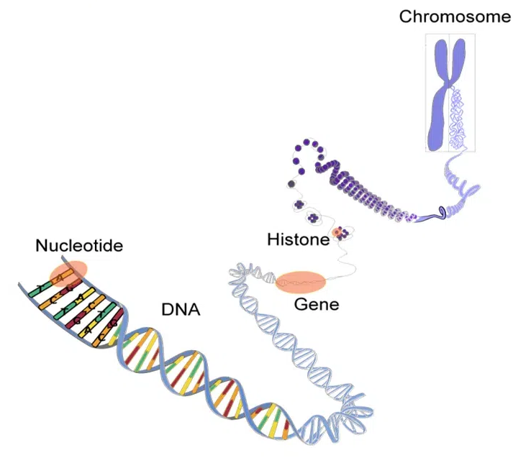
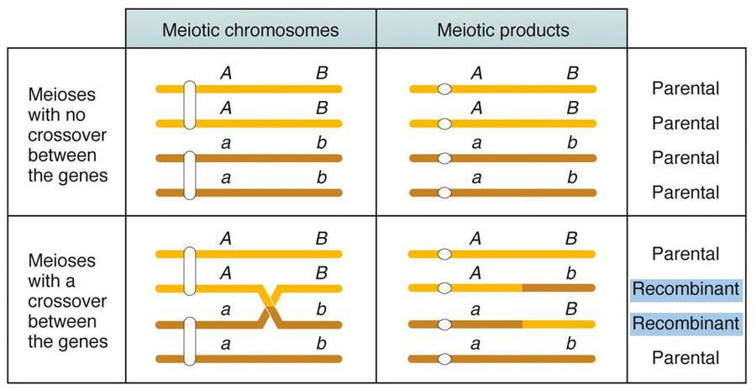
Linked Genes
Genes have specific locations on chromosomes
Linked genes are on the same chromosome and tend to be inherited together during cell division
Some linked genes are separated due to crossing over
A linkage map can show how close genes are on a chromosome
When offspring inherit phenotype of parents, they are considered parental types, and otherwise recombinants
Genes that are further apart from each other have a higher chance of crossing over and causing recombination

Slide 6
Linked Genes Practice
In fruit flies a gray body is dominant to a black body and normal wings are dominant to vestigial wings. The genes for the two traits are linked. Heterozygous flies were crossed with black + vestigial flies and produced the values below. How many map units apart are the genes?
778 | Gray normal
785 | Black vestigial
158 | Black normal
162 | Gray vestigial
Notes:
A map unit = 1% recombination frequency
Rf = combinants/total offspring X 100
Recombinants = 320
Total = 1883
17%

Slide 7
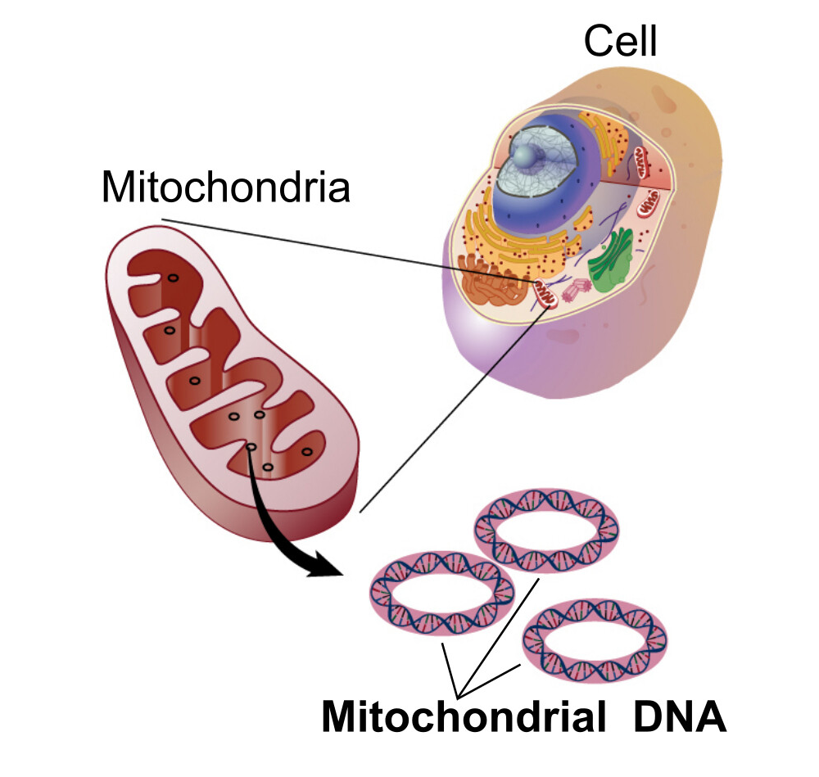
Mitochondrial DNA
Nonnuclear inheritance – mitochondria and chloroplasts contain genetic information; mitochondrial DNA is not passed down through meiosis
The only mitochondrial DNA in the zygote comes from the egg cell – only travels down the maternal line
Mitochondria are split randomly into gametes

Slide 8
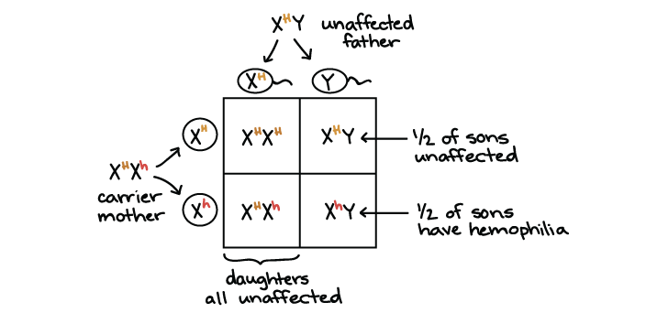
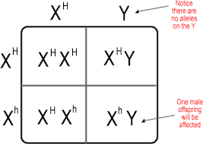
Sex-Linked Genes
A sex-linked gene is one located on a sex chromosome
Humans have X and Y chromosomes – XX and XY
Sex linked genes are either X-linked or Y-linked – X traits can be recessive or dominant in daughters, but always represented in sons
Fathers pass X linked genes to their daughters but not their sons
Sons will express the allele on the X chromosome inherited from their mother

Slide 9
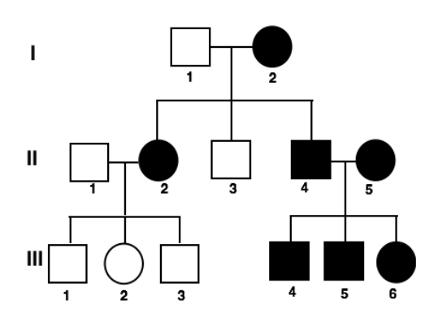
Pedigrees
Pedigree – a diagram that shows the relationship between parents and offspring across two or more generations
Circles = females, squares = males
Shaded = expresses trait
Can help predict the genome of future offspring
If individual III-4 married a man who was heterozygous for the trait, what % of their children would express the trait?

Slide 10
Non-Mendelian Genetics Review
Variations of dominance (incomplete, codominance, linked, multiple alleles)
Mitochondrial DNA
Sex-linked genetics

