Slide 1


AP BIO
TOPIC 5.5:
Environmental Effects on Phenotype

Slide 2
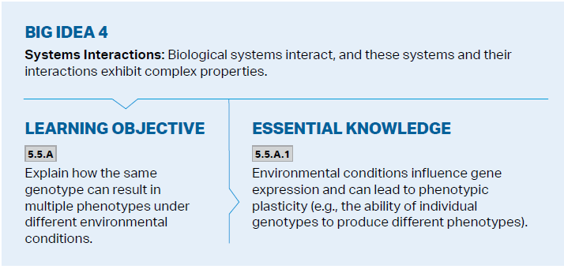
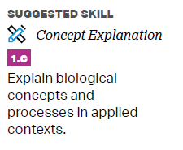
Objectives

Slide 3
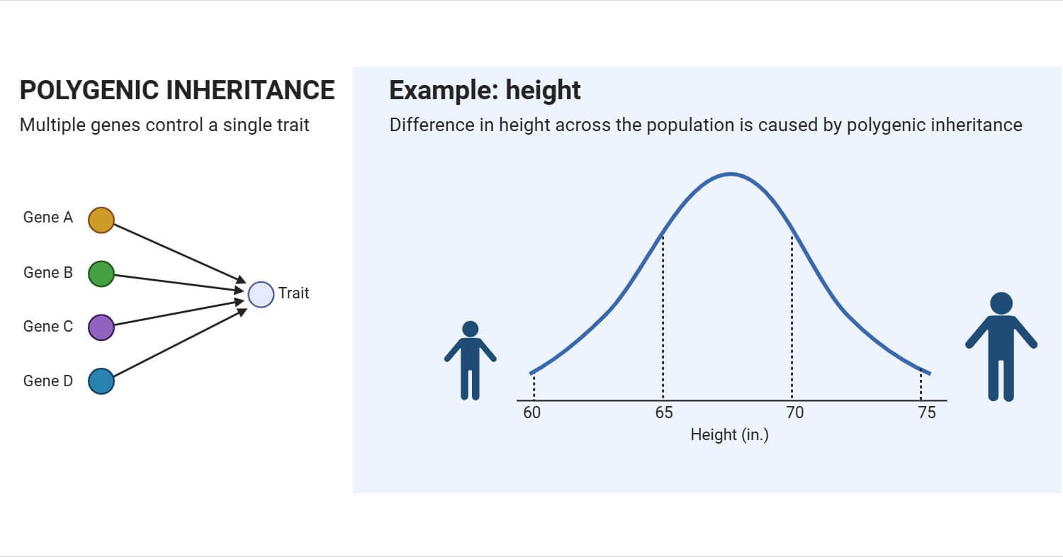

Polygenic Inheritance
Polygenic inheritance – two or more genes have an additive effect on a single character in phenotype (height, skin color)

Slide 4
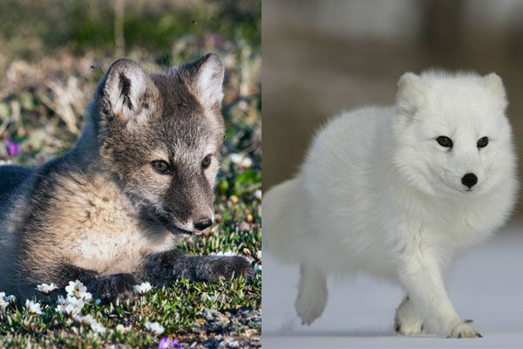

Environmental Effects on Phenotype
Phenotypic plasticity – individuals of a population have the same genotype but different phenotypes in different environments
Skin tone – melanin
Height and weight in humans
Flower color based on soil pH
Seasonal fur color in arctic animals

Slide 5
Environmental Effects on Phenotype Review
Polygenetic inheritance
Phenotypic plasticity

