Slide 1


AP Bio
Unit 6:
Gene Expression and Regulation

Slide 2
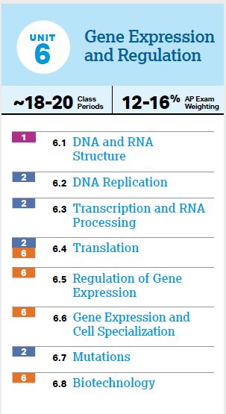
Unit 6: What You Need To Know
DNA vs. RNA
Replication, transcription, translation
Regulation of gene expression and how it contributes to cell specialization
The effects of mutations
Biotechnology

Slide 3
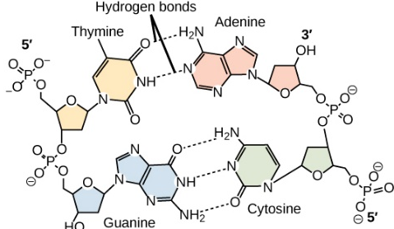
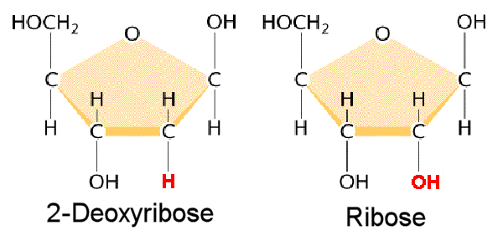
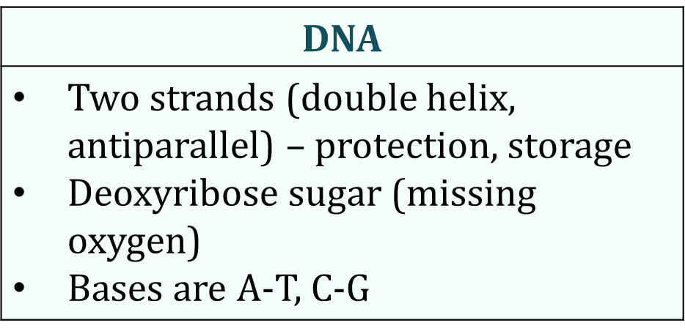
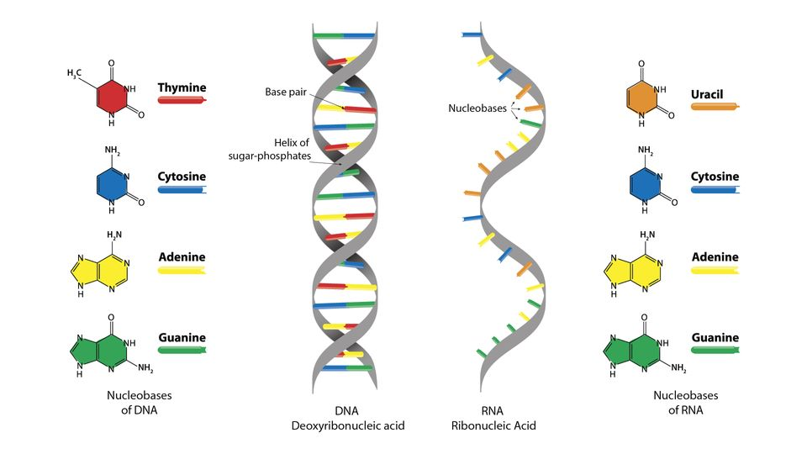
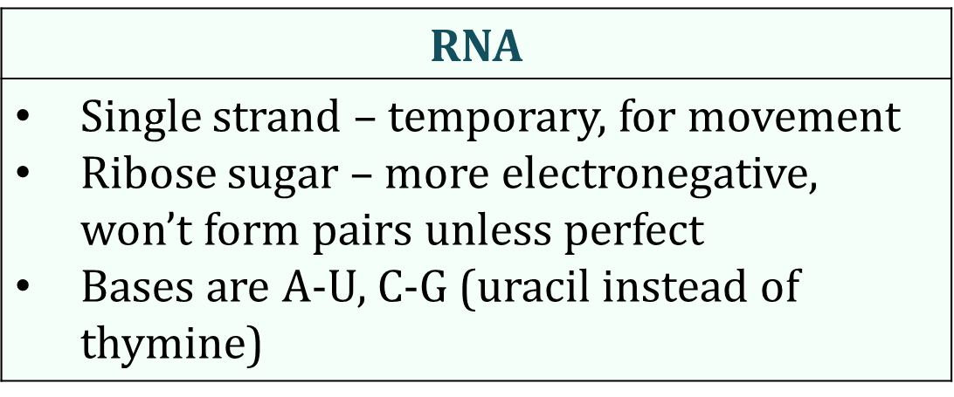
DNA and RNA (6.1)
DNA and RNA store and transmit genetic information – made up of nucleotides (5 carbon sugar, phosphate group, nitrogenous base)

Slide 4
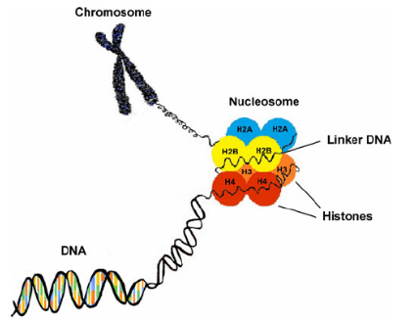
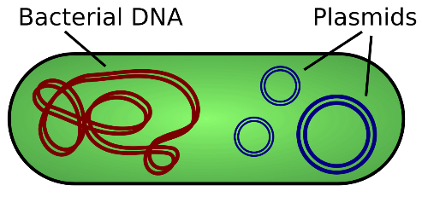
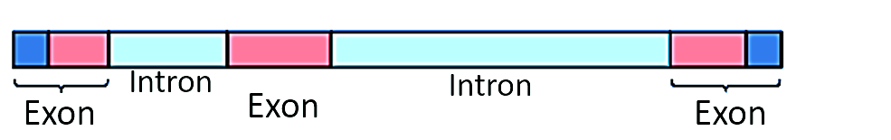
DNA Strands as a Unit (6.1)
DNA wraps around histone proteins, forming nucleosomes, which in turn make up chromosomes (chromatin)
Each chromosome is made up of introns and exons
Linear vs circular chromosomes
Plasmid - small circular DNA in prokaryotes that is extrachromosomal, can be shared by bacteria and help with genetic variation

Slide 5
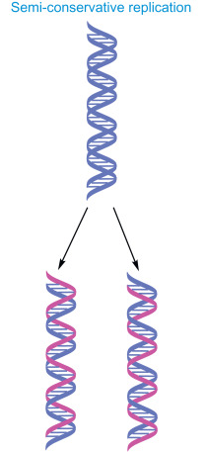
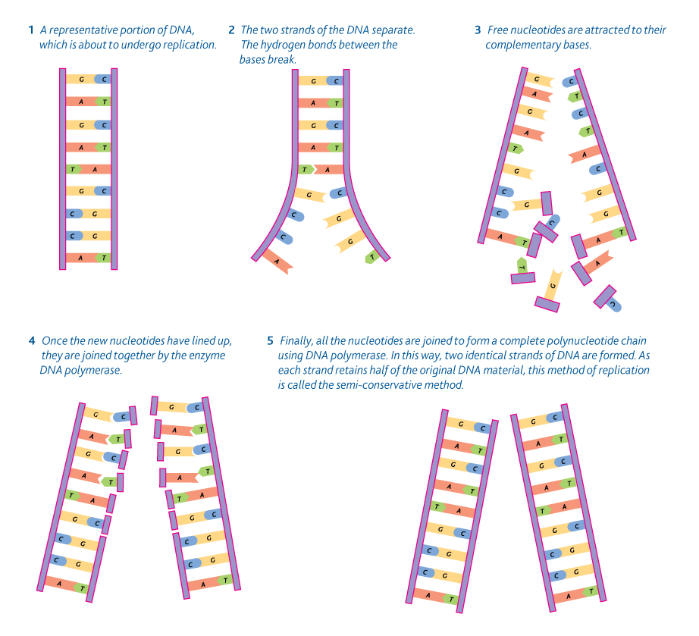
The Purpose and Steps of Replication I (6.2)
DNA Replication – ensures continuity of hereditary information
Semiconservative process – each of the daughter molecules has one old strand and one new strand
Helicase enzyme – unwinds
Destabilizes hydrogen bonds
Topoisomerase enzyme – further unwinding
Cuts backbone

Slide 6
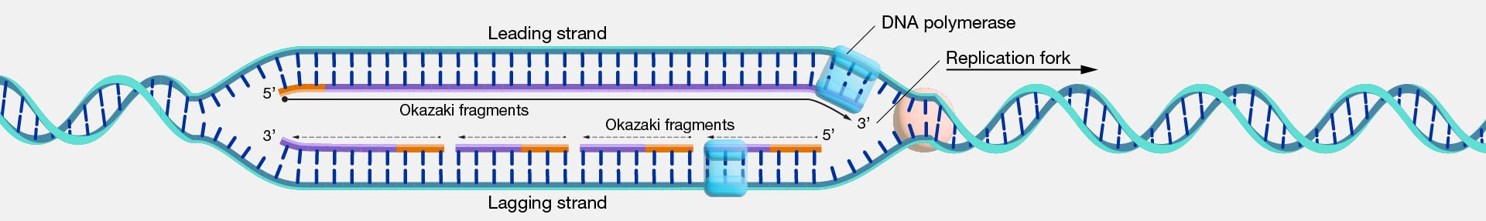
Steps of Replication II (6.2)
DNA polymerase – binds free nucleotides (base pairs)
Only to the 3’ end
Requires RNA primers to start replication
DNA replication runs continuously along the 5’->3’ strand (leading strand), but to add new nucleotides to strand running in the other direction, it must be copied in segments (lagging strand)
These segments are known as Okazaki fragments, which are then sealed together by ligase
Telomeres added to tips to protect genes (every mitosis removes end of DNA)
Notes:
Topoisomerase relieves further strain of twisting

Slide 7
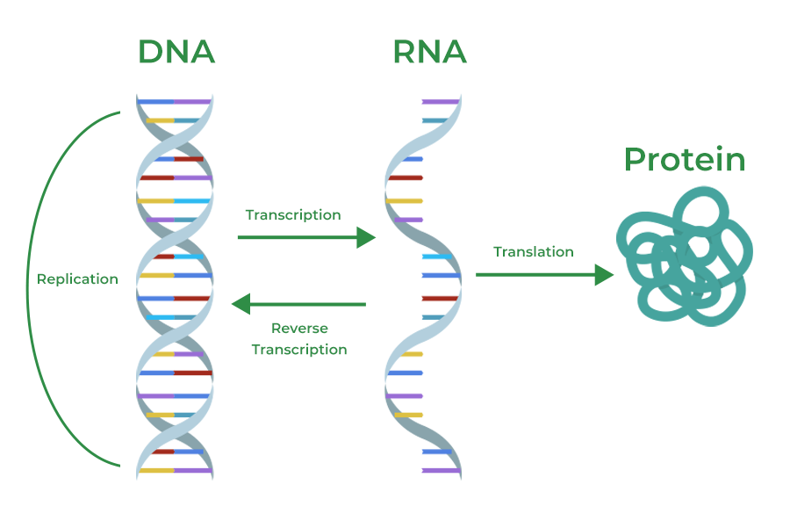
Gene Expression (6.3, 6.4)
Gene expression – the process by which DNA directs the synthesis of proteins -> each gene codes for one polypeptide
Genetic code is nearly universal
Central dogma
Transcription – the synthesis of RNA using DNA as a template (within the nucleus of eukaryotic cells)
Produces mRNA, sent to ribosomes
Translation – production of a polypeptide chain using the mRNA transcript (occurs at ribosomes)
Transcription and translation occur same time in prokaryotes

Slide 8
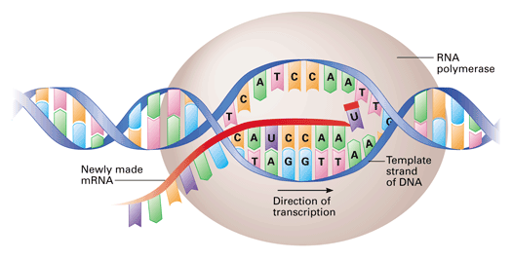
Steps of Transcription (6.3)
1 strand of the DNA is transcribed – template strand (the other strand is the coding strand – it will share the same sequence as the mRNA)
RNA polymerase – enzyme that separates two DNA strands and connects free RNA nucleotides as they base pair – add to 3’ end (phosphodiester bonds in the transcription bubble)
DNA is read 3’ to 5’
Attaches at the promoter DNA sequence and detaches at the terminator
Transcription factors assist the process

Slide 9
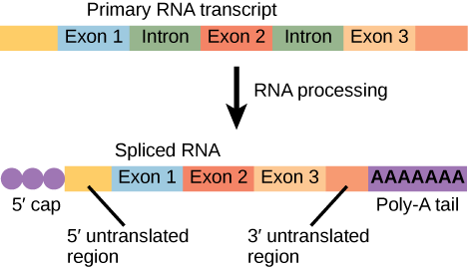
mRNA Processing (6.3)
This process creates primary RNA that must be processed before it becomes mRNA – only in eukaryotic cells
5’ cap – modified guanine nucleotide attached to 5’ end of mRNA
Poly-A-tail – 50-250 adenine nucleotides attached to 3’ end
Help mRNA export from nucleus, protect from degradation, and attach to ribosome
RNA splicing – specific sections removed (introns), remaining are exons and are bound together by a spliceosome
Powered by small RNAs – ribozyme (catalytic RNA)
An intron in one RNA can be an exon in the other – allows for 100,000 polypeptides from 20,000 genes (alternative RNA splicing)

Slide 10
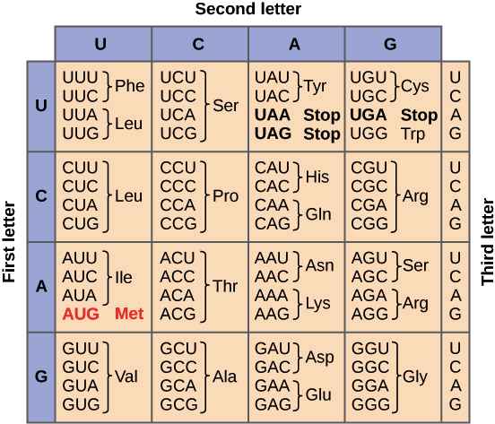
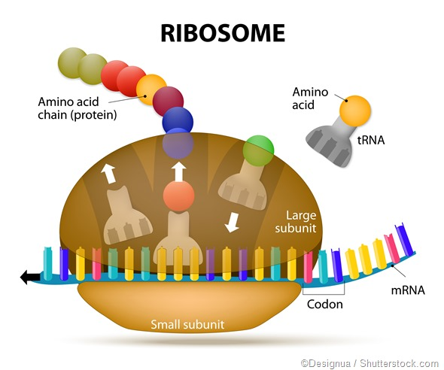
tRNA and rRNA (6.4)
tRNA transfers amino acids from the cytoplasm to the ribosome to assemble a polypeptide – has anticodon that allows it to base pair to the codon on the mRNA (group of 3 nucleotides -> 1 amino acid)
Ribosomes are made up of rRNA and proteins – has 3 binding sites for tRNA molecules
P – holds tRNA that carries growing peptide chain
A – holds tRNA with amino acid that will be added to the chain next
E – exit site
What amino acid will a DNA sequence of GTA code for?

Slide 11
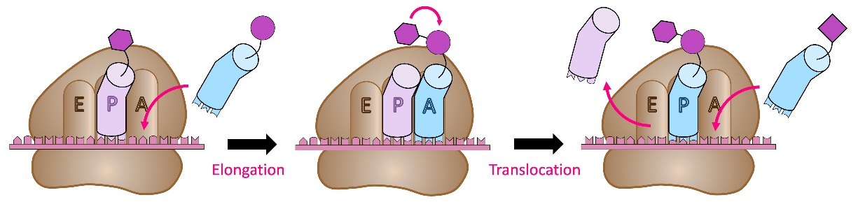
Initiation, Elongation, Termination (6.4)
Small ribosomal subunit binds to mRNA so that the “start” codon AUG is placed in the right position, 1st tRNA bonds, large subunit attaches
tRNA with correct anticodon will bind to A site -> peptide bond formed -> moved to tRNA in A site, then they all shift right to allow new tRNA in A site
A “stop” codon in mRNA is reached (3 options) -> polypeptide freed, undergoes protein folding
Signal peptide – sequence of 20 leading amino acids determines protein destination

Slide 12
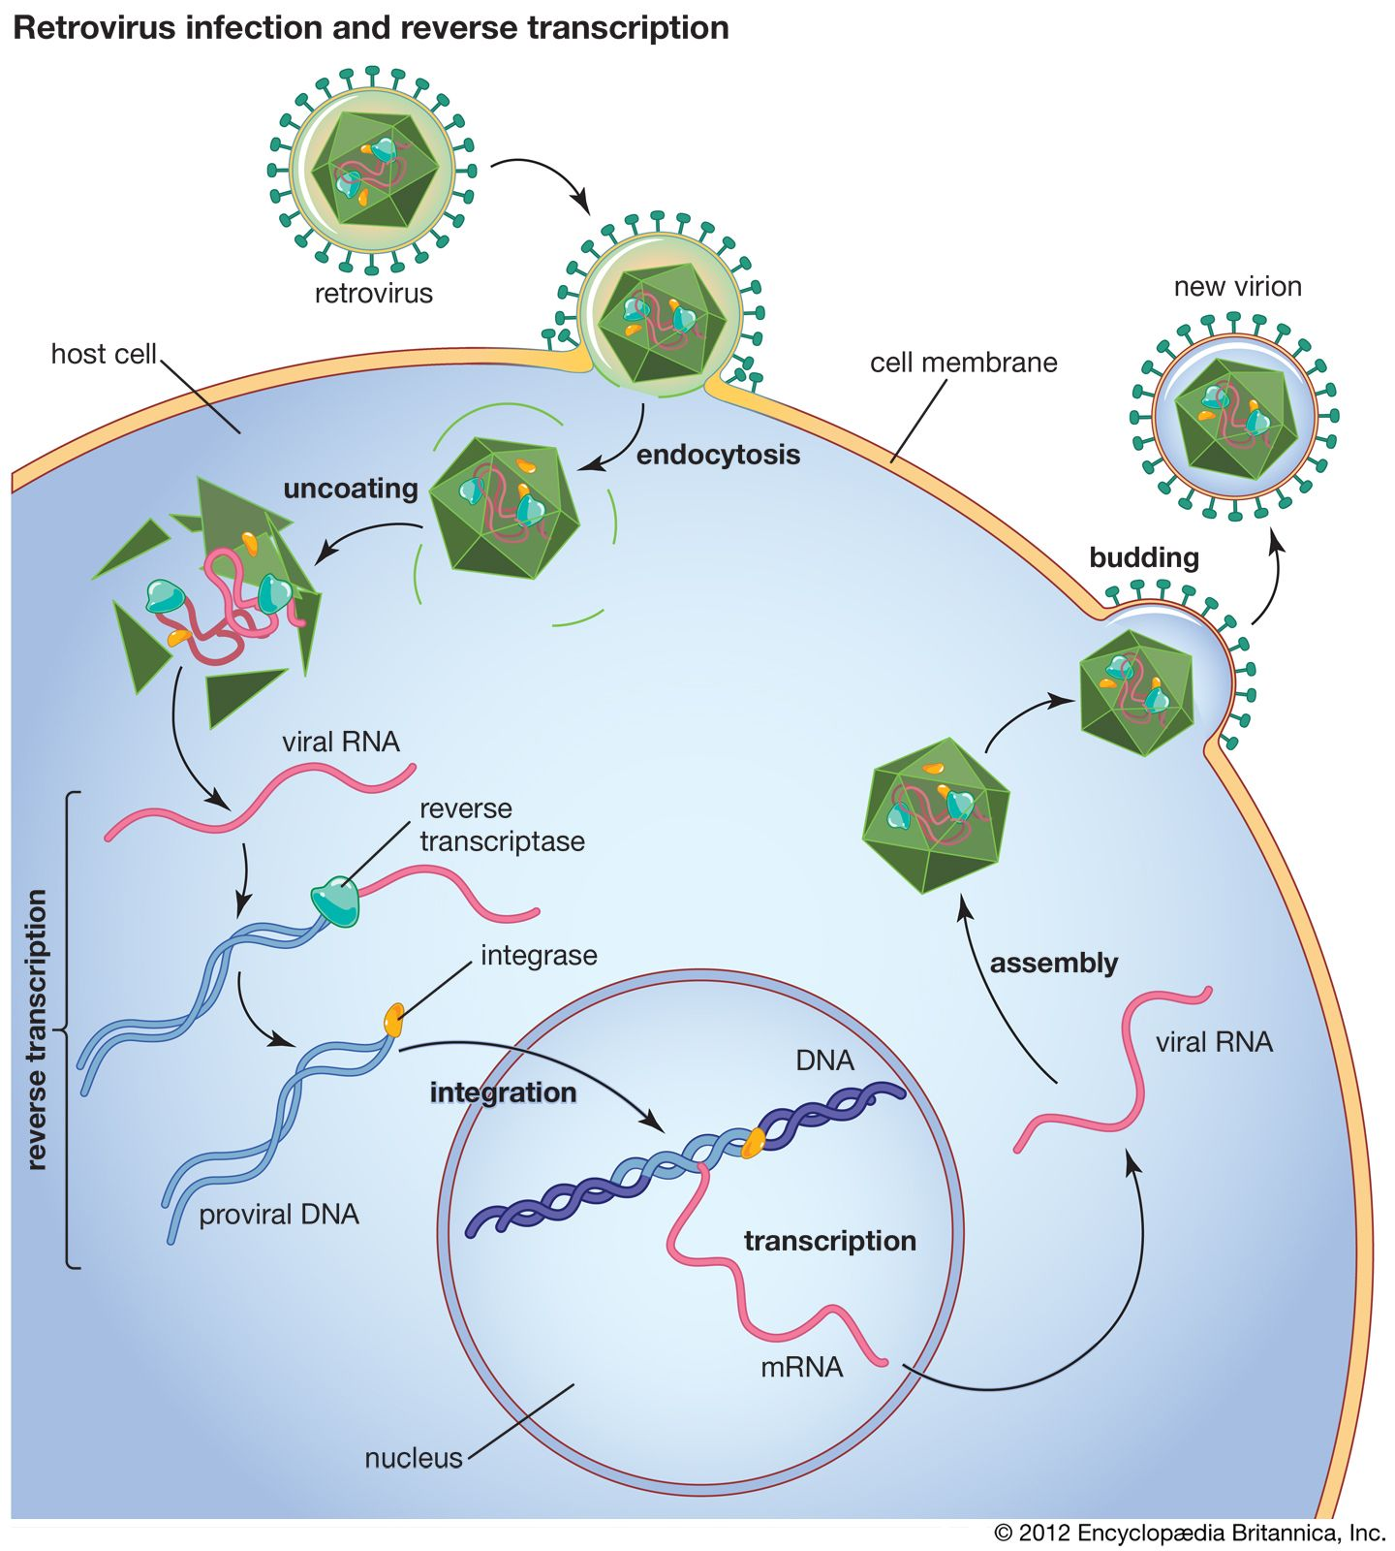
Retroviruses (6.4)
Alternate flow of genetic information – retroviruses have genetic information stored as RNA
RNA first reverse transcribed into DNA – reverse transcriptase
Then this DNA enters the host genome and is then transcribed and translated to “reproduce”

Slide 13
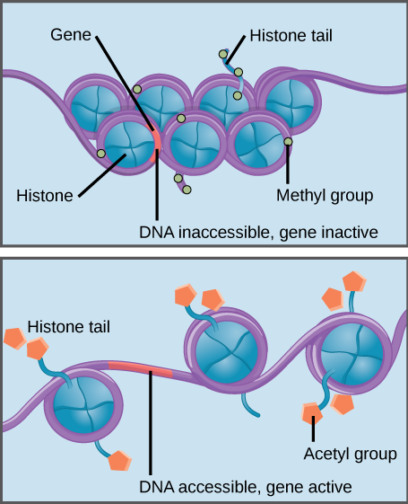
Epigenetic Changes – DNA Packing (6.5)
Every cell in an organism has the same genome – not every gene expressed in every cell
Can be regulated before and after both transcription and translation
Epigenetic change – DNA sequence is not changed but its expression is affected
DNA packing – more tightly bound DNA (how tightly wrapped around histone proteins) = less accessible for transcription
DNA methylation – adding methyl groups -> tighter packing
Histone acetylation – acetyl groups added to histones -> less tightly packed
Notes:
Eukaryotic
DNA packing

Slide 14
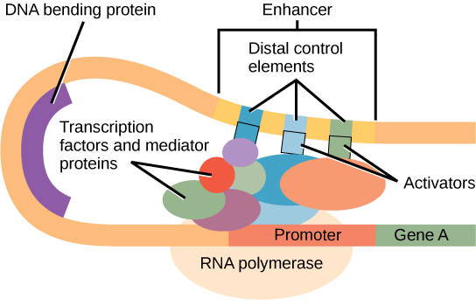
Transcription Regulation (6.5)
Regulatory sequences – stretches of DNA that interact with regulatory proteins to control gene expression (constitutive vs inducible expression)
Can promote expression or block it – inducer/repressor
Transcription initiation complex – activator proteins bind to an enhancer, general transcription factors, DNA bends bringing this complex to the promoter
Can be coordinated
Notes:
Eukaryotic
Regulatory sequences are stretches of DNA that interact with regulatory proteins to control transcription. Some genes are constitutively expressed, and others are inducible.
Transcription factors (can control multiple genes for coordination)

Slide 15
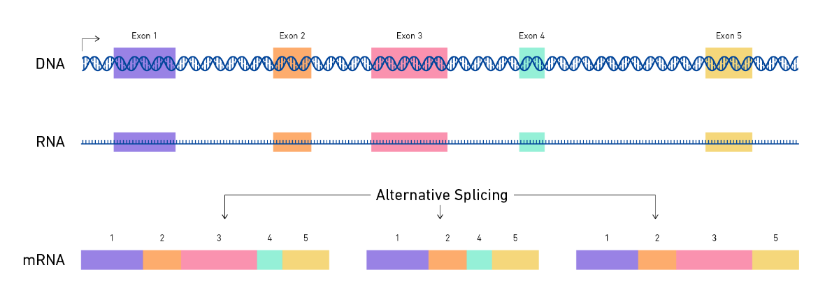
Post-Transcription and Translation Regulation (6.5)
Alternative RNA splicing – same mRNA strand can have different coding and noncoding regions (introns and exons) depending on goal of gene expression
5’ Cap and Poly A-Tail – longer tail allows mRNA to survive longer (protection from exonucleases)
Regulatory proteins can block translation
Protein activation can be inhibited (protein folding in order to make it functional) and proteins can be tagged and degraded post translation (ubiquitin)
Notes:
Eukaryotic
Splicing
Poly a tail

Slide 16
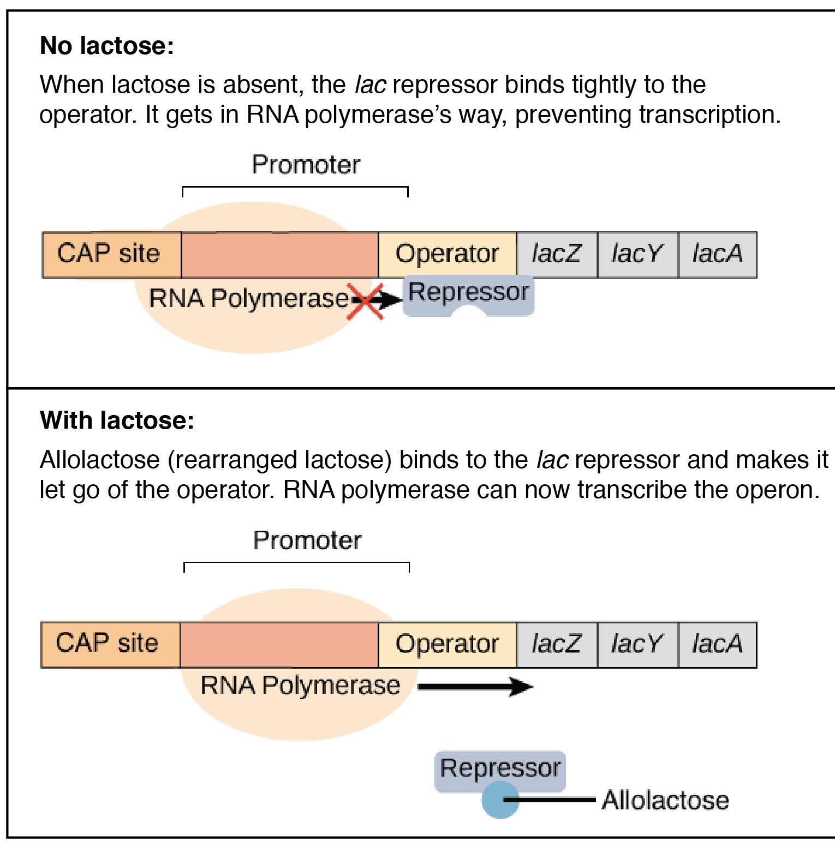
Operons (6.5)
In bacteria genes are clustered into groups (operons) – controlled as unit
Operator – Controls access of RNA polymerase to the gene, can have a repressor bound
Promoter – where RNA polymerase attaches
Inducible operon (lac) – normally off (so repressor on), catabolic
Lactose digestion enzyme only produced when needed
An inducer (allolactose) binds to the repressor protein, inactivating it -> operon on
Repressible operon (tryp) – normally on (so repressor off), anabolic
When too much tryptophan, it binds to the repressor, activating it -> operon off
Notes:
Prokaryotic
Similarity to transcription factors inducing transcription for multiple genes

Slide 17
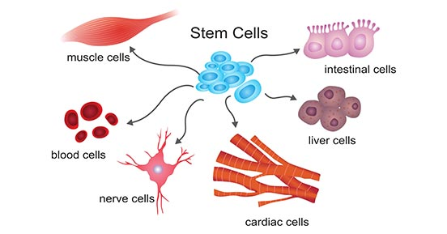
Gene Expression and Phenotype (6.6)
The phenotype of a cell/organism is determined by the combination of genes that are expressed and the levels at which they are expressed –> function + amount
Transcription begins during development –> sequential gene expression
Cell differentiation results from the expression of genes for tissue-specific proteins
Differential gene expression – the expression of different genes by cells with the same genome, influencing cell products and function
Small RNAs can also regulate gene expression
miRNA and siRNA can bind to mRNA and degrade the mRNA or block its translation (post transcription regulation)
Notes:
The phenotype of a cell or an organism is determined by the combination of genes that are expressed and the levels at which they are expressed.
i. Observable cell differentiation results from the expression of genes for tissue-specific proteins.
ii. Induction of transcription factors during development results in sequential gene expression.
iii. The function and amount of gene products determine the phenotype of organisms.

Slide 18
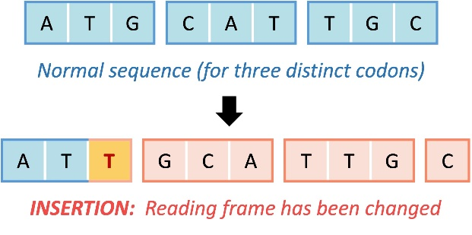

Point Mutations (6.7)
Mutation – random alterations in a DNA sequence – can affect changes in the amount/type of a protein produced, altering phenotype
Point mutation – alterations of just 1 nucleotide base pair (substitution)
Insertion/deletion – addition or loss of nucleotide pairs -> Frameshift mutation – mutation that interferes with the codon groupings
Nonsense mutation – causes premature stop codon
Silent mutation – no effect on the resulting protein
Notes:
UAC GUA ACG
AUG CAU UGC
Met (start) His Cys
UAA CGU AAC
AUU GCA UUG
Ile Ala Leu

Slide 19
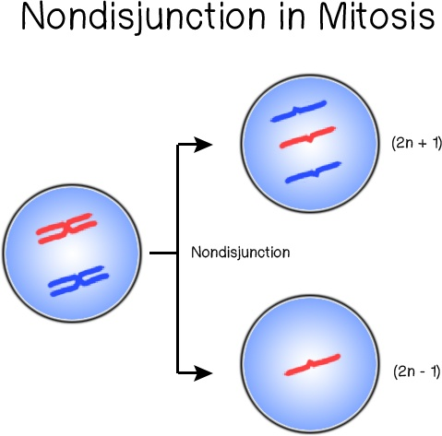
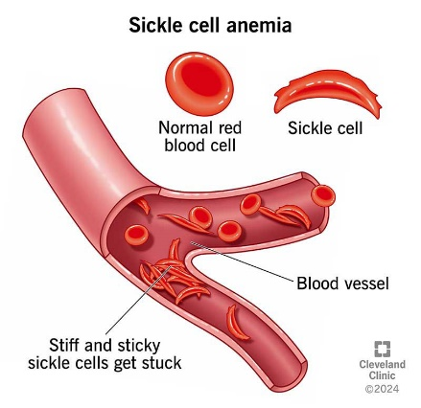
Causes of Mutations (6.7)
Mutagens – substances that interact with DNA in ways that cause mutations
Radiation
Errors in DNA replication, DNA repair, cell cycle can cause mutations
Alteration in chromosome structure leads to genetic disorders
Changes in chromosome number due to nondisjunction leads to changes in phenotype/genetic disorders (aneuploidy) – Down Syndrome
Mutations can be beneficial, detrimental, or neutral depending on the environment – primary cause of genetic variation!

Slide 20
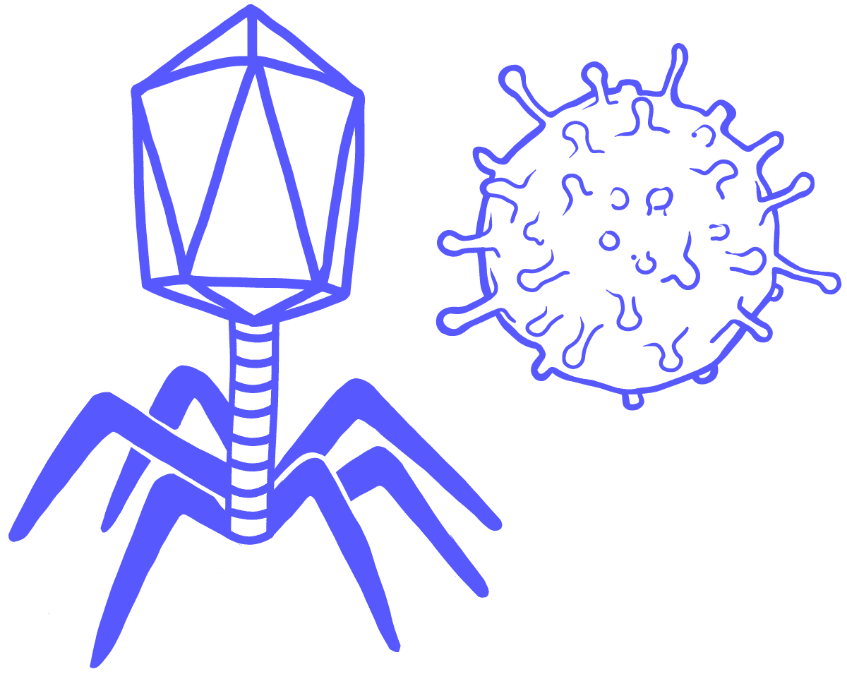
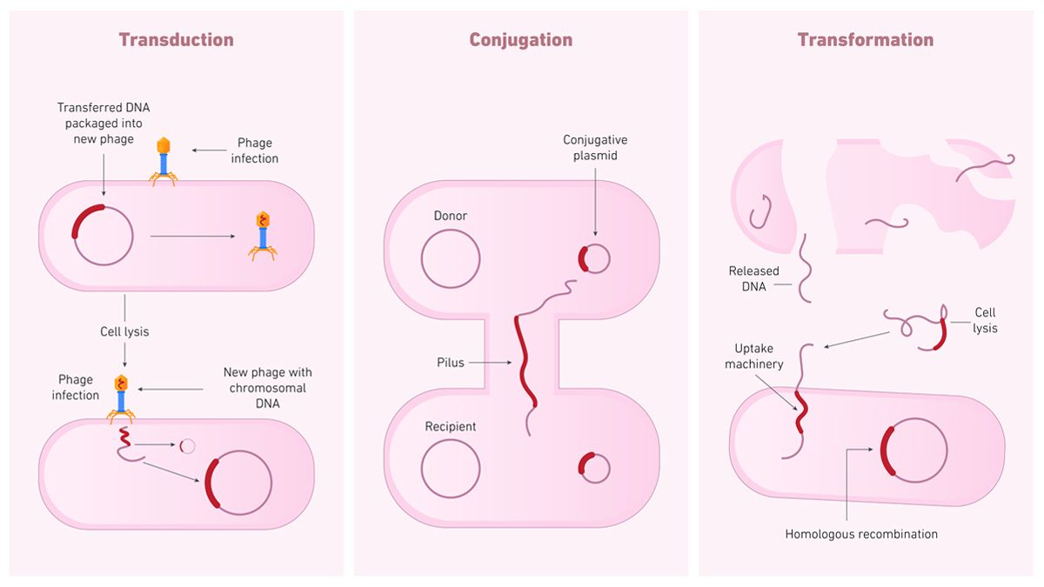

Horizontal Gene Acquisition (6.7)
Prokaryotic gene acquisition
Transformation – takes in DNA (plasmid) and adds it to genome
Transduction – takes in viral DNA and adds it to genome – related viruses can recombine DNA if they infect the same host cell
Virus - an infectious agent that replicates only inside the living cells of an organism
Conjugation – transfers DNA through cell-cell connection
Transposition – movement of DNA segments between DNA molecules

Slide 21
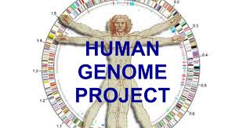
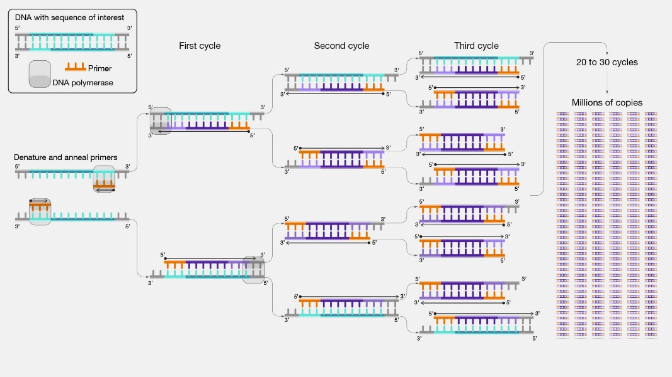
Biotechnology and PCR (6.8)
Biotechnology – the process of manipulating organisms for the purpose of making useful products
DNA sequencing – used to determine the complete nucleotide sequence of a DNA molecule using base pairing
Allows for comparison of DNA between species
Polymerase chain reaction – amplifies a piece of DNA without using cells
Quickly heat to denature and separate DNA strands
Allow cooling for primers to attach
DNA polymerase adds nucleotides to the 3’ end of the primer -> a bunch of identical DNA molecules
Notes:
Humans and potatoes share 50% of their genomes

Slide 22
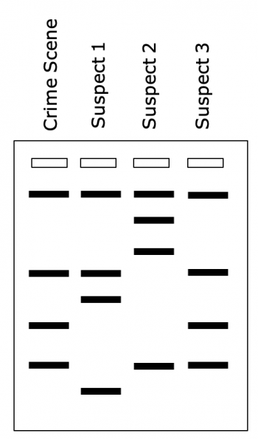
Gel Electrophoresis (6.8)
Gel electrophoresis – a lab technique used to separate DNA
DNA is placed in small depressions in a gel matrix that allows small molecules to move through it
An electric current is applied to the field – DNA is negatively charged and will migrate to the positive end of the field (smaller fragments move the fastest)
Difference in banding patterns allows for diagnosis of disease, paternity

Slide 23
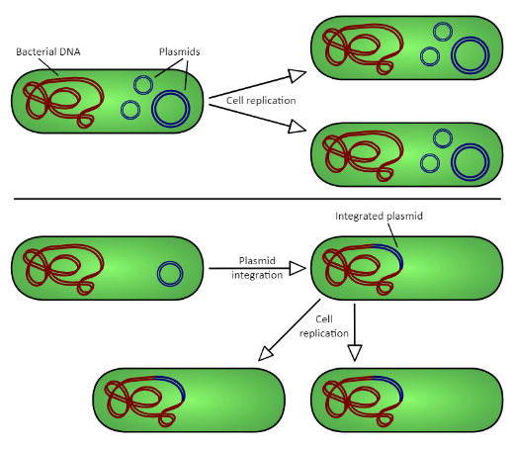
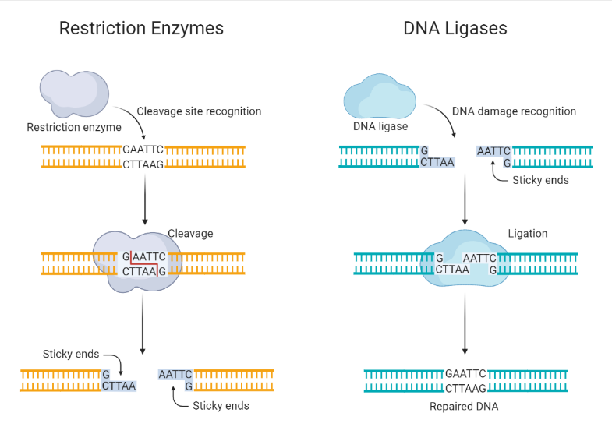
Recombinant DNA and Gene Cloning (6.8)
Recombinant DNA – artificially made DNA using DNA from different sources
Introducing human genes into bacteria
Gene cloning – process by which scientists can produce multiple copies of specific segments of DNA – turn the gene into a plasmid, enter it into bacteria, bacteria reproduces faster
Restriction enzymes (CRISPR-Cas9) cut DNA at a specific location -> restriction fragments, one single stranded end will be “sticky” – can bond to complementary strands using ligase
Notes:
Plasmid – small, circular, extrachromosomal loop of DNA

