Slide 1


AP BIO
TOPIC 6.1:
DNA and RNA Structure

Slide 2
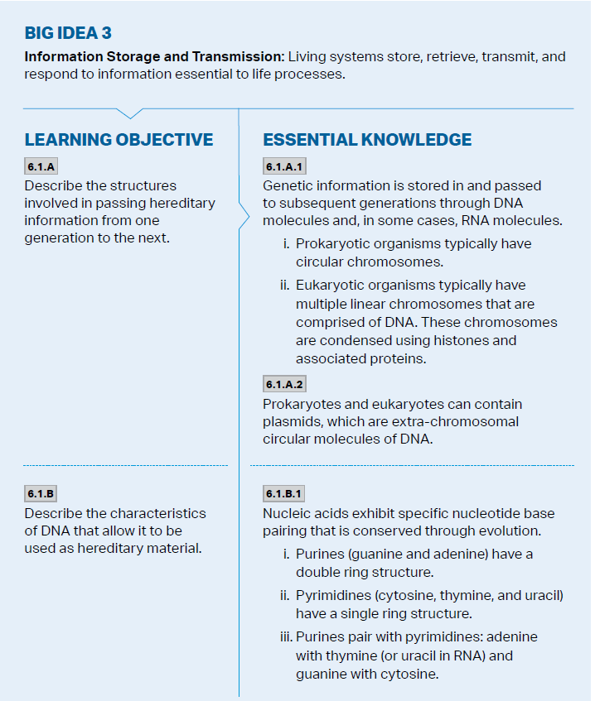
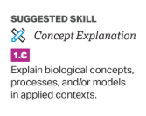
Objectives

Slide 3
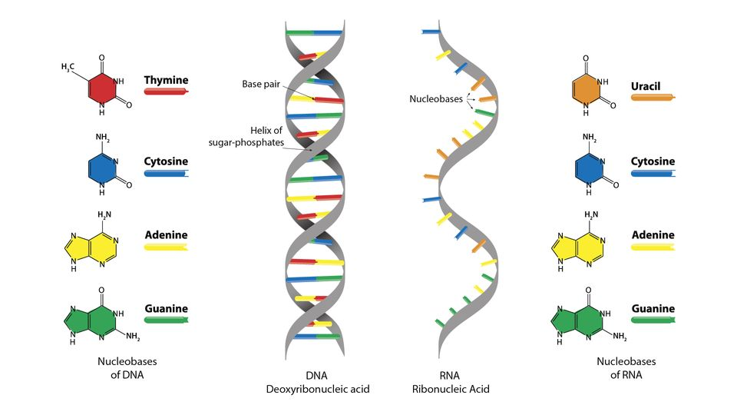
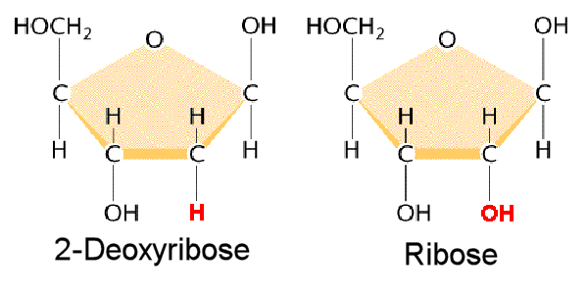
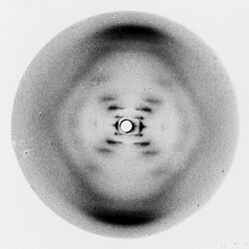
An Overview of DNA and RNA
DNA and RNA store and transmit genetic information – made up of nucleotides
DNA
Two strands (double helix, antiparallel) – protection, storage Deoxyribose sugar (missing oxygen) Bases are A-T, C-G

Slide 4
An Overview of DNA and RNA Cont.
DNA and RNA store and transmit genetic information – made up of nucleotides
RNA
Single strand – temporary, for movement Ribose sugar – more electronegative, won’t form pairs unless perfect Bases are A-U, C-G (uracil instead of thymine)

Slide 5
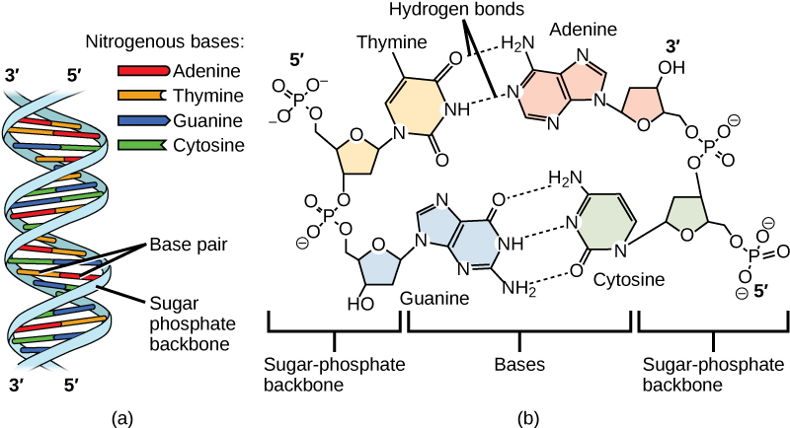
Purines and Pyrimidines
Nitrogenous bases that form base pairs can be one or two ringed – hydrogen bonding

Slide 6
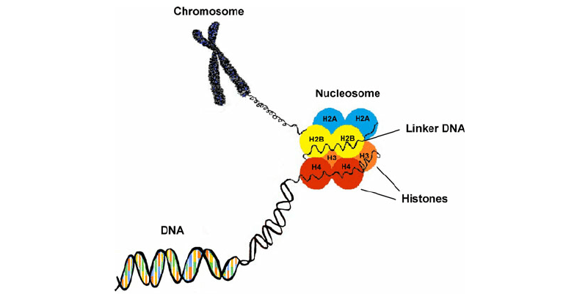
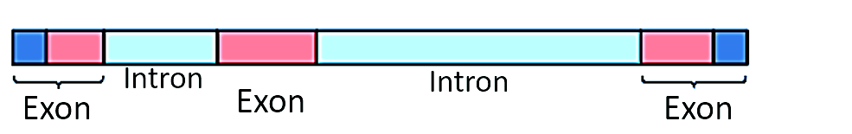
DNA Strands as a Unit
DNA wraps around histone proteins, forming nucleosomes, which in turn make up chromosomes (chromatin)
Each chromosome is made up of introns and exons
Linear vs circular chromosomes

Slide 7
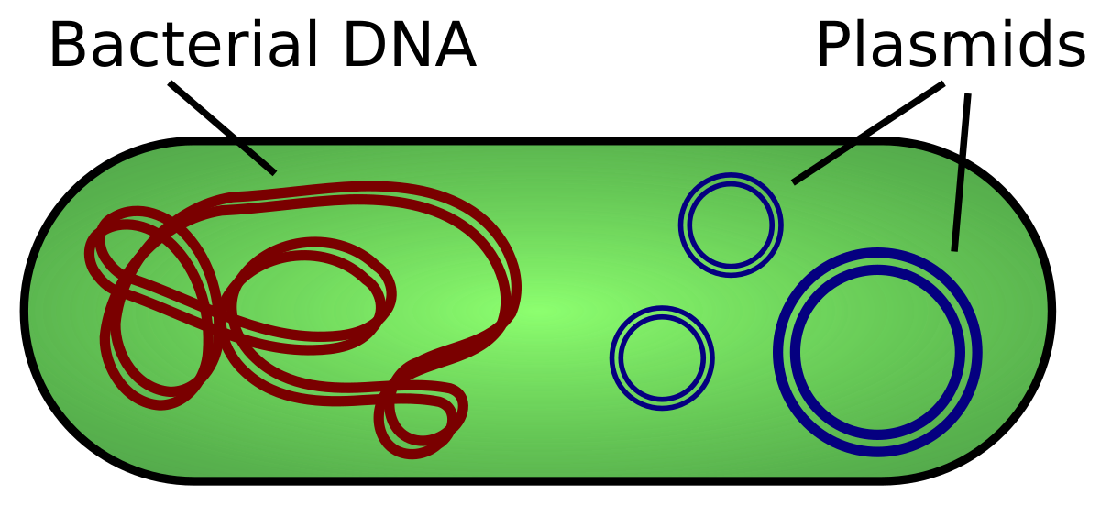
Plasmids
Plasmid - small circular DNA in prokaryotes that is extrachromosomal, can be shared by bacteria and help with genetic variation

Slide 8
DNA and RNA Structure Review
DNA vs. RNA
Nucleotides
Introns and exons
Plasmids

