Slide 1


AP BIO
TOPIC 6.2:
DNA Replication

Slide 2
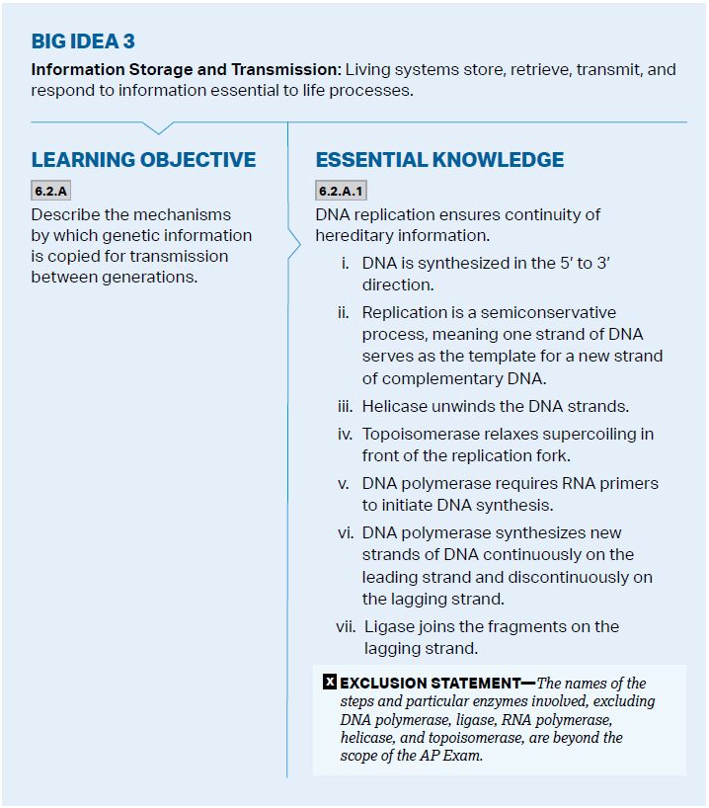
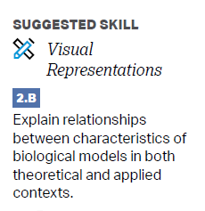
Objectives

Slide 3
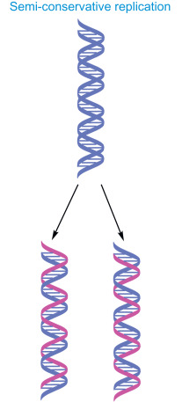
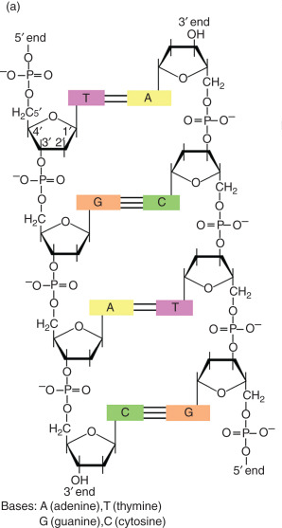

The Purpose of Replication
DNA Replication – ensures continuity of hereditary information
Semiconservative process – each of the daughter molecules has one old strand and one new strand
Replication begins at the origin of replication, and continues in the direction from the 5’ to the 3’

Slide 4
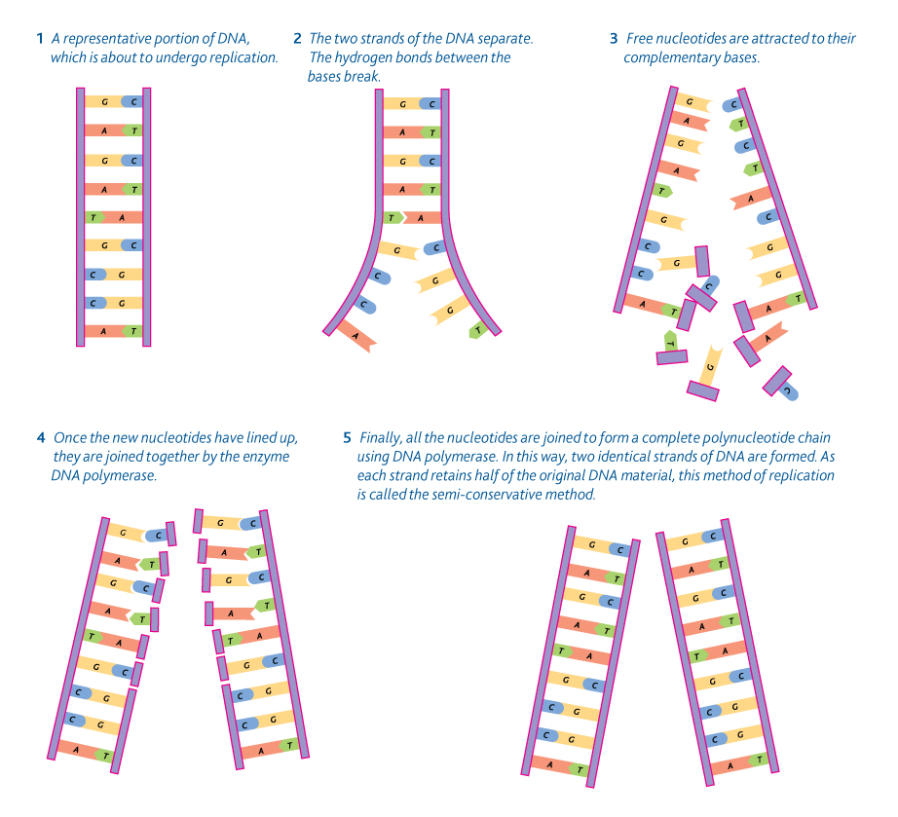
Steps of DNA Replication
Origin of replication
Helicase enzyme – unwinds
Destabilizes hydrogen bonds
Topoisomerase enzyme – further unwinding
Cuts backbone
DNA polymerase – binds free nucleotides (base pairs)
Only to the 3’ end
Requires RNA primers to start replication
Notes:
Topoisomerase relieves further strain of twisting

Slide 5
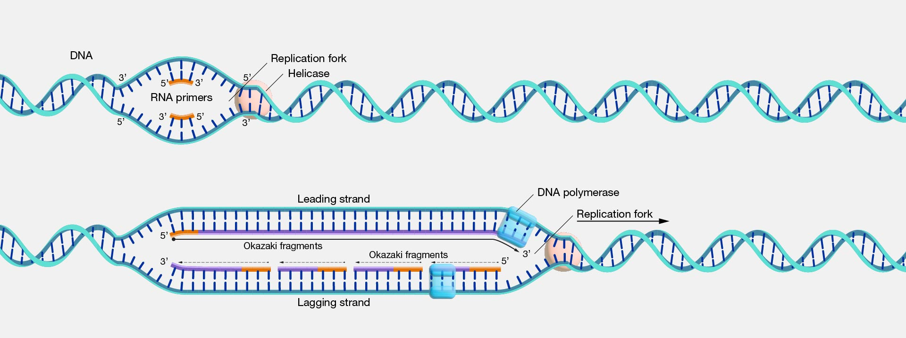
Leading vs. Lagging Strand
DNA replication runs continuously along the 5’->3’ strand (leading strand), but to add new nucleotides to the strand running in the other direction, it must be copied in segments (lagging strand)
These segments are known as Okazaki fragments, which are then sealed together by ligase (used to fill in gaps where RNA primers were)

Slide 6
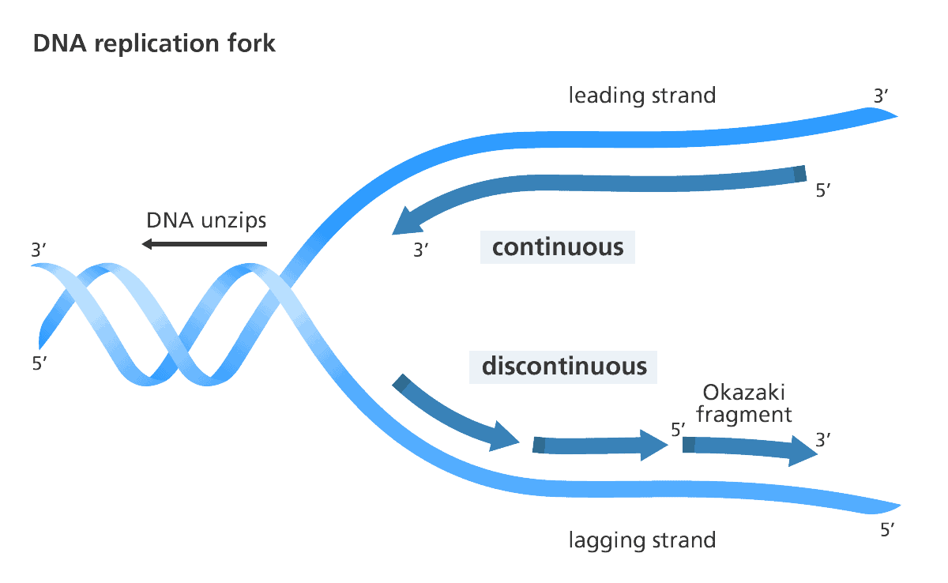
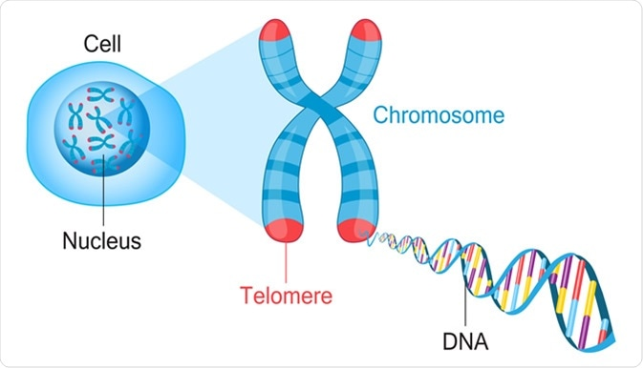
Telomeres
Every time chromosomes are replicated in mitosis, the tip of the chromosome is removed – to protect genes = telomeres
Degenerate over time

Slide 7
DNA Replication Review
Steps and enzymes used in DNA replication
Leading vs lagging strands

