Slide 1


AP BIO
TOPIC 6.3:
Transcription and RNA Processing

Slide 2
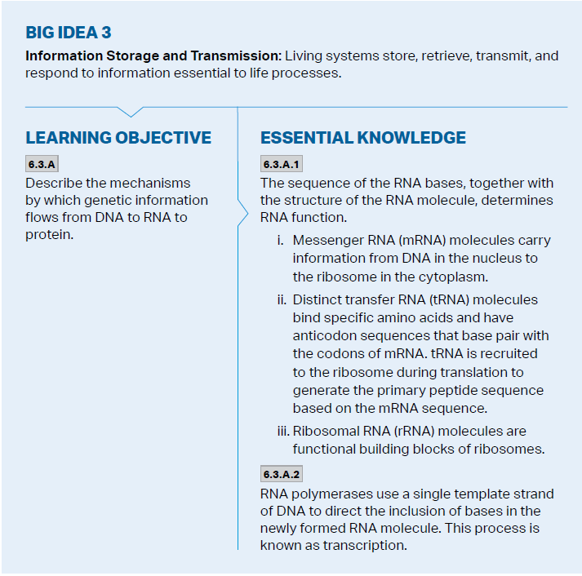
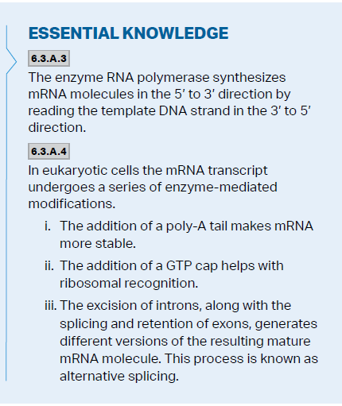
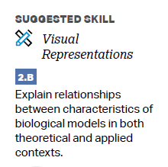
Objectives

Slide 3
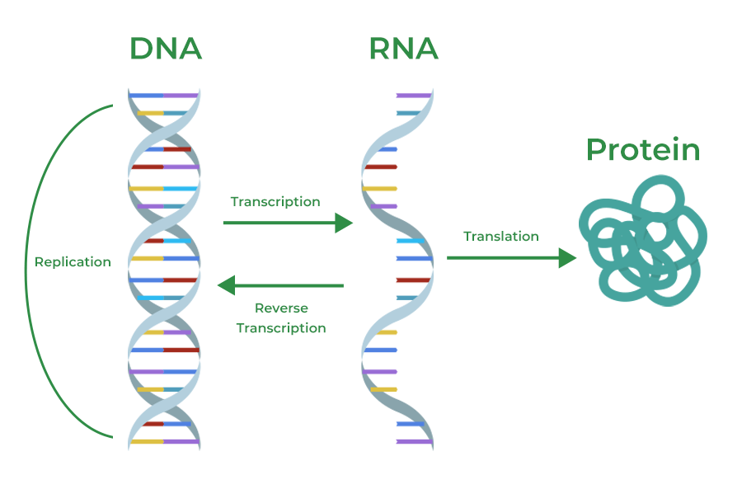
Gene Expression + The Goal of Transcription
Gene expression – the process by which DNA directs the synthesis of proteins -> each gene codes for one polypeptide
Genetic code is nearly universal
Transcription – the synthesis of RNA using DNA as a template (within the nucleus of eukaryotic cells)
The goal: mRNA – carries genetic message of DNA to the protein making machine in the cell, ribosomes
Central dogma

Slide 4
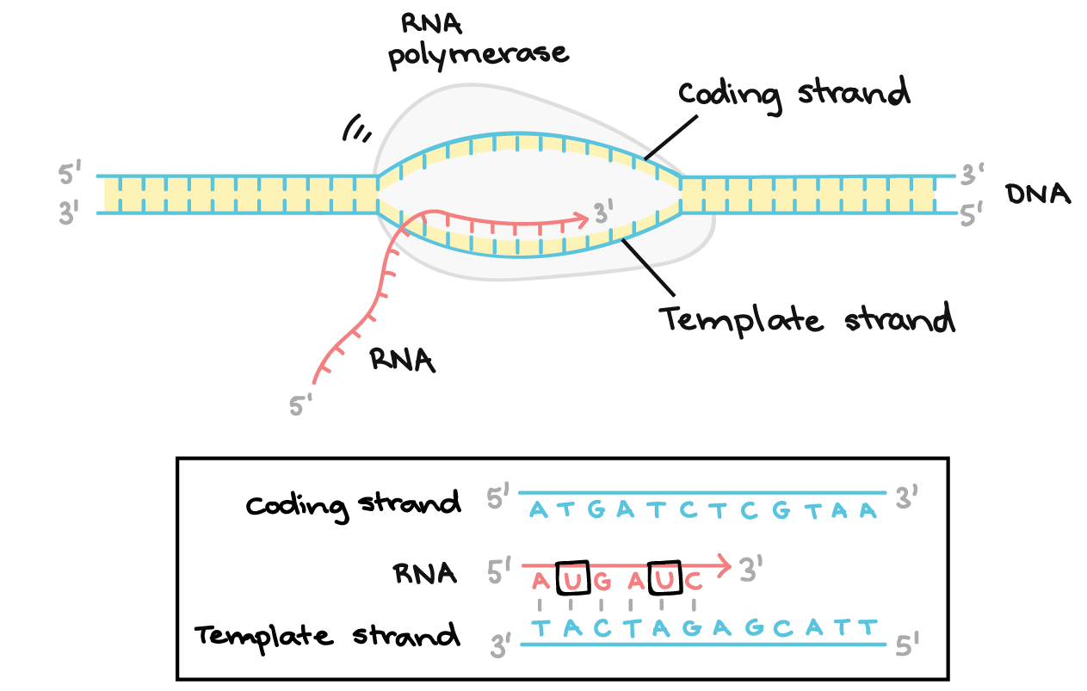
Steps of Transcription
1 strand of the DNA is transcribed – template strand (the other strand is the coding strand – it will share the same sequence as the mRNA)
RNA polymerase – enzyme that separates two DNA strands and connects free RNA nucleotides as they base pair – add to 3’ end (phosphodiester bonds in the transcription bubble)
DNA is read 3’ to 5’
Attaches at the promoter DNA sequence and detaches at the terminator
Transcription factors assist the process

Slide 5
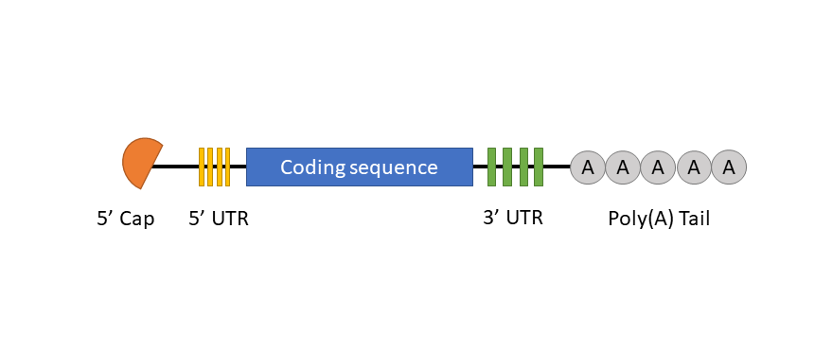
mRNA Processing 1
This process creates primary RNA that must be processed before it becomes mRNA – only in eukaryotic cells
5’ cap – modified guanine nucleotide attached to 5’ end of mRNA
Poly-A-tail – 50-250 adenine nucleotides attached to 3’ end
Help mRNA export from nucleus, protect from degradation, help mRNA attach to ribosome

Slide 6
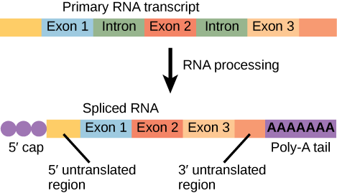
mRNA Processing 11: RNA Splicing
RNA splicing – specific sections removed (introns), remaining are exons and are bound together by a spliceosome
An intron in one RNA can be an exon in the other – allows for 100,000 polypeptides from 20,000 genes (alternative RNA splicing)
Special RNA in spliceosomes – small RNA’s – ribozyme (catalytic RNA)

Slide 7
Transcription and RNA Processing Review
Transcription and its role within the Central Dogma
mRNA processing post transcription

