Slide 1


AP BIO
TOPIC 6.4:
Translation

Slide 2
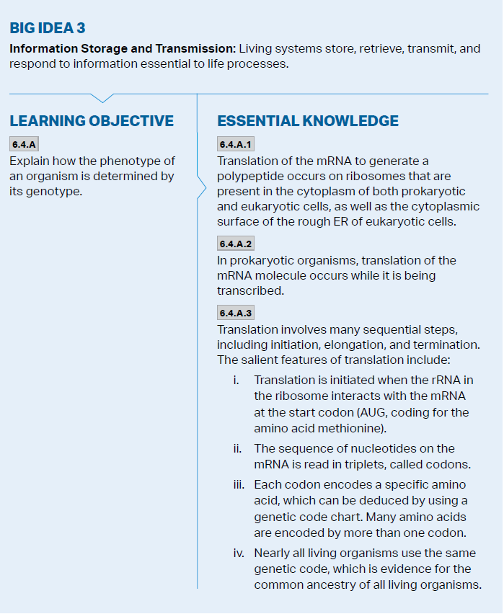
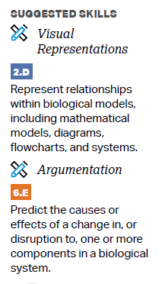
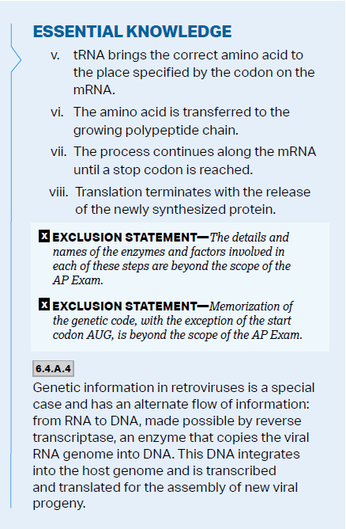
Objectives

Slide 3
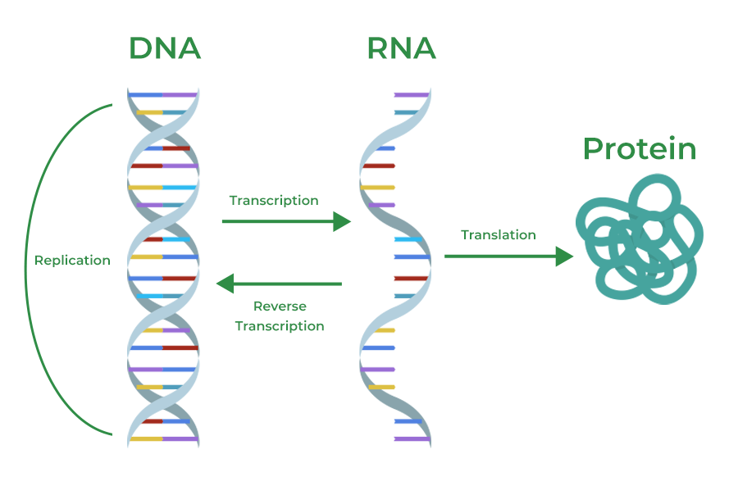
Gene Expression + The Goal of Translation
Gene expression – the process by which DNA directs the synthesis of proteins
mRNA is produced through transcription – carries genetic message to ribosomes (either free in cytoplasm or on Rough ER
Translation – production of a polypeptide chain using the mRNA transcript (occurs at ribosomes)
Transcription and translation occur same time in prokaryotes

Slide 4
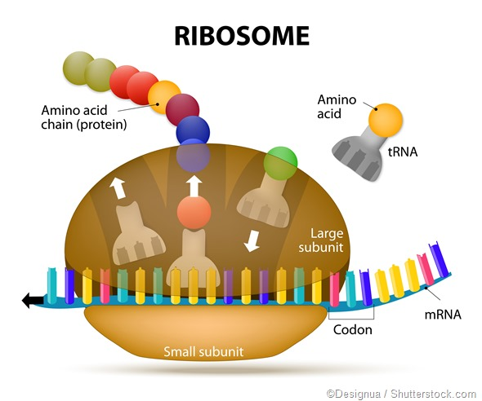
tRNA and rRNA
tRNA transfers amino acids from the cytoplasm to the ribosome to assemble a polypeptide – has anticodon that allows it to base pair to the codon on the mRNA (group of 3 nucleotides -> 1 amino acid)
Ribosomes are made up of rRNA and proteins – has 3 binding sites for tRNA molecules
P – holds tRNA that carries growing peptide chain
A – holds tRNA with amino acid that will be added to the chain next
E – exit site

Slide 5
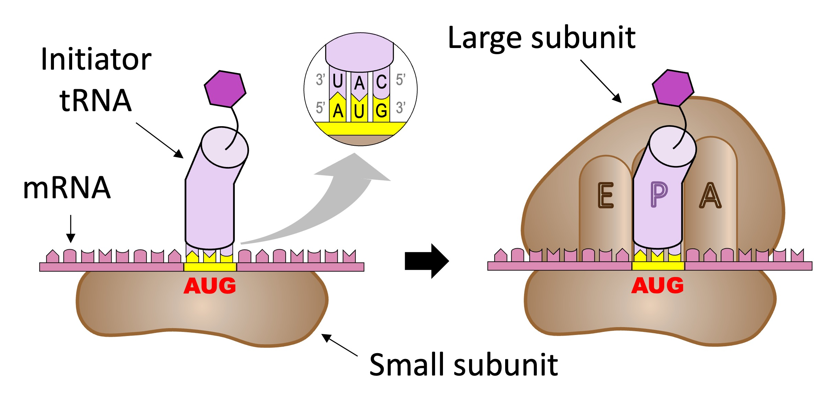
Initiation
Small ribosomal subunit binds to mRNA so that the “start” codon AUG is placed in the right position
tRNA with UAC (methionine) bonds to first codon
Large ribosomal subunit attaches - allows for more tRNA to bind to A site

Slide 6
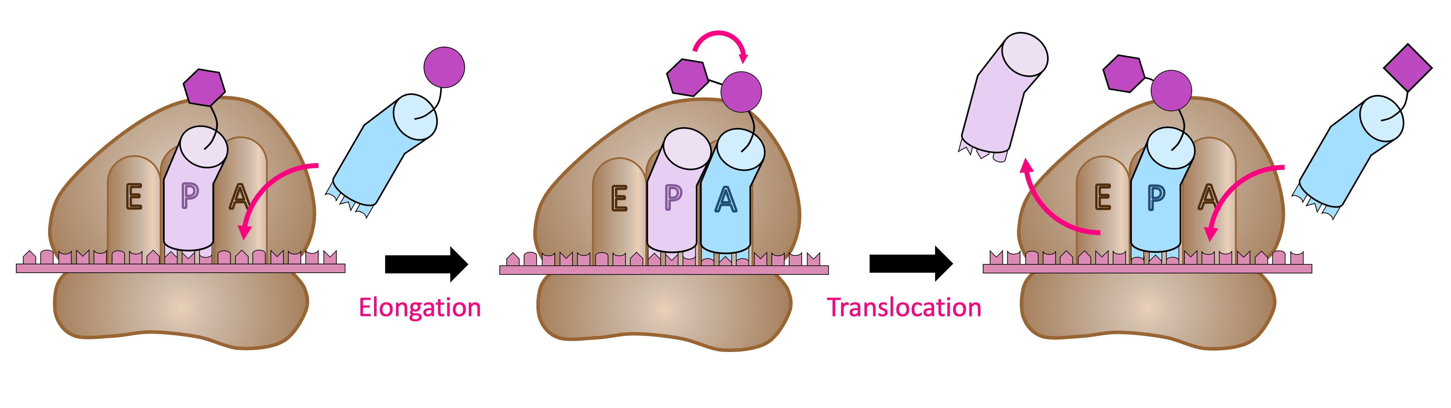
Elongation
tRNA with correct anticodon will bind to A site -> peptide bond formed -> moved to tRNA in A site, then they all shift right to allow new tRNA in A site

Slide 7
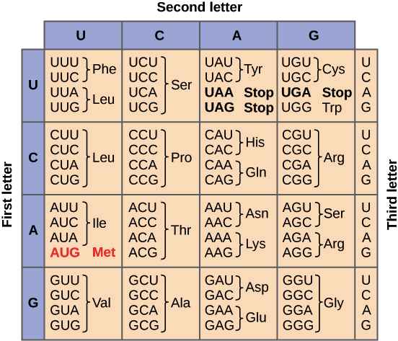
Termination
A “stop” codon in mRNA is reached (3 options), a release factor protein binds to the “stop” codon and the polypeptide is freed from the ribosome
Polypeptide undergoes protein folding, signal peptide – sequence of 20 leading amino acids determines protein destination
What amino acid will a DNA sequence of GTA code for?
Notes:
A-T, C-G
A-U, C-G
GTA -> CAU -> GUA -> Valine

Slide 8
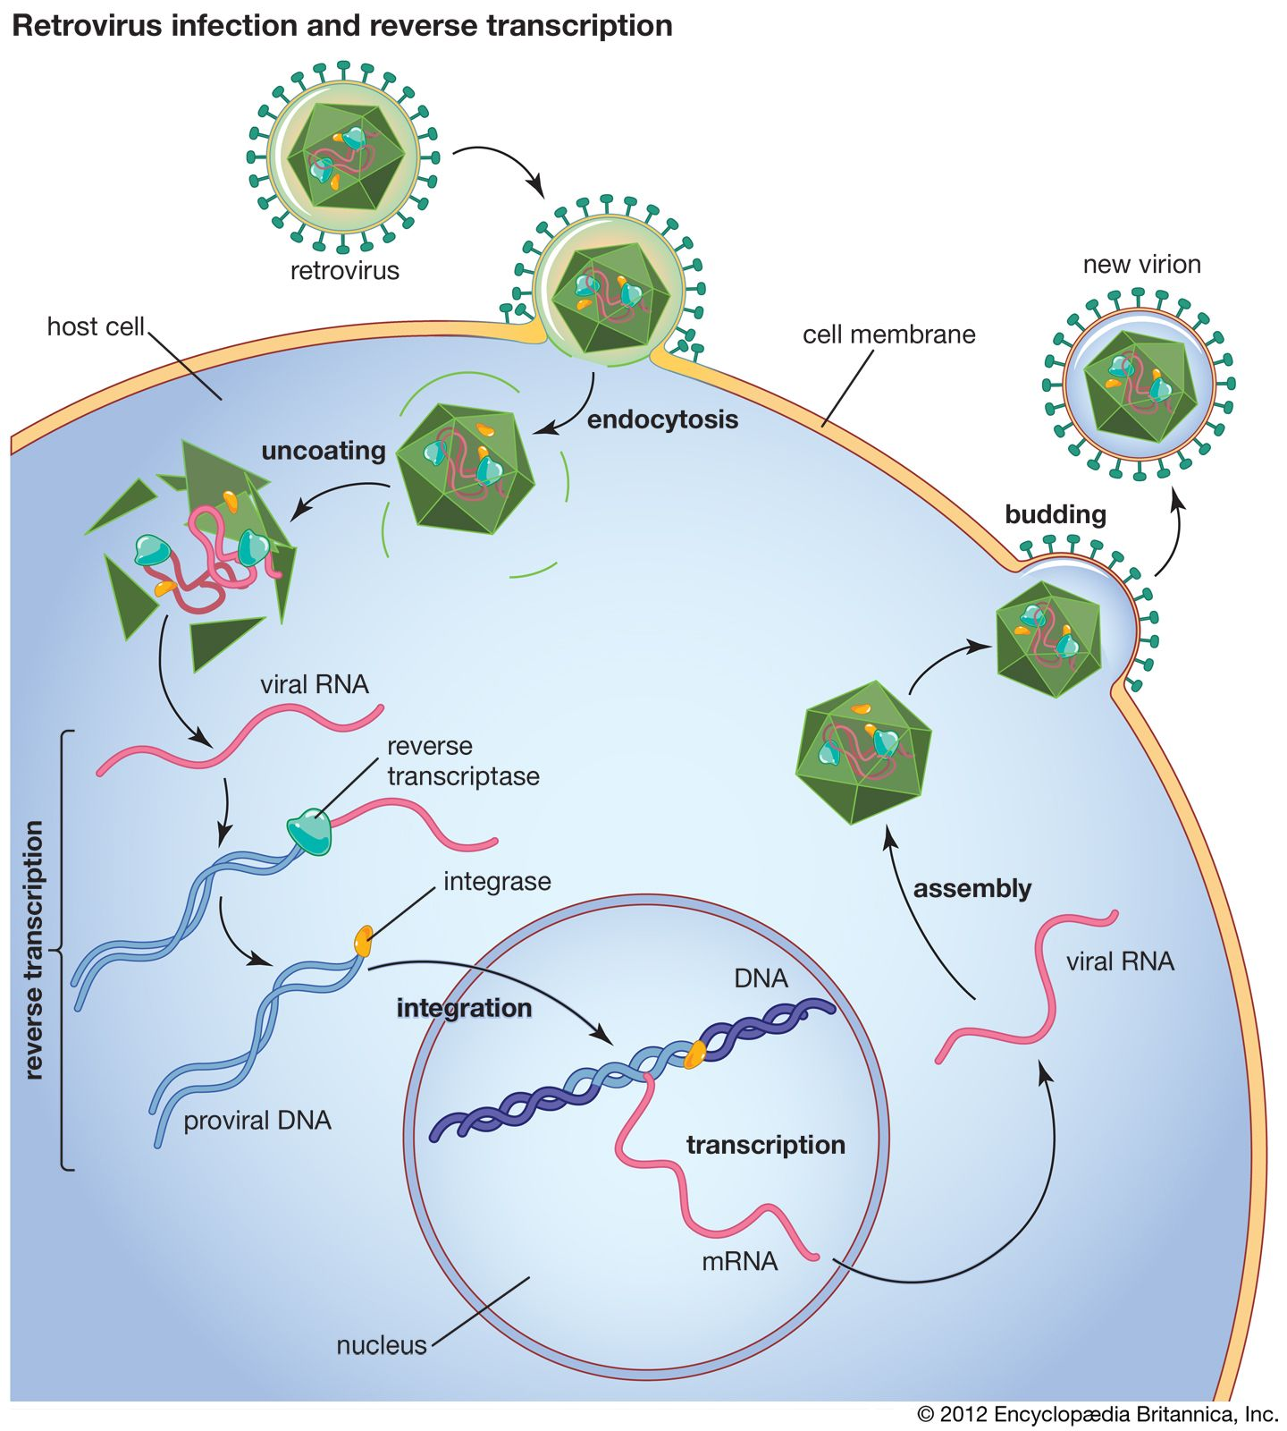
Retroviruses
Alternate flow of genetic information – retroviruses have genetic information stored as RNA
RNA first reverse transcribed into DNA – reverse transcriptase
Then this DNA enters the host genome and is then transcribed and translated to “reproduce”

Slide 9
Translation Review
Steps of translation
Gene expression in prokaryotes, eukaryotes, and viruses

