Slide 1


AP BIO
TOPIC 6.5:
Regulation of Gene Expression

Slide 2
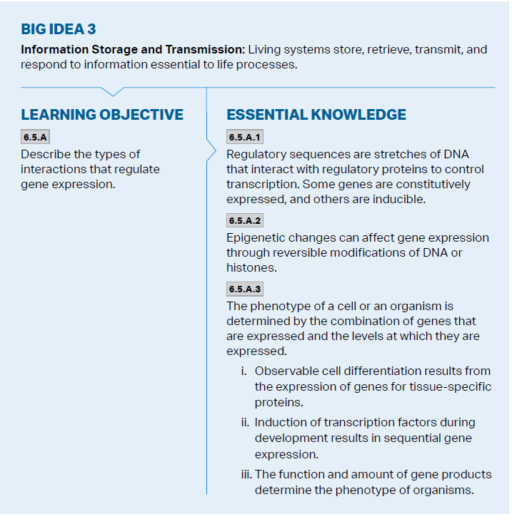
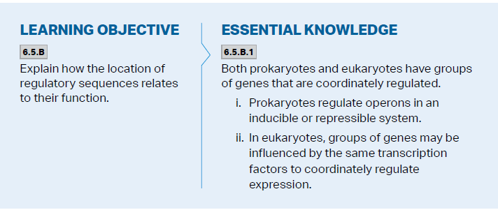
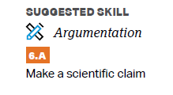
Objectives

Slide 3
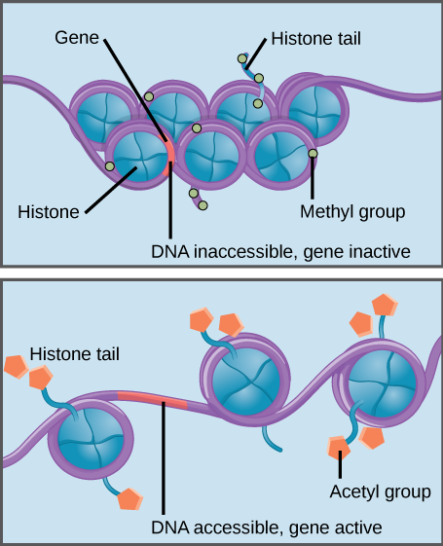
Epigenetic Changes – DNA Packing
Every cell in an organism has the same genome – not every gene expressed in every cell
Can be regulated before and after both transcription and translation
Epigenetic change – DNA sequence is not changed but its expression is affected
DNA packing – more tightly bound DNA (how tightly wrapped around histone proteins) = less accessible for transcription
DNA methylation – adding methyl groups -> tighter packing
Histone acetylation – acetyl groups added to histones -> less tightly packed
Notes:
Eukaryotic
DNA packing

Slide 4
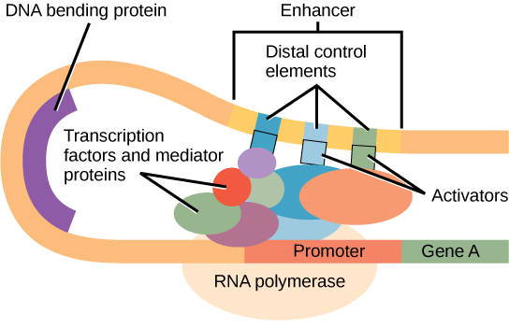
Constitutive vs. Inducible Gene Expression
Regulatory sequences – stretches of DNA that interact with regulatory proteins to control gene expression (constitutive vs inducible expression)
Can promote expression or block it – inducer/repressor
Transcription initiation complex – activator proteins bind to an enhancer, general transcription factors, DNA bends bringing this complex to the promoter
Can be coordinated
Notes:
Eukaryotic
Regulatory sequences are stretches of DNA that interact with regulatory proteins to control transcription. Some genes are constitutively expressed, and others are inducible.
Transcription factors (can control multiple genes for coordination)

Slide 5
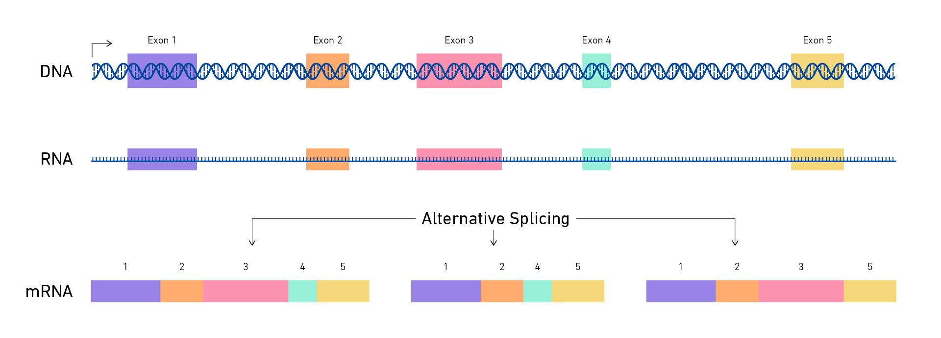
Post-Transcription Regulation
Alternative RNA splicing – same mRNA strand can have different coding and noncoding regions (introns and exons) depending on goal of gene expression
5’ Cap and Poly A-Tail – longer tail allows mRNA to survive longer (protection from exonucleases)
Notes:
Eukaryotic
Splicing
Poly a tail

Slide 6
Translation and Post-Translation Regulation
Once again, regulatory proteins can block translation
Protein activation can be inhibited (protein folding in order to make it functional)
Proteins can be degraded after translation – when tagged with ubiquitin, protein will be destroyed by proteosome
Notes:
Eukaryotic
Translation initiation
Protein processing
Protein degradation - ubiquitin

Slide 7
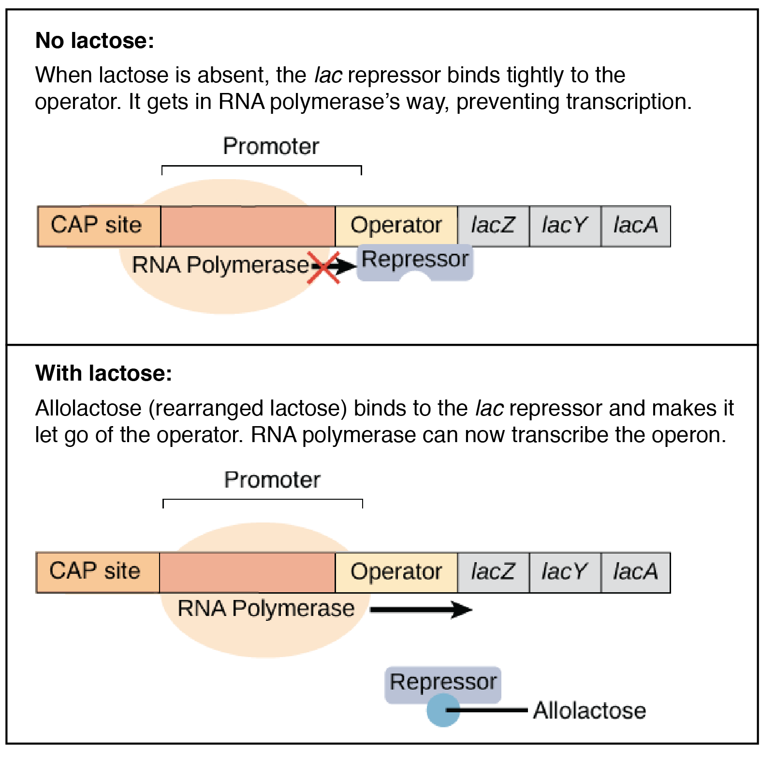
Operons
In bacteria genes are clustered into groups (operons) – controlled as unit
Operator – Controls access of RNA polymerase to the gene – can have a repressor bound – prevents expression
Promoter – where RNA polymerase attaches
Inducible operon (lac) – normally off (so repressor on), catabolic
Lactose digestion enzyme only produced when needed
An inducer (allolactose) binds to the repressor protein, inactivating it -> operon on
Repressible operon (tryp) – normally on (so repressor off), anabolic
When too much tryptophan, it binds to the repressor, activating it -> operon off
Notes:
Prokaryotic
Similarity to transcription factors inducing transcription for multiple genes

Slide 8
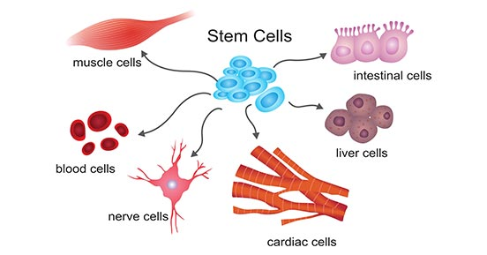
Gene Expression and Phenotype
The phenotype of a cell/organism is determined by the combination of genes that are expressed and the levels at which they are expressed –> function + amount
Transcription begins during development –> sequential gene expression
Cell differentiation results from the expression of genes for tissue-specific proteins
Notes:
The phenotype of a cell or an organism is determined by the combination of genes that are expressed and the levels at which they are expressed.
i. Observable cell differentiation results from the expression of genes for tissue-specific proteins.
ii. Induction of transcription factors during development results in sequential gene expression.
iii. The function and amount of gene products determine the phenotype of organisms.

Slide 9
Regulation of Gene Expression Review
Gene regulation in eukaryotes and prokaryotes
The connection between phenotype and gene expression

